Slide 1
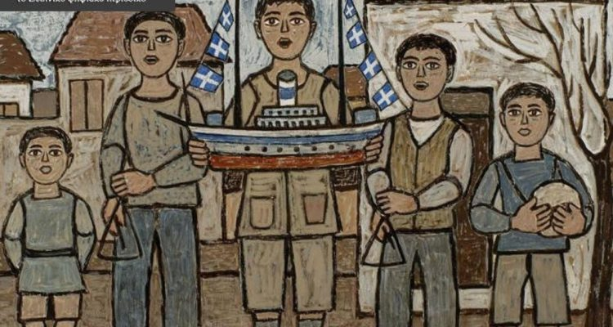
JESUS CHRIST IS BORN!
CHRISTMAS

Slide 2
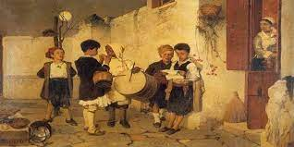
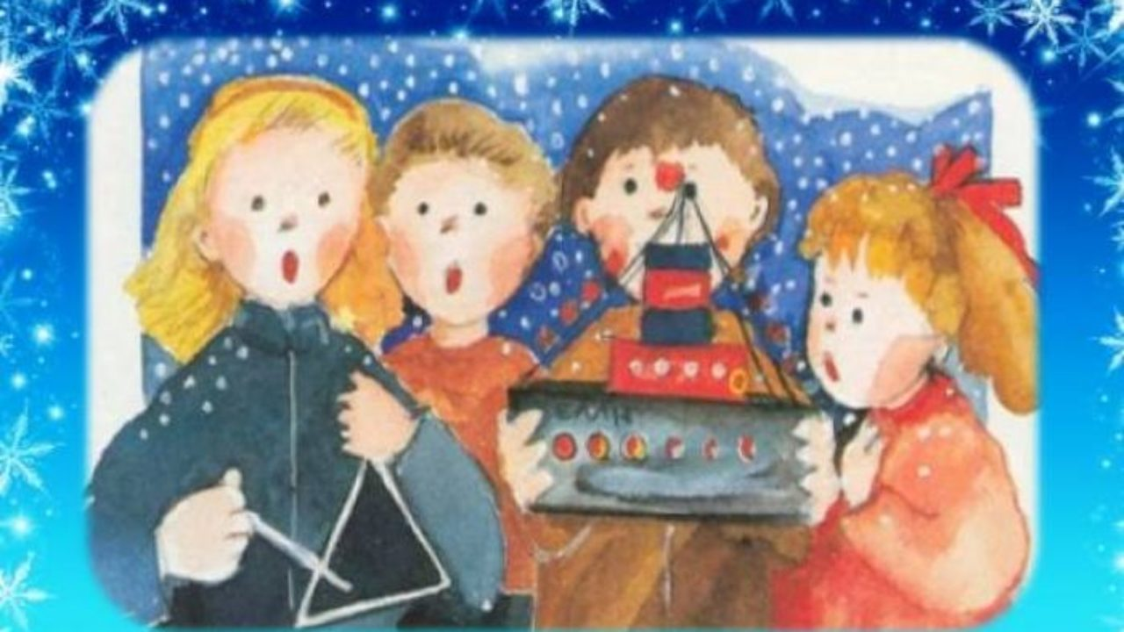
CHRISTMAS CAROLS
On Christmas Eve, children go from door to door singing the Christmas carols. They play their drums and their triangles as they sing. People give them money or sweets.

Slide 3
During Christmas holidays we give wishes.

Slide 4
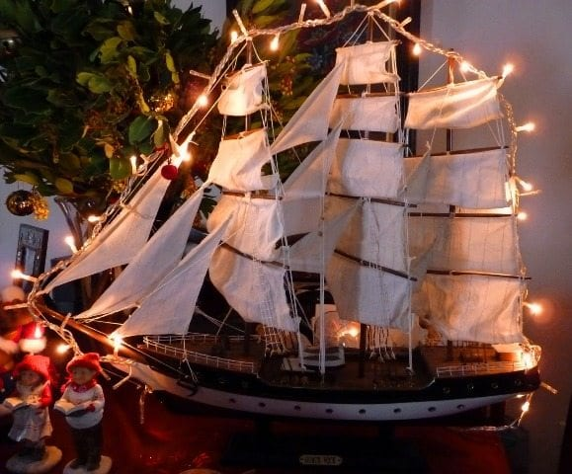
Decorated ships are an old tradition in Greece. People used to decorate small ships in their homes, as sailors returned from a long trip in the sea.

Slide 5
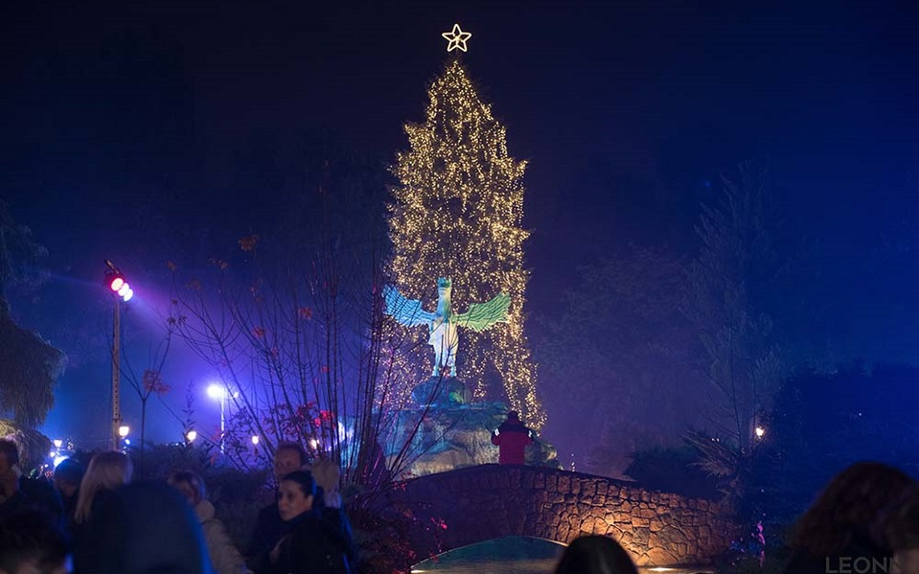
Nowadays, we decorate Christmas trees in our houses and in the central squares of the cities in Greece.

Slide 6
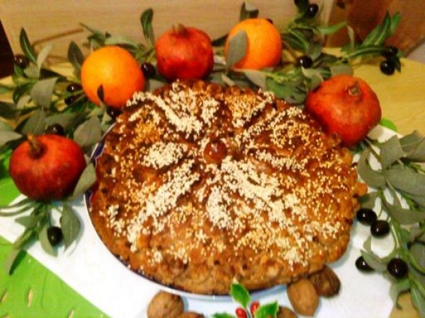
Christopsomo
Christ’s bread
Christopsomo (Christ’s bread) is a traditional cake.

Slide 7
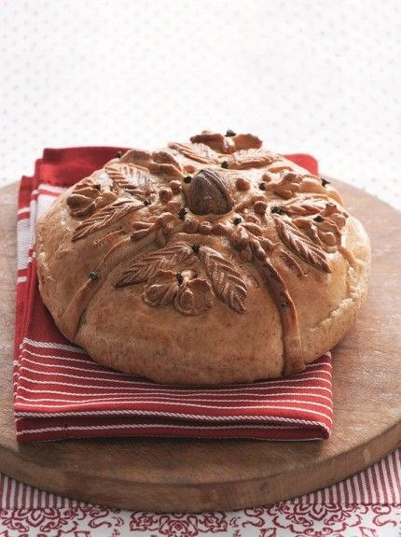
The top is decorated with a cross.

Slide 8
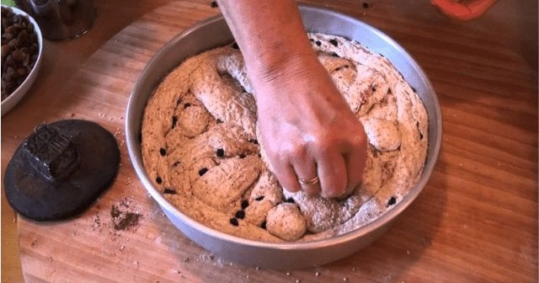
We put cinnamon, orange and raisins inside.
We eat it on Christmas Day.

Slide 9
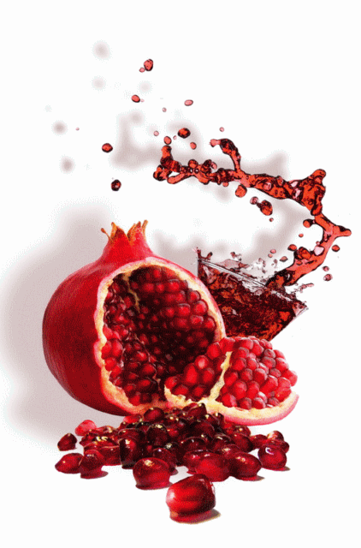
Breaking the pomegranate
The pomegranate is the symbol of good fortune, youth and fertility. On New Year’s Day we break it in front of the house’s gate hitting it hard on the floor, so that it brings happiness and good health to the family.

Slide 10
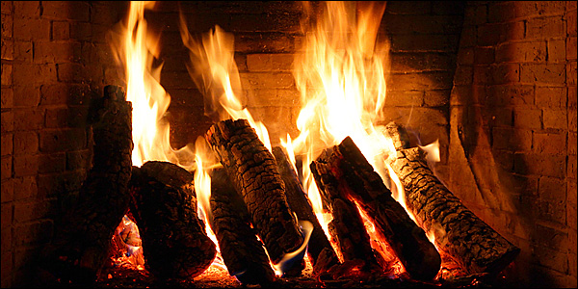
Burning the Christmas wood
In some villages, in Northern Greece they celebrate the custom of Christmas wood. They choose the best wood from pine or olive tree and burn it in the fireplace during the Christmas holidays. As long as it burns, little Jesus keeps himself warm in his cave.

Slide 11
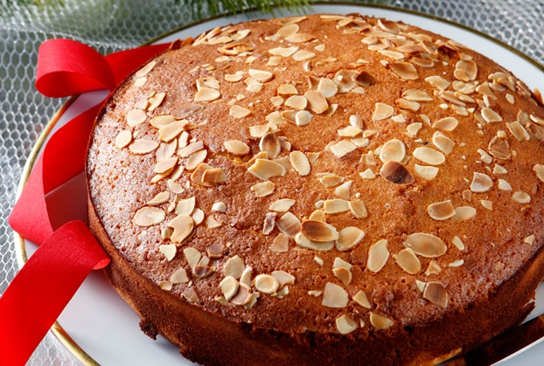
Vassilopita
We prepare this cake for the supper of New Year’s Eve. We usually eat it after midnight, when the New Year has come.

Slide 12
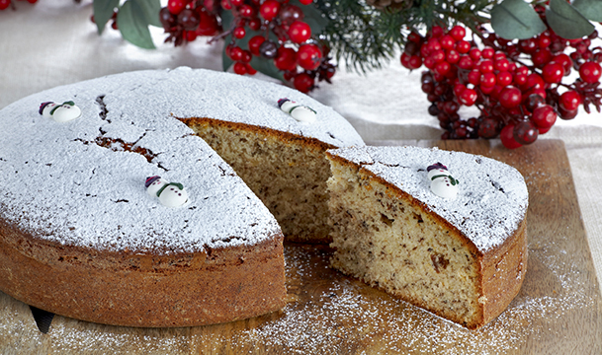
It has a coin inside. The person who finds it will be lucky for the year.

Slide 13
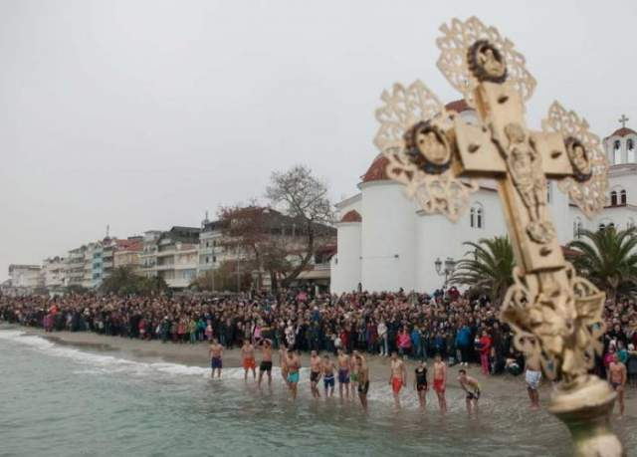
Epiphany
On the 6th January, we celebrate Epiphany. Young men dive into lakes, rivers and the sea and try to be the first to get the cross that a priest throws into the water.

Slide 14
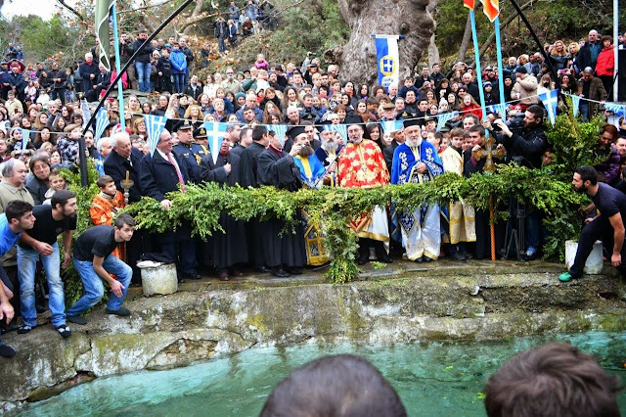
Whoever gets the cross first, has good luck for the coming year.

