Slide 1
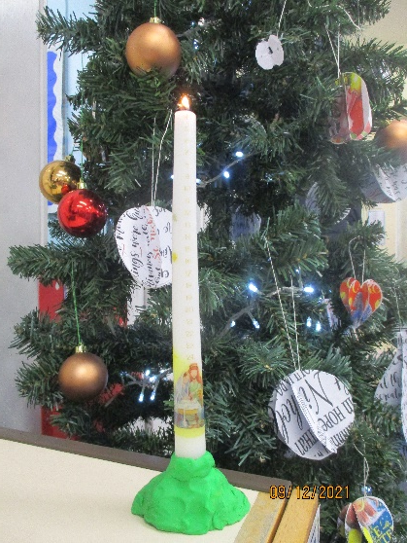
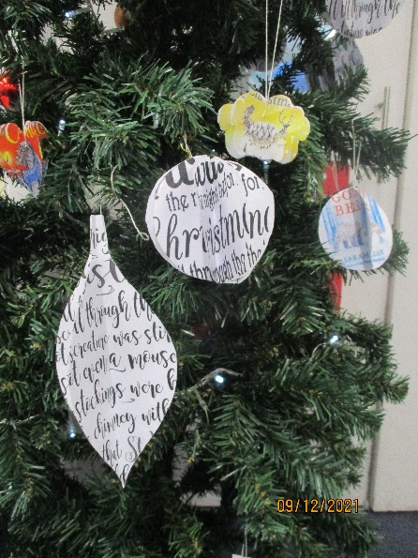
Our School Traditions
Instead of putting an angel or star on top of the tree we decided to put an ‘elf on the shelf’ on top of our tree.
We made baubles out of paper instead of using the traditional plastic baubles.
We also have an advent calendar showing the Nativity scene instead of the popular chocolate advent calendars around at this time of year.
Orla, Henry & Ellie

Slide 2
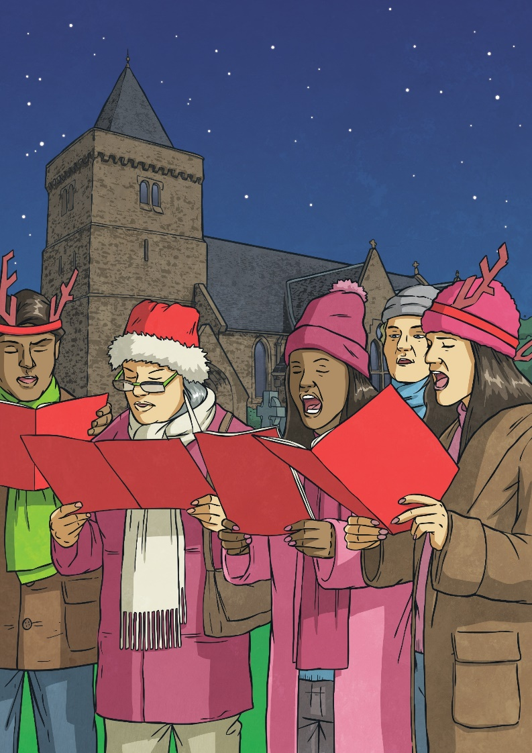
Singing Carols
A ‘carol’ is a special Christmas hymn that is sung during Advent and Christmastime.

Slide 3
FATHER CHRISTMAS
Father Christmas is the jolly fellow who flies all around the world.
He spreads love and joy whilst giving presents to everyone who has been good.
We also call him Santa.
Liam & Raff

Slide 4
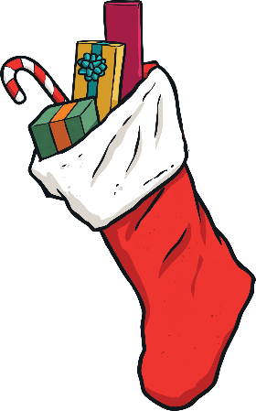
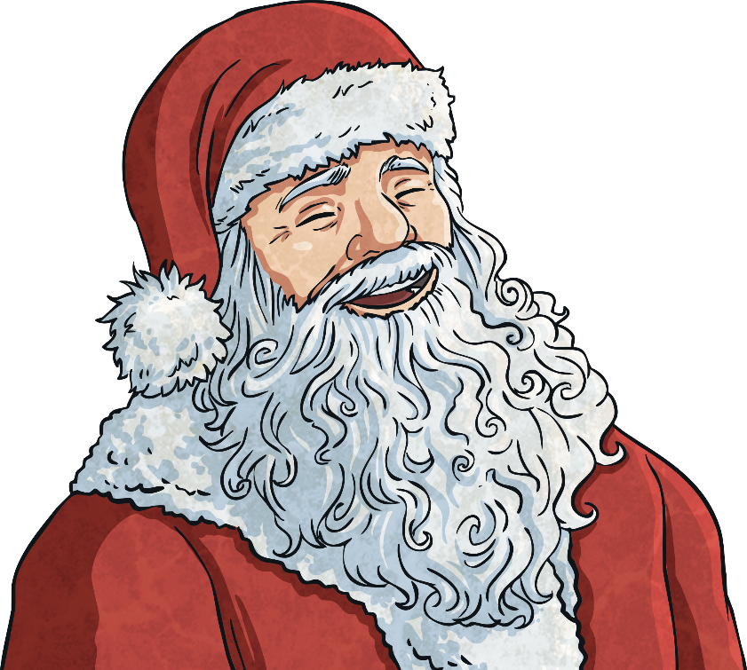
Father Christmas and Presents
In England, on Christmas Eve, many children prepare for the arrival of Father Christmas by hanging a stocking or sack in their homes.
It is believed that Father Christmas travels on a sleigh pulled by reindeer on Christmas Eve night.

Slide 5
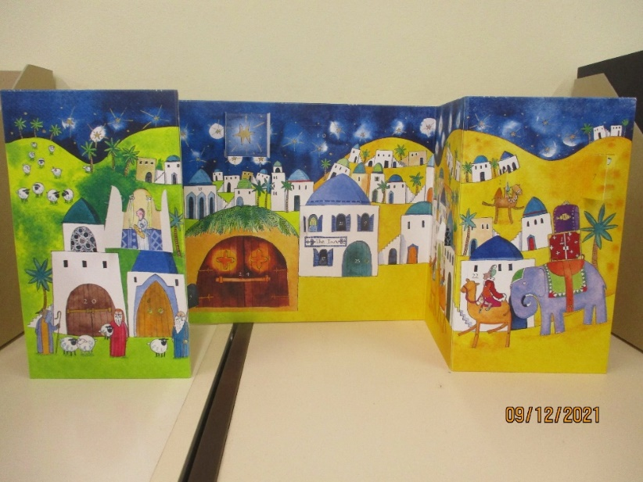
What we do on Christmas Eve and Christmas Day. By Omer & Delilah
We open one present on Christmas Eve.
We give Father Christmas rum or milk and
cookies or mince pies.
We put a variety of baubles on the tree and it is tradition to place a
star or angel at the top of the tree.
We normally enjoy eating roast turkey on Christmas Day.

Slide 6
Christmas Crackers
Tom Smith invented the Christmas Cracker. In England, we pull Christmas crackers and usually find jokes or little toys inside and more.
When Tom died, his three sons took over his cracker business.
Crackers are also named ‘cosaques,’ but we don`t really call them that name. They are a big part of Christmas.
(by Busby and Jessica)

Slide 7
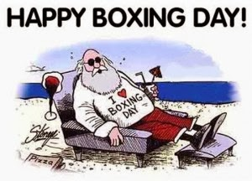
Boxing Day
Boxing Day takes place on the 26th of December, the day after you go to church. The name comes from a time when the rich gave presents to the poor.
Boxing Day used to mean that the servants got a day off work. It is also called ‘offering day.’
by Jess and Busby

Slide 8
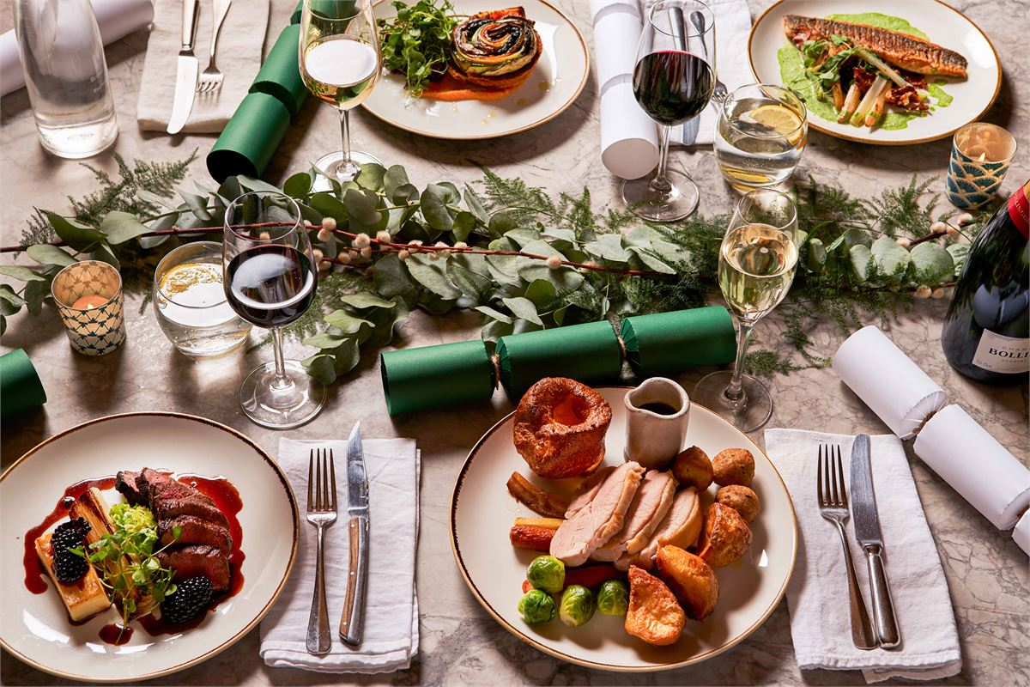
On Christmas Day, families and friends gather to enjoy a feast of delicious foods.
In Willow Class, our favourite part of the Christmas feast is sausages wrapped in bacon -we call these ‘pigs in blankets’. The stuffing is also very popular – delicious and savoury.
If we are not too full, it is tradition to enjoy some Christmas pudding served with brandy butter or lots of cream! Christmas pudding is full of dried fruits and is very rich!
Arthur & Ted
By Teddy and Arthur

Slide 9
We hope you now know more about Christmas traditions in the UK.
By Willow Class

