Slide 1
THE ENVIRONMENTAL PROBLEMS
Tricase Via Apulia secondary school - Italy

Slide 2
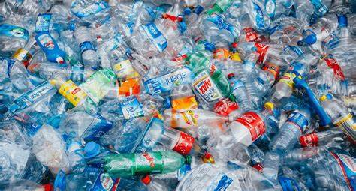
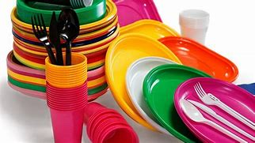
PLASTIC
Plastics are used from everyone for a broad number of reasons:
For drinking (cups and bottles);
For eating;
And so many and many things.

Slide 3
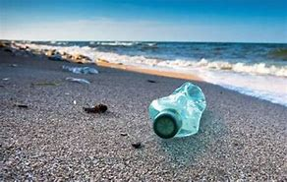
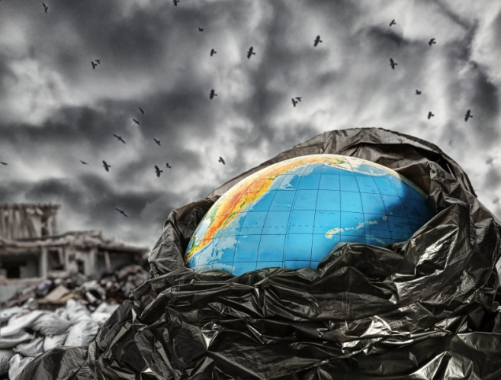
But this element can cause pollution and contributes to global warming.
So, for example, when we throw a plastic bottle on the ground, we do a big damage to our environment.

Slide 4
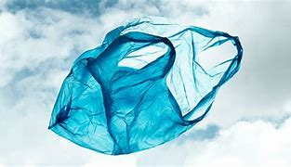
Plastic bottles take 450 years to decompose and plastic bags take 10-20 years. Every single plastic item is really common in our lives, but it becomes very dangerous for the planet, if we don’t recycle it .

Slide 5
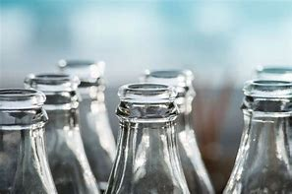
Glass takes million years to decompose.
Let’s think :the only thing to do is:
reduce waste, reuse and recycle as much as possible

Slide 6
ENVIRONMENT PROBLEMS IN ITALY
There are some environment problems also in our country:
Air pollution, climate change and waste disposal are the worst environment problems in Italy.
The problem of smog is worse in north Italy for factories. The problem of waste is everywhere, but worse in the south.
There is also the pollution of water ( rivers, lakes, sea…) and the shortage of water ( because of the climate change).

Slide 7
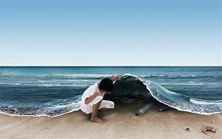
Another big problem is traffic and parking, because not many people use a bike or public transport.
The problem of the use of plastic is also serious.
There’s lots of waste ( plastic, glass, cigarettes, paper…) around us, in the streets and in the countryside.
We should keep the nature and the towns clean.

