Slide 1
How we can reduce food weste.
Sandra Kyšová 7.A

Slide 2
How we can reduce food weste.
1. Don´t buy unnecessarily much food but only the ones you will eat.
2. When we cook something, we only cooks as many portions as we eat.
3. When we come to the restaurant, we only order as much as we eat.

Slide 3
How we can reduce food weste.
4. If we do not finish the food in the restaurant, we will have a packet.
5. We can put some foods like meat in the freezer to make them last longer.

Slide 4
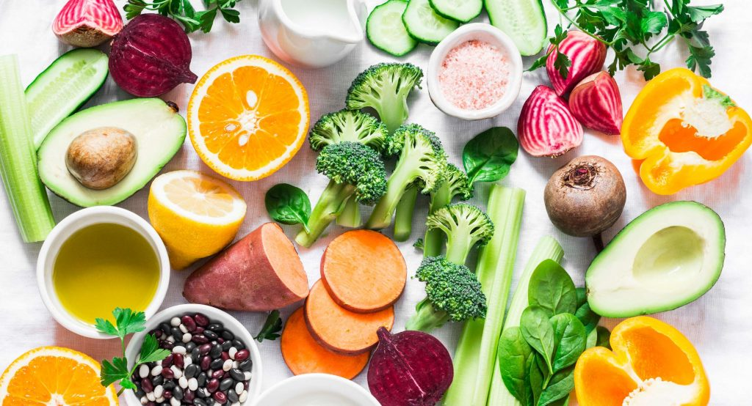
How we can reduce food weste.

