Slide 1
Why do we need to reduce our energy consumption?
We’re more dependent on electricity than we were fifty years ago. This fact is causing serious environmental problems.

Slide 2
We use a lot of energy in our life everyday. Our homes use electrical energy in many ways:
Home heating / cooling systems
Heating water systems
electric lighting
appliances, such as toasters, microwave ovens, televisions, washing machines, dishwashers, dryers, computers, vacuum cleaner and so on…

Slide 3
What is non-renewable energy?
A lot of the energy we use to power our homes and businesses comes from fossil fuels, like coal, oil, natural gas.
When we burn fossil fuels, we send greenhouse gases into the atmosphere, that cause global warming, very dangerous for our environment.
If we reduce the amount of the energy we use, we can reduce the need for burning fossil fuels.

Slide 4
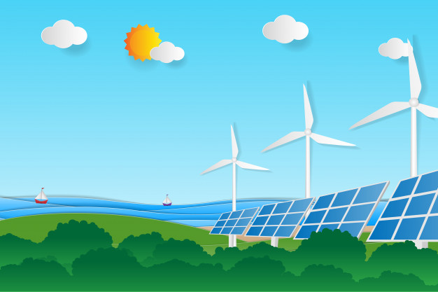
What is renewable, green energy?
We can use new alternative forms of energy!
Renewable energy is any natural resource that can replace itself quickly .
Renewable energy sources are sustainable, and environmentally-friendly
Wind and sun are 2 examples of renewable, clean, energy

Slide 5
“ We must become more conscious of how to use energy and save it”.
we must become more ENERGY EFFICIENT, using less energy, but having the same product or service
Reducing your energy consumption
doesn't mean
making big changes to your life.

Slide 6
How can we reduce energy consumption?
Remember the 3 Rs
It is important to Reduce our Consumption, Reuse products and Recycle materials . When we recycle, we save energy.

Slide 7
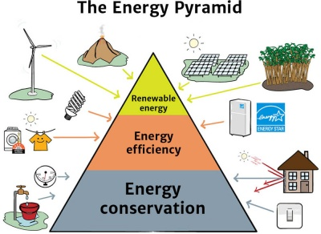
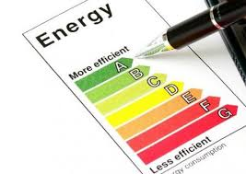

Slide 8
We must reduce the Environmental Impact of our energy use
Some ways to save energy: simple changes in our everyday routine can help the planet
turn off lights when you leave a room
unplug electronics when not in use ( computers, printers…
keep the refrigerator door closed
wash clothes in cold water when it’s possible
take shorter showers
go on foot
ride a bike

Slide 9
More tips…
buy LED bulbs, or compact fluorescent light bulbs. They are more expensive, but they save you money in the long run, using less energy than old incandescent light bulbs .
avoid using a “screensaver” with an image. The energy consumed by the monitor to form colors is greater.
paint walls in light colors.
make the most of the sunlight, whenever possible.
choose efficient appliances that consume less energy
use less air conditioning . When the air conditioning or heating system is on, make sure that the windows and doors are properly closed.

