Slide 1
Deforestation is the most urgent problem in Western Ukraine. People cut down forests in the Carpathian Mountains illegaly.
Work Romanchuk Natalia

Slide 2
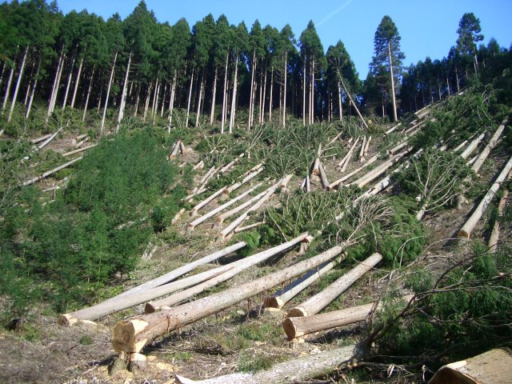
Deforestation causes landslides and floods.

Slide 3
It disturbs the natural balance and ruins the natural habitats of many species of animals, birds, insects and plants.
Cut down the forest
And they have nothing to eat
Що нам їсти?

Slide 4
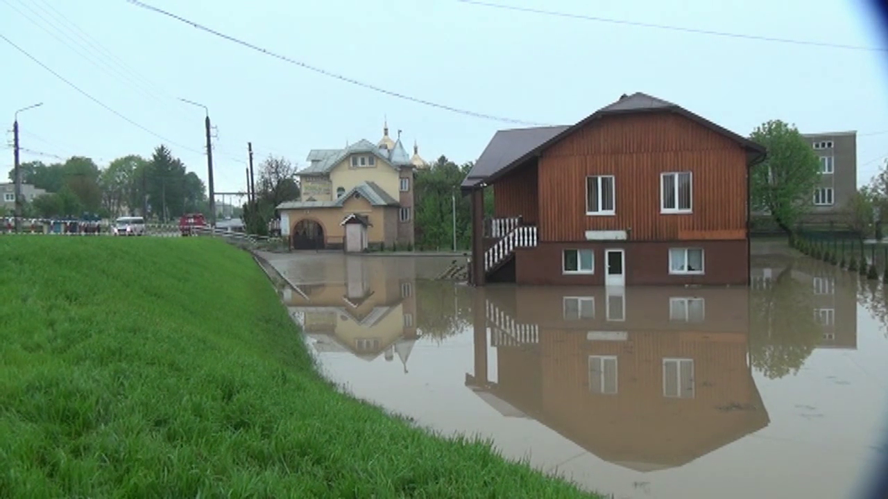
Floods destroy roads, bridges, flood houses and yards.

Slide 5
Every year floods kill several people and animals.
Consequences of floods for people
Consequences of floods for animals

