Slide 1
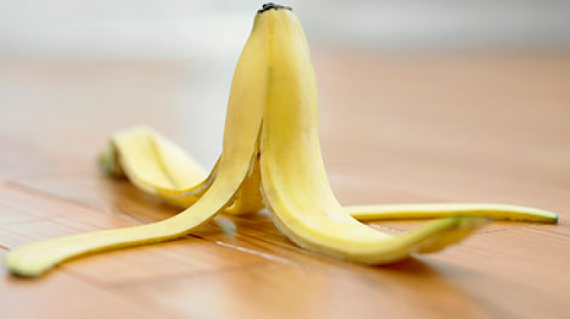
banana peel disappears in 2 to 5 weeks

Slide 2
paper disappears in 3 months

Slide 3
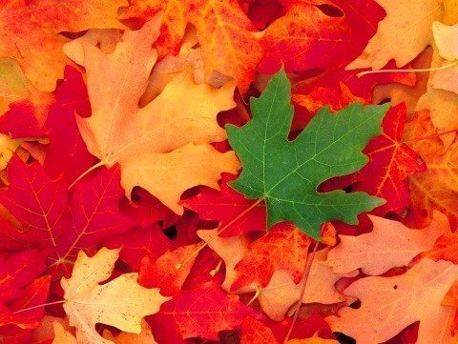
leaves change color, mix with the soil and rot

Slide 4
cotton shirt fades between 1 month and 5 months

Slide 5
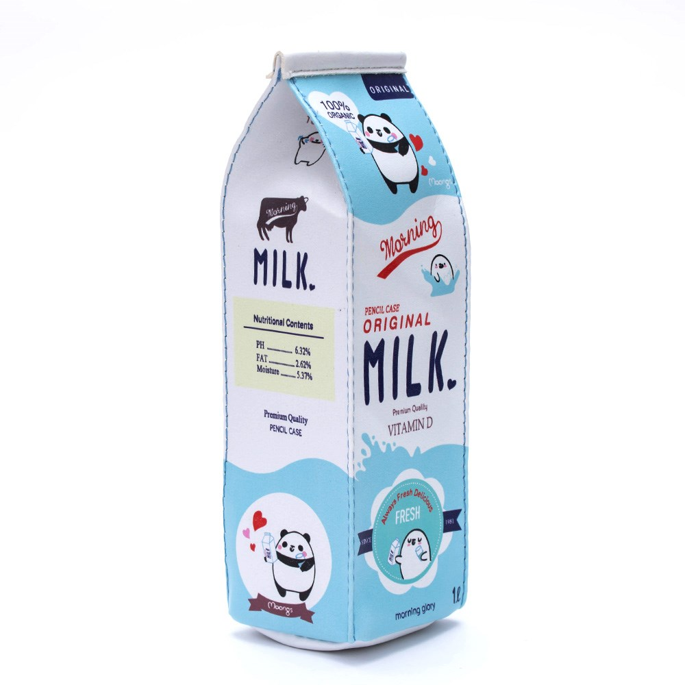
milk carton disappears in 3 months

Slide 6
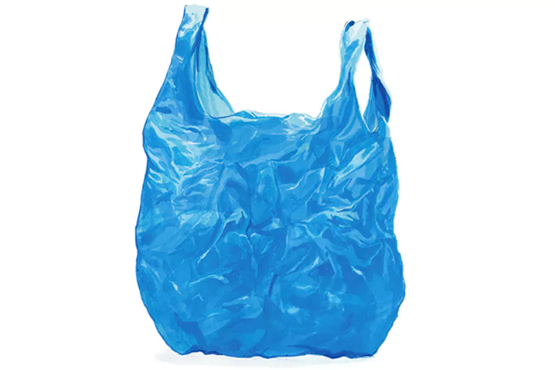
plastic bag disappears in 400 years

Slide 7
PET bottle disappears in 400 years

Slide 8
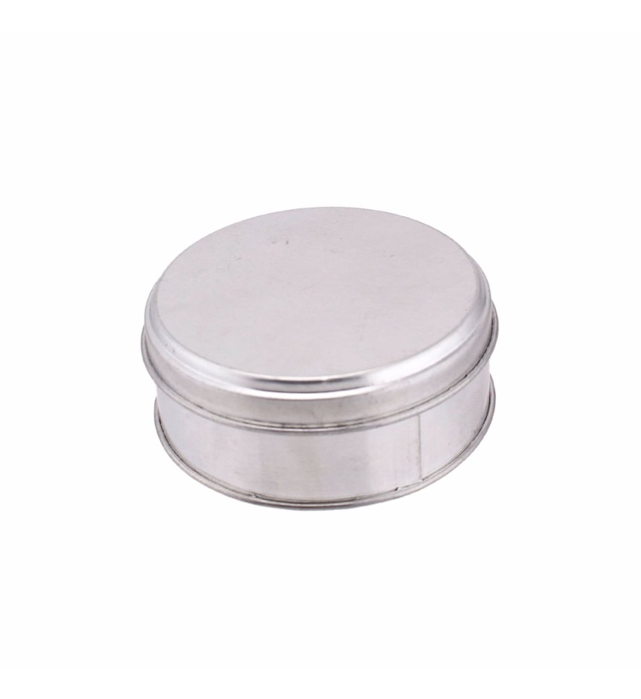
the canister disappears in 10 years

Slide 9
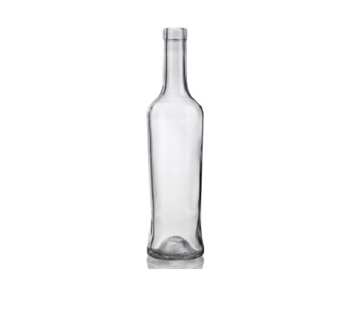
glass skewer disappears in 4000 thousand years

