Slide 1
zero waste
CAN GÜNGÖR

Slide 2
What ıs zero waste
Zero waste is one of the most important environmental issues.
Waste is the symbol of ineficiency and misallocated recources.
Significant progress can be achieved in reducing the waste.It varies from city to city.
Zero waste is making materials reused and recycled.
Recycling materials can be:
Industrial
Food
Packaging
Textile
Electronical

Slide 3
The countrıes makıng zero waste Projects
Austuria
Germany
Taiwan
Egypt
Brazil
Singapore
South Korea
United Kingdom
Italia
Slovenia
Belgium
Switzerland
Netherland
Luxembourg
Sweden
Denmark
Scotland
Norway
Northern Ireland
Finland
Hong Kong
United States
England
Poland
France
Wales

Slide 4
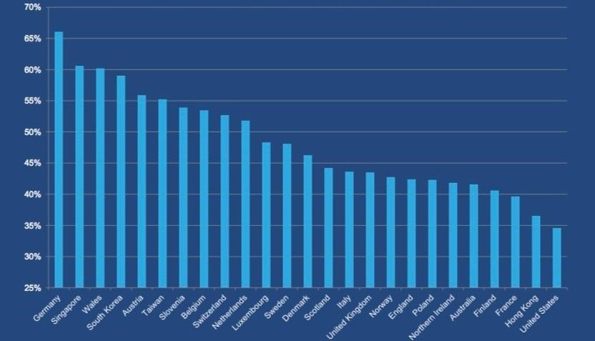
The countrıes makıng zero waste Projects

Slide 5
All these countries have common ability:
They all support their citizens to make them collect their waste for recycling.
They also support citizens financially.
They all have political and performance targets.

Slide 6
If a country only recycle 60% of only one kind of material it doesn’t mean zero waste.
The critical issue about zero waste subject is to recycle all kind of materials at the same time.
Glass
Paper
Aluminium
Plastic
Battaries
Fuels (Oils)
Organic wastes
Textile
Electronic waste
Metals
Wood

Slide 7
For Example:
In Turkey, the recycling percentage of all kinds of materials is about 7%.
But it is 20% for packaging materials.
This is not a real succes because its only recycling of one kind of material.

Slide 8
What types of zero waste projects can be get started ın turkey
For a sustainable generation of Turkey we can take control of our wastes for leaving next generation a fresh,clean and liveable world.
We need to support the citizen and political strategies for zero waste.

