Slide 1
Envormental problems ın turkey
Kuzey Sahin 5-C

Slide 2
Turkey since 2002 with data collected from other provinces were studied to determine environmental problems. A report was published in 2014 by combining the data from the provinces. Based on this report 32 provinces in Turkey water pollution, air pollution 27 cities, 19 cities of waste, noise pollution 2 cities, 1 city erosion is the primary environmental problems. Compared to previous years, the number of provinces where waste and air pollution is a priority has decreased. It is thought that the construction of waste facilities and the use of natural gas have caused this development. There has been an increase in the number of provinces experiencing water pollution.

Slide 3
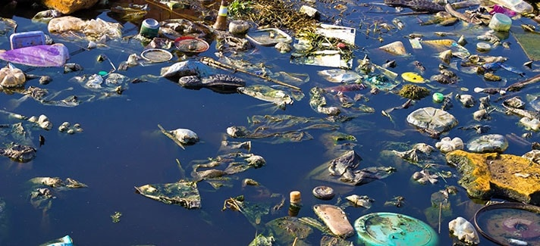
Surface waterS
According to the determinations of surface waters coming from provinces; 38.9% is highly polluted water, 28.4% is polluted water, 16% is less polluted water, 16.7% is in the high quality water class. Factors polluting surface waters; agricultural fertilizer and medicine use, domestic solid wastes, especially domestic wastewater.

Slide 4
Groundwater
Groundwater is mostly contaminated by the use of agricultural fertilizers and pesticides. Domestic wastewater, industrial wastewater, livestock wastewater are other pollutants.

Slide 5
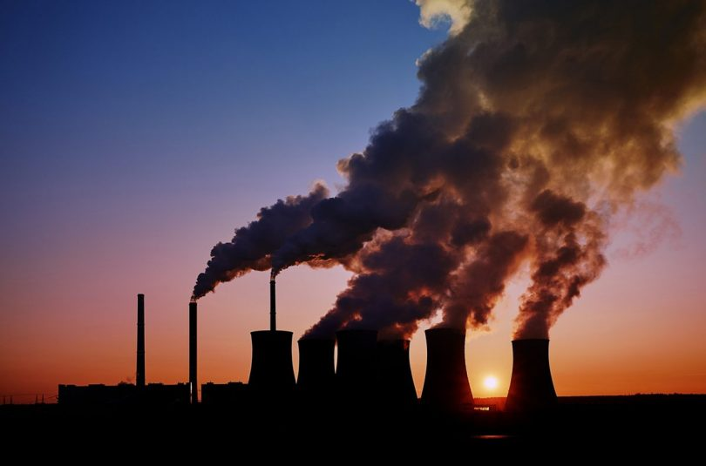
AIr pollutIon
Main air pollutants of 81 provinces were determined as follows: 1 thermal power plant, 2 other industry, 5 highway traffic, 5 manufacturing industry, 67 residential heating.

Slide 6
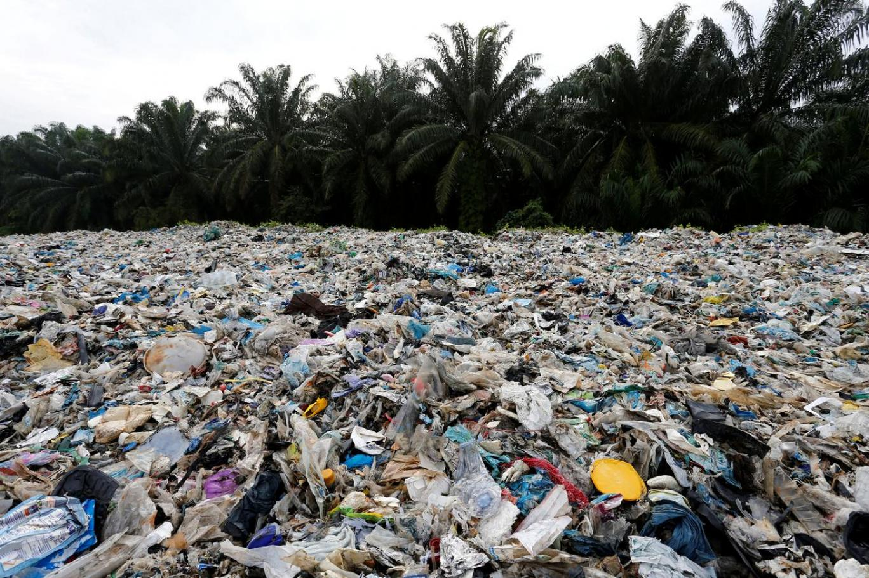
WASTES
In most residential areas in Turkey it is not a landfill or is inadequate. Our recycling facilities are quite insufficient. The main cause of soil pollution is wild garbage storage in 38 provinces and industrial waste in 12 provinces.

Slide 7
Noıse pollutıon
1 priority environmental problem of noise pollution in Turkey, where there are two provinces: Adana and Eskisehir. In Adana; The music sound of entertainment venues, the location of small workshops in the city and the noise of TEM are the main problems. In Eskişehir; Noise of entertainment venues in the city center is a source of complaint

Slide 8
solutıons
• An effective environmental control system should be established.
• It should be ensured that future generations are raised with a good environmental education.
• The number of non-governmental organizations should be increased to solve environmental problems.
• Non-governmental organizations and public institutions should work together.
• Planned urban areas should be created instead of unplanned urbanization.
• Forests should be reproduced and protected.
• Regular and environmentally friendly organized industrial zones should be established.
• Efforts should be made to separate the garbage at its source.
• Quality fuels should be used.
• Effective laws should be established by the state to prevent environmental problems.

Slide 9
THANK YOU FOR WATCHİNG😁😁😁

