Slide 1
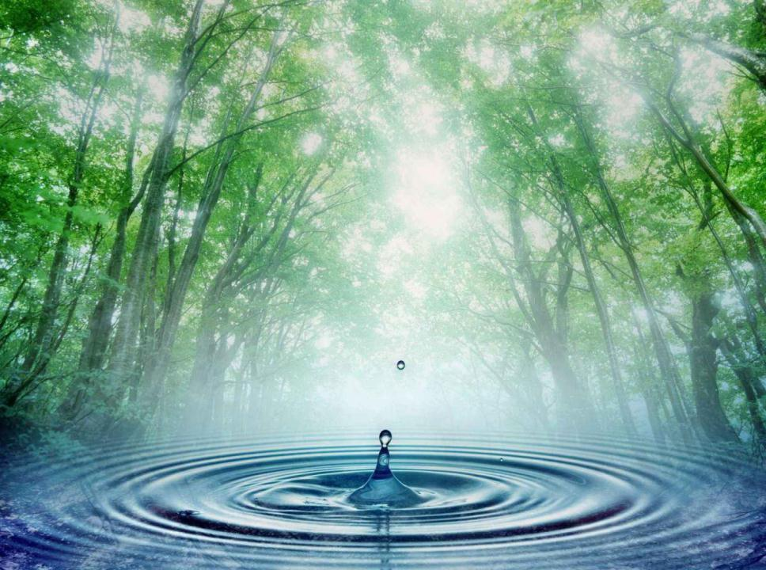
Reducing Water consumption
10 helpful tips

Slide 2
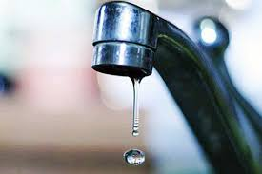
1. Repair plumbing fixtures in time, fix or change leaking taps When your tap is leaking, from 24 to 144 liters of water a day is wasted. In average, the lost of water can be up to 4000 liters a month.

Slide 3
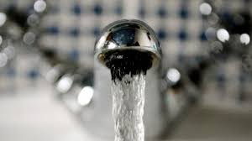
2. Turn off a tap tightly

Slide 4
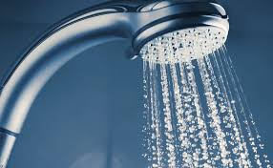
3. Take a shower instead of a bath. You need about 50 liters of water to have a shower compared to 200 liters for a bath.

Slide 5
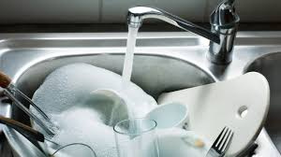
4. Turn off the tap from time to time while doing the washing up. If you don’t do that you’ll waste the water and the washing liquid.

Slide 6
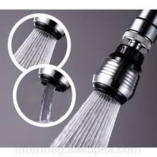
5. Use water dispensers on the taps — it helps you to save up the water

Slide 7
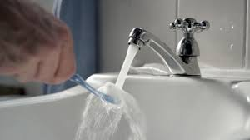
6. Turn off the water when you clean your teeth. Use the water from the glass when you need to clean your mouth. It saves up to 45 liters of water..

Slide 8
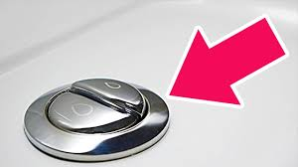
7. Use two flush buttons on the tank of the toilet.

Slide 9
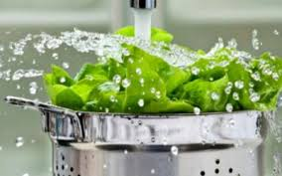
8. Don’t waste the running water. Wash fruit and vegetables in a bowl. You’ll need up to 3 liters of water instead of 15 liters.

Slide 10
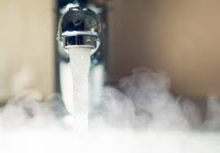
9. Don’t defrost products using the running water.

Slide 11
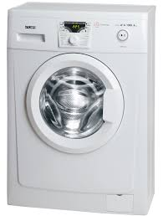
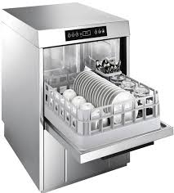
10.Use only modern electrical appliances and plumbing fixtures.

Slide 12
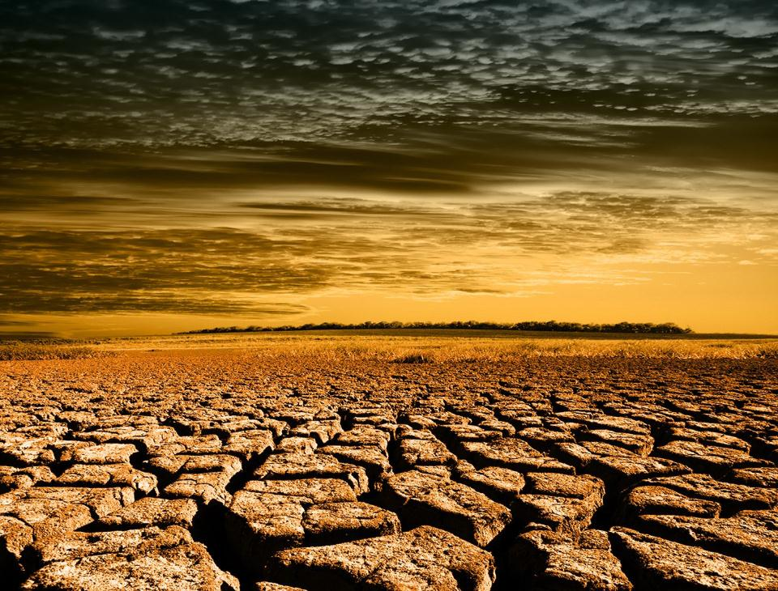
Living matters can’t live without water!

