Slide 1
ZERO WASTE FOR A CLEAN WORLD

Slide 2
WHAT IS ZERO WASTE
“Zero Waste” is a waste management approach. It includes the prevention of waste, the more efficient use of resources, the reduction of the amount of waste generated, the establishment of an effective collection system, and the recycling of waste.

Slide 3
ZERO WASTE SYSTEMS

Slide 4
THE BEST COUNTRIES IN THE WORLD FOR RECYCLING
RECYCLING IS AN IMPORTANT PART OF ZERO WASTE SYSTEM

Slide 6
"Smart recycling container" in Istanbul

Slide 7
This Orange Juice Vending Machine
Converts Peels into Cups
- PROJECT NAME - “Feel the Peel”

Slide 8
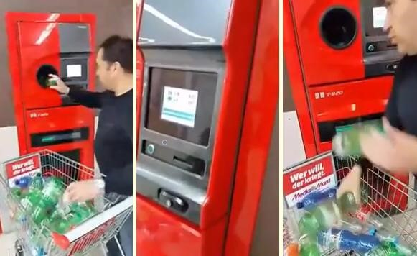
RECYCLING MACHINES ARE IMPORTANT FOR ZERO WASTE SYSTEMS

Slide 9
WE CAN INSTALL ZERO WASTE SYSTEMS ALL AROUND OUR COUNTRY.

Slide 10
