Slide 1
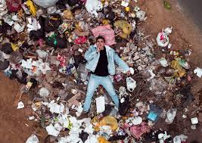
Littering
Tetiana Shalena

Slide 2
Only 3% of municipal solid waste is currently being recycled in Ukraine. There are a lot of huge waste dumps around any town or city in Ukraine.

Slide 3
As a rule, litter is just burnt. Carbon dioxide and greenhouse gases are emitted into the air. It causes air pollution and contributes into global warming.

Slide 4
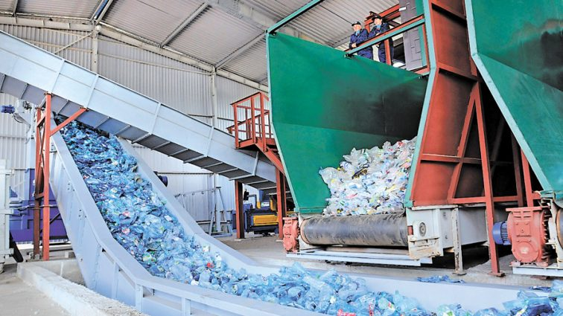
There is no infrastructure for collecting, sorting, recycling and safe disposal of waste.

