Slide 1
ENVIRonment

Slide 2
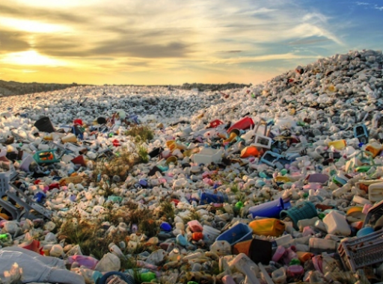
Plastic bottles take 450 years to decompose.
Plastic Bags decompose in
10-20 years.
Plastic products are very common in our modern life. According to an estimate, every year we use approximately 1.6 million barrels of oil just for producing plastic bottled water. Plastic items take up to 1000 years to decompose in landfills.

Slide 3
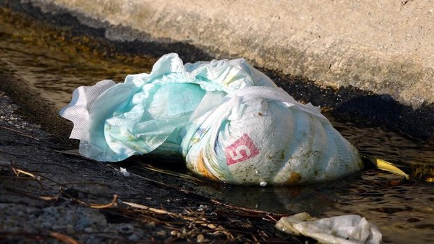
In the United States, every year more than 18 billion disposable diapers are thrown away. These disposable diapers take approximately 550 years to decompose in landfills.

Slide 4
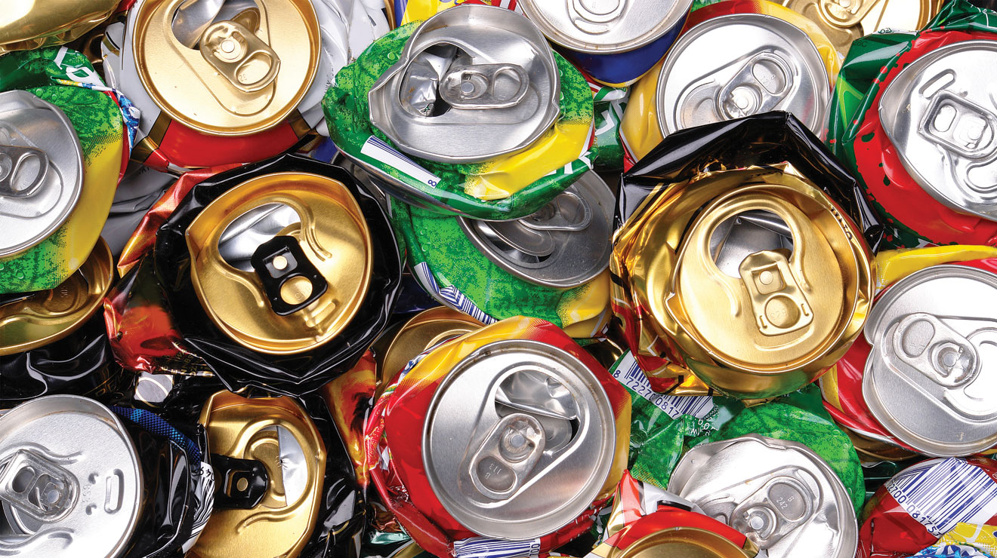
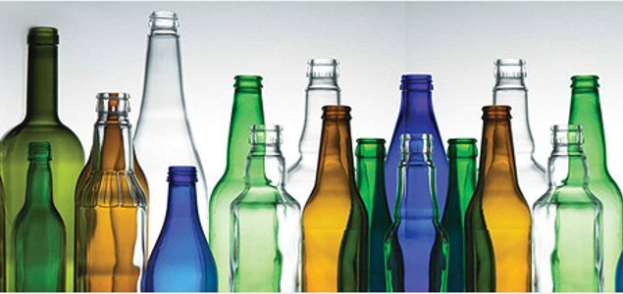
Glasses are thrown away in landfills, it takes million years to decompose. According to some sources, it doesn’t decompose at all.
Aluminum cans take 80-200 years in landfills to get completely decomposed

Slide 5
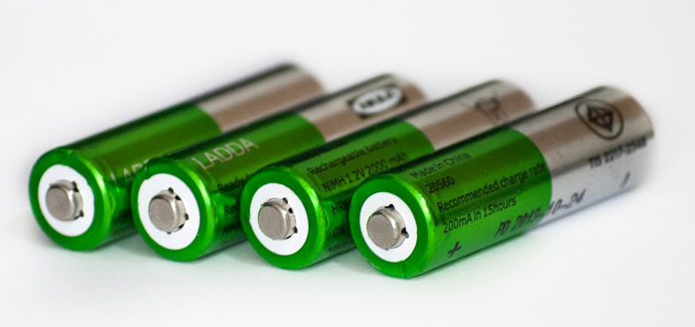
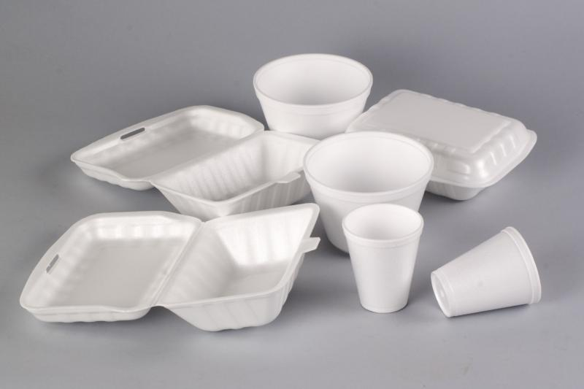
Batteries decompose in 100 years.
Foamed Plastic Cups the decompose in
50 years.

Slide 6
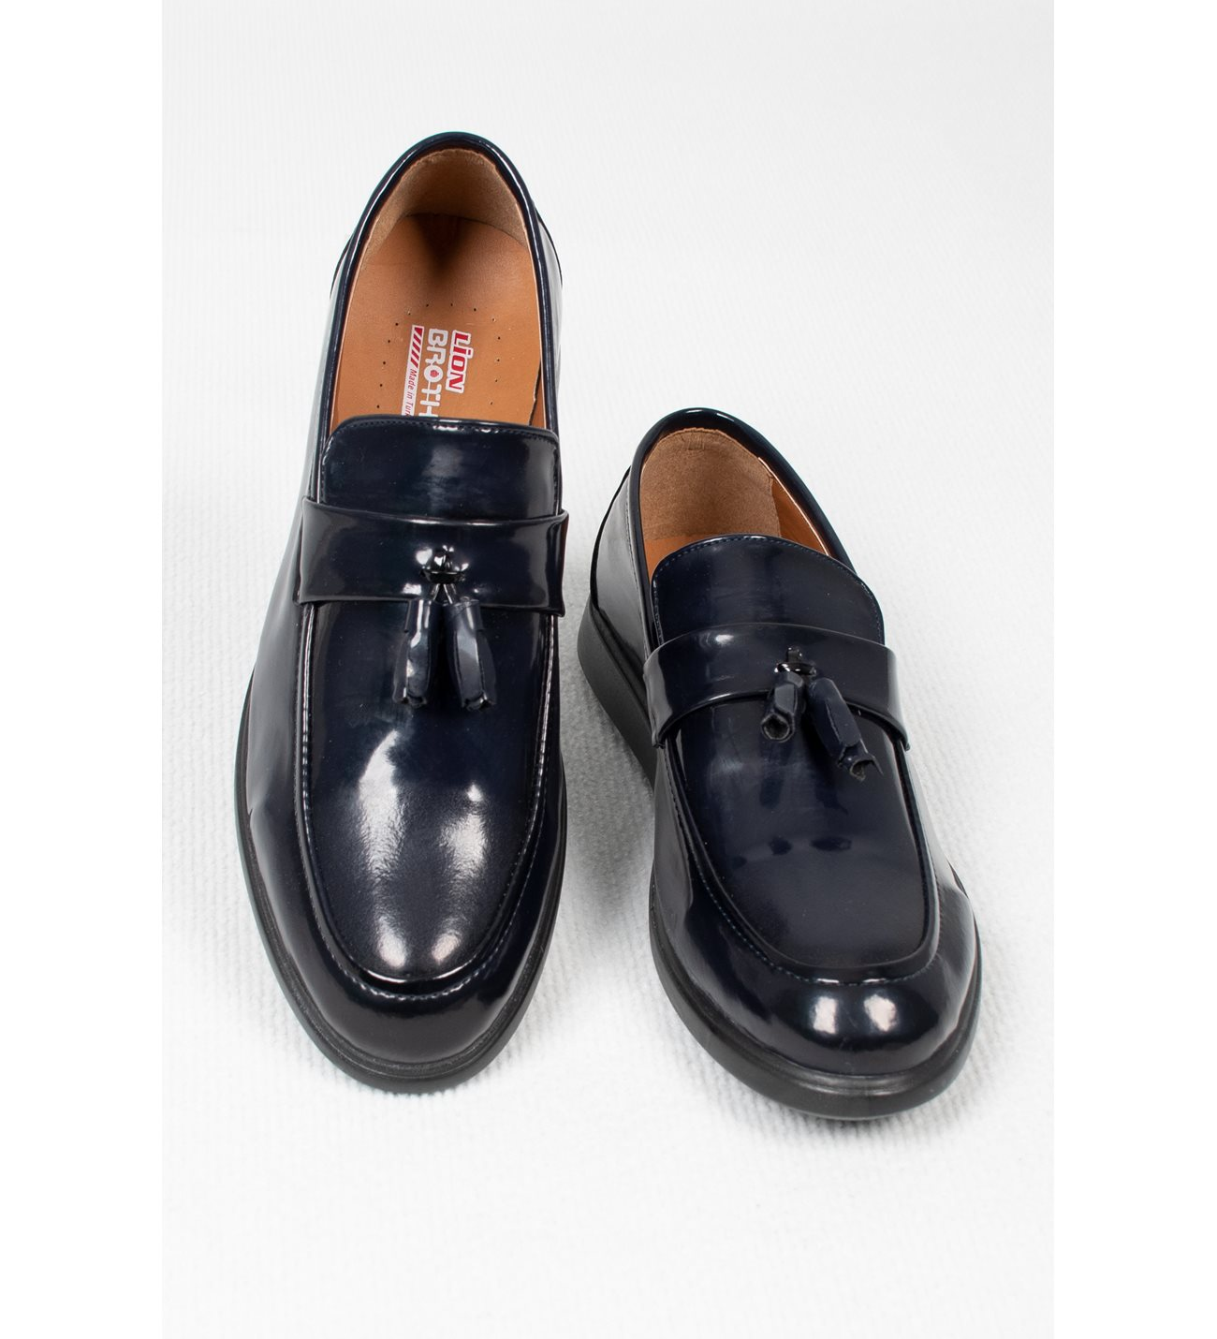
Wool clothes decompose in 1-5 years.
Leathers shoes decompose in 25-30 years.

Slide 7
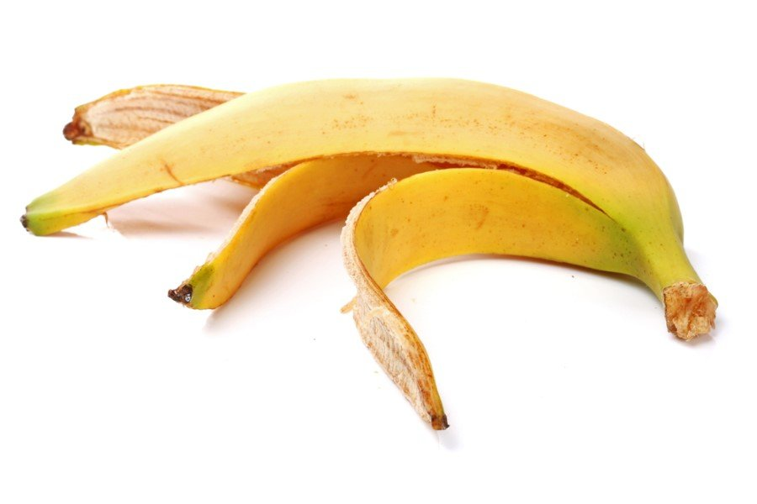
Organic waste:
Orange and banana peals decompose in 2-5 weeks.

Slide 8
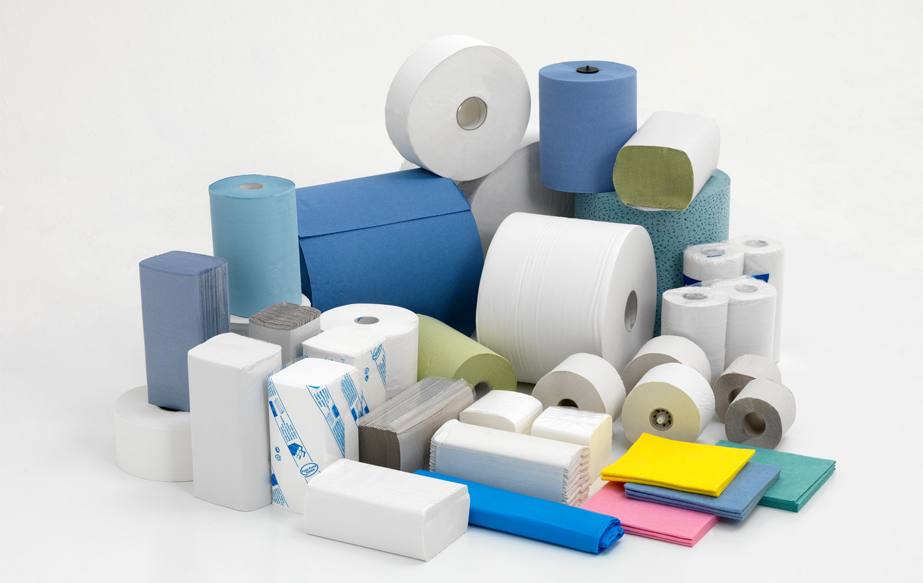
Paper towels decompose in 2-4 weeks
Newspapers decompose in 6 weeks.

