Slide 1
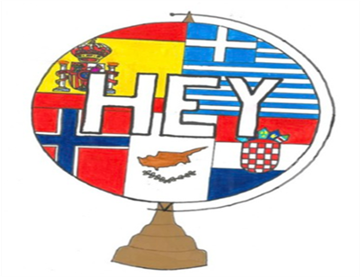
History Teaching in Greece: reflections and perspectives
Dr. Anastasios Kountouris

Slide 2
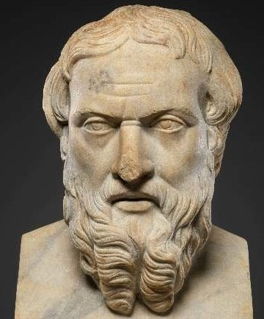
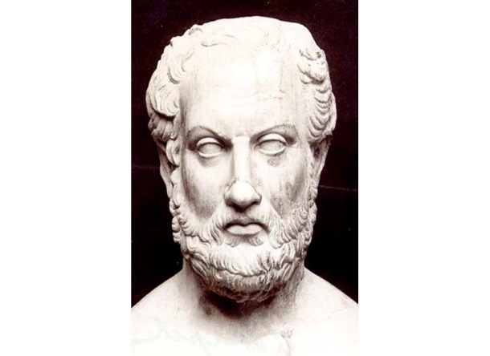
BIRTH AND EVOLUTION OF HISTORY SCIENCE
History is the science that deals with the systematic study of the past, the recording and understanding of past events.
“History” as a word derives from the noun "Histor" which means the one who knows, the judge, the reliable witness (οἶδα: I know well).
Many peoples made recordings of the past. However, History begins with the ancient Greek tradition, when myth is separated from reality and logic.
Herodotus: records the Persian Wars in his work Ἱστορίαι. He was described as the "father" of history by the Roman orator Cicero.

Slide 3
Thucydides: records the Peloponnesian War in his work Ἱστορίαι. For the first time, issues about the reliability of the testimonies, the cross-referencing of the information and the accuracy in the recording of the facts are raised.
For centuries after the fall of the Roman Empire, the written histories will be a mixture of secular and ecclesiastical elements, with literary characteristics, and will mainly concern the works of kings.
In the 19th century the movement of Positivism will lay the foundations for the creation of real historical science. The main currents that will be created will be those of Historicism, the Annales School, the Marxist School and New History.

Slide 4
DEVELOPMENT OF HISTORY TEACHING IN GREEK EDUCATION
Modern Greek Enlightenment movement (mid 18th century - 1821): education of the people is a precondition for the realization of the value of freedom and the claim of national emancipation (Kountouris, 2011).
Dominant ideological currents: Romanticism (creation of national consciousness) and Neoclassicism (revival of the ancient Greek spirit).
During the period of Bavarian rule (1833-1862), antiquarianism prevailed. It was considered that classical education would give the newly formed Greek state the glamor of the past and the necessary supplies for its development (Bouzakis, 2002)

Slide 5
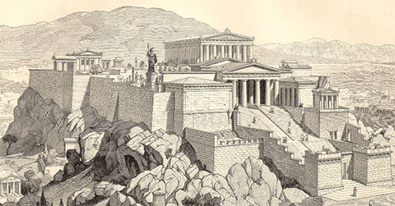
For almost two centuries, emphasis has been placed on the continuity of Hellenism from antiquity to the present, an element that is a fundamental component of Greek national identity.
Greece's entry into the European Union, in combination with the modernization of didactic concepts, led to a tendency to shift the interest of school history from the national dimension to the formation of historical consciousness, to the understanding of the complexity of modern societies and globalization.

Slide 6
PROBLEMS REGARDING HISTORY TEACHING
Emphasis on mechanistic memorization and rote learning.
Review of the same historical periods in High School and Lyceum.
Fragmentary teaching. Unable to format a complete image for events, people, eras.
Non-examination of modern history. Absence of local history.
Theoretical approach of the course. Lack of experientiality. Understanding of historical terms is not achieved and historical consciousness is not cultivated.

Slide 7
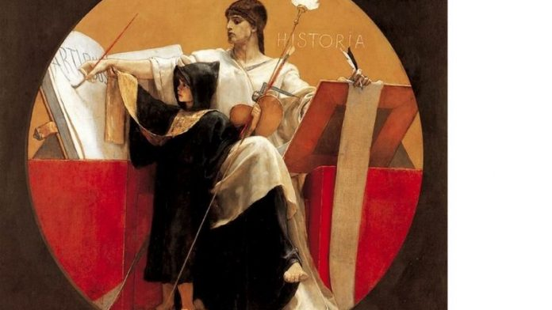
The subject is taught by teachers who do not have the necessary scientific and pedagogical training.
Reproduction of stereotypes by teachers in relation to historical events.
Insufficient further education. Inadequacy of textbooks.
Pre-formed perception of historical periods and events by students that is often based on unscientific theories.
Established belief that history is not useful. Insufficient connection to the present.

Slide 8
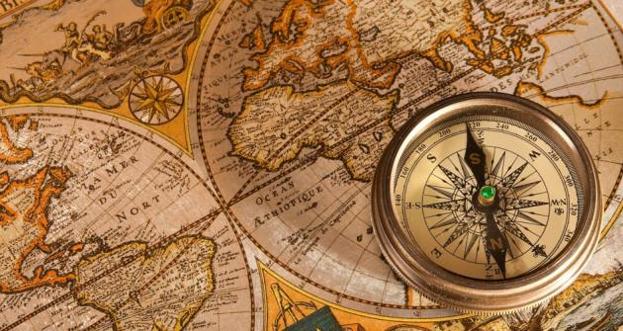
SUGGESTIONS TO IMPROVE THE TEACHING OF THE HISTORICAL SUBJECT
Restructure and re-approach the content of the subject of history. Enrichment of teaching material.
Modernization of textbooks.
Collaborative teaching and assignment giving.
Change in the way the course is examined. Emphasis on the cultivation of critical and historical literacy, not on memorization.
Utilization of Communication Information Technologies (Kokkinos & Nakou, 2006).

Slide 9
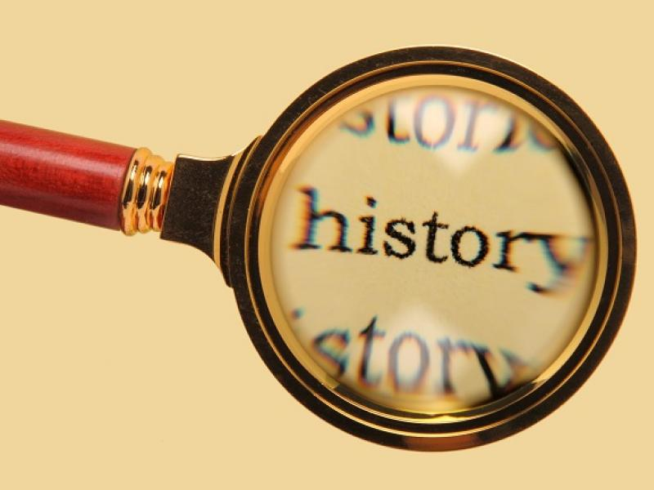
Creation of appropriate educational software. Utilization of existing electronic games with historical content and creation of new ones.
Teacher’s further education.
Experiential approach to historical knowledge. Visits to places of historical interest.
Connection of past with present. Awareness of historical causality.
Creation of "historical workshops" in schools on a permanent basis.

Slide 10
THE IMPORTANCE OF HISTORICAL KNOWLEDGE IN MODERN TIMES
Modern globalized and multicultural context: dialogue but also conflicts on issues of cultural heritage, memory and historical consciousness (Kokkinos, 2003).
Rejection of unscientific views on historical figures, events and periods. Rejection of conspiracy theories about history.
The aim of school history is the development of the historical critical thinking and consciousness of young people. The correct scientific and pedagogical teaching of history → a valuable tool for forging integrated personalities.

Slide 11
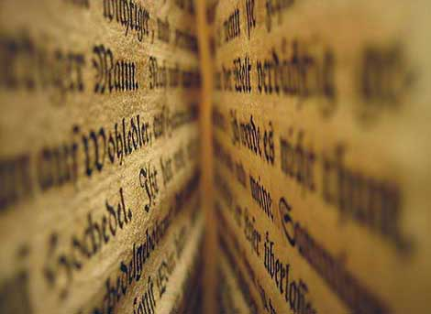
Promoting the value of peace and reconciliation in contemporary conflict environments (Page, 2000). Understanding phenomena such as refugee flows, migration and demographic change. Development of multicultural consciousness.
Awareness of the instrumentalization of History by political interests. Resistance to the spirit of revisionism that threatens the foundations of world peace.

Slide 12
THANK YOU FOR YOUR ΑΤΤΕΝΤΙΟΝ

