Slide 1
European platforms for History teachers: Scientix, Europeana, eTwinning live
Angeles Anaya García- Tapetado
Scientix Ambassador

Slide 2
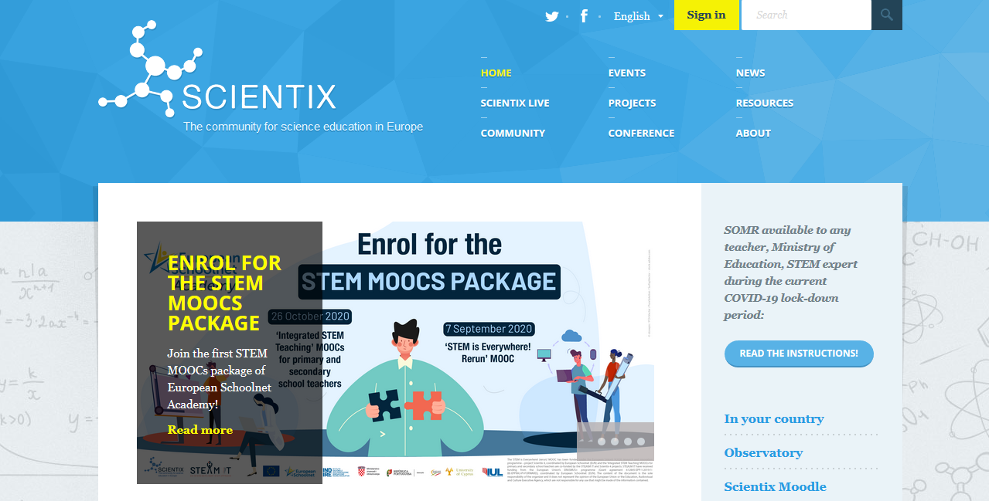
http://www.scientix.eu
Projects on STEM education
Resources
Europeana
Training opportunities for teachers
Blog entries: https://blog.scientix.eu/

Slide 3
Training Opportunities for teachers (online and onsite)
Workshops for teachers (in the Future Classroom Lab in Brussels, online and within other events)
Online courses on the EUN (European Schoolnet Academy) Academy
(MOOCs)
Webinars

Slide 4
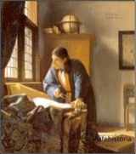
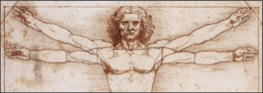
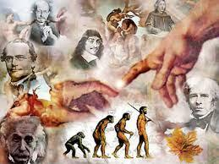
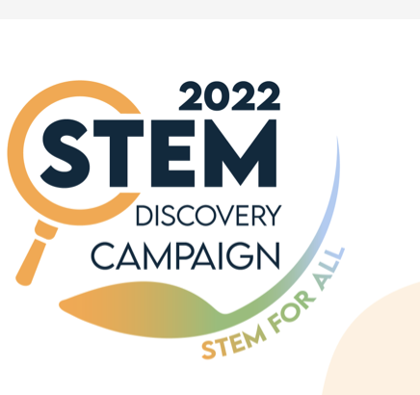
There is science in art, in history, in politicts and values

Slide 5
The Teaching with Europeana blog is first and foremost a meeting point for teachers searching for resources and advice connected to much of Europe’s rich digital cultural data. Te main objective is to use Europeana resources in their classroom.
You have display a catalogue of learning scenarios based on Europeana content, updated almost every day. There are also stories of implementation on how the learning scenarios presented are being implemented by teachers in their classrooms.
About Europeana
Europeana is Europe’s digital cultural heritage platform and provides access to almost 58 million items in a digital format from more than 3,700 European museums, galleries, libraries and archives.
Over 20 million of these artworks, artefacts, books, films and music are openly licensed and can be freely reused in various educational and research projects.

Slide 6
eTwinning, our hero ; )

Slide 7
Thank you <3
More information: Agueda Gras agueda.gras@eun.org
Head of the Science Education Department
Notes:
7
Scientix came to:
Ensure the information doesn’t disappear (the portal)
Help the dissemination (newsletters, presentations, teacher training)
Ensure there is collaboration between projects (project workshops)
→ very important: Scientix HAS a portal. Scientix IS NOT a portal.

