Slide 1
THE OTTOMANS ON RHODES
Marija Bogović, Antonia Pek, Nika Smolar, Natalija Štoos,
Mihael Vranar, Hrvoje Belinić

Slide 2
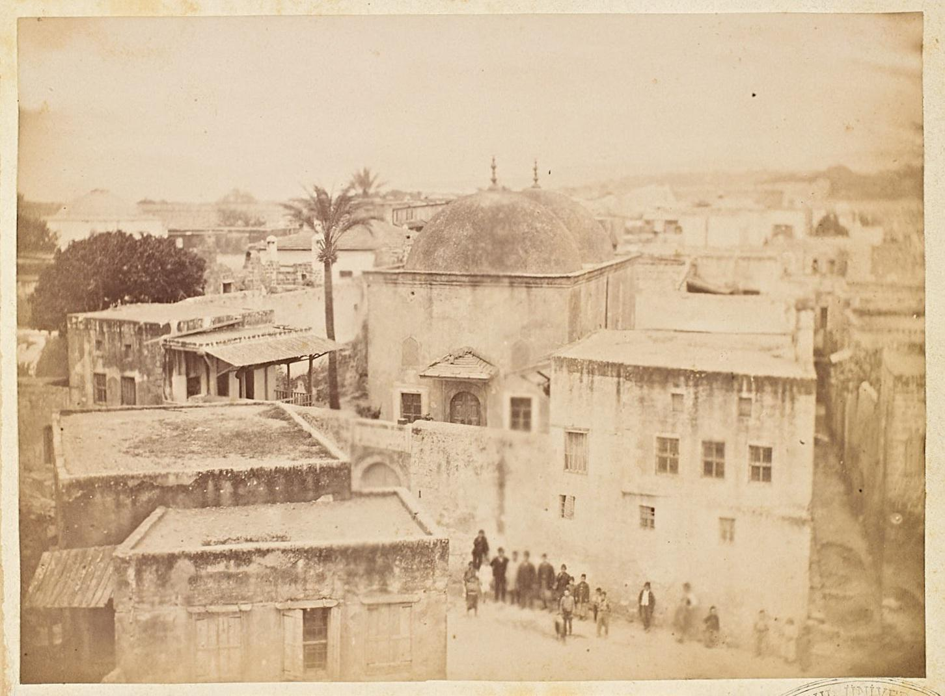
HAFIZ AHMED AGHA LIBRARY

Slide 3
Founded in 1793
Located in the medieval city of Rhodes
ABOUT THE BUILDING ITSELF
Protected by UNESCO
(UNESCO World Heritage Site)
One of the last Ottoman landmarks

Slide 4
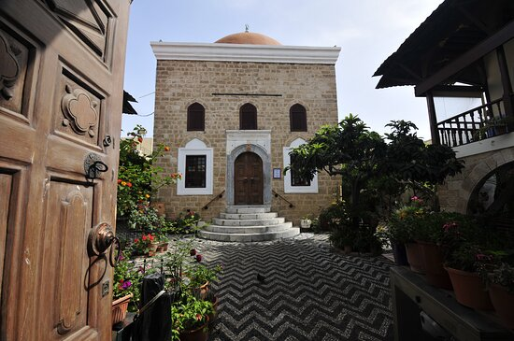
ABOUT THE FOUNDER OF THE LIBRARY
Hazif Ahmed Agha
Served as Chief Equerry to Sultan
Born in Asgourou in 18th century
Retired 1789
Member of a wealthy Ottoman family
Was called back into service
Founded the library in 1793
Died between 1800 and 1802
Delegate of the Empire to Mecca

Slide 5
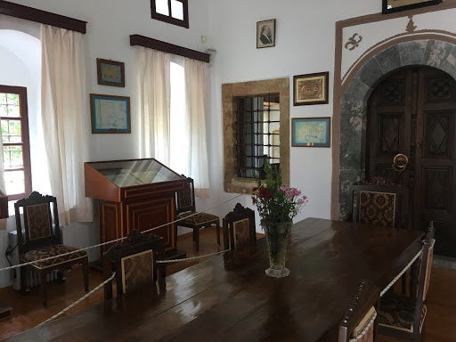
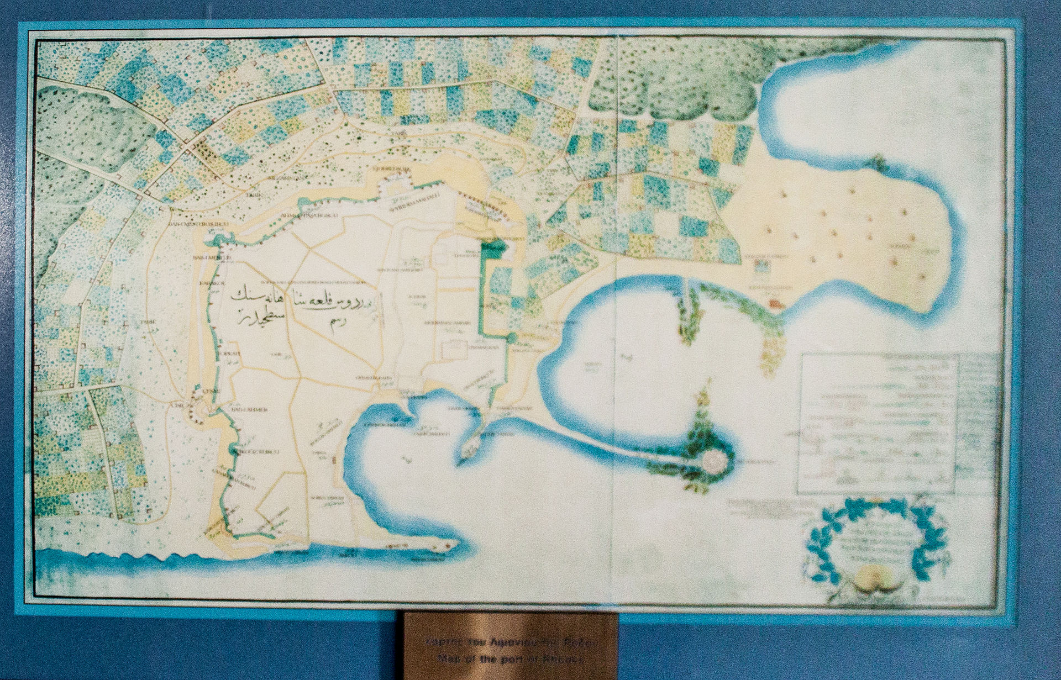
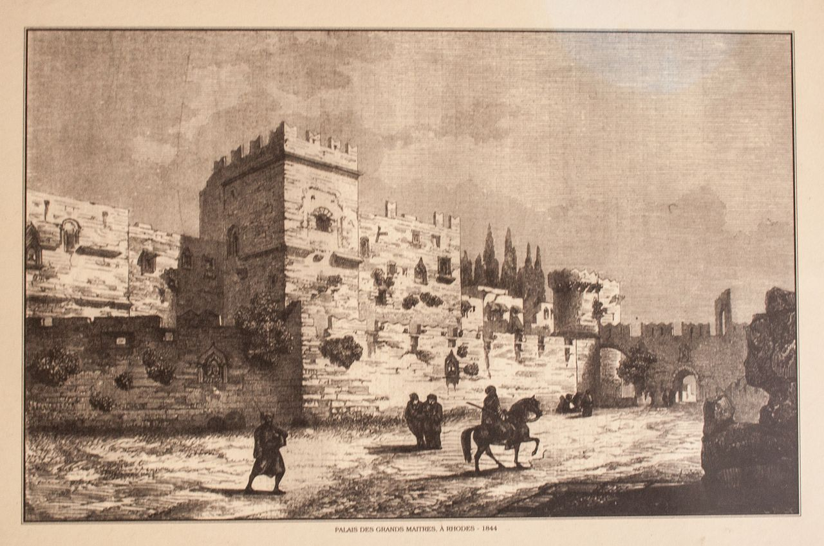
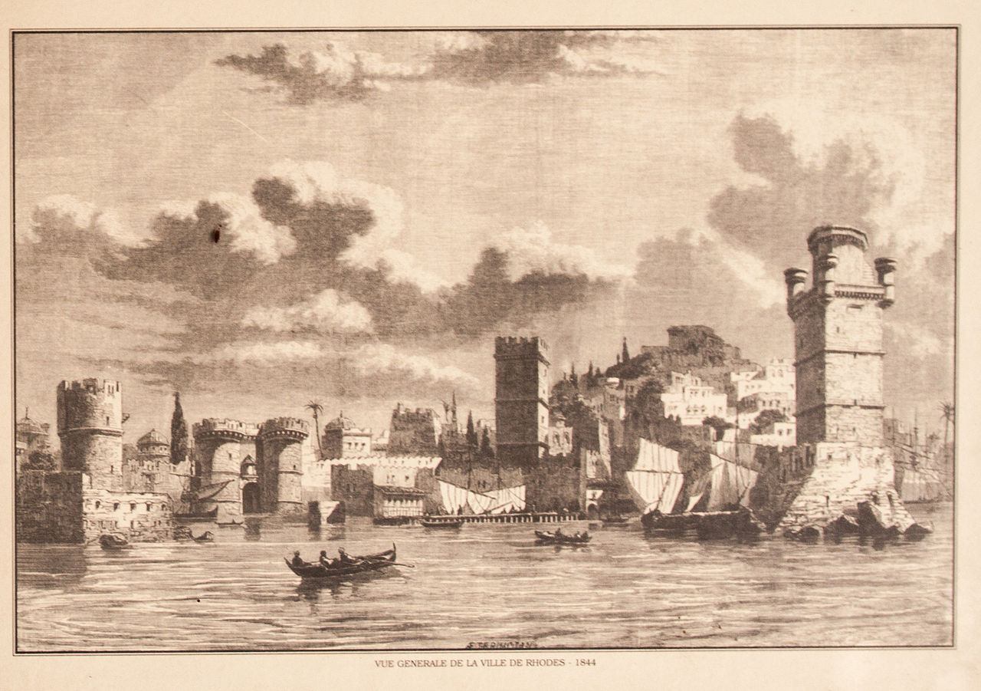
Around 1200 manuscripts
ABOUT THE LIBRARY’S CONTENTS
Old maps and pictures of Rhodes
Koran from 1540
History of Turkish siege of the city in 1522

Slide 6
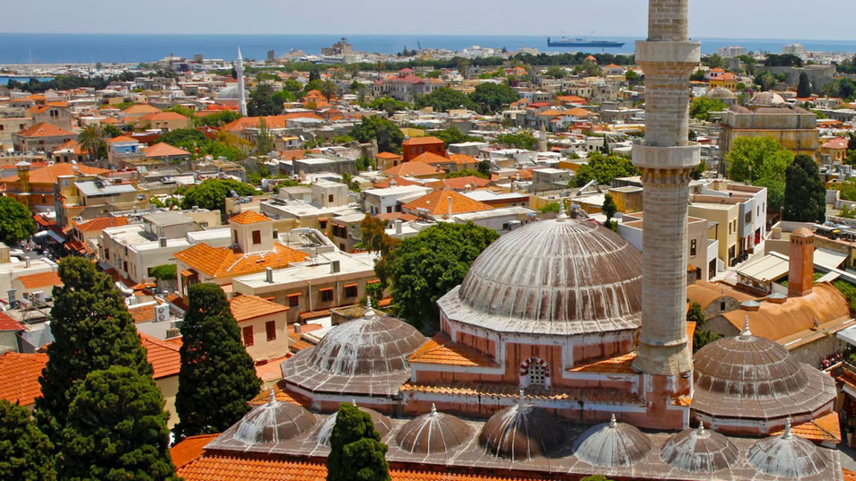
MOSQUE OF SULEIMAN

Slide 7
SULEYMANIYE MOSQUE
Built in 1522
Named after Sultan Suleiman
The first mosque in the town of Rhodes

Slide 8
Reconstructed- 1808
Arcade belonged to the Christian church
Rose colored stone exterior

Slide 9
Honorary distinction in 2006
Currently- museum

Slide 10
MEHMET AGA MOSQUE

Slide 11
MEHMET AGA MOSQUE
Built in 1820
The mosque
The minaret
Location: Socrates Street, Rhodes
View to the old town
Supported by a column
Second floor above the building
Wooden minaret

Slide 12
The ceremonial washing corner
Street level
Destroyed
Earthquakes and bombing
Closed for visitors
Today
Mosque
Open for ceremonies

Slide 13
THANK YOU FOR YOUR ATTENTION!
THANK YOU FOR YOUR ATTENTION!

