Slide 1
“LET’S EAT TOGETHER, EVERYBODY AROUND THE TABLE”
SKYPE SESSION
BUCATAREL IN BULGARIA
DETSKA GRADINA “VESELA”
DOBRICH, BULGARIA

Slide 2
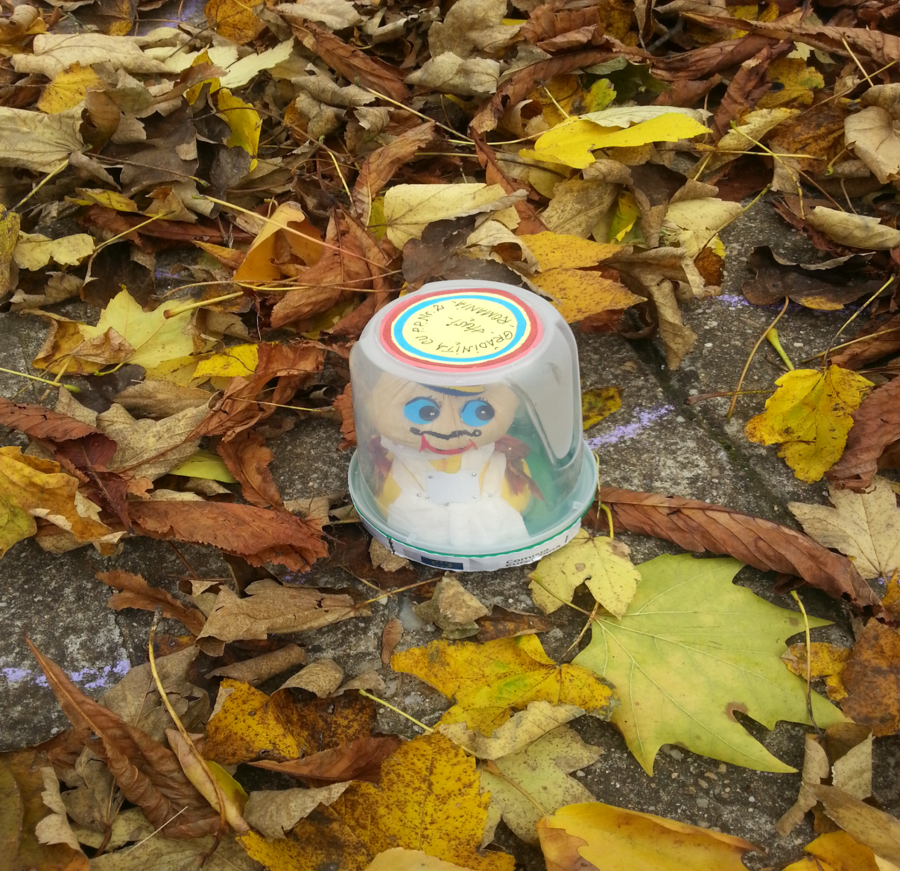
OUR GUEST BUCATAREL

Slide 3
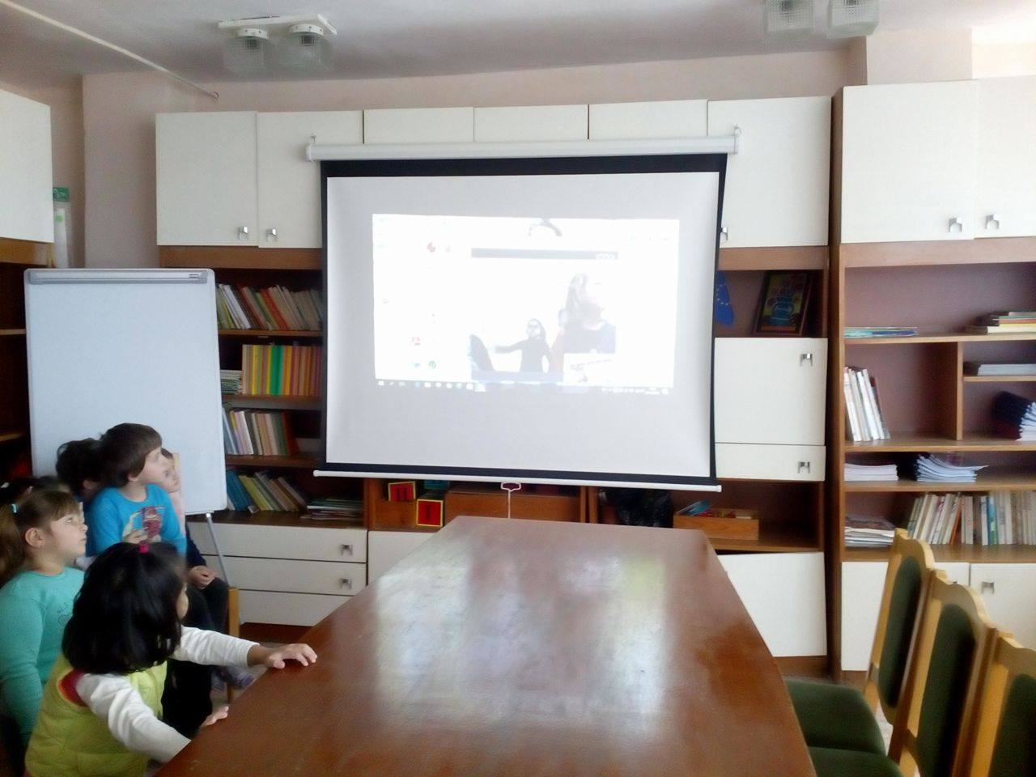
The romanian children are smiling, just like us!

Slide 4
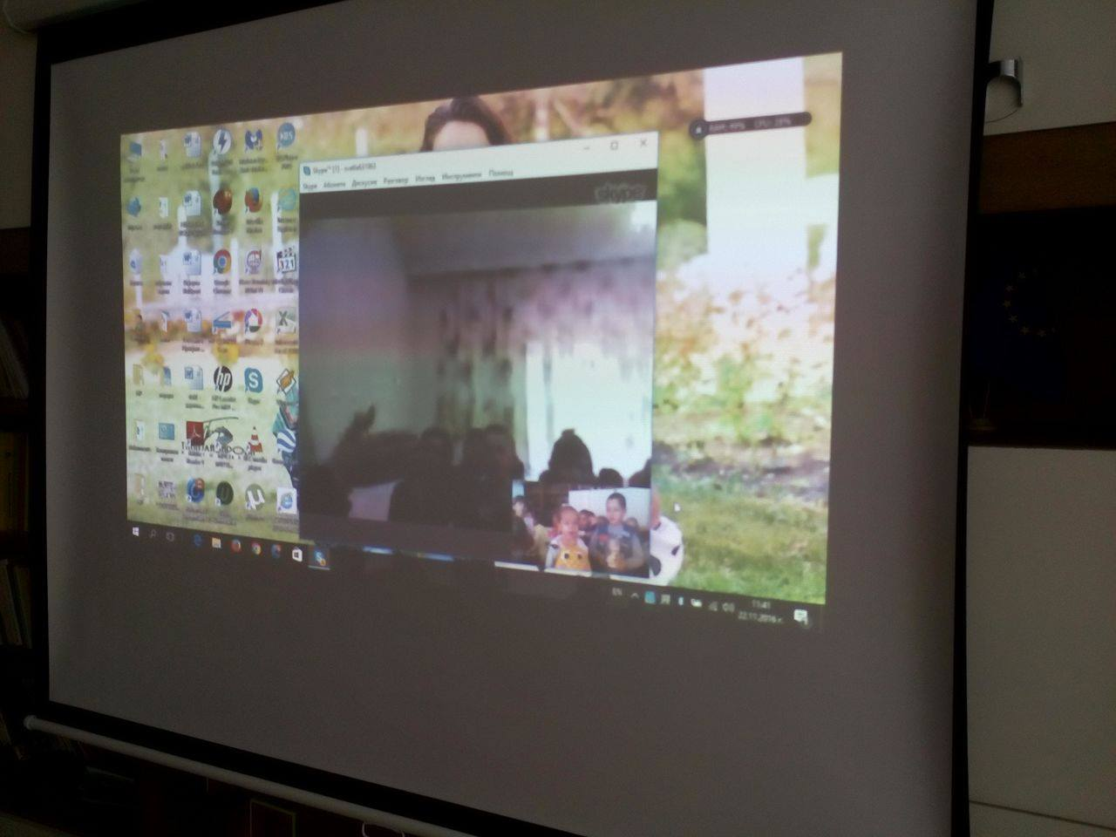
Speaking, singing, we have a fun together…

Slide 5
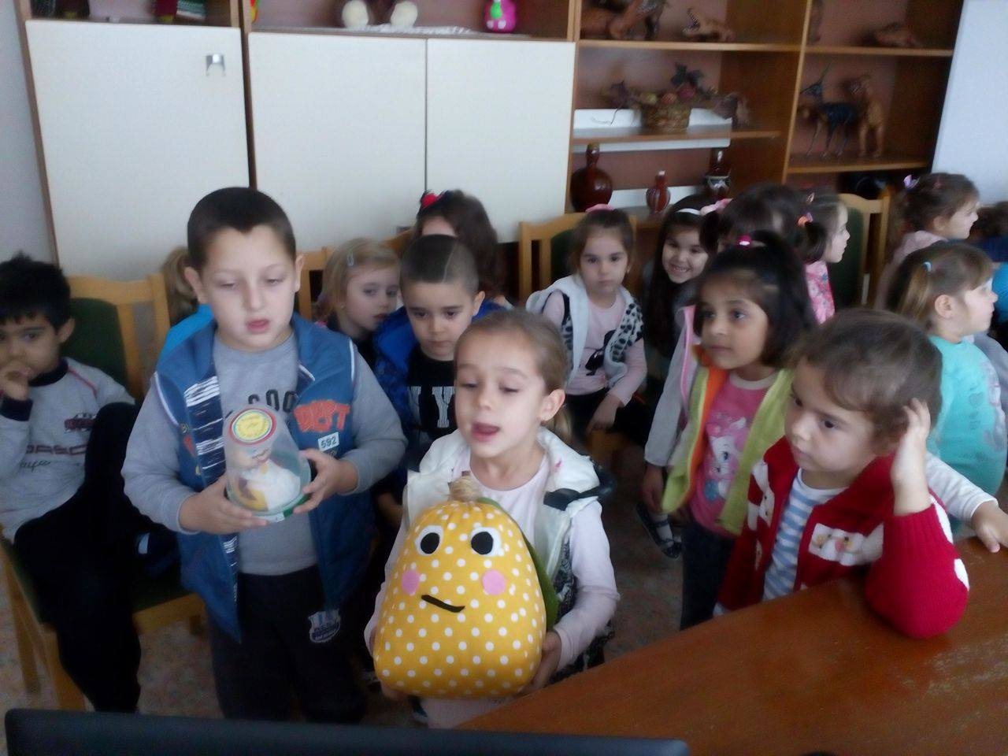
lBucatarel has a new friend- Lokumu

Slide 6
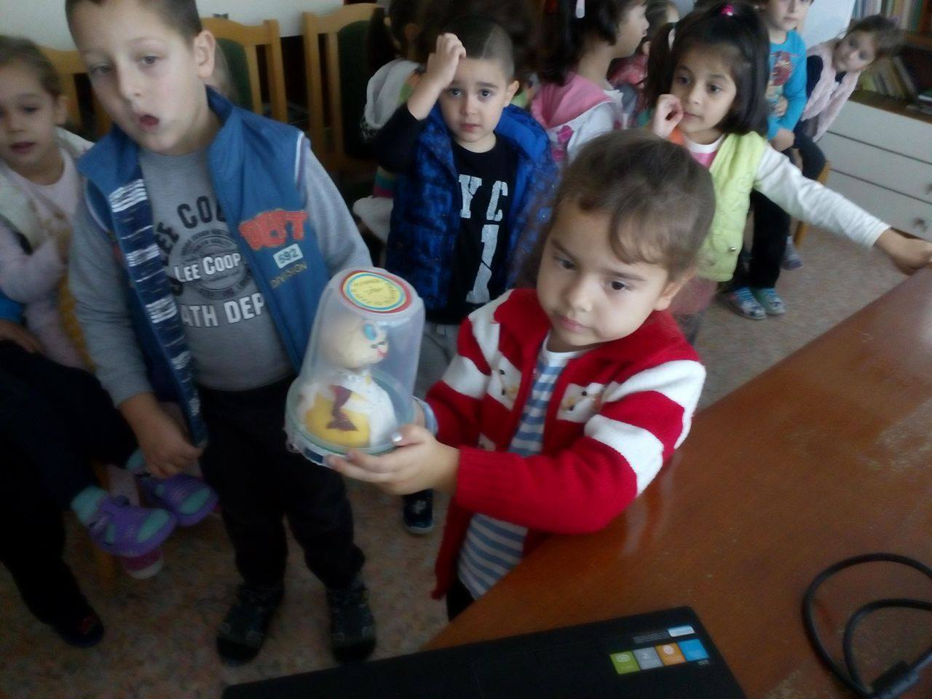
We care very well for Bucatarel, you can see

Slide 7
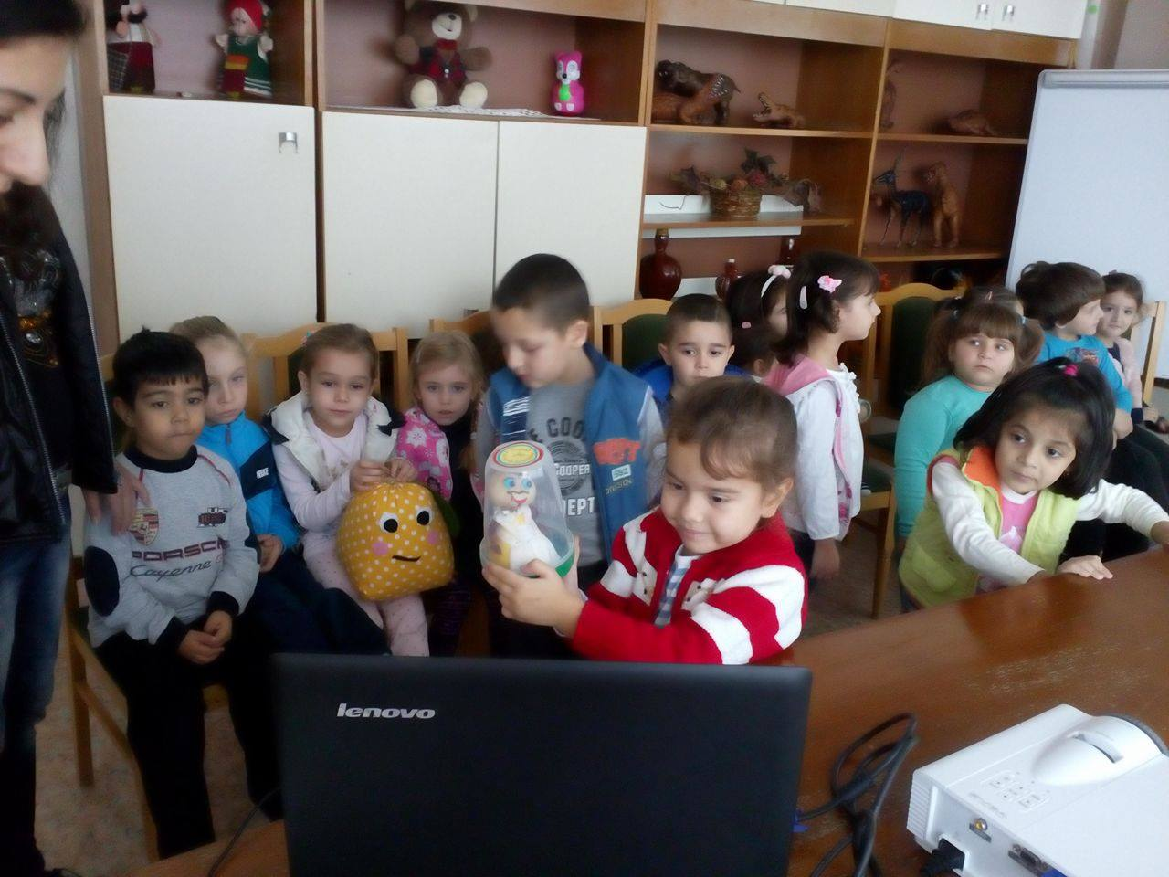
and we love to play with him

Slide 8
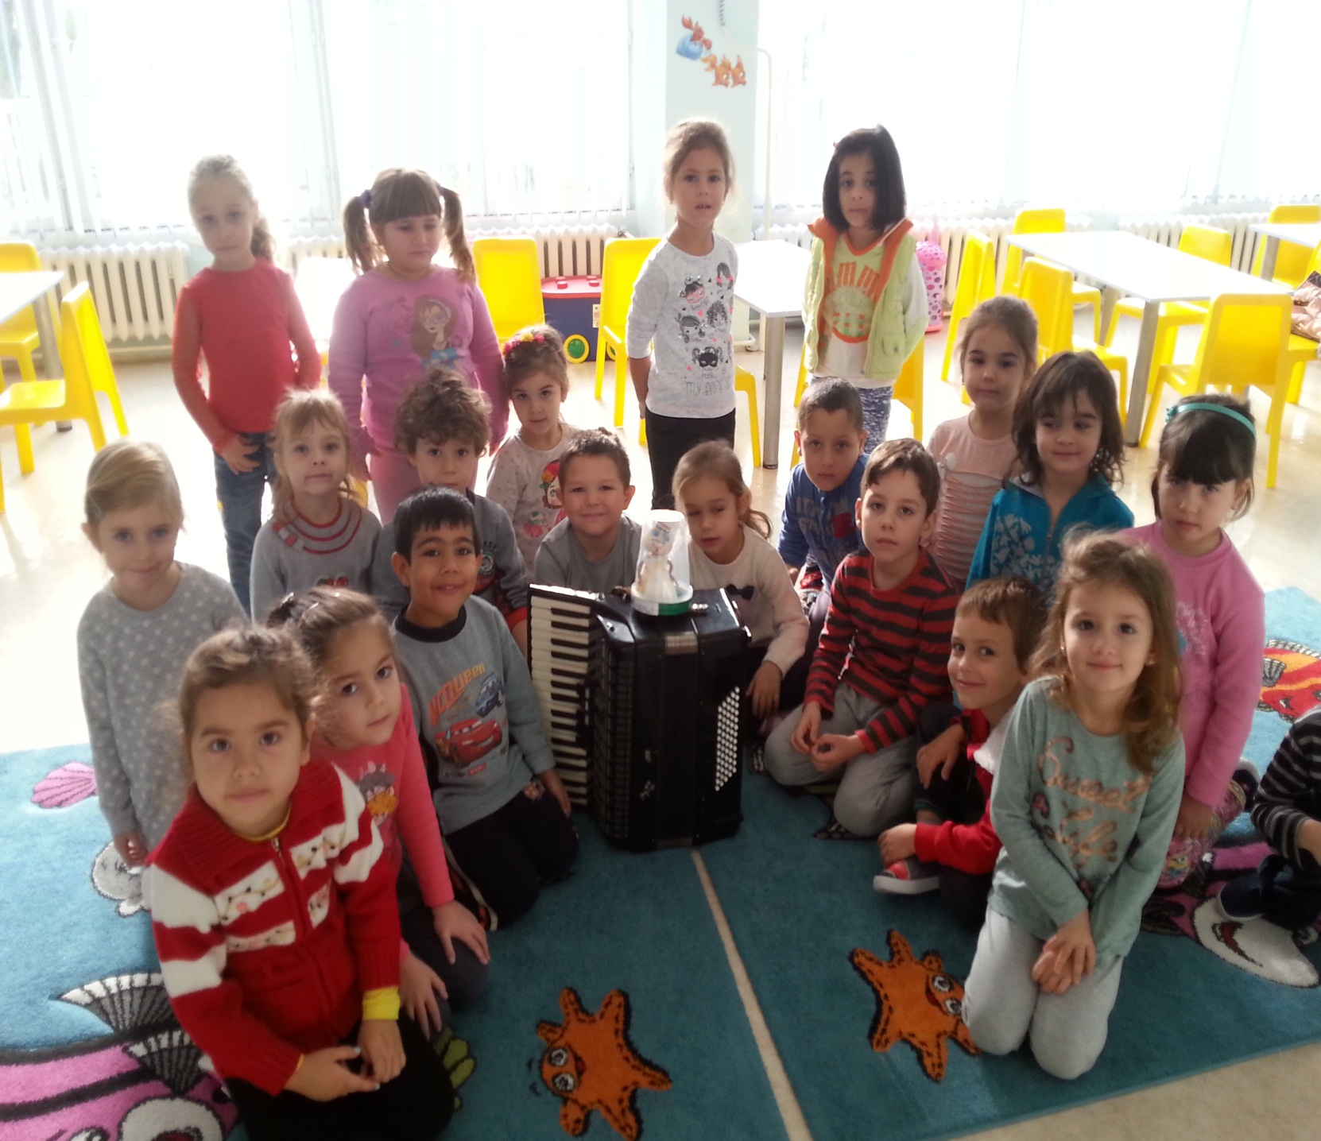

Slide 9
This project has been funded with support from the European Commission.
This publication [communication] reflects the views only of the author, and the
Commission cannot be held responsible for any use which may be made of the
information contained therein.

