Slide 1
“LET’S EAT TOGETHER, EVERYBODY AROUND THE TABLE”
SKYPE SESSION WITH TURKEY
DETSKA GRADINA “VESELA”
DOBRICH, BULGARIA

Slide 2
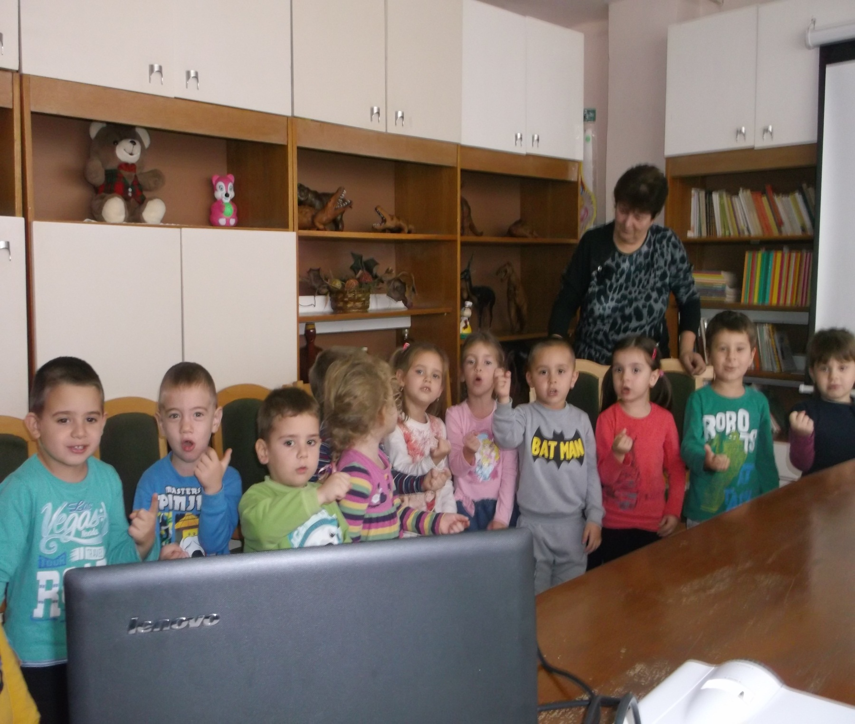

Slide 3
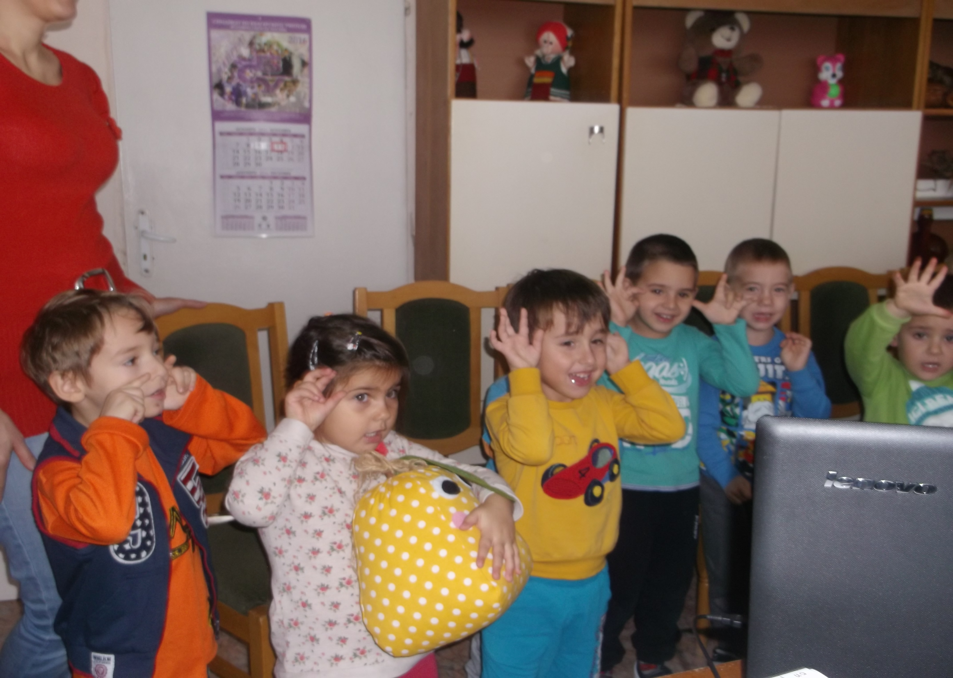

Slide 4
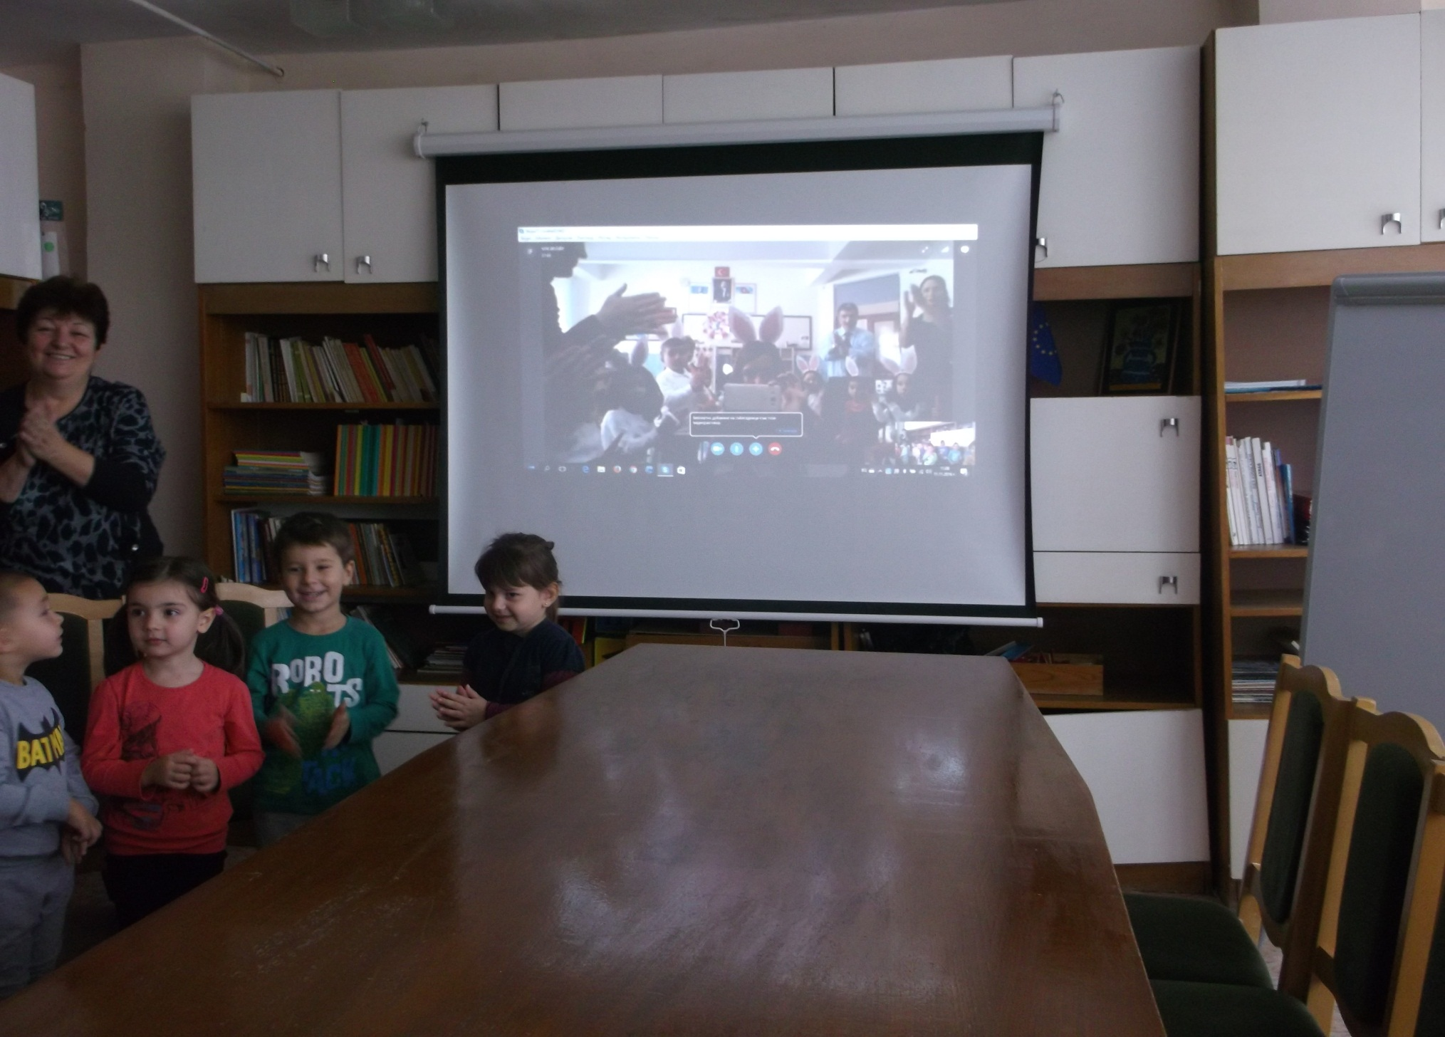

Slide 5
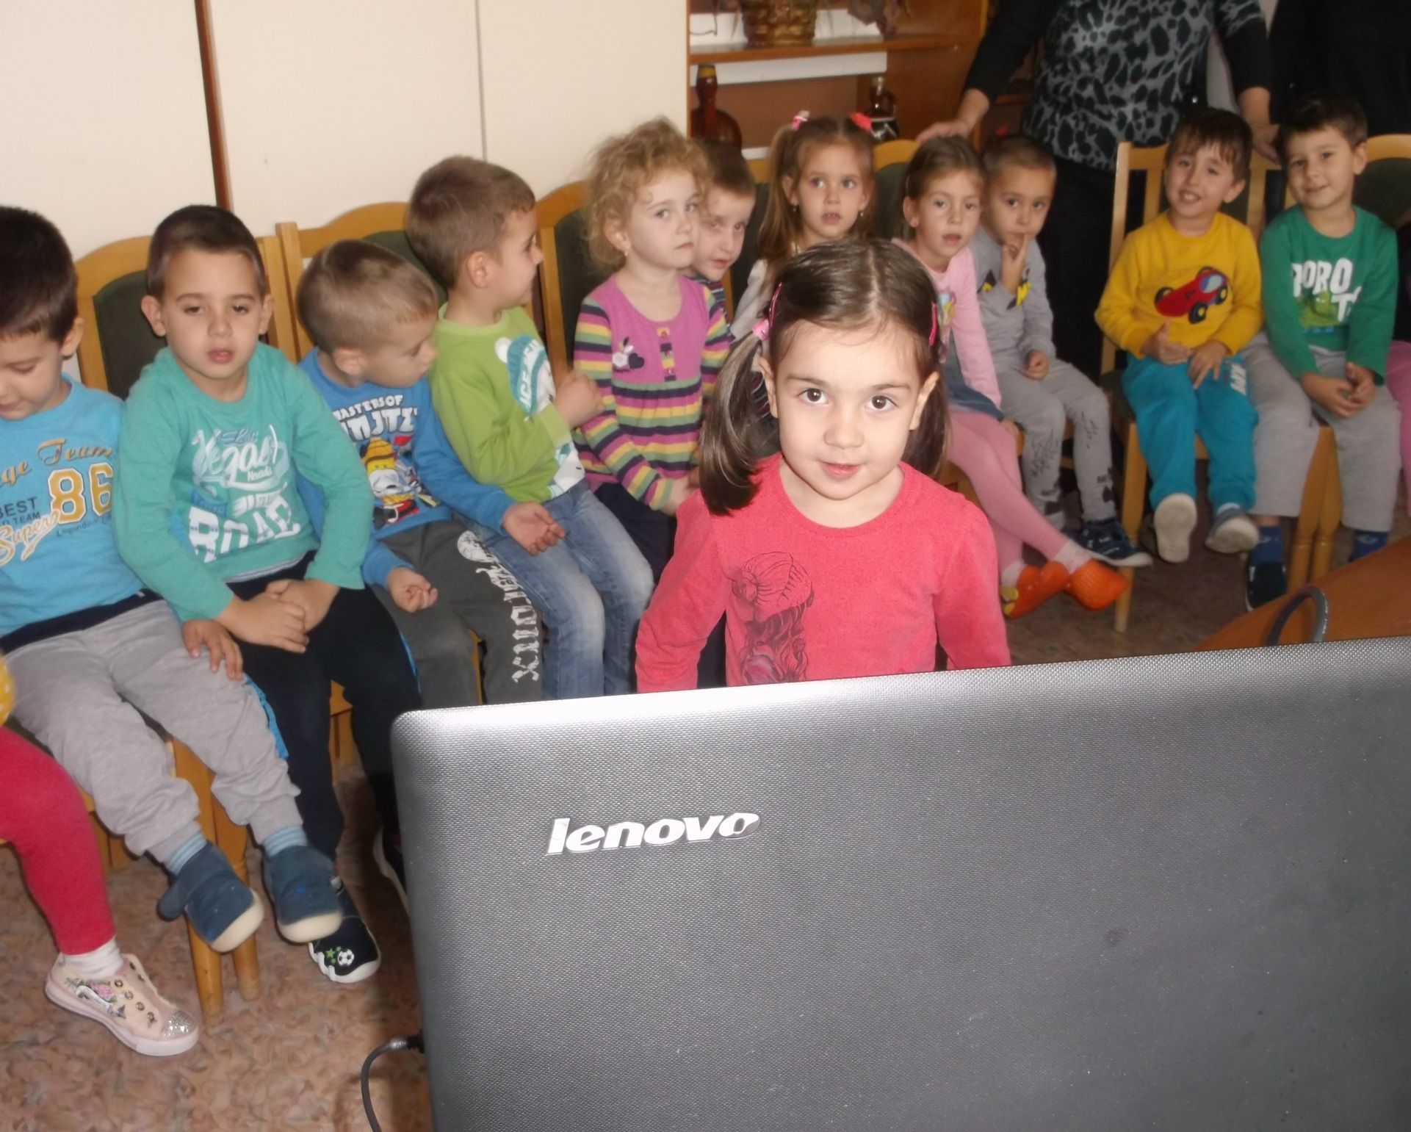

Slide 6
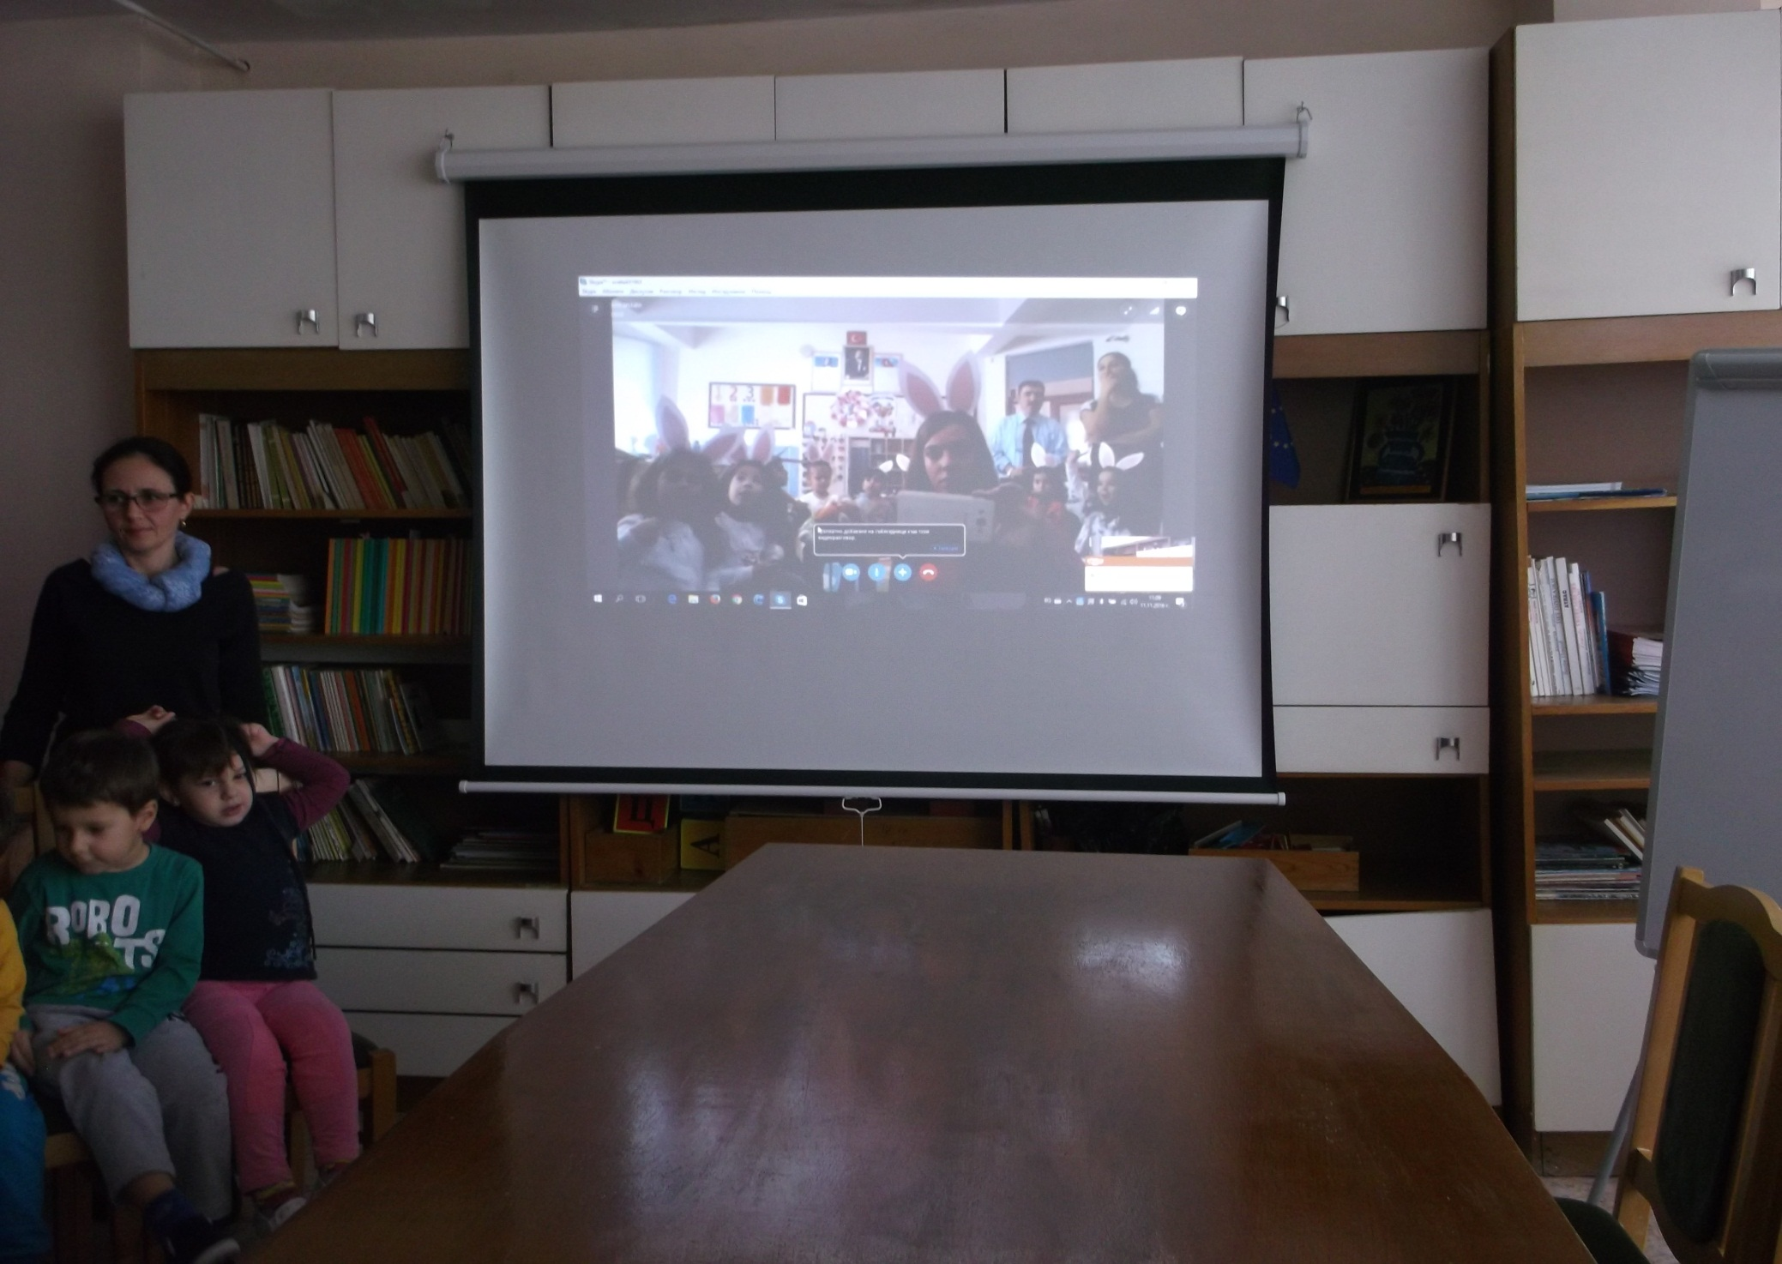

Slide 7
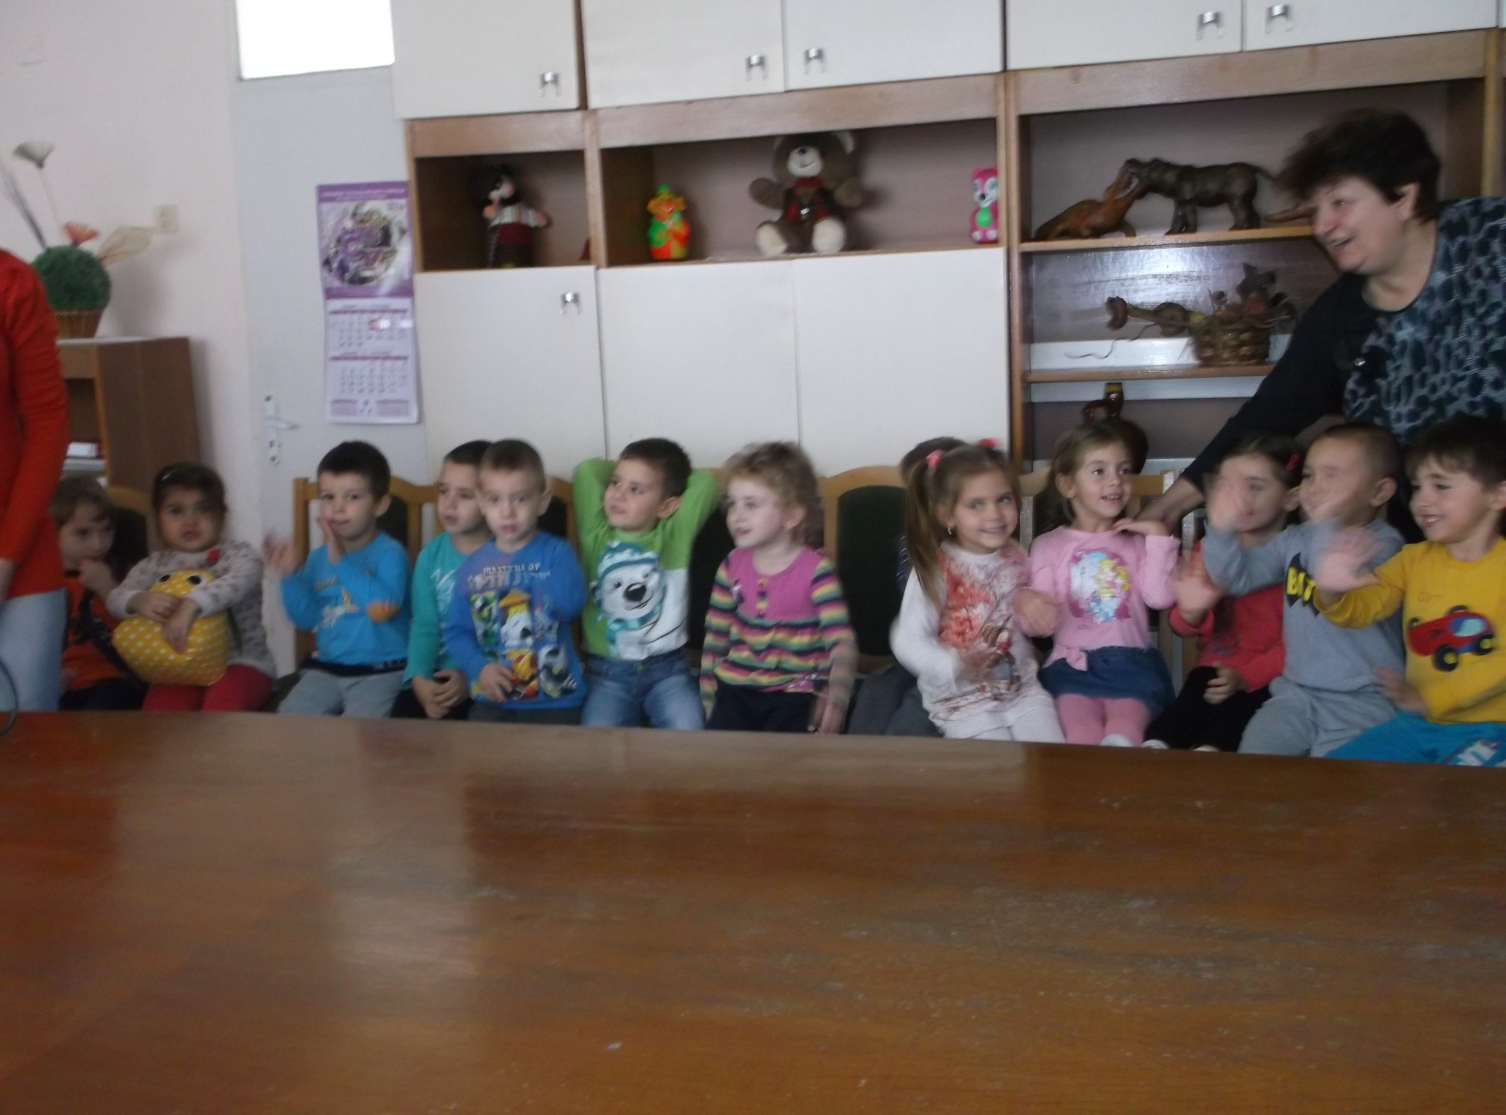

Slide 8
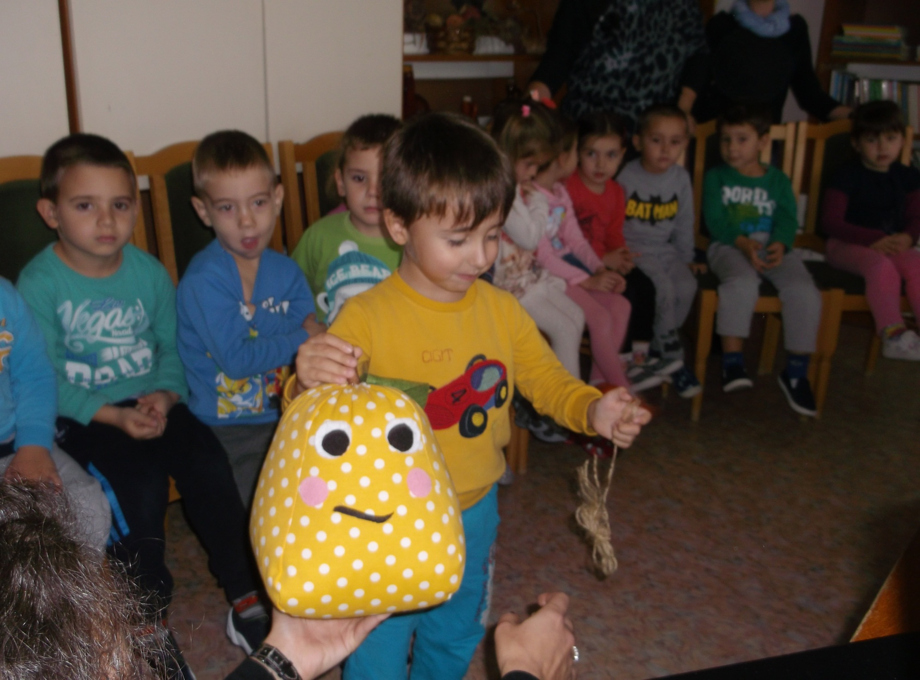

Slide 9
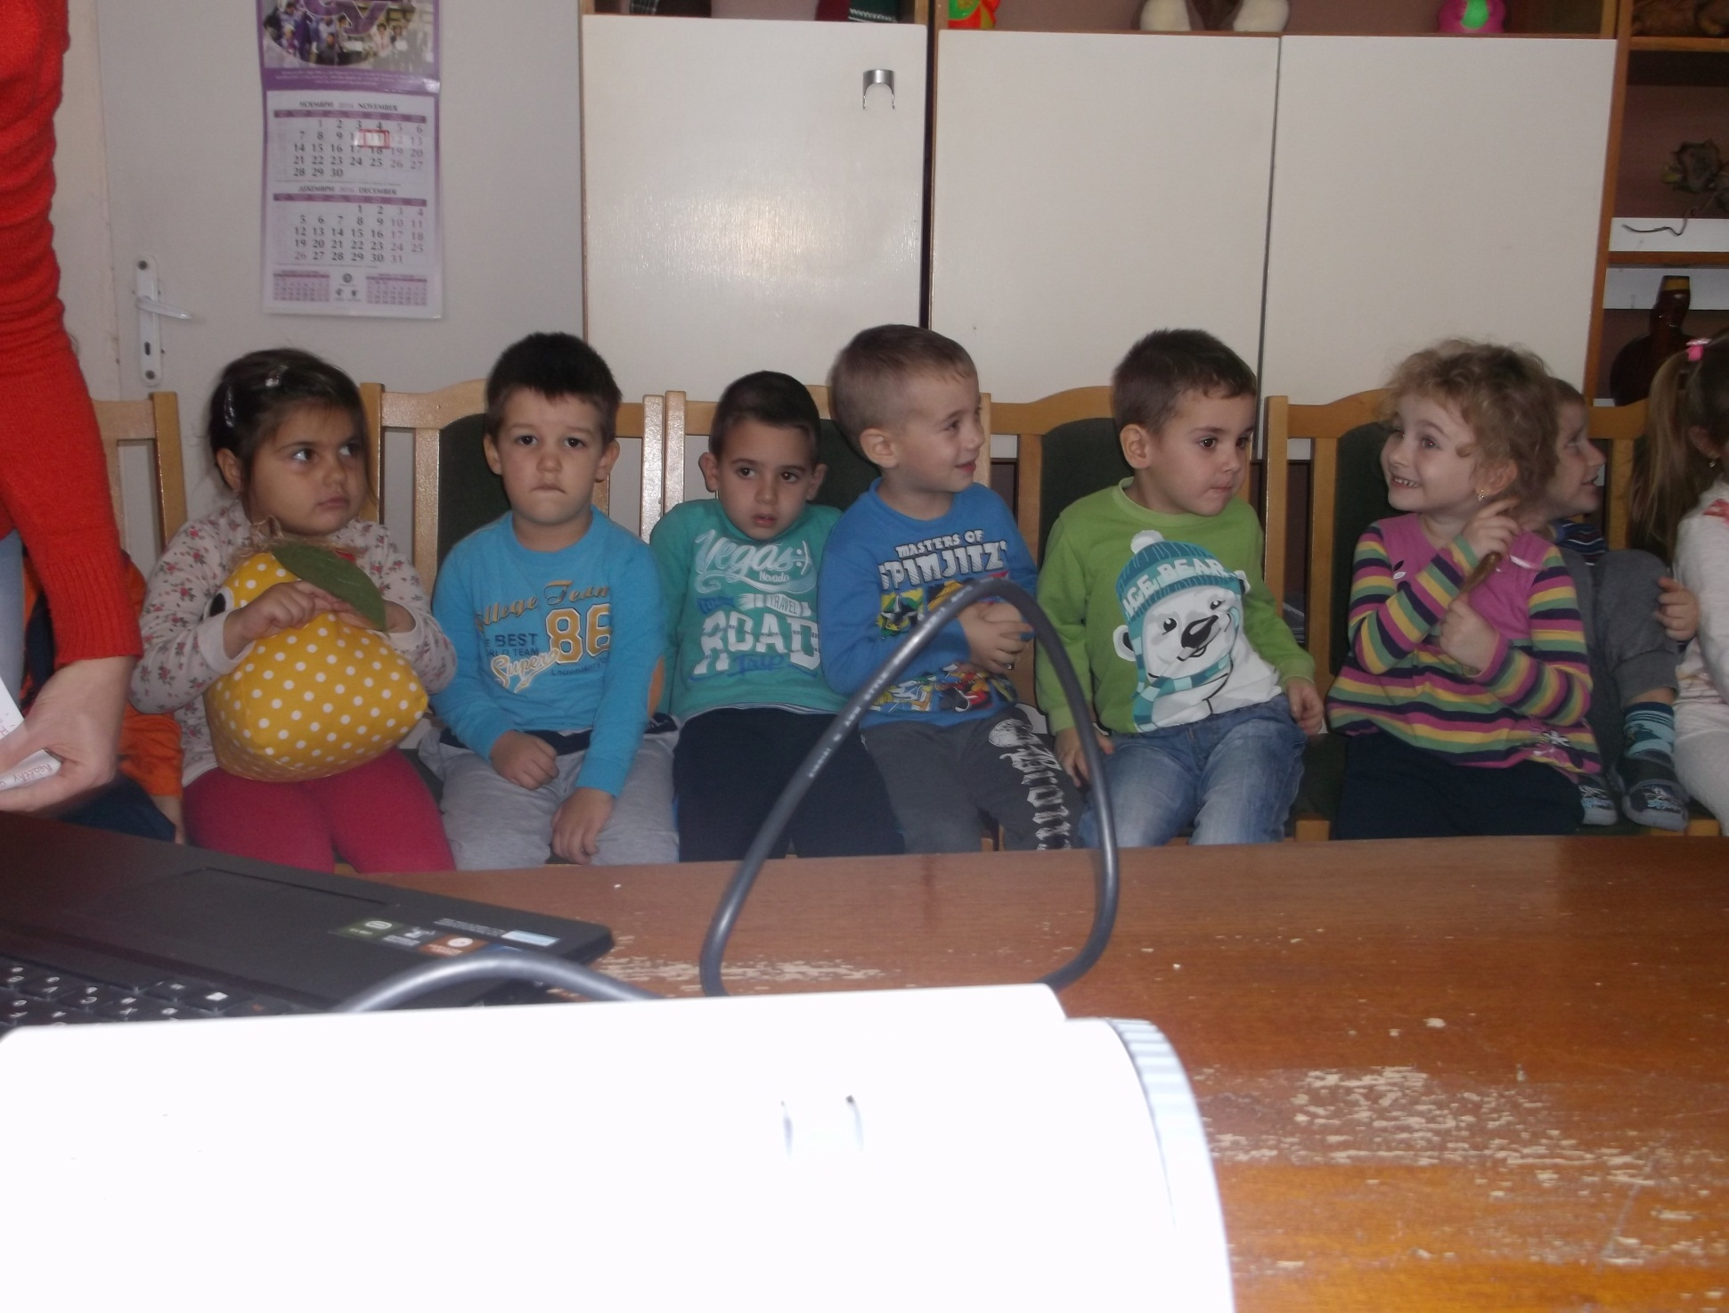

Slide 10
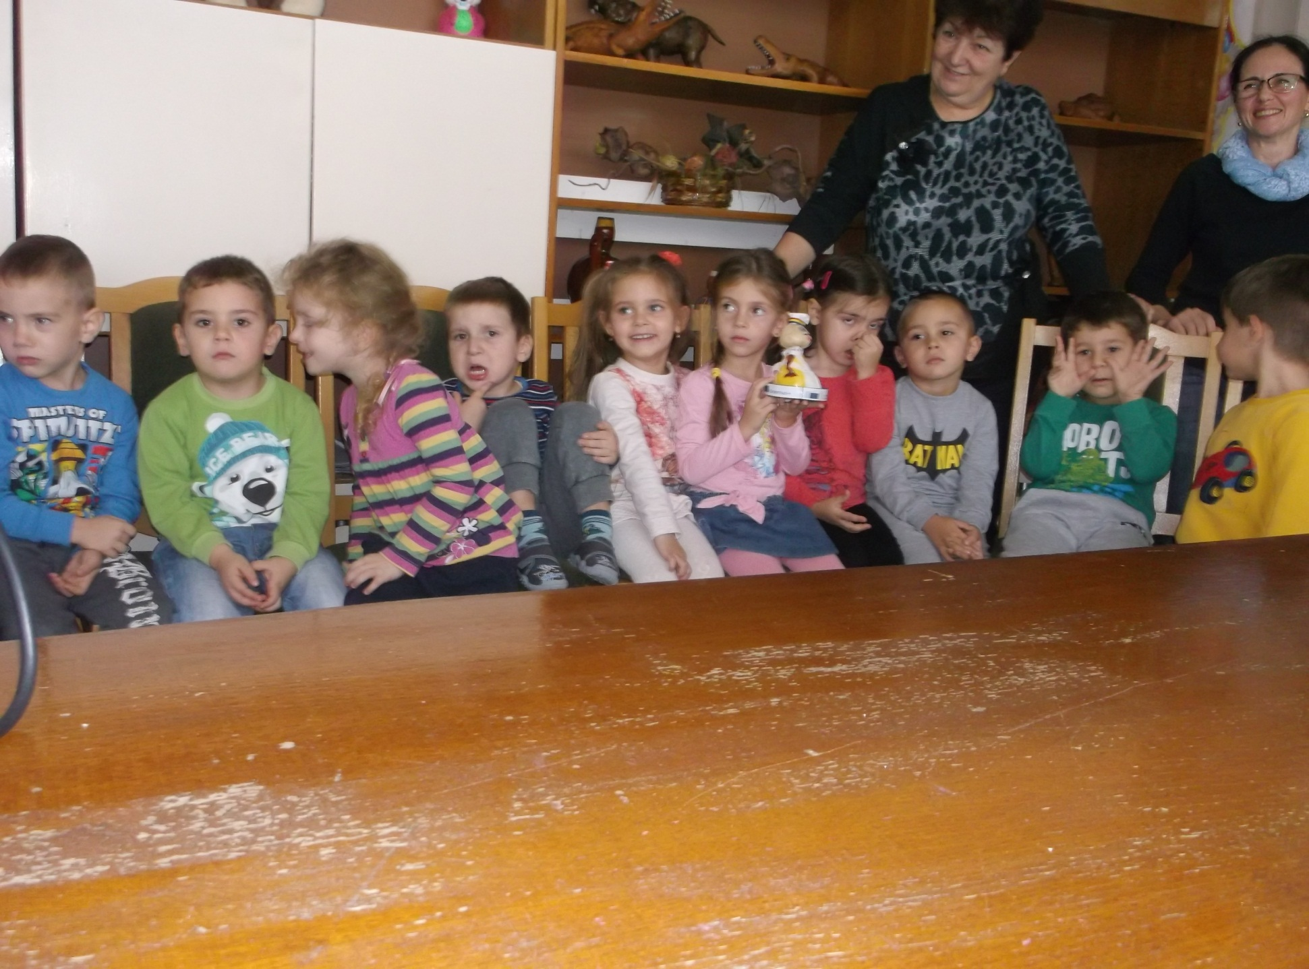

Slide 11
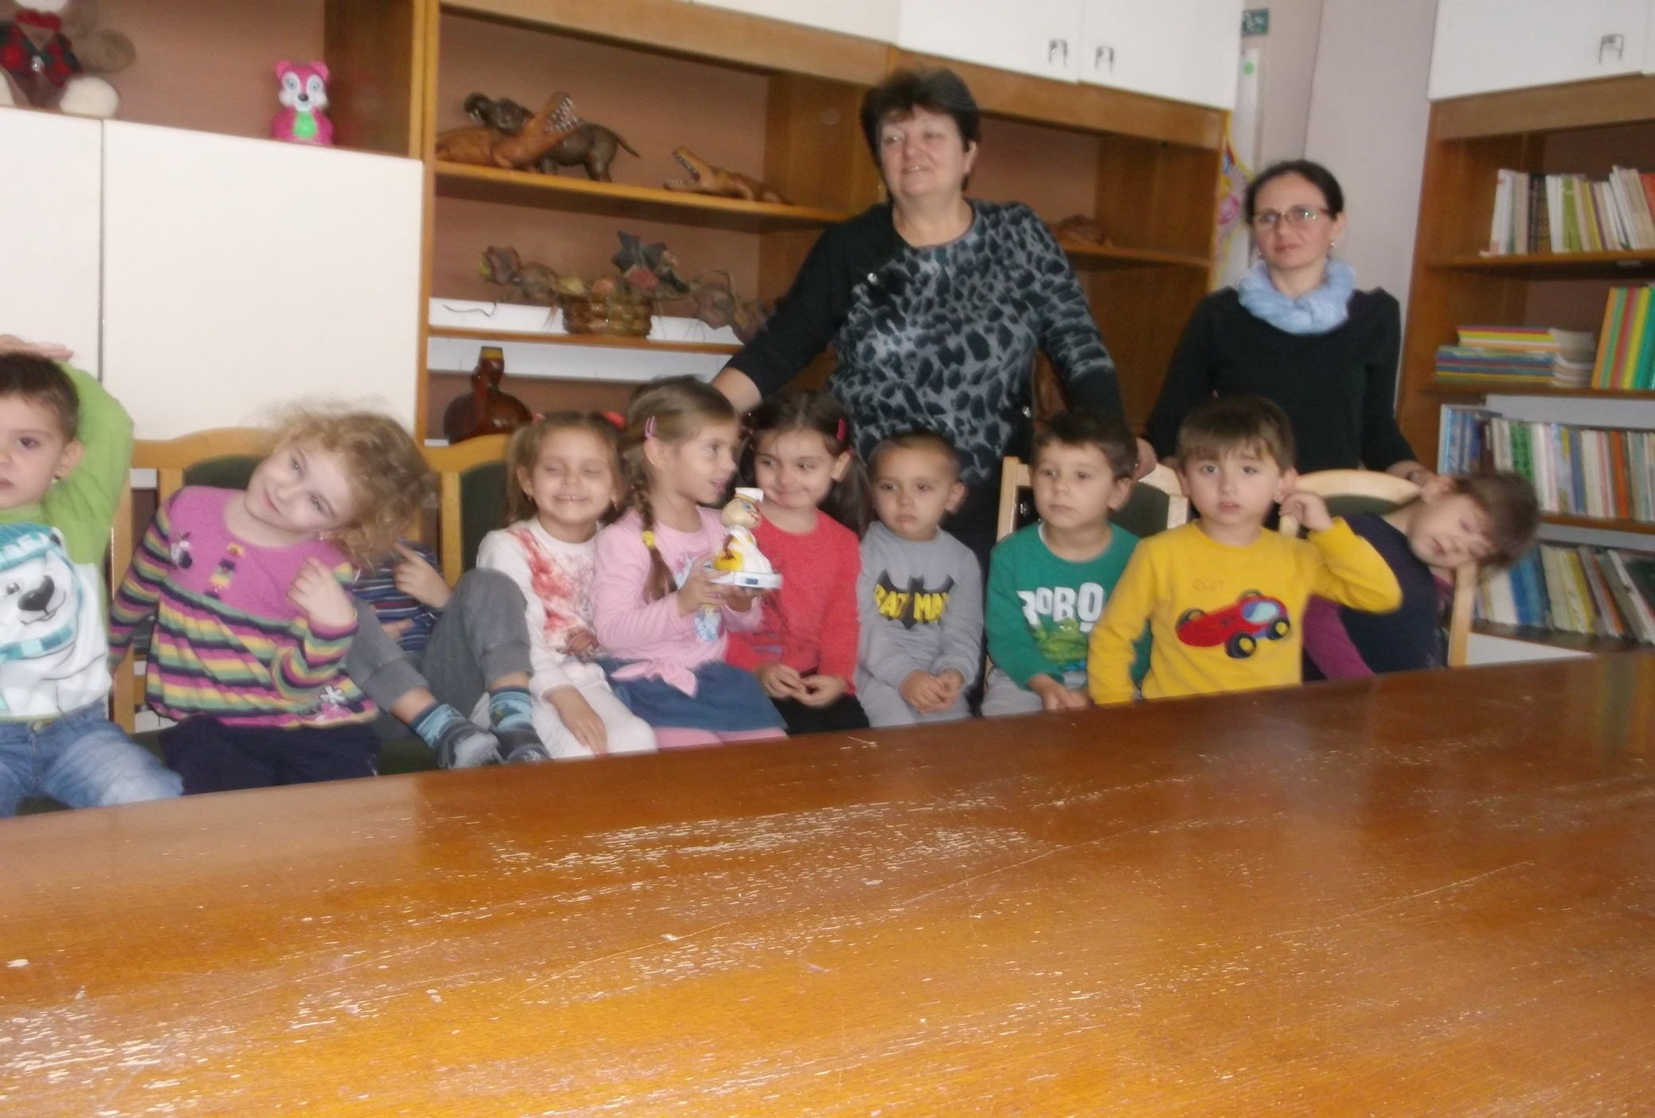

Slide 12
This project has been funded with support from the European Commission. This publication [communication] reflects the views only of the author, and the Commission cannot be held responsible for any use which may be made of the information contained therein.

