Slide 1
Not
expensive

Slide 2
About us…
Penair School, Cornwall
Our company create eco friendly notebooks with sustainable materials and sell them at reasonable prices.

Slide 3
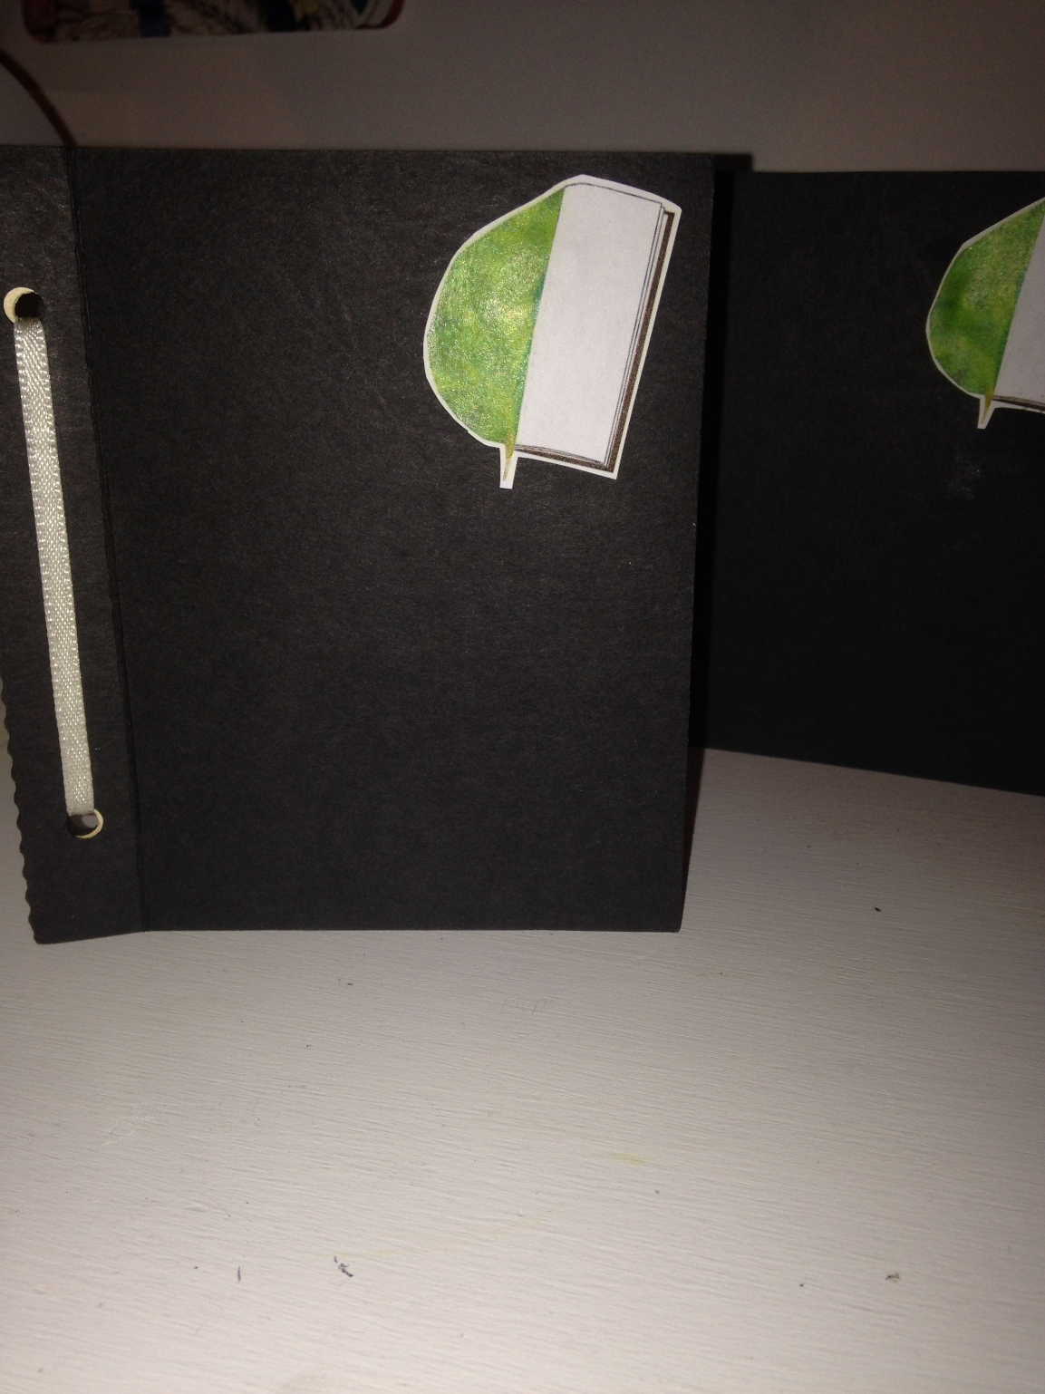
Our Product…
We use recycled materials found around our school to make our notebooks such as scrap paper and old ribbon. You’d be surprised how much scrap paper is wasted by all schools. We innovated our marketing approach by utilising this free resource and processing it into a sellable product.

Slide 4
4 Ps of Marketing
Product
Price
Place
Promotion
Recycled Notepad
Those concerned or considerate of the environmental impact from paper manufacture will appreciate the fact that we use 100% recycled materials.
£1.99
We feel that this price, while affordable, gives us a reasonable profit margin, which helps us sustain a healthy business.
Students
Since we are based at a school, we aim to sell these notebooks to students requiring materials for note making, or sketching.
Advertising
Again, we utilise the school, advertising around the building. We have set up several social media accounts, based on Facebook and Instagram.
This helps us appeal to a younger generation.

Slide 5
How it’s made and sold…
Product Plan
We collect recycled paper from the school’s recycling.
We sort through the recycling to select suitable paper.
We then cut the paper into the right shape for our notebook.
After hole-punching our paper, we put the sheets together along with 2 covers on the outside using ribbon.
A logo is added to each notebook, and then sold at local fairs, our school and events.
Materials used:
Recycled card
Recycled paper
Recycled ribbon (to bind pages)

Slide 6
Advertising
We had to think of a creative and modern way to advertise which would be relevant for our age group.
The options were Facebook or Instagram, however, as most people had Instagram we thought that it would be the best option. It is also good because it’s an easier way to post pictures and use hashtags.
We post pictures of us working in groups to promote the statutes of our company to show us working together. We also post pictures of our logo so that it will become recognisable.
To get our product seen, we use commonly searched hashtags so that the world can see our product.

Slide 7
Cost, Price and Profit…
All profit is donated to charities of our choice, while using enough of our profits to maintain our business, manufacture and advertising.

Slide 8
What we have done since the meeting in Palermo…

Slide 9
Price and improvements
At first, we decided that the price our notebooks should be £1.99, but some people in the company thought that this was too much. So, we have created a survey and asked people what price they, as customers, would be willing to pay for our product. We’ve also asked people what they would improve about the product, so they would be more likely to purchase it.

Slide 10
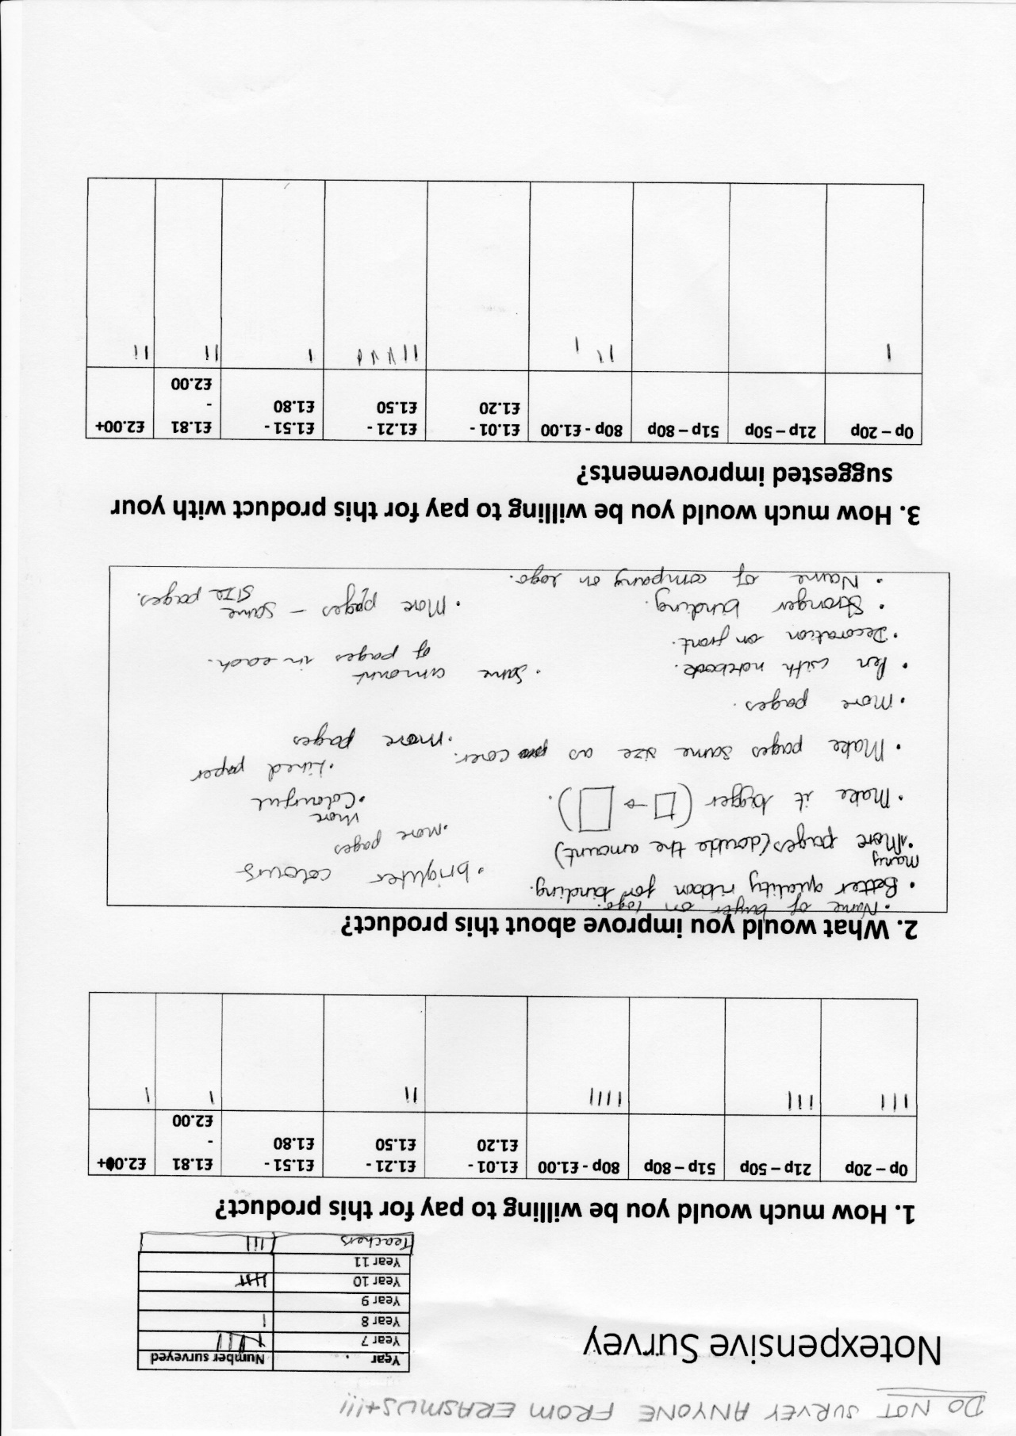
Here is the survey that we did.

Slide 11
Here is a poster that we’ve designed in order to advertise a sale for our product.

Slide 12
Profit Evaluation
Our projected profit for the first 10 weeks was £40 (selling the books at £1.50)
This is based on an average number of 4 books sold/week with a 50p/book production cost (including resources)
During the first 10 weeks of sale, we made a profit of £36, £4 less than our predicted total.

Slide 13
Calculating income

Slide 14
Our next steps…
To survey more people, so it’s more accurate and we can have a larger range of results.
To display these results in a visual way, e.g. in the form of a graph. Then, we can draw a conclusion to what the most suitable price for our product is.
To make more notebooks, with the suggested improvements from the survey.

