Slide 1
Waste management

Slide 2
HOW DOES OUR SCHOOL RECYCLE?
Kitchen?
Lab?
Where do we take them?
Who?
How much?

Slide 3
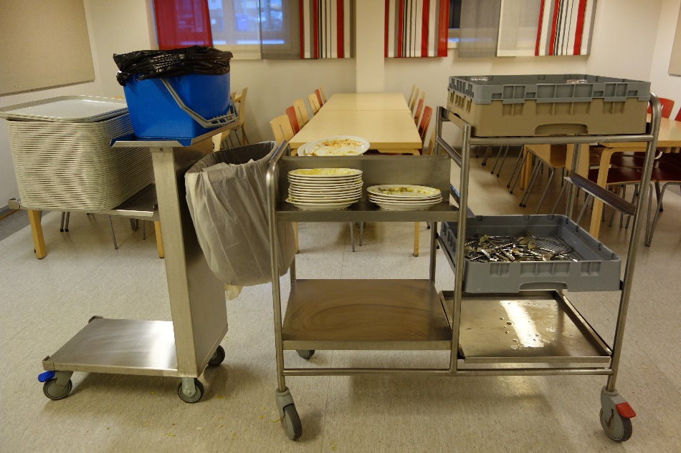
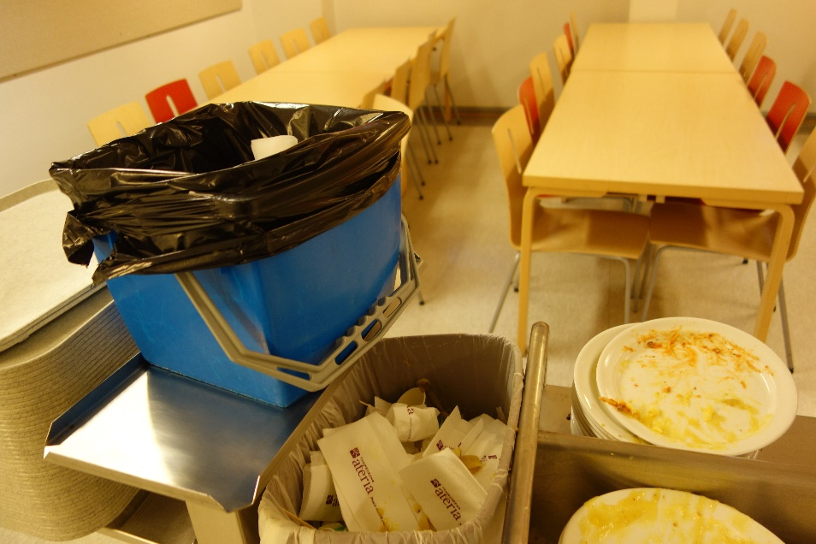
OUR SCHOOL KITCHEN?
♻ Sustainable development
♻ Recycles biowaste, metal, card board and paper
♻ Our staff is educated and well briefed on recycling
♻ Our school offers free vegetarian food for everyone

Slide 4
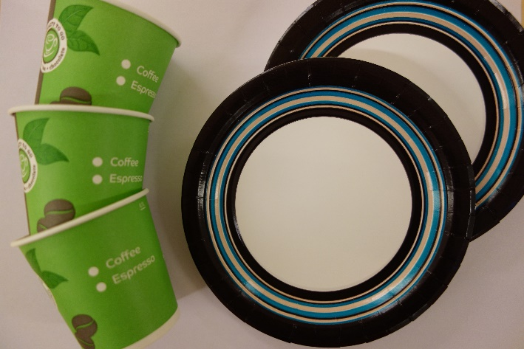
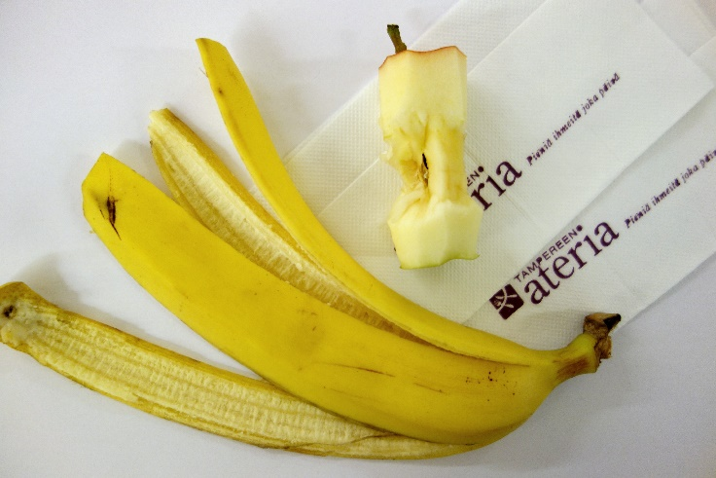

Slide 5
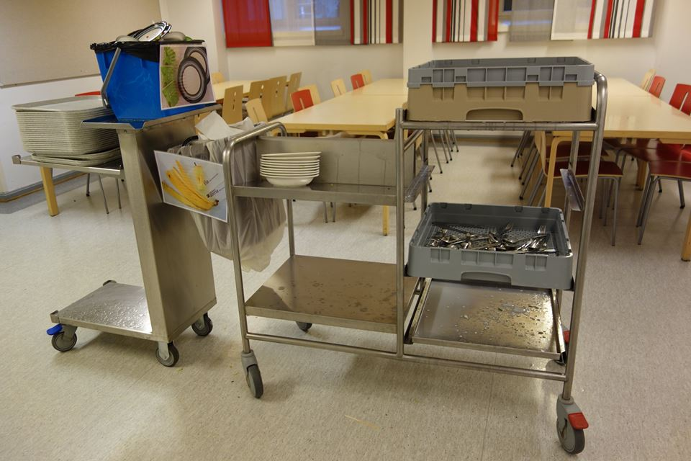

Slide 6
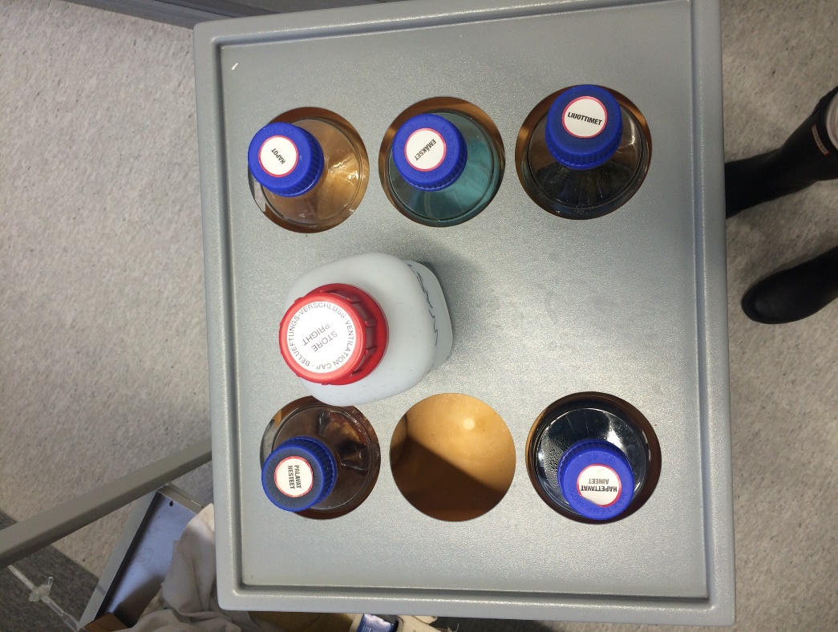
LAB WASTE?
♻ Chemistry teachers can make some of the waste harmless, e.g. evaporating.
♻ At the end of a school year, a truck starts a round and collects hazardous waste from all the schools in Tampere.

Slide 7
Who takes the waste of our school? And where?
WASTE AT OUR SCHOOL?
MISTER X

Slide 8
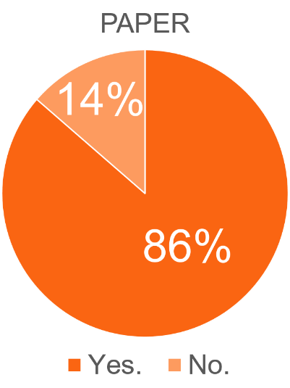
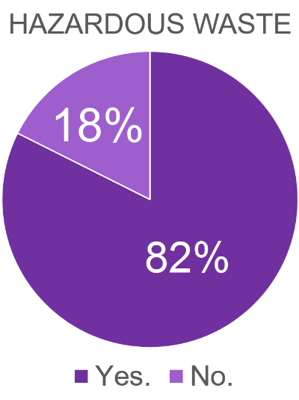
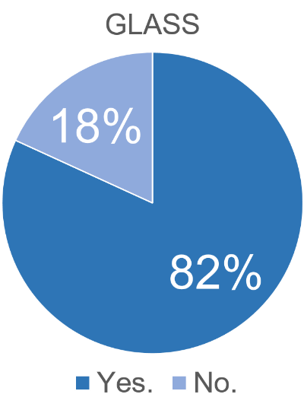
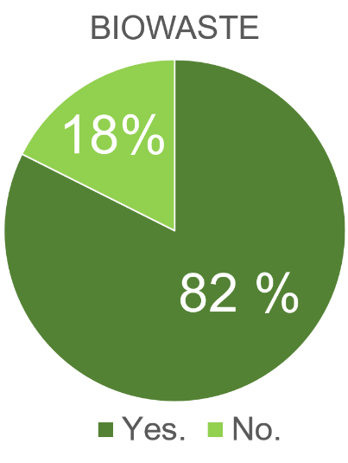
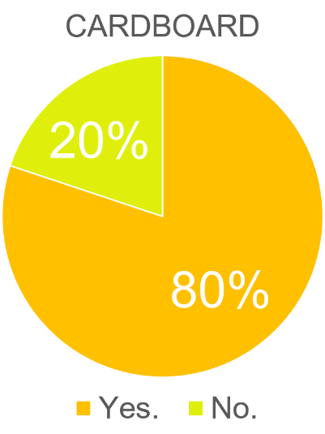
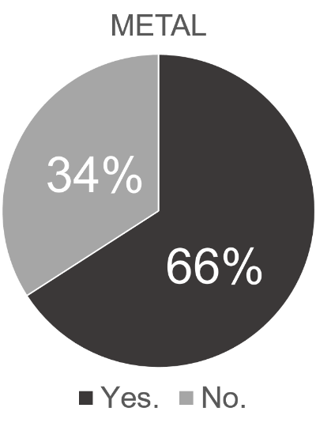
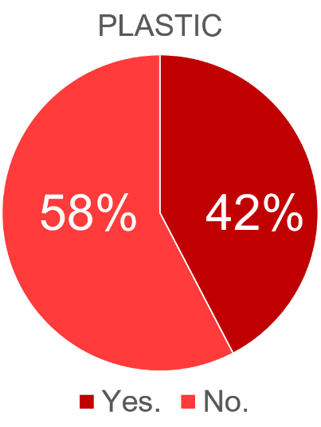
ON AVERAGE
- taken to a public refuse bin.
- been recycled always as far as the answerers know
- accumulated about 10-20 litres in a week
ON AVERAGE
- taken to a public refuse bin.
- been recycled always, as far as the answerers know
- accumulated less than 10 litres in a year
ON AVERAGE
- taken to a public refuse bin.
- been recycled always, as far as the answerers know
- accumulated less than 10 litres in a week
ON AVERAGE
- taken to a compost or a biowaste bin which is shared with neighbours.
- been recycled always as far as the answerers know
- accumulated about 1-2 average sized bags in a week
ON AVERAGE
- taken to a public refuse bin or burned in fireplace/sauna.
- Been recycled always as far as the answerers know
- accumulated about less than 10 litres in a week
ON AVERAGE
- taken to a public refuse bin.
- been recycled always as far as the answerers knew
- accumulated about less than a 10 litlers a week
ON AVERAGE
- taken to a public refuse bin.
- been recycled some months
- accumulated about 1-2 average sized bags in a week

Slide 9
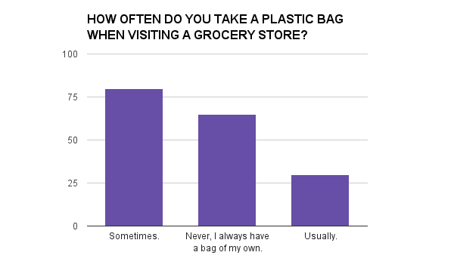

Slide 10
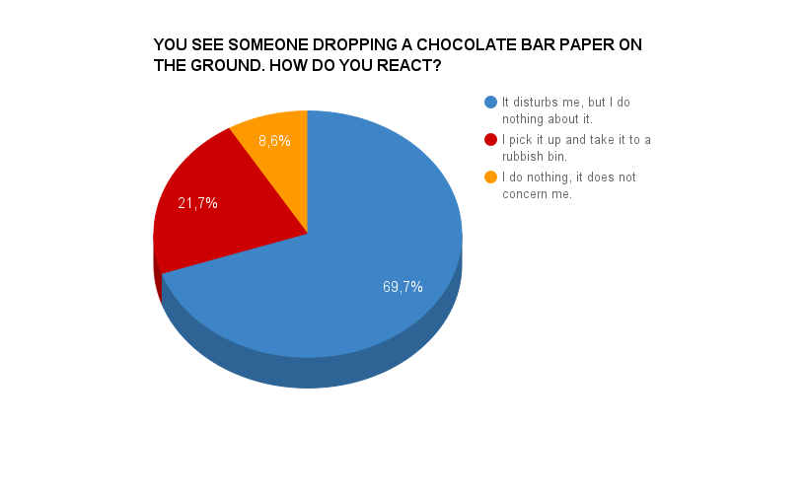

Slide 11
Concentrate on the food thrown away.
The windows should be fixed so that the warm air stays inside in winter.
We should have more trashcans and save electricity by switching off the lights when we don't use them.
Cafeteria people could clarify whether or not the plastic plates and tea/coffee cups are recyclable or not.
A second-hand shop in Rellu and the money what you get from there could be donated to the Red Cross

Slide 12
Better salads so I do not have to throw them away after discovering it is uneatable.
If there was a problem
yo I'd solve it
Check out my hook
while the DJ revolves it.
Recycle teachers and administrative people.
I don’t know, not my job.
Nope.

