Slide 1
ART OERs

Slide 2
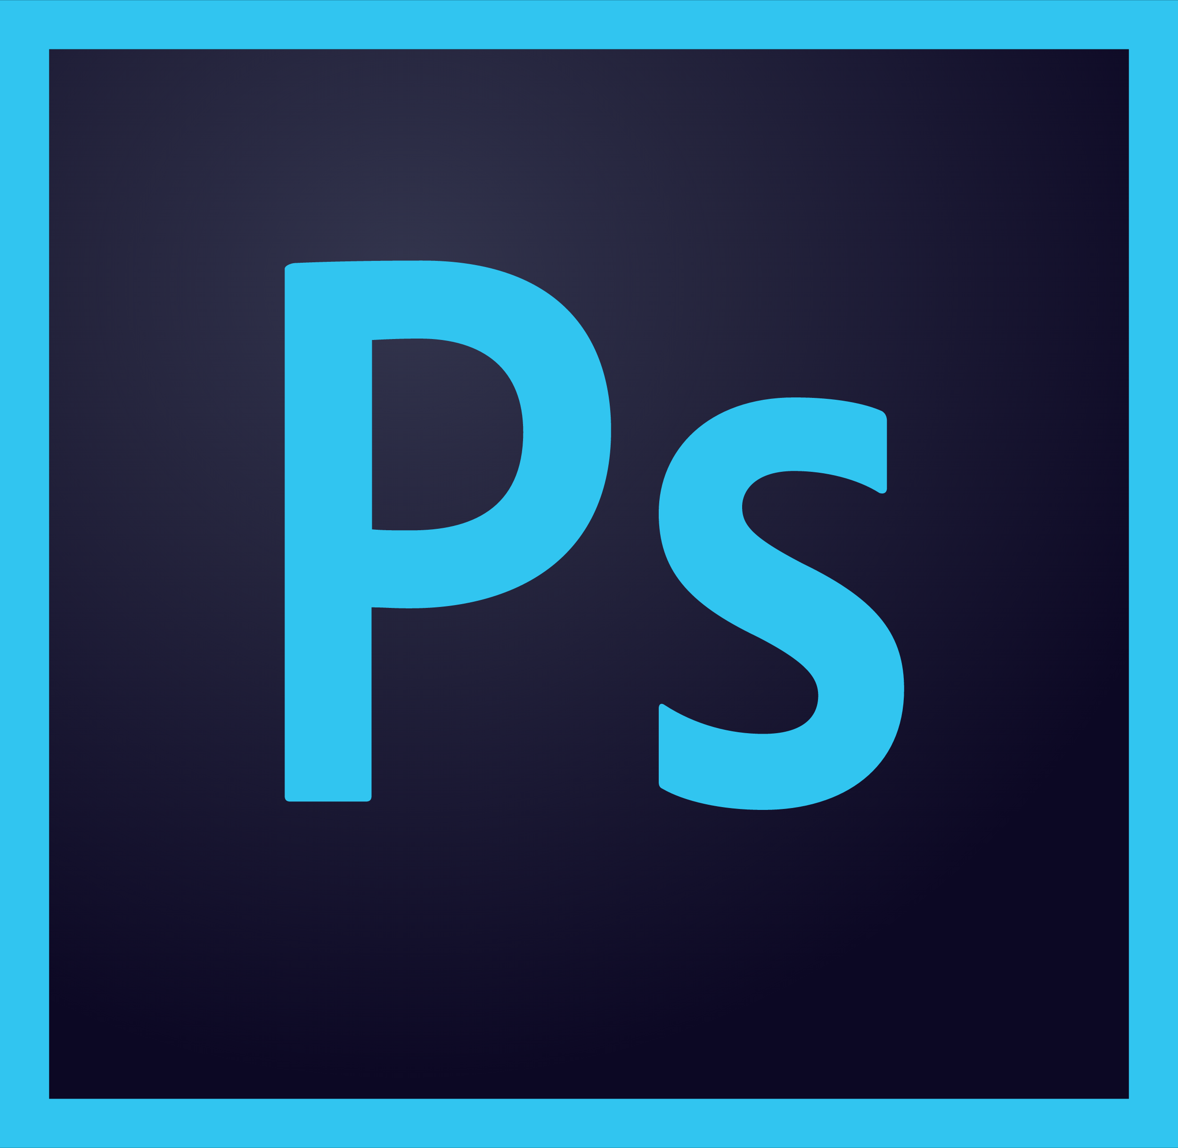
Photoshop
Photoshop is used for editing photos.
We can use this as part of our exams at the school, in Graphic Communications (a type of art).

Slide 3
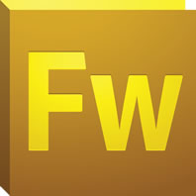
Adobe Fireworks
Fireworks is used to create illustrations and graphic designs. This is used by younger age groups and is used to provoke creativity.

Slide 4
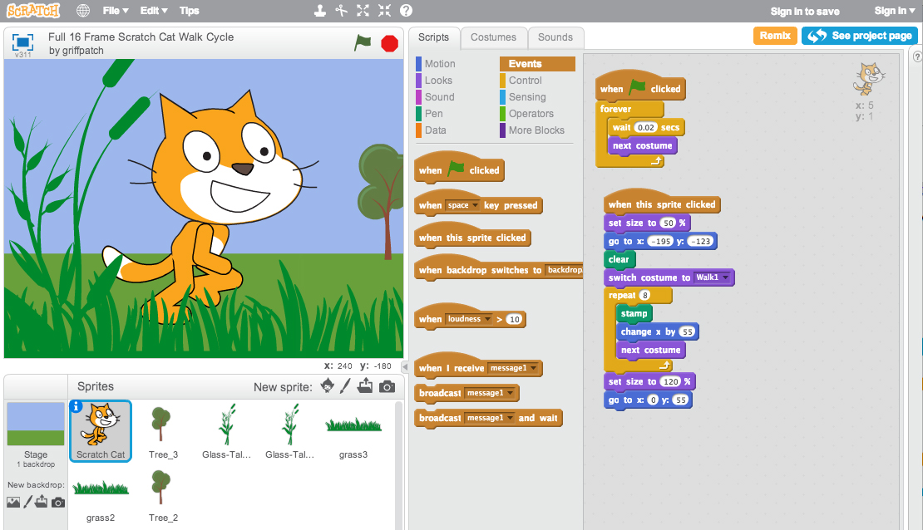
Scratch
Scratch is used for making animations and for game design.
It is used in computing or ICT in school as well as in the art department.

Slide 5
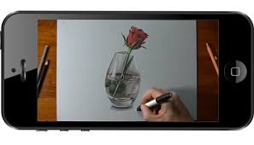
YouTube
YouTube is incredibly useful for watching tutorials (videos with instructions on how to do a certain task.
This is available for everyone at home however in school we cannot use it due to Safeguarding reasons.

Slide 6
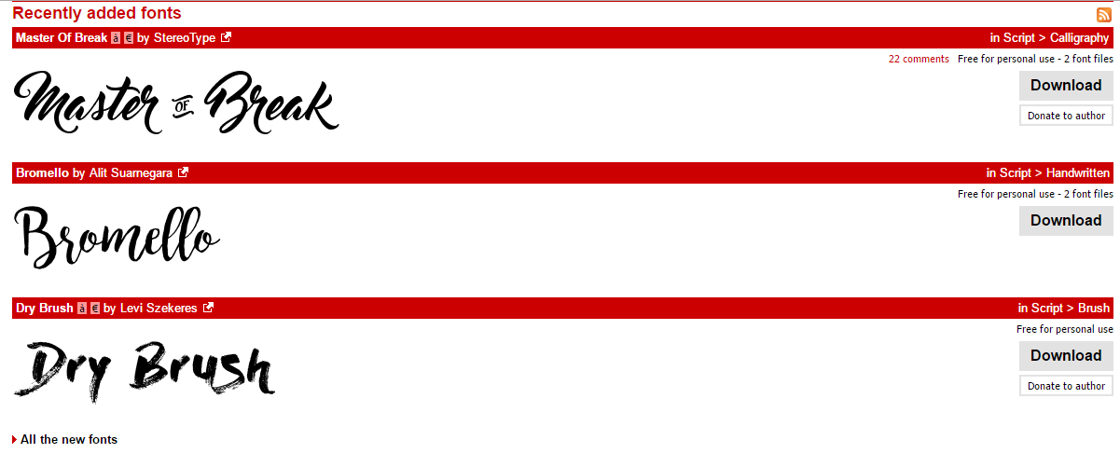
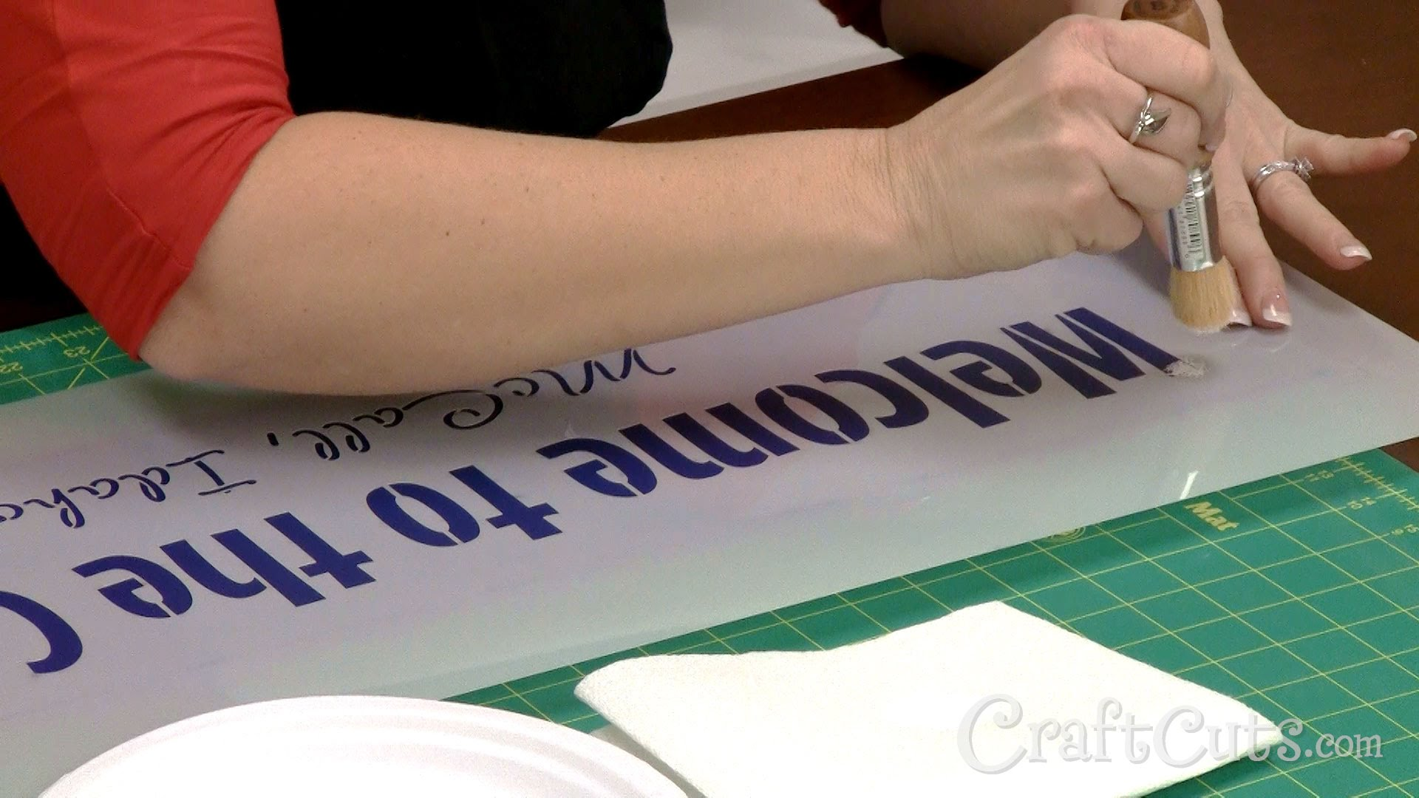
Dafont
Dafont is an online program used for downloading different fonts. We use this for printing words onto our artwork, stencilling or copying different letters.

