Slide 1
Fowe Income statement

Slide 2
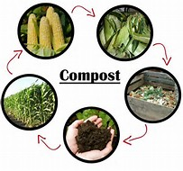
Gross Gain

Slide 3
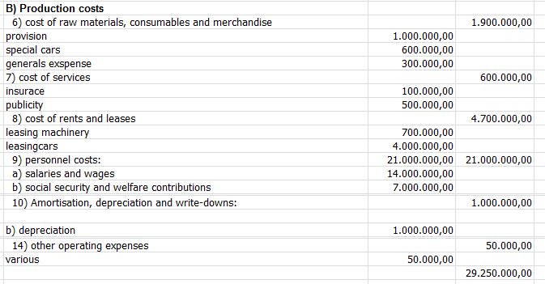
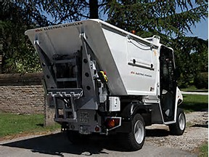
Costs

Slide 4
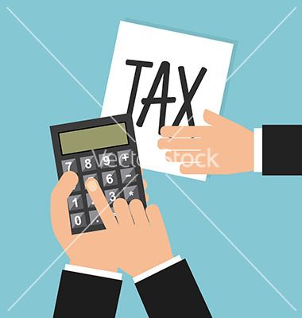
Taxes

Slide 5
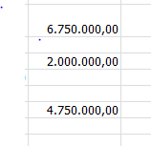
Profit

Slide 6
Summing up
Gross Gain | 36.000.000,00
Costs | 29.250.000,00
Taxes | 2.000.000,00
Profit | 4.750.000,00

