Slide 1
LIQUIDATION PLAN OF CUPS2GO

Slide 2
Maps
CUPS2GO

Slide 3
1.1
Winding up or Liquidation Plan

Slide 4
A liquidation plan, or ‘winding up’ of a company is a formal and legal process of dissolving a business and ending its corporate existence, by selling off its assets and paying the creditors from the proceeds of the sale.

Slide 5
1.2
What are the procedures necessary to dissolve a mercantile society?

Slide 6
The first step is to settle the obligatory payments incurred and recover the collection rights. This procedure is called liquidation.

Slide 7
1.3
Insolvency proceeding

Slide 8
The administrator ceases in his position and appoints a liquidator
The appointment of liquidators shall be registered in the Mercantile Register
A final balance sheet will be drawn up
a copy will be presented in the Tax Agency accompanied by the census Model 036

Slide 9
1.4
Final Report

Slide 10
Summary of difficulties encountered in putting the mini company into practice, and possible solutions in order to be solved in the future.

Slide 11
2.
Problems and Solutions

Slide 12
2.1
Excess of Fruit

Slide 13
PROBLEM
The first day, students cut a lot of fruit. The amount of slice fruit was far higher than the amount of sold fruit.

Slide 14
SOLUTION
Cutting fruit ONLY when it is required. Sellers will ask for more fruit in case they need it.

Slide 15
2.2
Fruit price

Slide 16
PROBLEM
Fruit price is increasing. The first day it cost around 1-1,20 EUR/kg. The Fifth day it cost approximately 1,60-1,80 EUR/kg.

Slide 17
SOLUTION
We should buy fruit in “MercaMálaga”. It is a wholesale fruit trade. Fruit will cost cheaper.

Slide 18
2.3
Students’ permission

Slide 19
PROBLEM
Some students can’t leave their lessons in order to prepare the materials needed.

Slide 20
SOLUTION
Teachers should let students leave their lessons to prepare all the materials.

Slide 21
3.
Why didn’t we continue with Cups2Go?

Slide 22
3.1
Lack of Time

Slide 23
Many students of first and second of high school couldn’t carry out some tasks that the project required.
Also teachers didn’t allow us to leave lessons to prepare all the materials for sale.

Slide 24
3.2
Timetable

Slide 25
Some teachers didn’t allow us to leave lessons to prepare all the materials we needed.
This became a problem because of the timetable. We were able to sell fruit only at lunchtime (30 minutes).

Slide 26
3.3
Exams

Slide 27
Due to exams and other projects we had to carry out, we couldn’t continue developing Cups2Go.

Slide 28
4.
Economy of Cups2Go

Slide 29
4.1
Materials

Slide 30
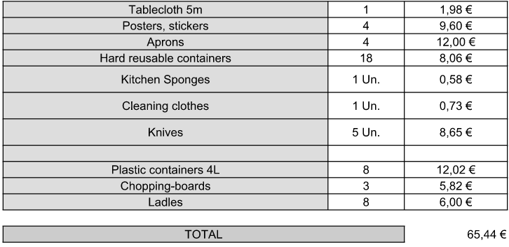
MATERIALS

Slide 31
4.2
Benefits

Slide 32
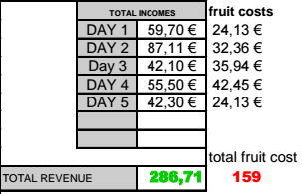
BENEFITS

Slide 33
THANKS!
Gabriel Auñón Fernández
Enrique Aycart Maldonado
Javier Fernández Campano
Javier Gutiérrez Montiel

Slide 34
THANKS!
I.E.S HUELIN
MÁLAGA
SPAIN

