Slide 1
Music and Art
OERs

Slide 2
INDEX
Fun & Games with music
ArtyFactory
ArtGraphica
Technical Drawing
J.A. Cuadrado. Com
Educa Thyssen
NoteFlight

Slide 3
Fun & Games with Music

Slide 4
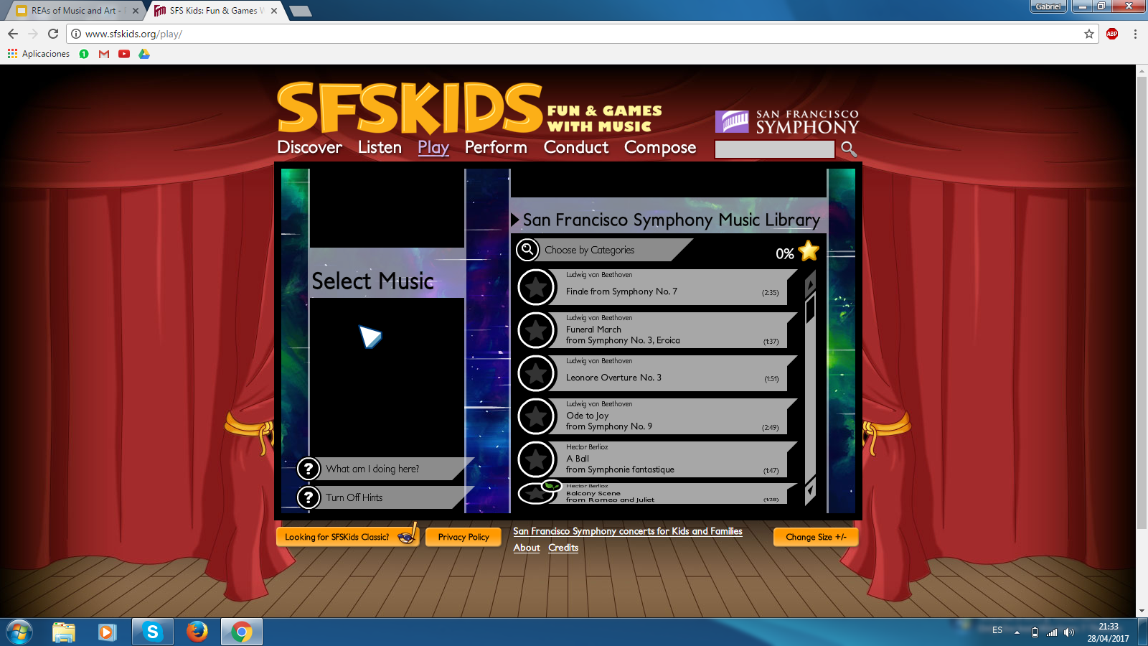
You can listen to different classical pieces from different artistic movements. Also, you can perform different instruments and make them sound. Specially useful for ages 12-14.
Place your screenshot here

Slide 5
ArtyFactory

Slide 6
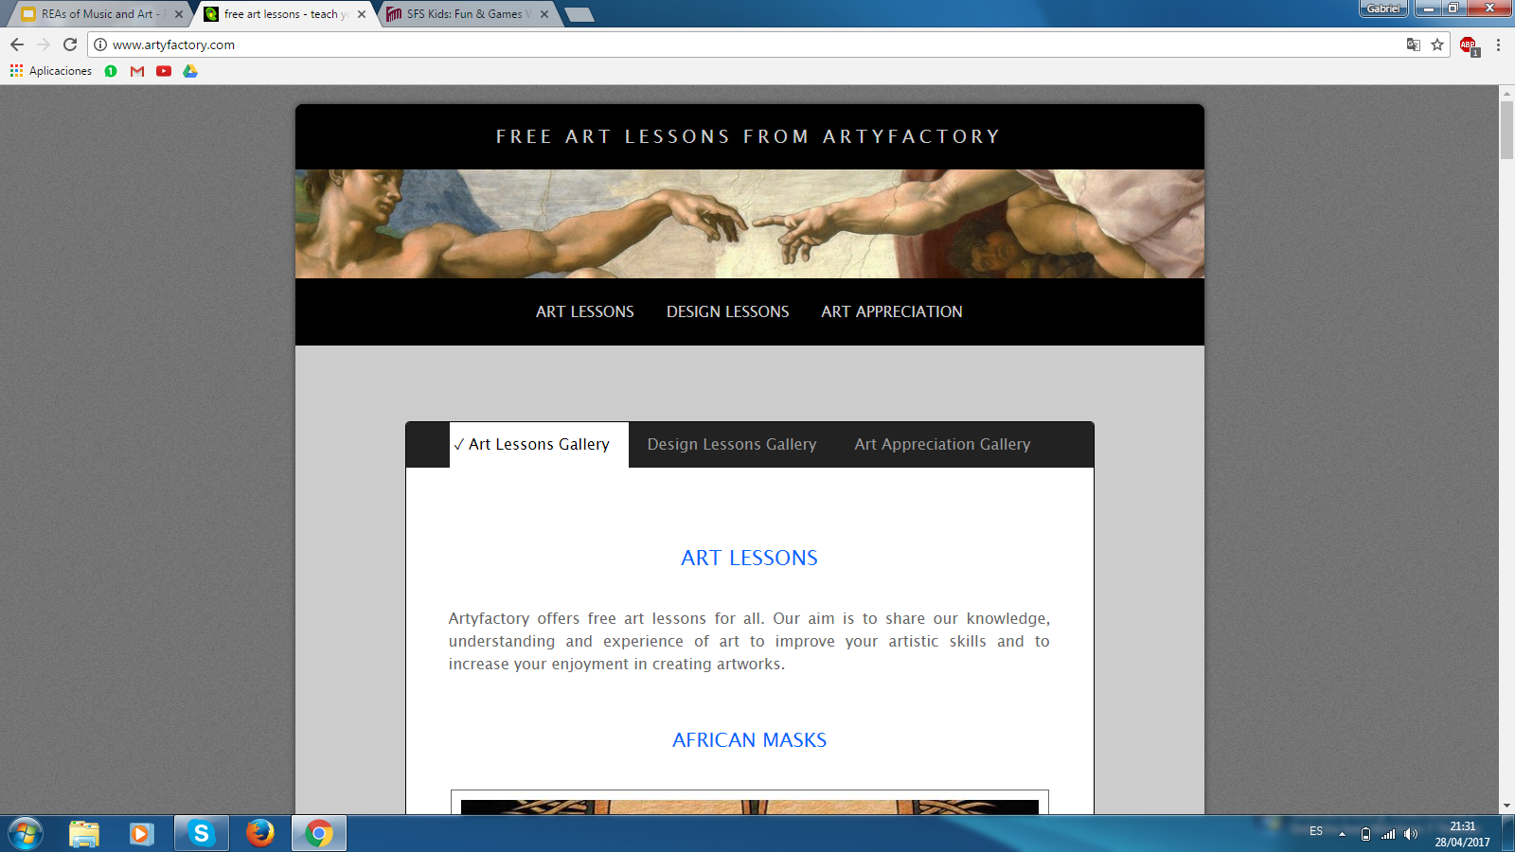
It offers free art lessons. You can develop understanding and experience of art to improve your artistic skills and to increase your enjoyment in creating artworks.
Place your screenshot here

Slide 7
ArtGraphica

Slide 8
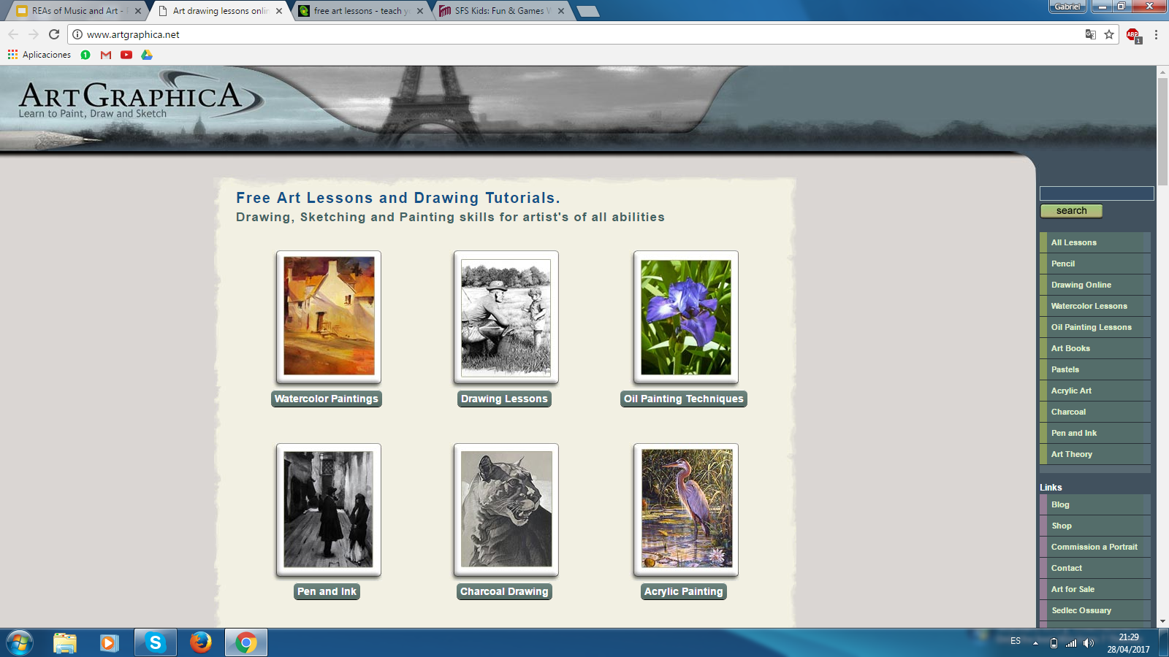
Artgraphica offers more than a hundred quality free art lessons to develop art skills in a variety of mediums from graphite, oils, and watercolor through to charcoal, acrylics and ink, and from sketches to finished works of art.
Place your screenshot here

Slide 9
Technical Drawing

Slide 10
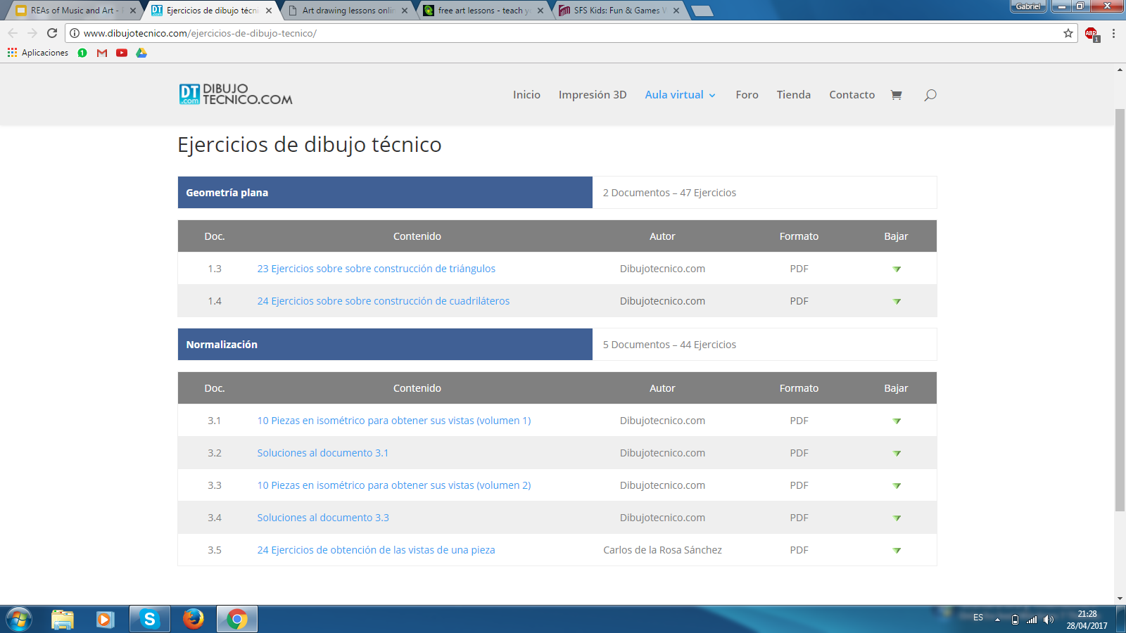
This Spanish OER is about Technical Drawing. You can do as many exercises as you want. Also, theoretical lessons about technical drawing and technical vocabulary of that subject.
Place your screenshot here

Slide 11
J.A. Cuadrado.com

Slide 12
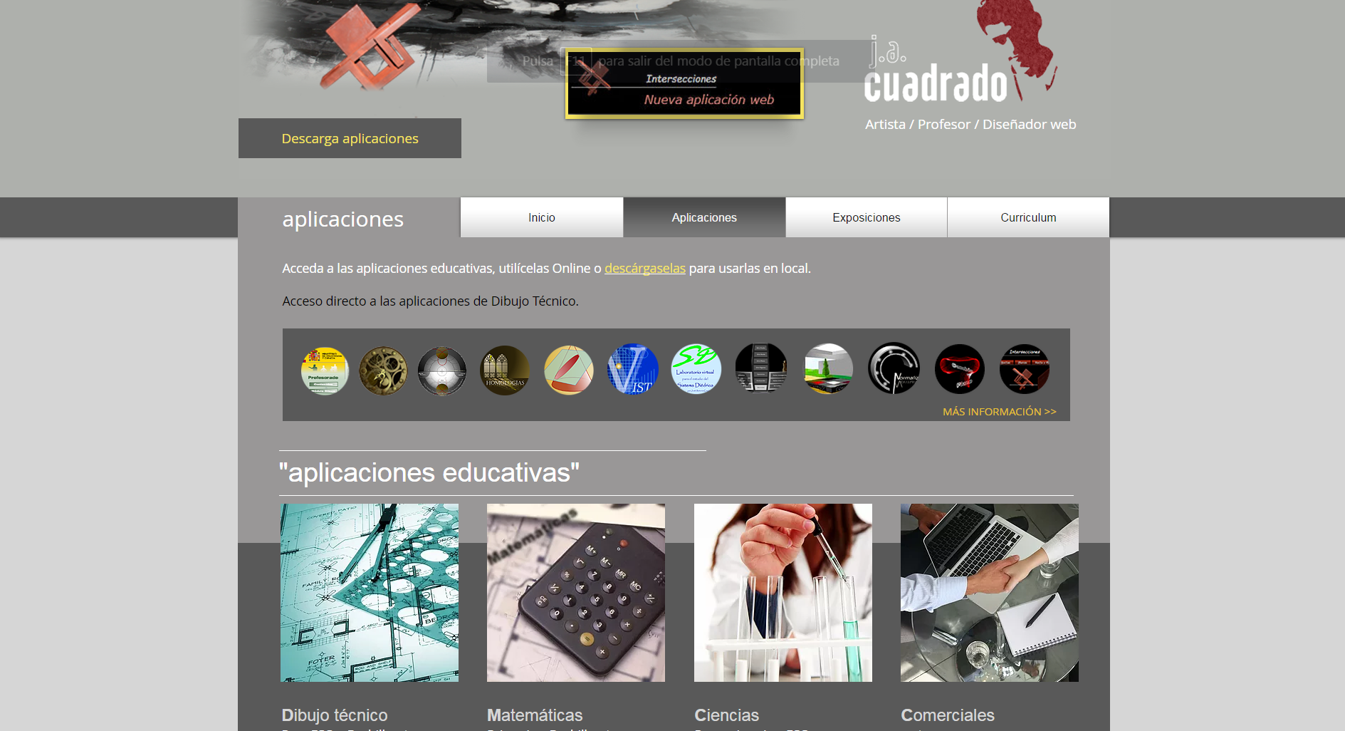
J. A. Cuadrado is a Spanish teacher and artist, whose website offers several exercises and exams about Technical Drawing for A-levels. He also informs students about stimulating exhibitions which help them in their school subjects.

Slide 13
Educa Thyssen

Slide 14
This website was created by the Thyssen organization and its main purpose is to inform students about what projects and exhibitions are taking place at Malaga’s Thyssen museum .It is for different levels and includes different topics, techniques and museums.

Slide 15
NoteFlight

Slide 16
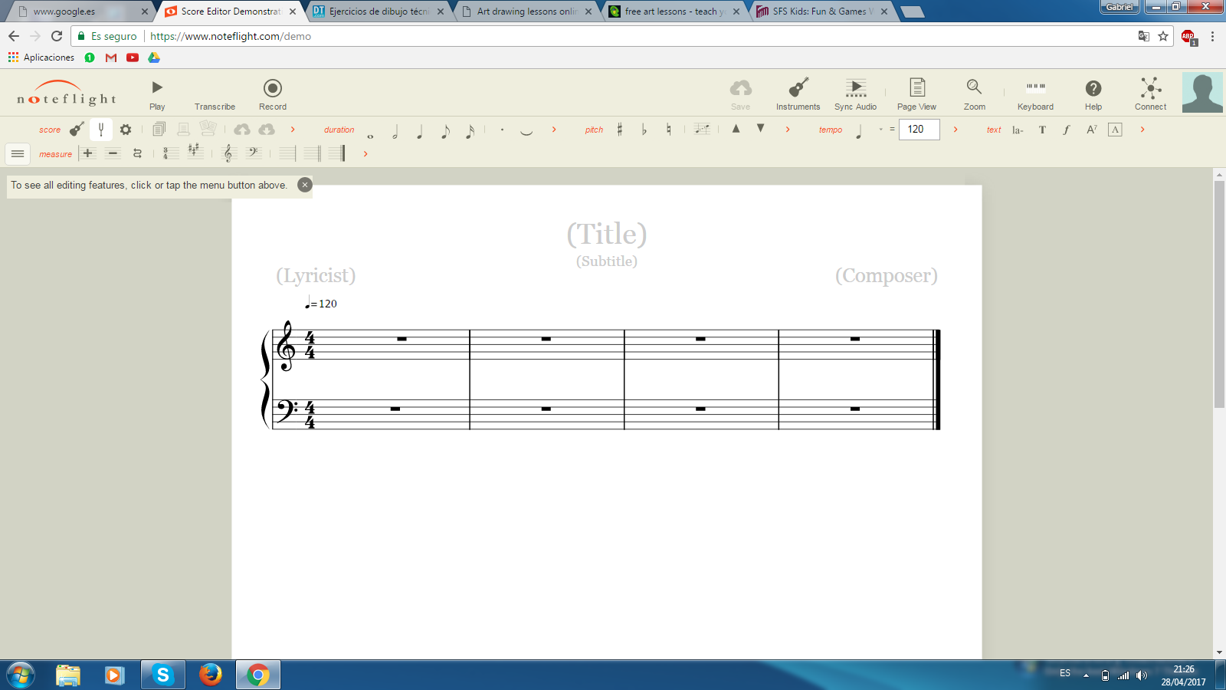
OER for writing scores. It’s so useful for music students who have to make music projects and compositions. It allows you to listen to what you are writing and different instruments. You can register or try with a demo
Place your screenshot here

Slide 17
Thanks!
Gabriel Auñón Fernández
Enrique Aycart Maldonado
Javier Fernández Campano
Javier Gutiérrez Montiel

Slide 18
Thanks!
I.E.S HUELIN
MÁLAGA
SPAIN

