Slide 1
carbon footprint within the home
By Penair School, England

Slide 2
What is carbon footprint?
The official definition of a Carbon Footprint is:
‘The amount of carbon dioxide released into the atmosphere as a result of the activities of a particular individual, organisation, or community’

Slide 3
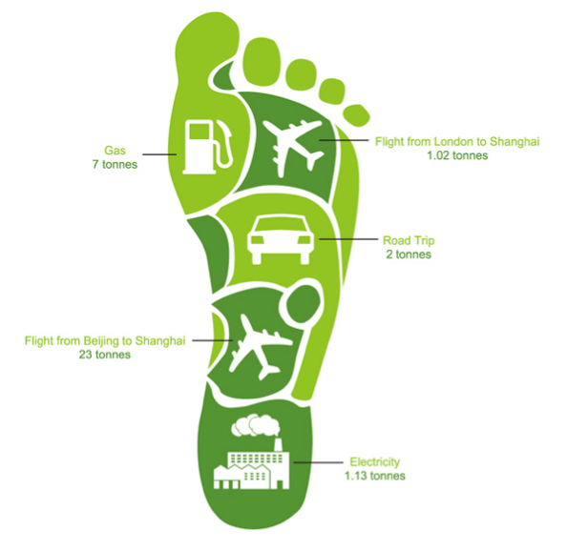

Slide 4
What kind of things contribute to your carbon footprint within the home?
Driving
Central Heating
Charging your phone
Using a Desktop
Washing Machines
Tumble dryers
Watching TV

Slide 5
How to reduce your carbon footprint
You can take many steps to reduce your Carbon Footprint:
Shower instead of bathe
Unplug your charger when it’s not charging
Try to walk more than drive
Turn off the lights when your not in the room
Try and use less water!
Support clean energy sources; such as wind, solar and geothermal energy!

Slide 6
Here is a little video we made to show our carbon footprint at home

Slide 7
Examples of some electricity co2 Emissions from an average household in England and Spain
Months | Energy consumption (KWH) | Cost (£) | Co2 Emissions (KG)
January | 523 | 74.74 | 281
February | 464 | 64.79 | 249
March | 476 | 66.87 | 256
April | 442 | 62.32 | 237
May | 433 | 61.34 | 233
June | 391 | 55.76 | 210
July | 366 | 52.73 | 197
August | 374 | 53.76 | 201
September | 380 | 54.34 | 204
October | 431 | 61.09 | 231
November | 455 | 63.99 | 244
December | 483 | 67.73 | 265

