Slide 1
Monday
Monday | 830 – 8.50 | Registration
 | 8.50 – 9.00 | To Staff Room
 | 9.00 – 10.00 | Ice breakers | International
 | 10.00 – 10.50 | School tour, then questions/discussion – what is similar/different | International
 | 10.50 – 11.10 | Break
 | 11.10 – 12.10 | Sharing OER – Languages - Learning languages abroad - presentation | National
 | 12.10 – 1.10 | Presentation of business project | National
 | 1.10 – 2.00 | Lunch
 | 2.00 – 3.05 | Work experience session – what happens at Penair School? Schools to review | National

Slide 2
Tuesday
Tuesday | 830 – 8.50 | Registration
 | 8.50 – 9.00 | To Staff Room
 | 9.00 – 10.00 | What have you found out about sustainable tourism in your country - discussion | International
 | 10.00 – 10.50 | Talk/workshop on Sustainable Tourism from COAST | International
 | 10.50 – 11.10 | Break
 | 11.10 – 12.10 | Talk/workshop on Sustainable Tourism from COAST | International
 | 12.10 – 1.10 | Skills audit/introduction to group task | International
 | 1.10 – 2.00 | Lunch
 | 2.00 – 3.05 | Success criteria for the task | International

Slide 3
Sustainable Tourism
Group work task…
To produce a presentation that shows what you have learnt so for during this Erasmus+ project.
You are going to create an idea for a tourism business – it could be a single business such as a hotel or a visitor attraction or it could be a whole resort.
You need to produce a business plan and then sell the idea to a panel of judges on Friday
The success criteria for this project will be…

Slide 4
Success criteria?
These are the things that we will agree on so that everyone knows what they have to try to include in their presentation
It is then down to each group HOW they do this
So, what should we agree on?
Remember to build on each others’ strengths too!

Slide 5
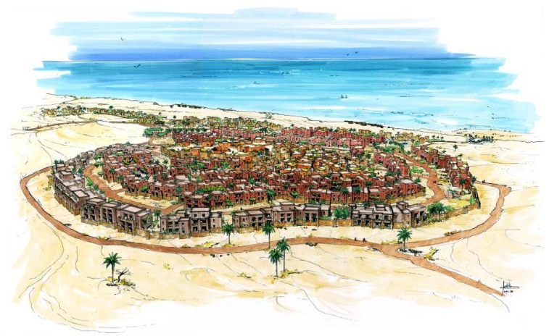
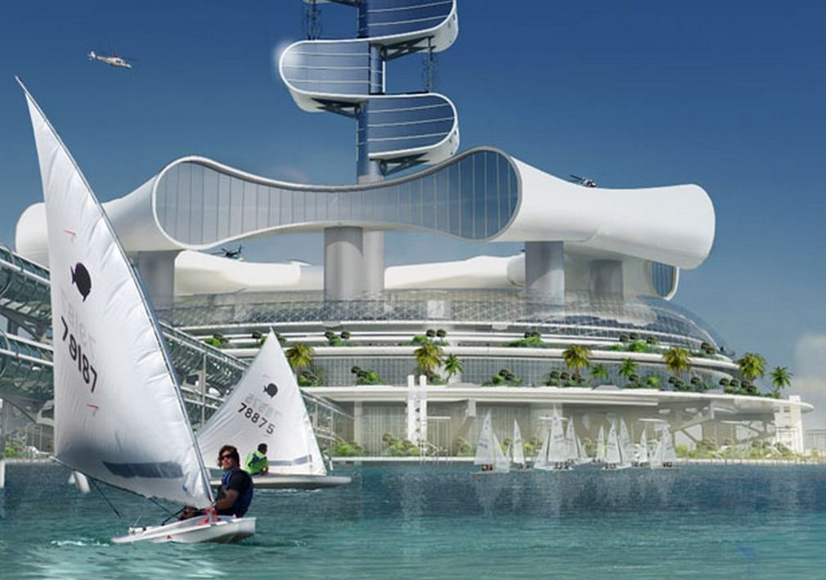
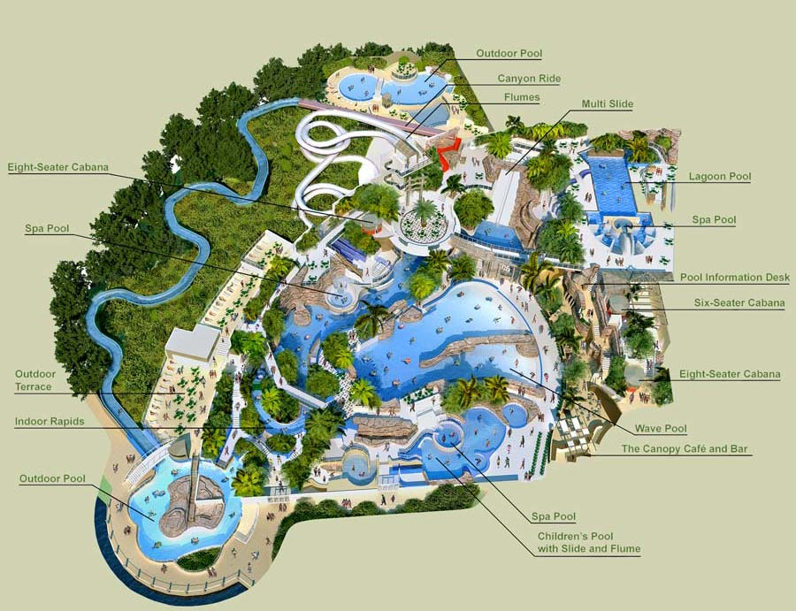
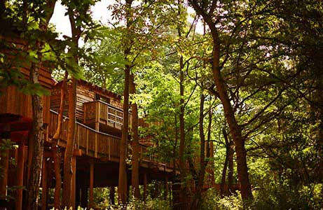
…something like this…or not…

Slide 6
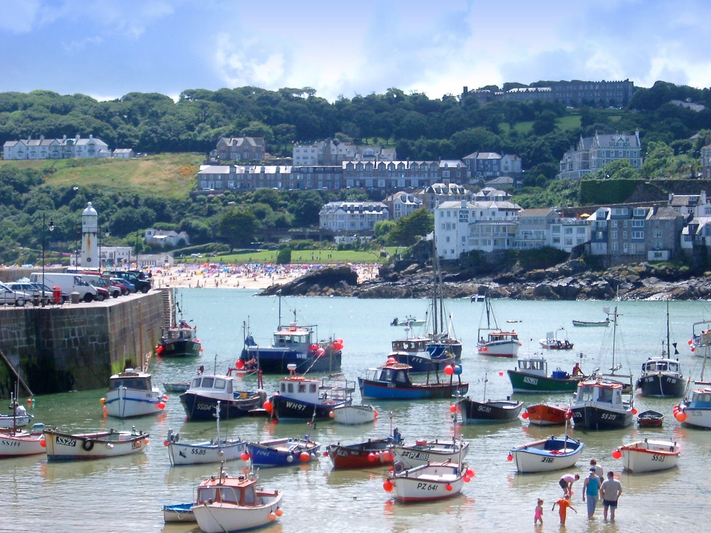
Wednesday
St Ives
Sustainable tourism – what ideas can you collect?
What evidence can you see?
What do businesses have to say?
What about visitors?
…Yes, you could ask people!

Slide 7
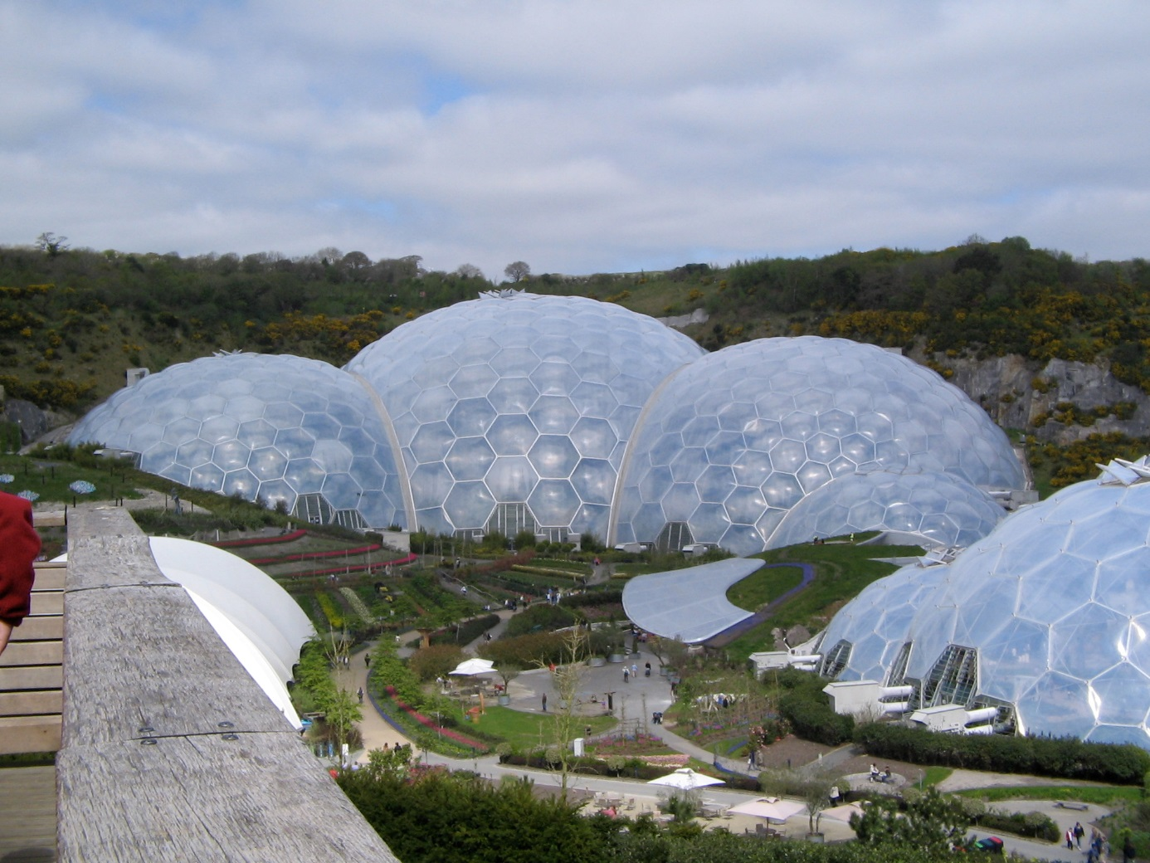
Thursday
Eden Project
Sustainable tourism – what ideas can you collect?
What evidence can you see?
What do businesses have to say?
What about visitors?
…Yes, you could ask people!

Slide 8
Friday
Friday | 830 – 8.50 | Registration
 | 8.50 – 9.00 | To Staff Room
 | 9.00 – 10.00 | Work on project | International
 | 10.00 – 10.50 | Work on project | International
 | 10.50 – 11.10 | Break
 | 11.10 – 12.10 | Presentation of projects and peer feedback | International
 | 12.10 – 1.10 | Judging using success criteria and prizes | International
 | 1.10 – 2.00 | Lunch
 | 2.00 – 3.05 | Evaluation and next steps (Liquidation of business) | National

