Slide 1
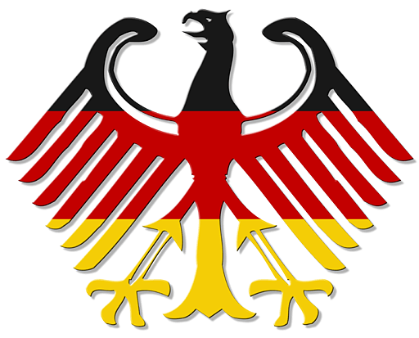
Germany
Politics and Geography

Slide 2
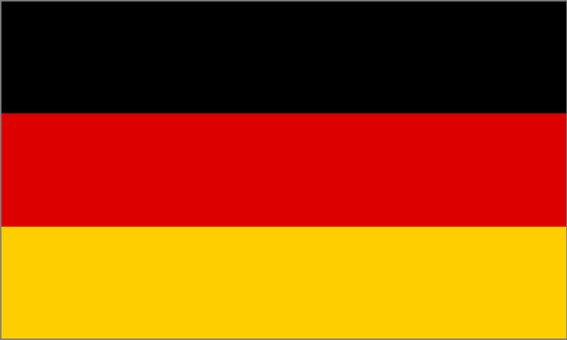
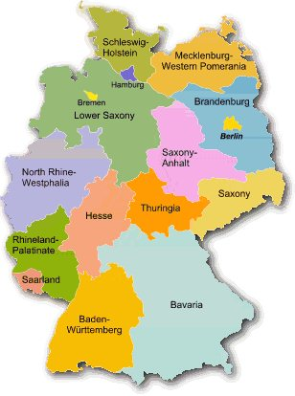
Germany-the most important infos
-360.000 km^2
-82 million inhabitants
-Capital: Berlin
-There are 16 federal states
-Biggest federal state is Bavaria: 12.7 million inhabitants
-Smallest federal state is Bremen: 661 900 inhabitants
-The federal state with the most inhabitants is
North Rhine Westphalia

Slide 3
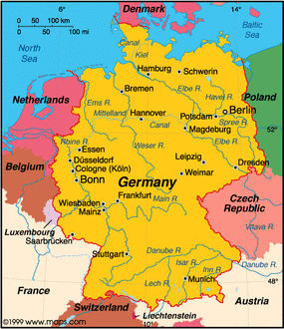
Neighbour countries
The neighbour countries are:
-Denmark
-Poland
-Czech Republic
-Austria
-Switzerland
-France
-Luxembourg
-Belgium
-Netherlands

Slide 4
The National Parliament
Permissions/tasks:
-change/make laws
-keep an eye on the government/control them
-knows on what the government spends money
Who is in the Parliament?
-630 deputies
-elected for 4 years by the german inhabitants
Election of the chancellor
-one of the most important people
-the president suggests somebody
-secret election

Slide 5
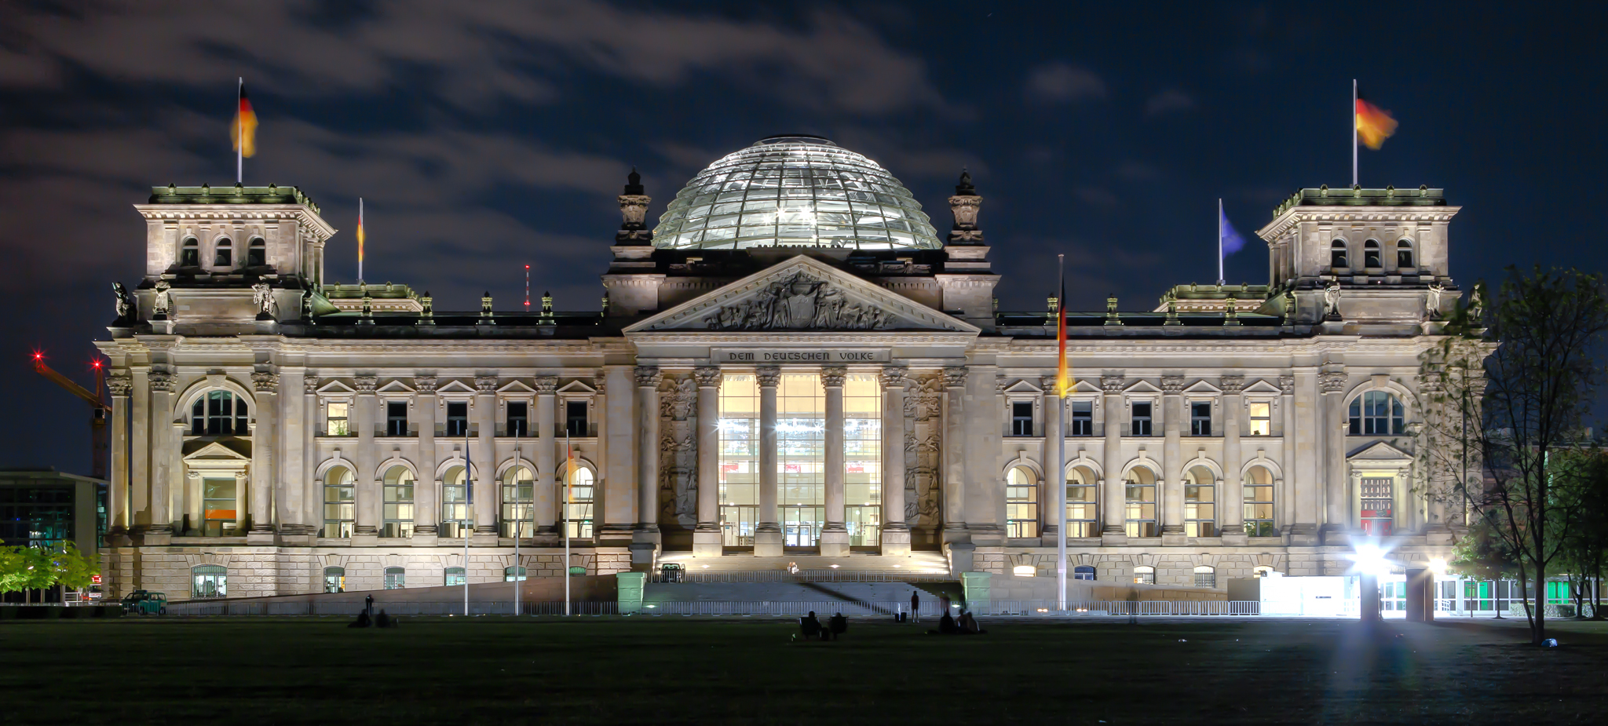
The „Reichs-Tag“ in Berlin
-Built by Paul Wallot in 1894
-in the 2nd world war it was destroyed
-until 1991, Bonn was the capital of Germany
-in 1994-Lord Norman Foster began the renovation
-1999 the building was finished again

Slide 6
The most
important
years

Slide 7
1949
After the war, there were 4 occupied zones .
The three Western Allies and the Russians were unable to agree on the division of the German capital Berlin and the rest of the country. Then 2 States were founded on German soil: The German Democratic Republic in the Russian-occupied zone and the Federal Republic of Germany in the occupied zone of the Western Allies . The States also received different currencies .
Many people left the GDR. As a result, the Berlin Wall was built in 1961.

Slide 8
1989
Peaceful Revolution of the citizens in the German Democratic Republic. Many DDR citizens fled into the Czech Republic . Due to the pressure of citizens and the poor economy of the DDR , the wall was opened on the part of the DDR . This happened on November 9th .

Slide 9
1990
The opening of borders between the DDR and BRD started the reunification of Germany. The GDR was dissolved and converted into the BRD . There was only one currency , the German Mark. A special tax by the “West Germans” was to finance the reunification. The reconstruction of the economy and towns of the former DDR like Dresden or Leipzig began.

Slide 10
We hope
you
enjoyed

