Slide 1
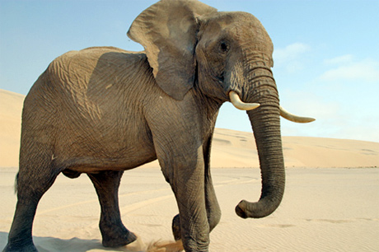
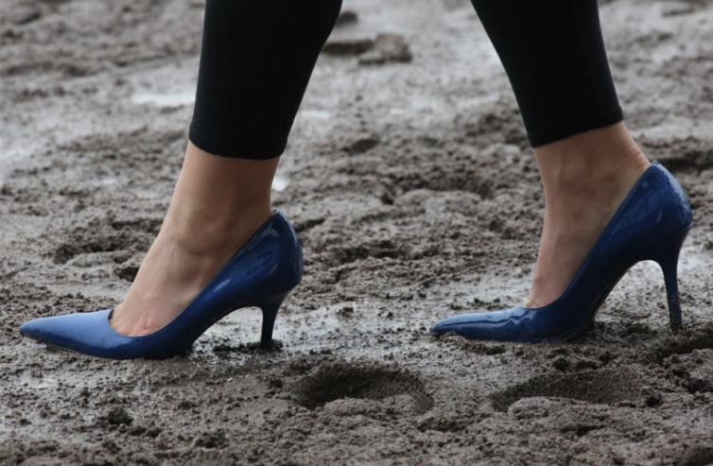
Pressure
Starter Activity (back of jotter):
During a game of tug of war the rope doesn’t move. Why is this? Answer in terms of balanced and unbalanced forces.
Why do parachutists fall? Answer in terms of balanced and unbalanced forces.
A bag of sugar that weighs 10N sits on a shelf. What will be the upward force of the shelf?

Slide 2
Learning Intentions
What is pressure?
How do you calculate pressure?

Slide 3
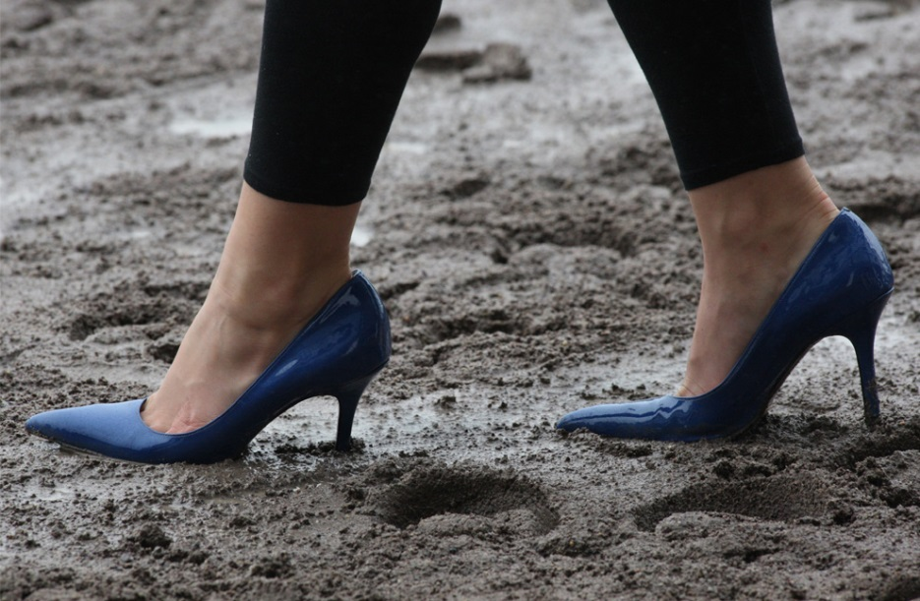
Think, pair, share
Which of these will produce the largest pressure on the ground?

Slide 4
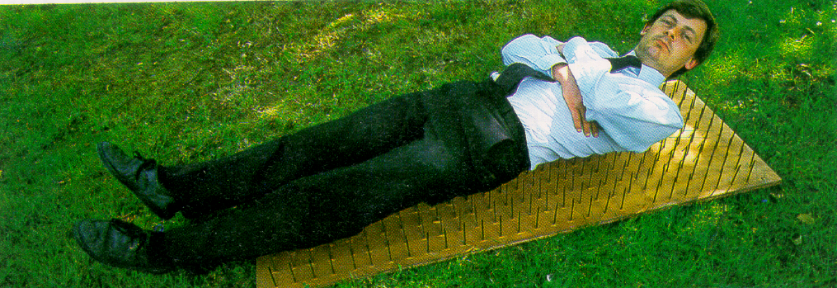
Think, pair, share
Why can this man lie on a bed of very sharp nails?

Slide 5
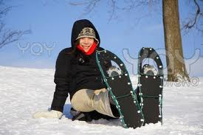
Think, pair, share
Why do these snow shoes stop you sinking?

Slide 6
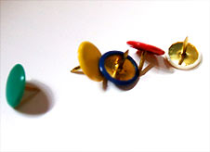
Think, pair, share
Why do you think drawing pins have a big rounded area on top?

Slide 7
Pressure
Pressure is how much something is pushing on something else
It is related to force and the area that force is applied to
If a force is applied to a large area the pressure will be ________.
If a force is applied to a ________area the pressure will be greater.
To reduce pressure, we can ________ the surface area.

Slide 8
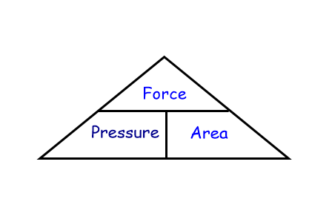
Calculating Pressure
Write the 3 equations you can get from this triangle
Pressure = Force / Area
Force = Pressure x Area
Area = Force / Pressure

Slide 9
Calculating Pressure
Pressure = Force (in Newtons)
Area (in cm² or m²)
Units: N/cm² or N/m²

Slide 10
Calculating force
If we are given the mass in kg, we multiply this by 10 to find out the force (N).
A man has a mass of 70kg. Calculate the force he puts on the ground
A bag of sugar has a mass of 1kg. Calculate the force it puts on the ground
A pencil has a mass of 15g. Calculate the fore it puts on the ground

Slide 11
Q1. An ostrich of weight 700N stands on 1 foot. The foot has an area of 0.03m². Calculate the pressure exerted by the ostrich on the ground.
P = F/A
P = 700N/0.03 m²
P = 23,333 N/m²
Q2. A light wooden post with bottom surface area of 0.0012m² is driven into sand with a force of 180 Newtons. Calculate the pressure exerted by the post on the sand.
Q3. An elephant has a mass of 1000kg. The total surface area of its four feet is 0.25m².
Calculate the pressure the elephant’s four feet place on the ground.
Q4. A man has a mass of 75kg and his shoes have an area of 0.02m².
How much pressure does each shoe place on the ground?

Slide 12
How much pressure do objects place on the ground?
Aim:
To calculate the amount of pressure objects place on the ground
Method:
Take an object’s mass using the scales (convert to kg if needed)
Calculate the force (mass in kg x 10)
Draw around object on graph paper and calculate the area
Calculate pressure (P = F/A)

Slide 13
Pressure Results
Fill in the table using your results and the results of the other
pupils on your table. Use these to draw a bar graph
Object | Pressure (N/cm²)

Slide 14
Learning Intentions
What is pressure?
How do you calculate pressure?

