Slide 1
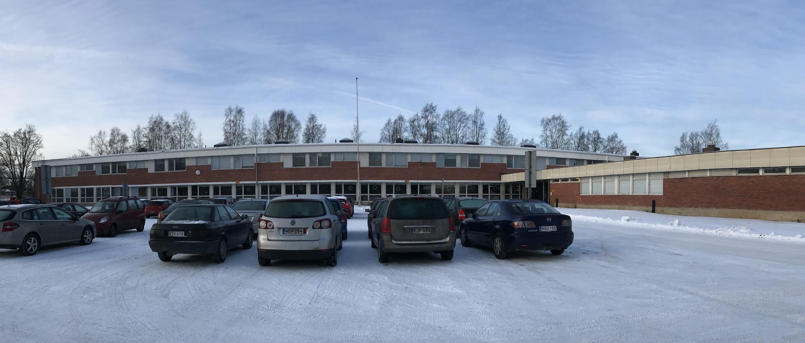
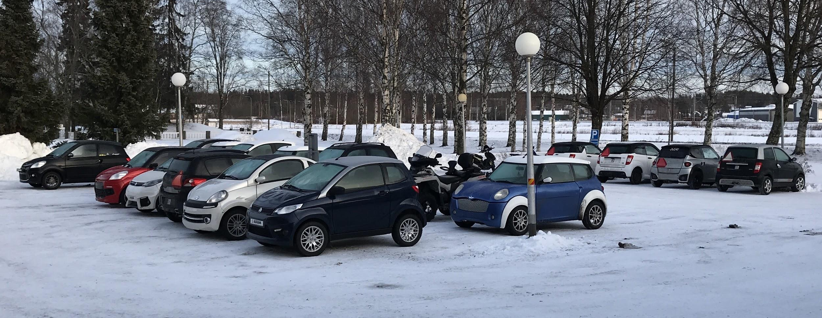
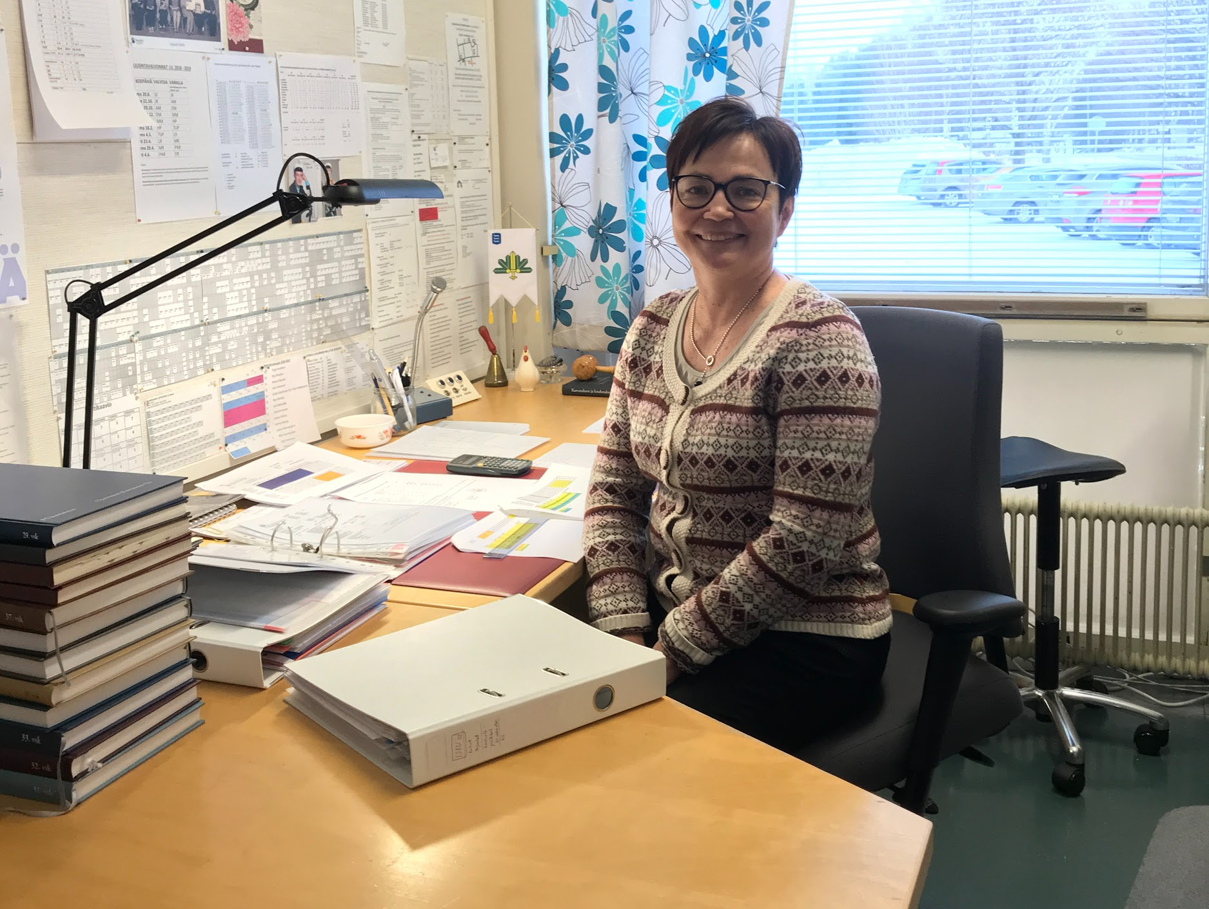
The upper secondary school of Lapua
Our headmaster Kaisa Piiparinen.
She has been our headmaster since 2009.

Slide 2
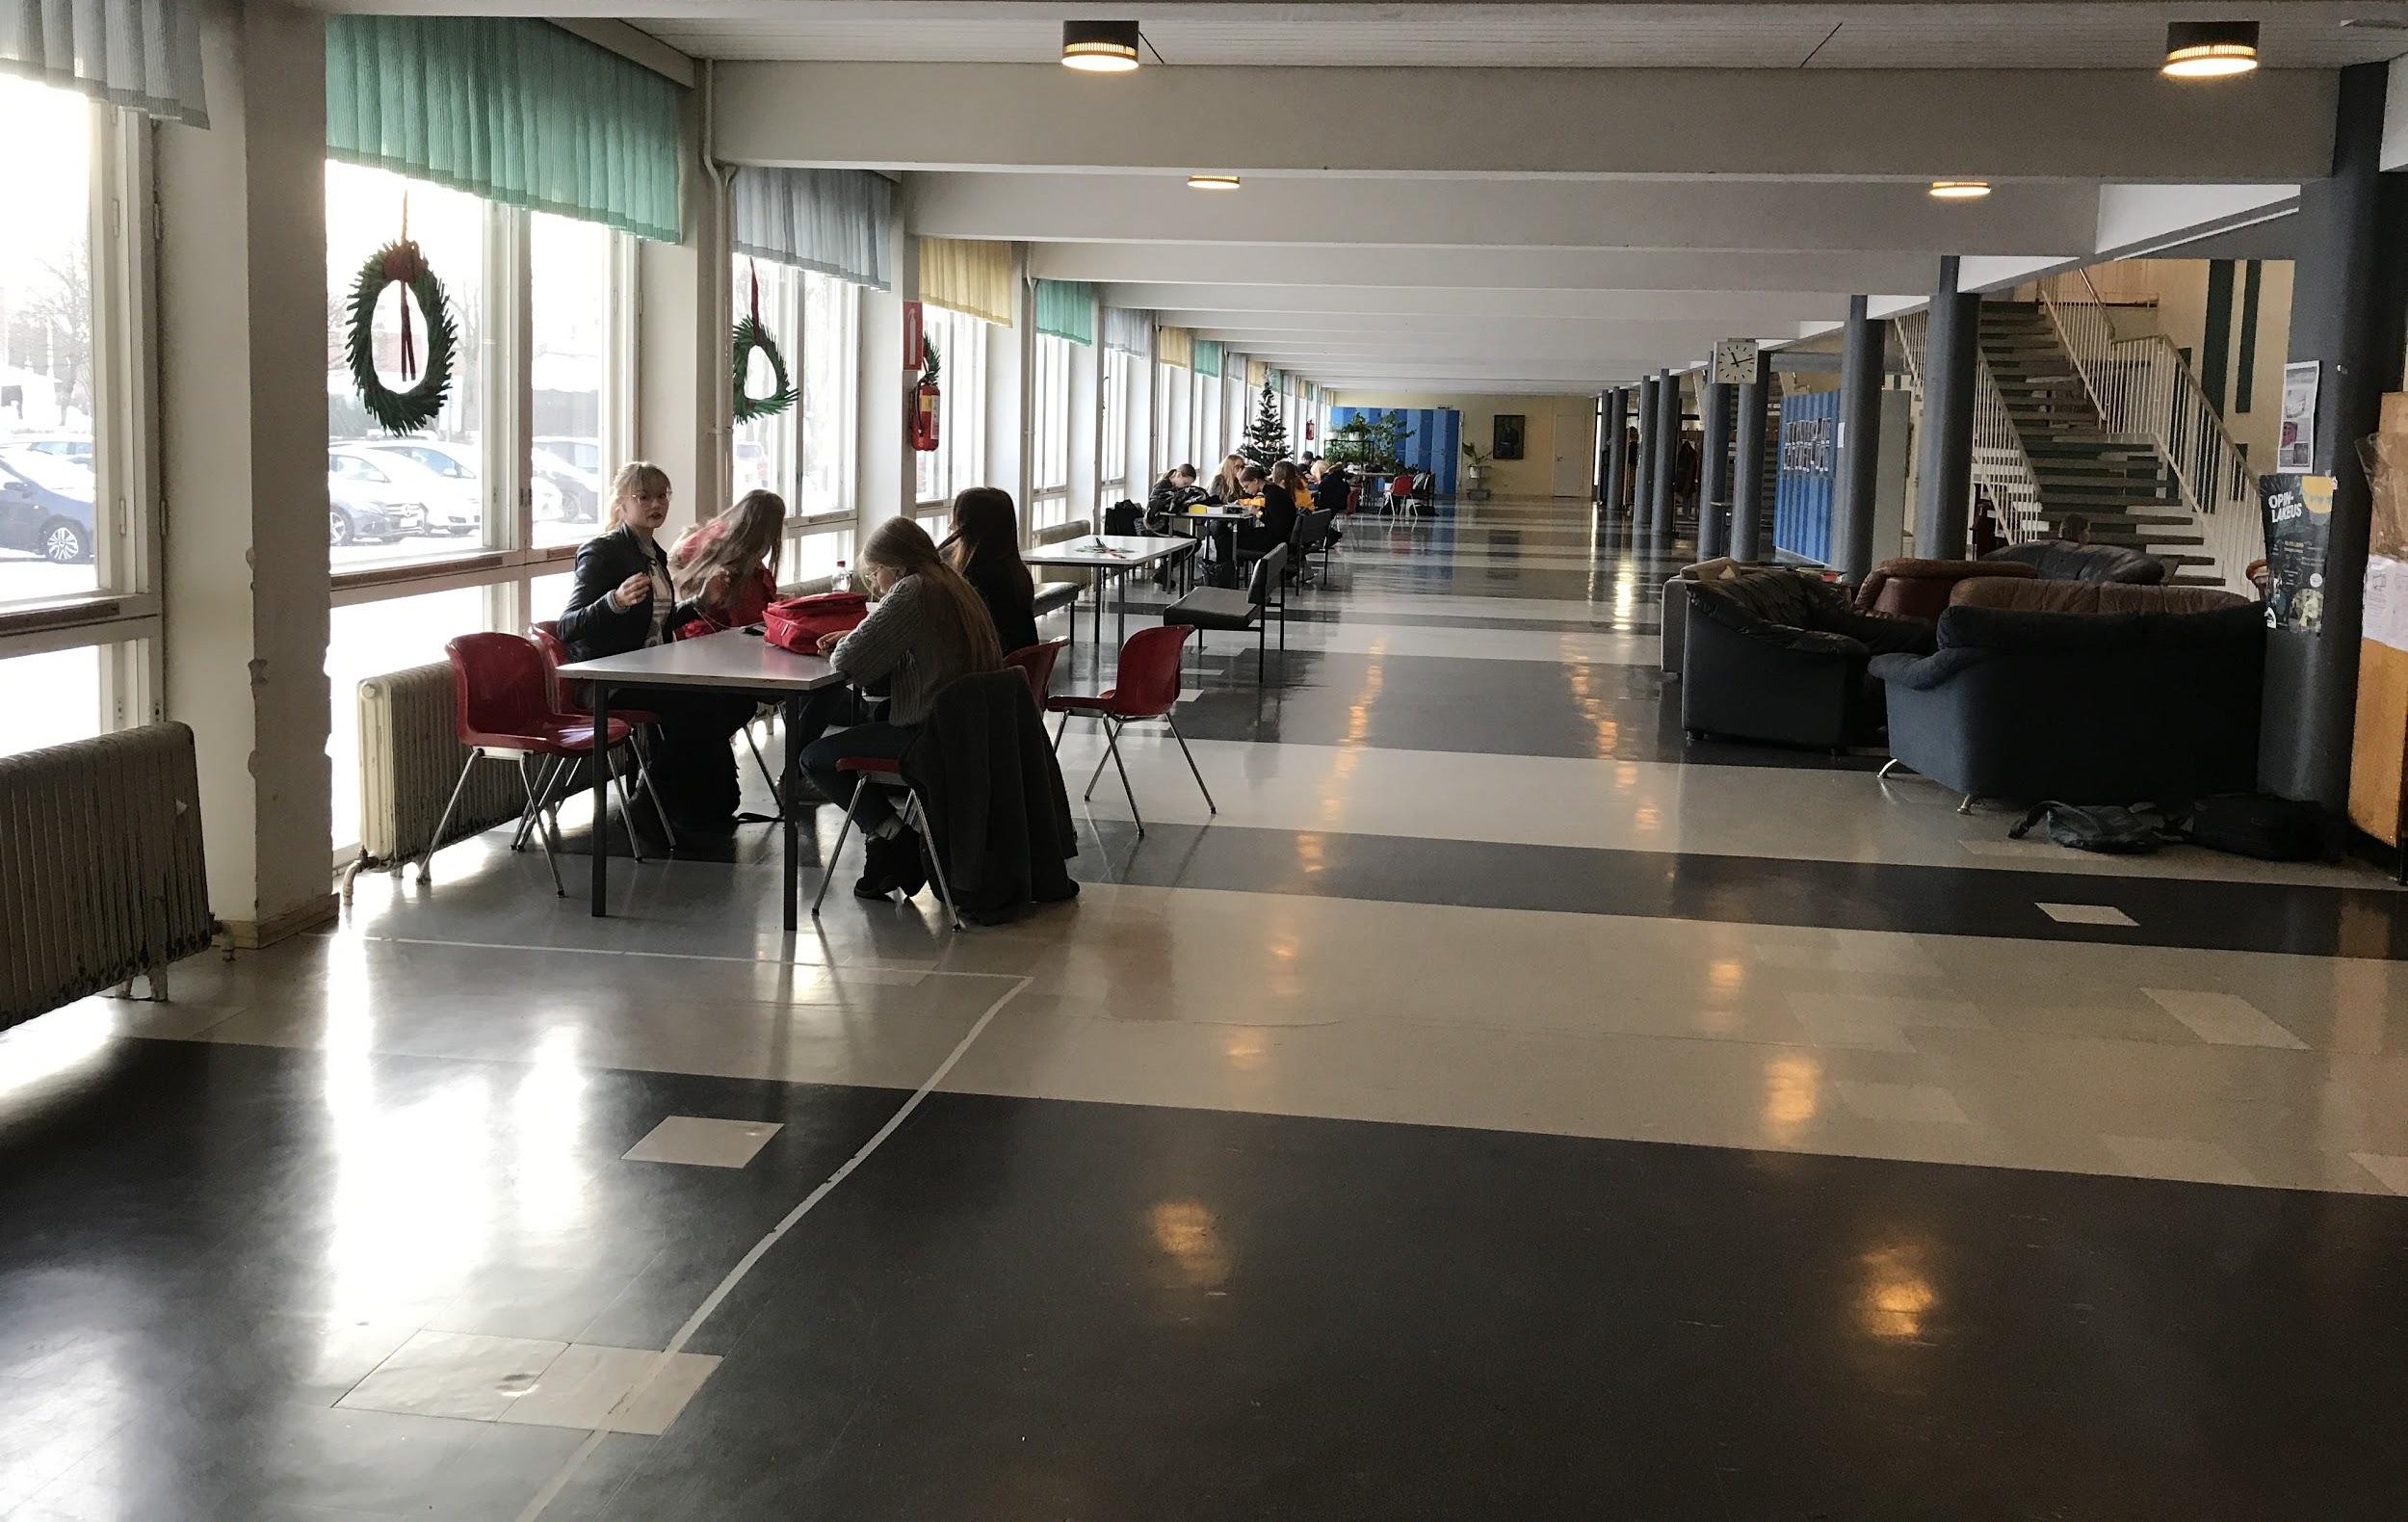
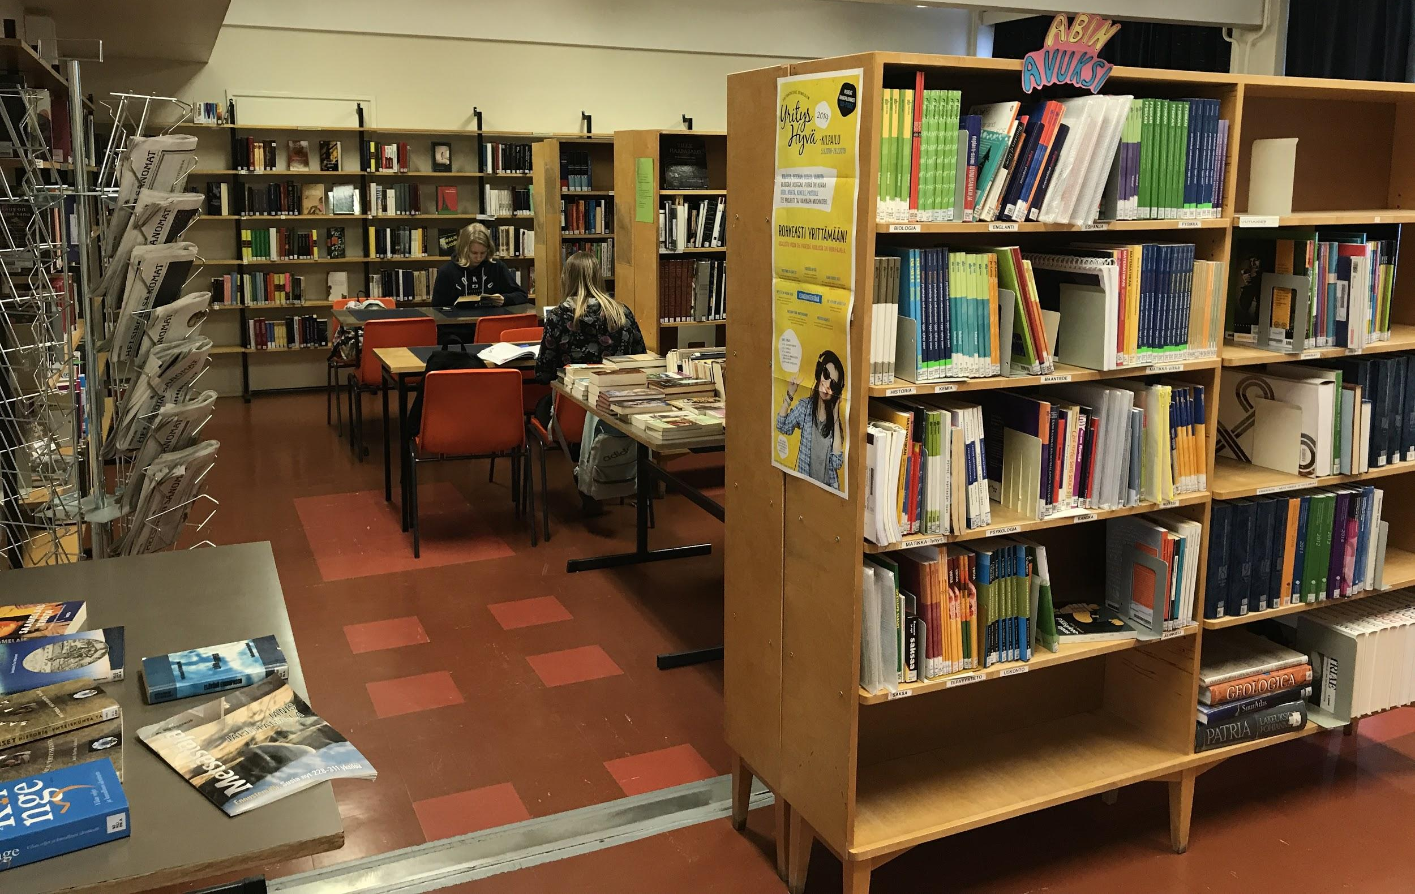
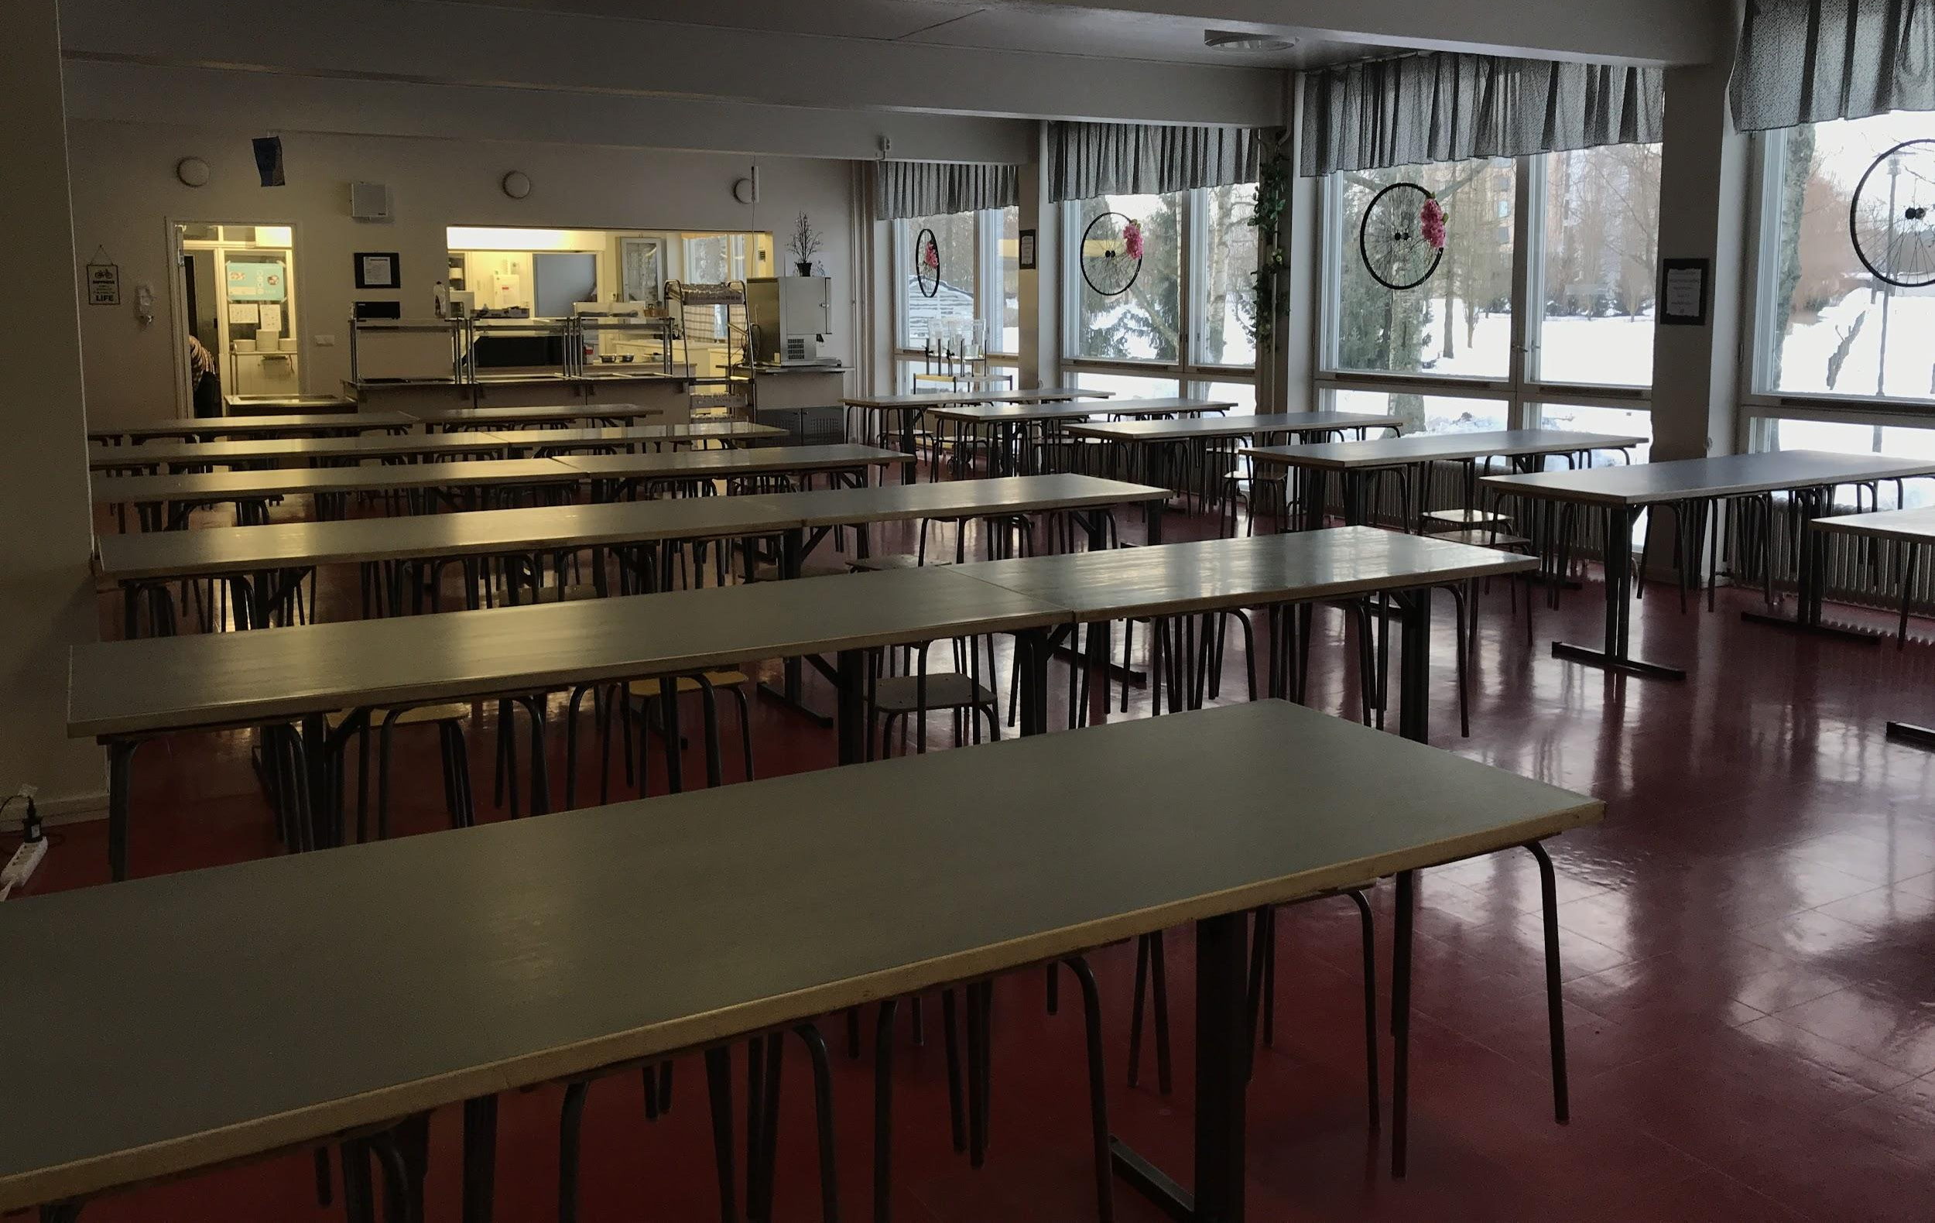
The main hallway
The school library
The dining room

Slide 3
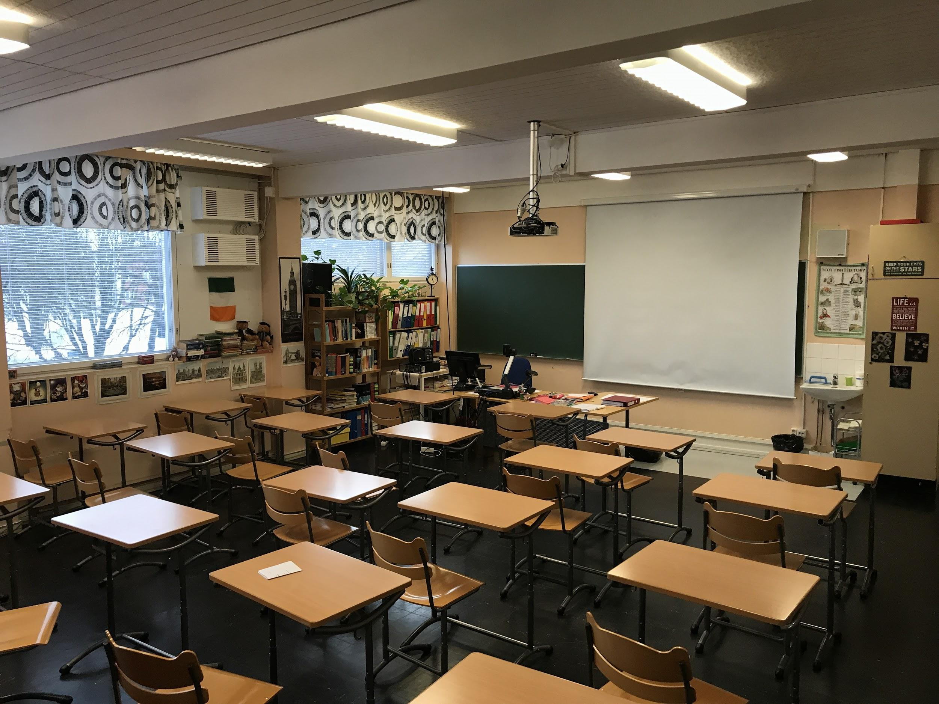
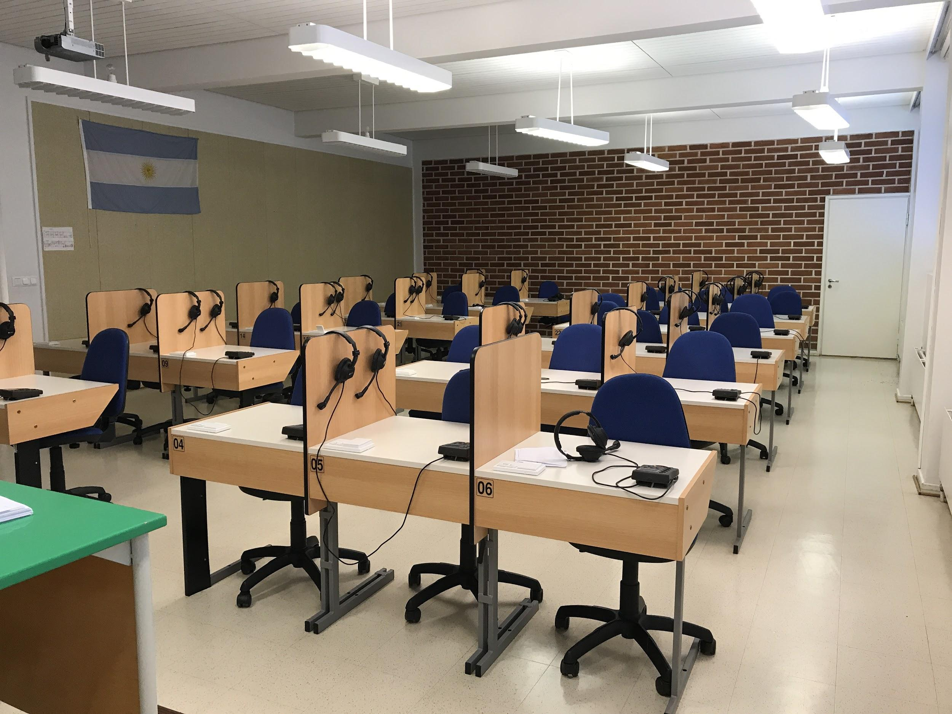
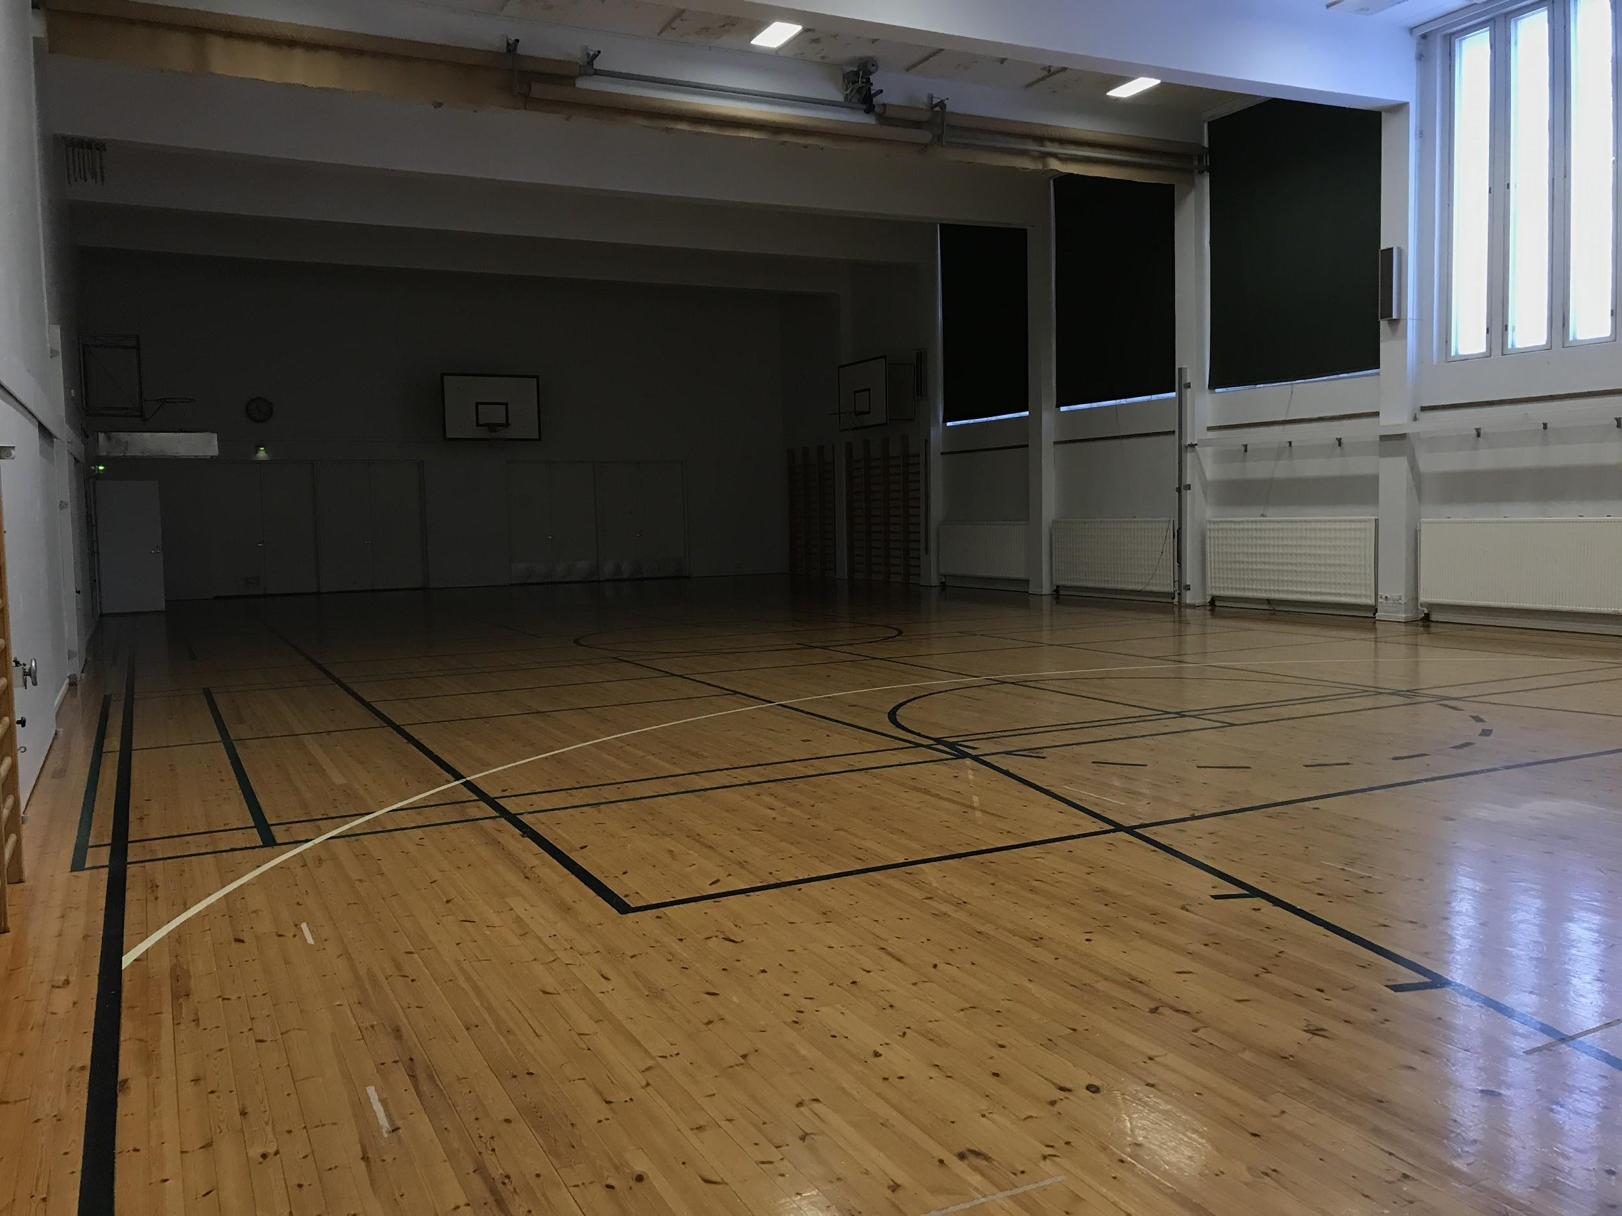
English classroom
The language lab
The school gym

Slide 4
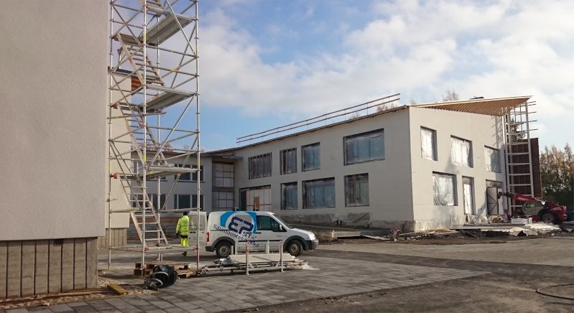
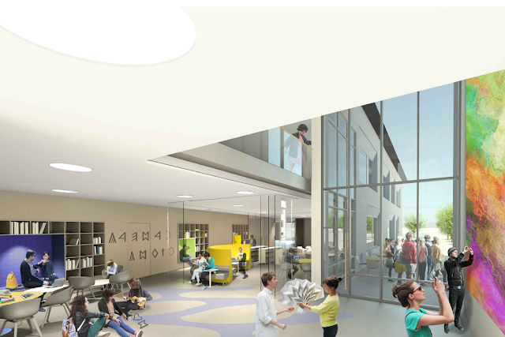
Our new school
Picture: uusilapuanlukio.blogspot.com
Picture: Arkkitehdit von Boehm - Renell Oy
http://uusilapuanlukio.blogspot.com

