Slide 1
SECUNDARY SCHOOL IN SPAIN
IESO QUERCUS

Slide 2
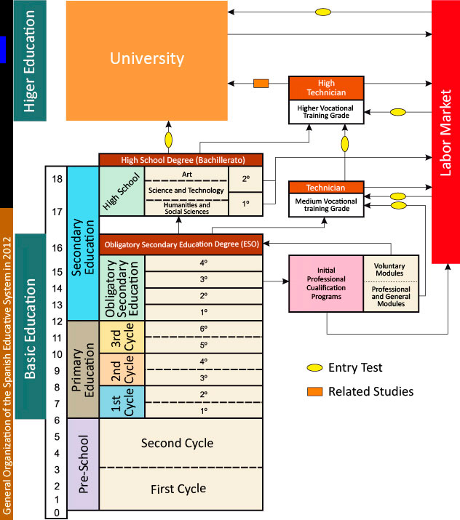
ORGANIZATION TODAY

Slide 3
FUTURE ORGANIZATION
UNIVERSITY
Higher vocational training grade
Laboral market
college admission test
admission Higher vocational training grade test
final test high school
High school | 2º
 | 1º
Medium Vocational training grade | 2º
 | 1º
4º cycle(16 years old | Evaluation | Evaluation
 | Academic | Applied
First cycle (13-15 years old) | 3º | Improvement program
 | 2º | Improvement program
 | 1º
basic vocational training | 2º
 | 1º
primary (3-6 year old) | final evaluation
 | 6º
 | 5º
 | 4º
 | evaluation
 | 3º
 | 2º
 | 1º
Infant Initial (0-3 years old) | 3º
 | 2º
 | 1º
Infant (3-6 years old) | 3º
 | 2º
 | 1º

Slide 4
IN OUR SCHOOL
OUR SCHOOL IS CALLED IESO BECAUSE WE OFFER ONLY COMPULSORY SECUNDARY EDUCATION (12-16 YEARS OLD)
WE HAVE THEN:
1º ESO (12-13 YEARS OLD)
2º ESO (13-14 YEARS OLD)
3º ESO (14-15 YEARS OLD)
4º ESO (15-16 YEARS OLD)
WHEN THE FINISH 4º ESO THEY HAVE TO GO TO ANOTHER HIGH SCHOOL TO DO THE REST OF SECONDARY SCHOOL, CALLED “BACHILLERATO”

Slide 5
SUBJECTS OFFER
SUBJETS | CYCLE 1º | CYCLE 2º | CYCLE 3º | CYCLE 4º
Common | Natural science Geography and history Physical education Spanish English Maths Art Technology In at least a cycle Arts Music Technology Ethics education |  |  | Geography and history Ethics Physical education Spanish English Maths
 |  |  |  | Students have to choose three from this subjets: Biology and geology Arts Chemistry and physics Computer science Latin Music English Technology
Free choice | Teachings of religion: - Religion - History and Culture of Religions Educational attention |  |  | Teachings of religion: - Religion - History and Culture of Religions Educational attention
Optionals | On the set of Three courses are elective Some may take Agreement with the framework established by education authorities. supply of materials in this general area of optional must include: Second foreing language Classical culture |  |  | Will be able to take one or more optional subjects , according to the framework established by the education authorities

