Slide 1
Short-term joint staff training events “Designing online photo album’’
Project ‘’OPEN EUROPE,OPEN HEARTS’’

Slide 2
How to Create an Album on Google Photos
You can create two different types of albums on both the Google Photos website and in the mobile app. The first is a standard new album, which is only visible to you. If you want to share photos with others, try creating a different kind of album called a shared album. A shared item can also be made collaborative, which will allow others to add their own photos.

Slide 3
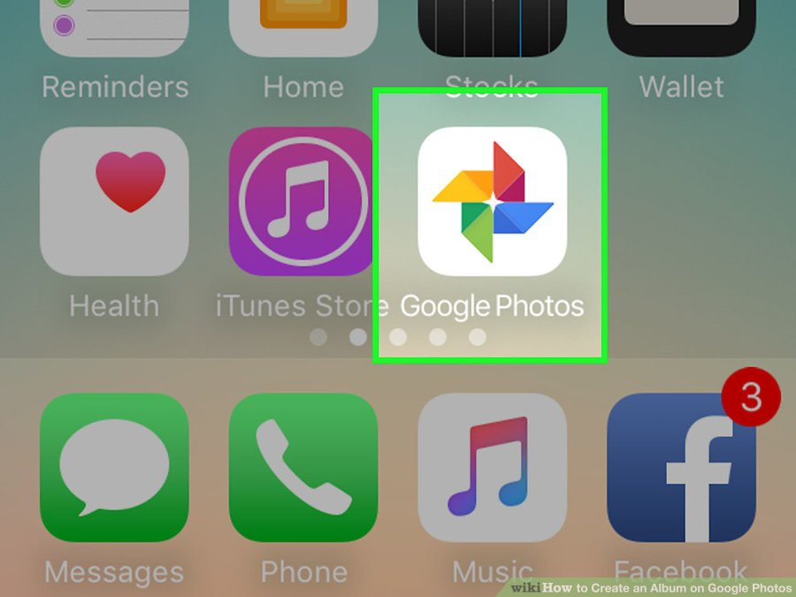
1 Open the Google Photos app. You can use Google Photos to create and manage groups of photos or videos that only you can see. You’ll need to have the Google Photos app and a Google account to use this method

Slide 4
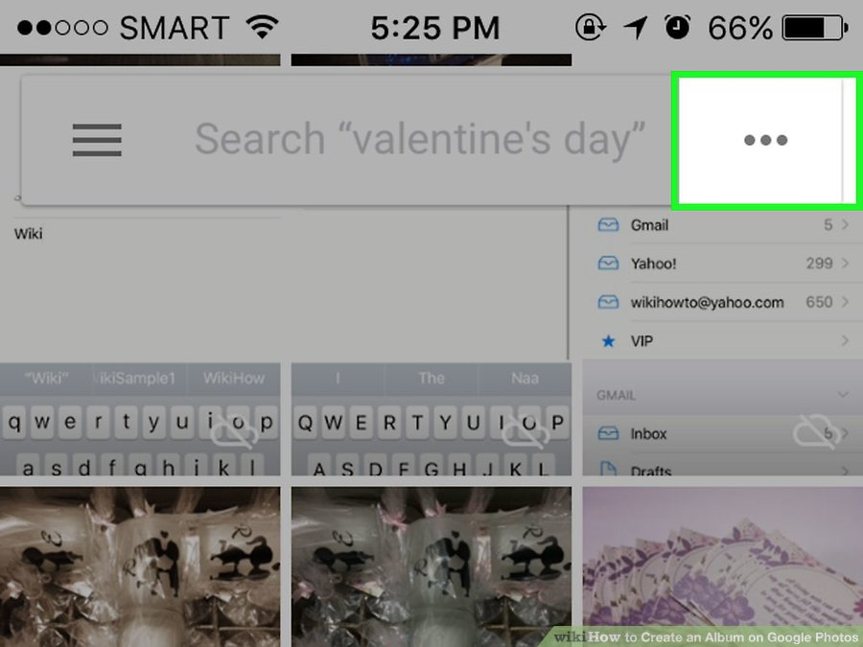
2 Tap the ⁝ icon . You’ll see this at the top right corner of the app at the end of the search box. You’ll see the “Create New” menu appear.

Slide 5
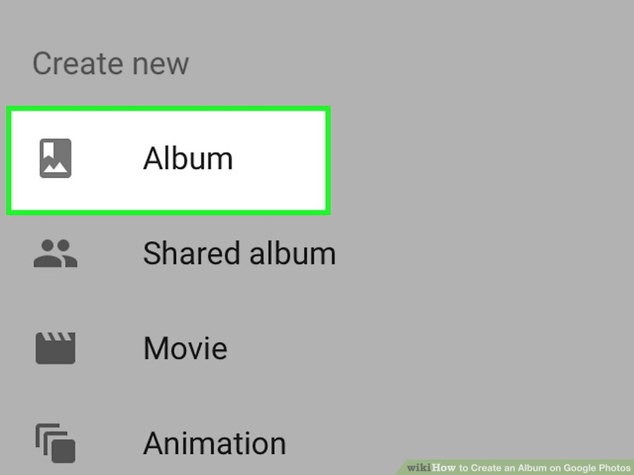
3 Tap “Album.” Now you’ll see a list of all photos synced with Google Photos. Each photo or video thumbnail has a circle at its top left corner.

Slide 6
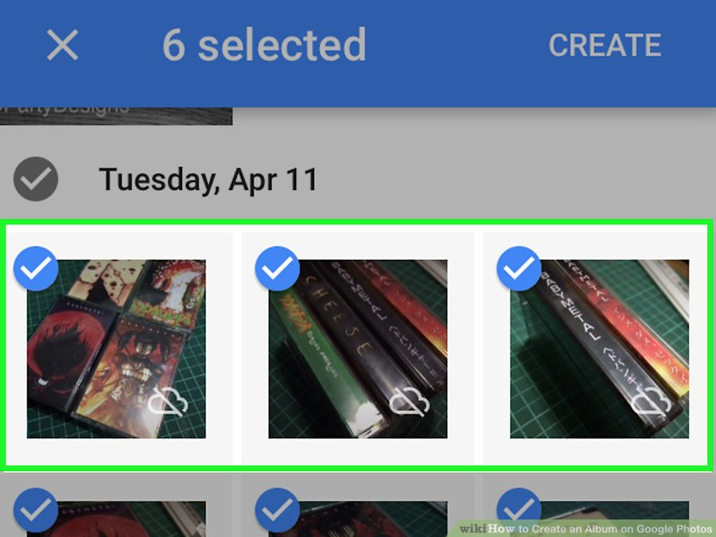
4 Tap to select photos for your new album. As you tap photos, the circle at the corner of each thumbnail will turn to a check mark. If you change your mind about including a photo, just tap it again to remove the check mark.

Slide 7
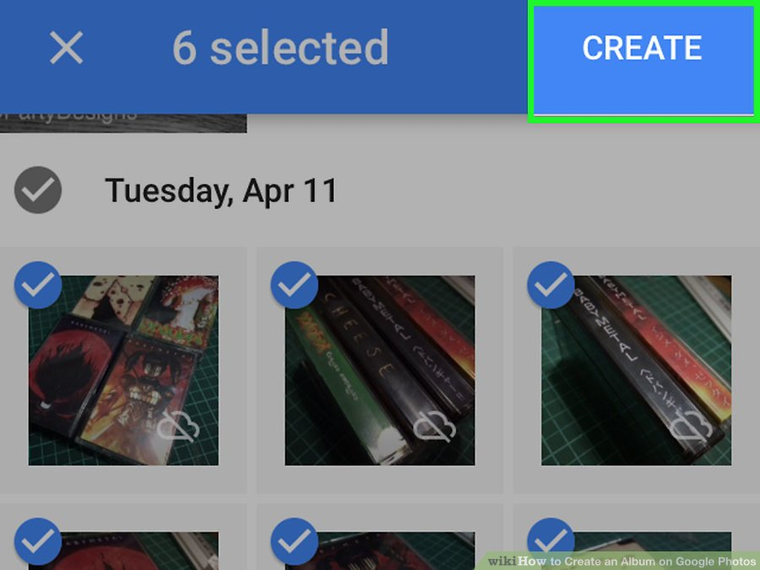
5 Tap “Create.” Now you’ll see the album settings screen, with a text field at the top that says “Untitled.” You’ll also see a list of all photos and videos included in the album.

Slide 8
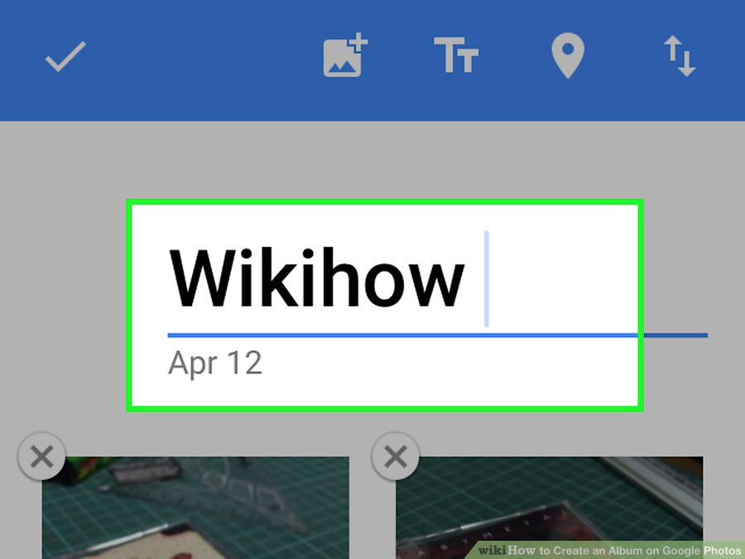
6 Type a name for the album. Giving your album a name that describes its contents will help you locate this album in the future.Tap “Untitled” to launch your keyboard if it didn’t appear.

Slide 9
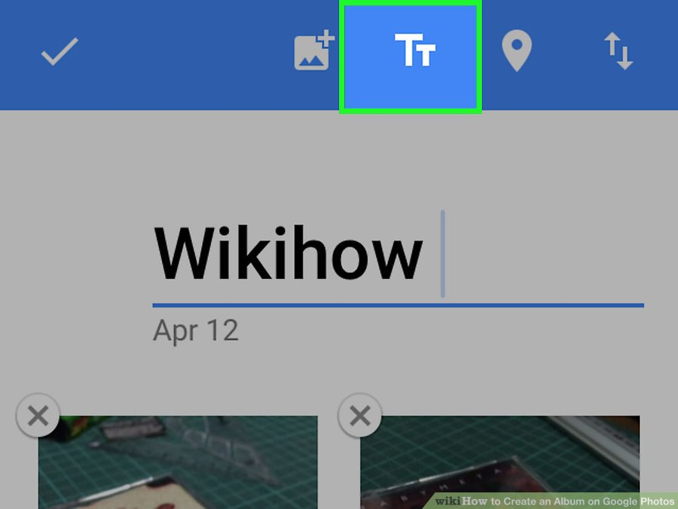
7 Tap the “TT” icon to add a description. This is optional, but you can do this if you want to display additional text beneath the album title.

Slide 10
8 Tap the checkmark to save the album. The checkmark is at the top left corner of the screen.

Slide 11
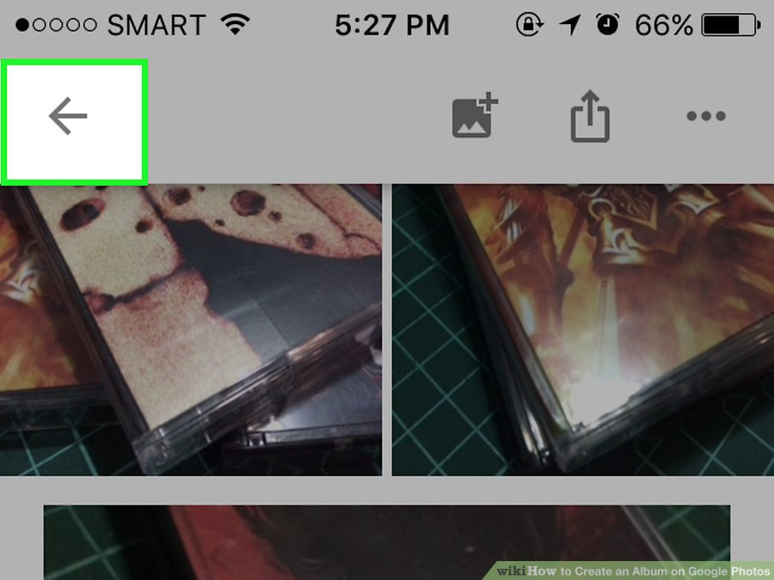
9 Tap the back arrow to view the album list. The newest album appears at the top of the list.

Slide 12
10 View your album at a later date. Tap the Albums icon at the bottom of the screen and select the album you want to see.Add more photos to this album by tapping the Add Photos icon (a square icon of a painting with a + symbol).

Slide 13
Creating a Shared Album in the Mobile App 1 Launch the Google Photos app. You can use the app to create an album to share with others. You’ll be able to control with whom the album is shared, as well as whether other people can add or modify its contents. You must have the app installed and a Google account to use this method.

Slide 14
2 Tap the ⁝ icon. It’s at the top right corner at the end of the search box. The “Create New” menu appear.

Slide 15
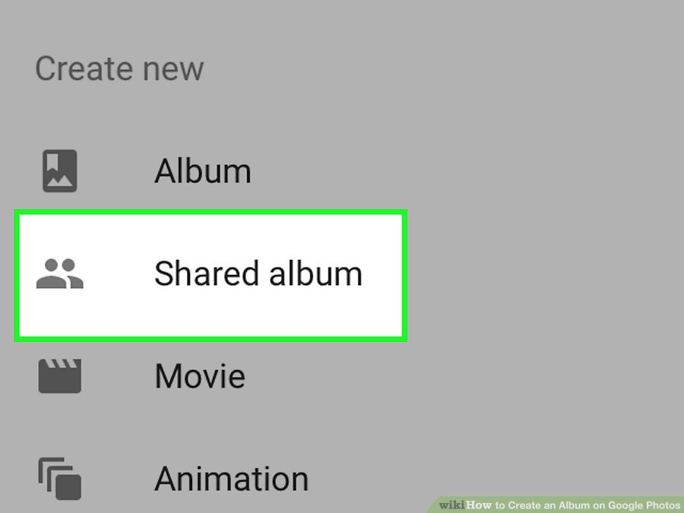
3 Select “Shared Album.” You’ll see a list of photos and videos on your device, as well as those already uploaded to Google Photos.

Slide 16
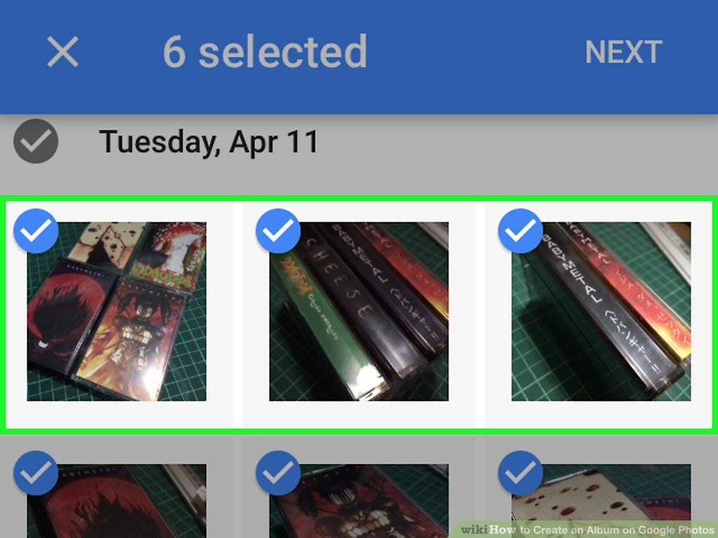
4 Tap each photo you want to add to the album. As you tap, checkmarks will fill the circles on each photo.If you change your mind about including a photo, tap it again to remove the checkmark.

Slide 17
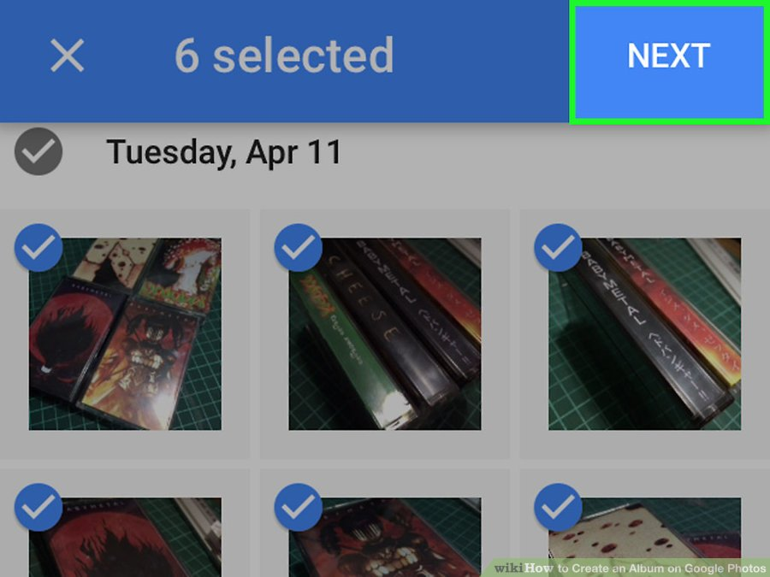
5 Tap “Next.” This link is at the top right corner of the screen. If you chose photos or videos that aren’t synced, those photos will upload now. In a few seconds, you’ll see their thumbnails, along with a text field that says “Untitled.”

Slide 18
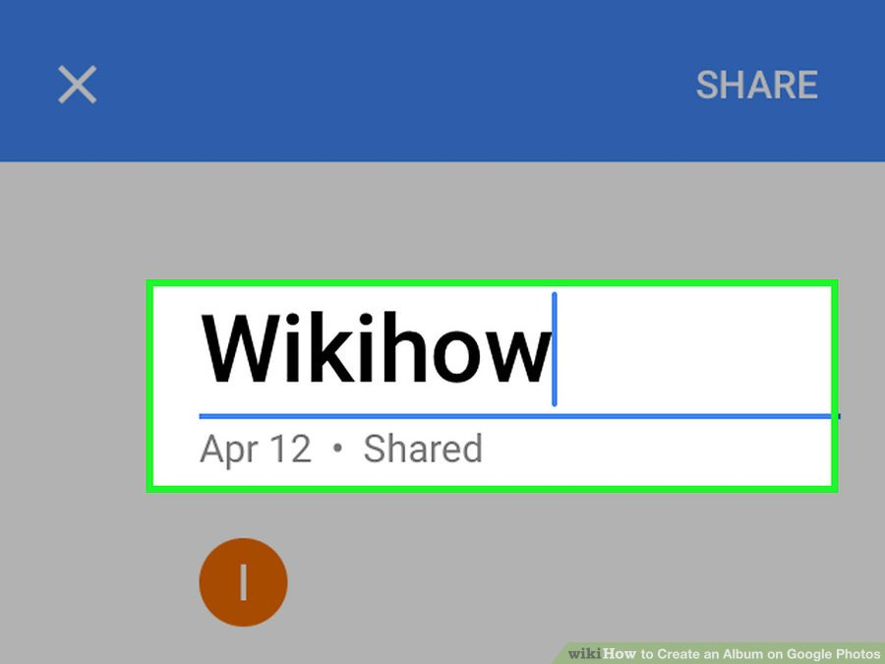
6 Type a name for the album in the text field. When you share this album with others, this is the name they will see.

Slide 19
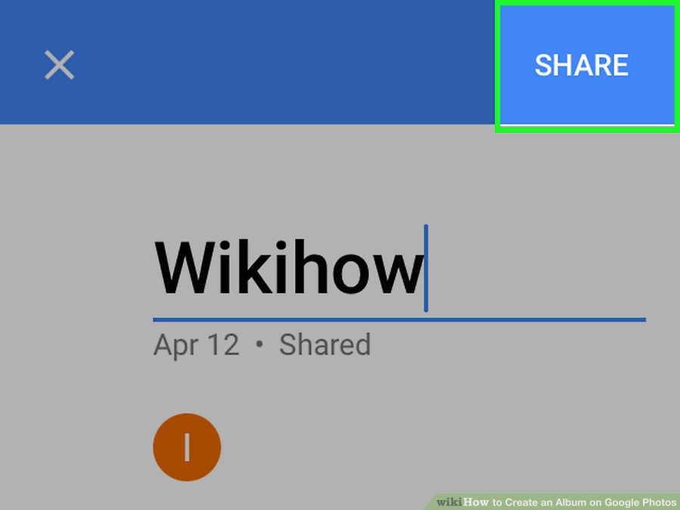
7 Tap “Share.” This link is at the top right corner. Tapping it will save the album and pop up your device’s sharing options.

Slide 20
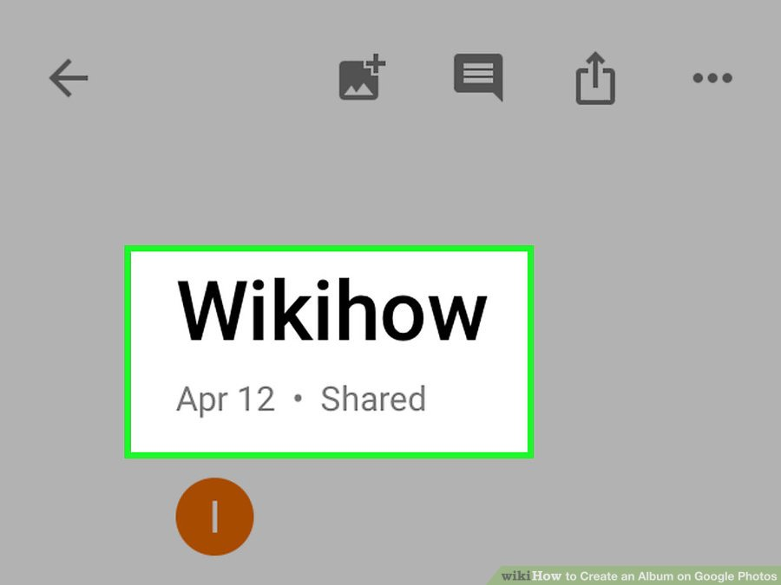
8 Tap anywhere in Google Photos except the pop-up menu. This will close the pop-up. You’ll want to do this so you can edit your sharing options before putting your album out into the world.

Slide 21
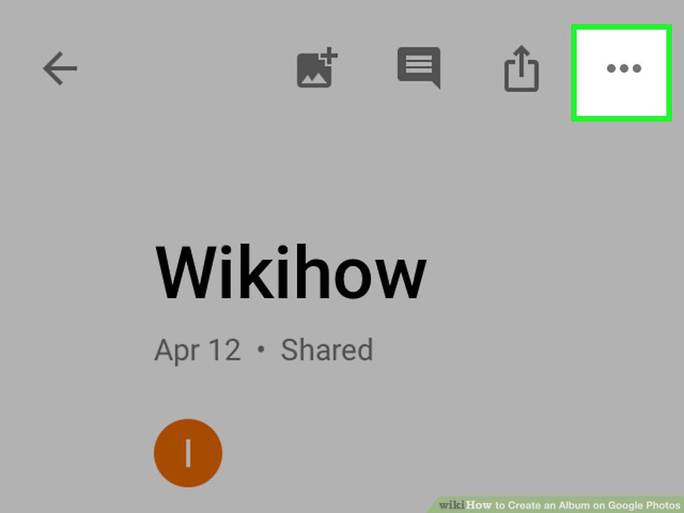
9 Tap the ⁝ menu. It’s at the top right corner of the screen. A menu will appear.

Slide 22
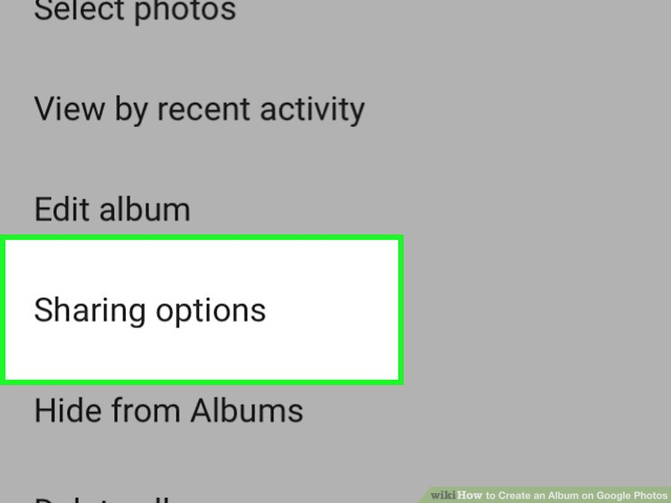
10 Tap “Sharing Options.” A new pop-up will appear, containing several options for sharing your album with others.

Slide 23
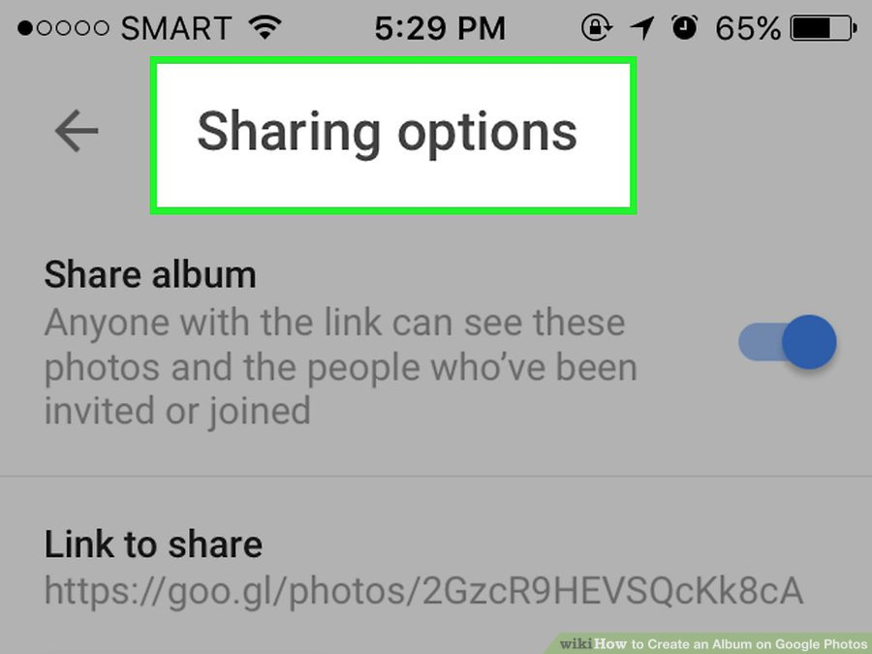
11 Set your sharing options. Adjust these options to suit your needs and then click the X to save your changes.Share: Make sure this switch is in the On position so your desired recipients can view the album. Collaborate: If you want others to add their own photos and videos to the album, enable this option. Comment: Turn on this option to allow people to comment on photos and videos in the album.

Slide 24
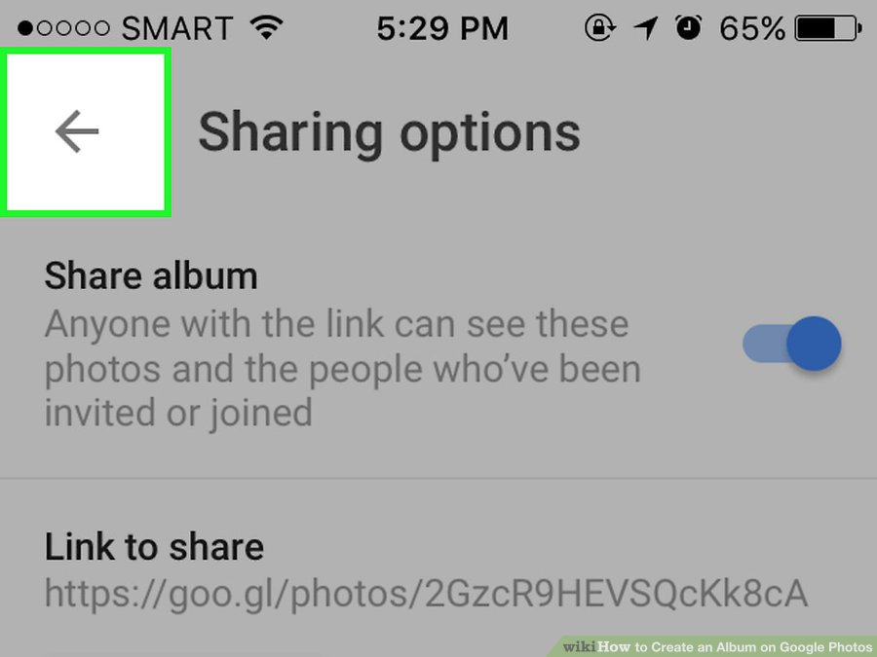
12 Tap the arrow to save your changes. Now you’ll return to the album.

Slide 25
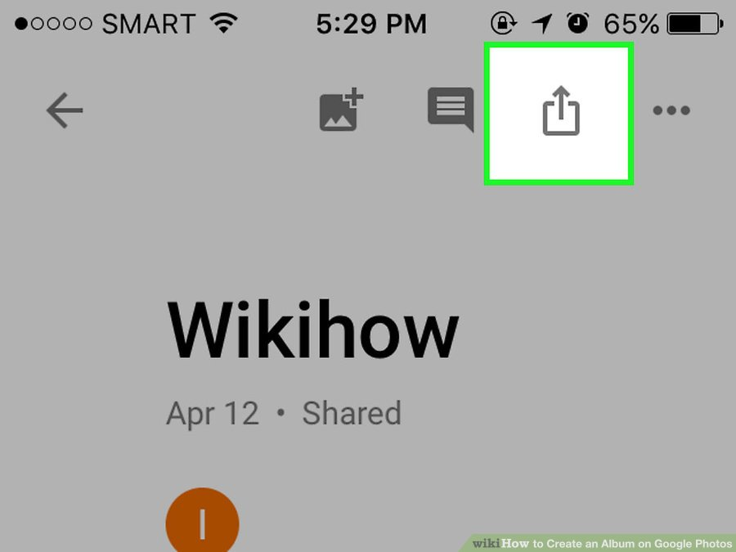
13 Tap the Share icon. It’s at the top right (next to the ⁝). On Android, it looks s like a less-than symbol (<) with dots at each of its points. On iOS devices, it’s a square with an arrow pointing up. When you click it, the Sharing pop-up menu will appear once more.^{[3]}

Slide 26
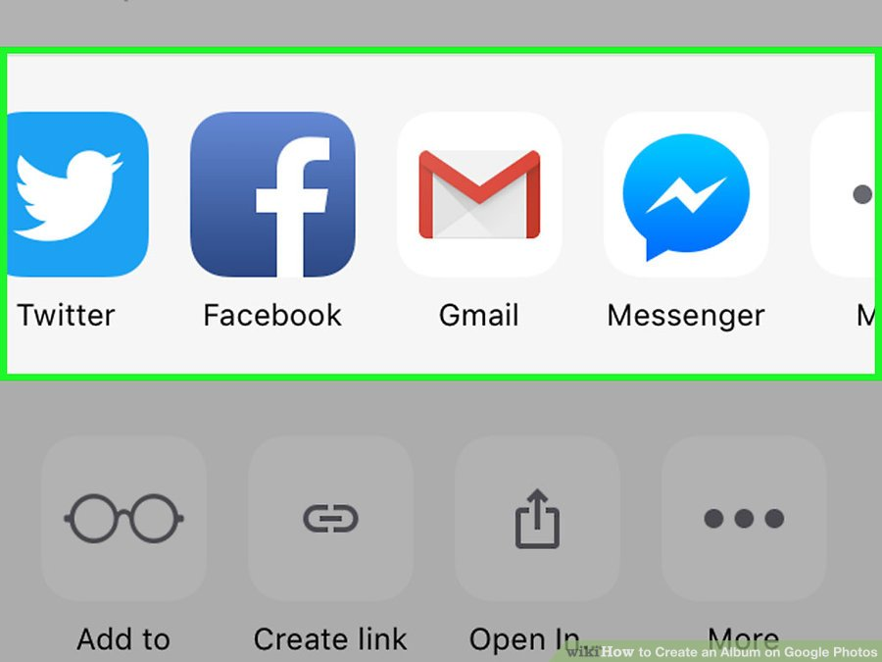
14 Share your album. Sharing options vary across devices, but here’s some tips for sharing:Tap the icon of a social media app to share with someone who also uses that service. For example, tapping Snapchat will launch the app and display your contacts—tap to select your recipients, and then send the message. The recipient(s) will receive a link to the album. Type a contact’s name, email address, or phone number in the “To” field. You can share with many contacts, if you wish. Your device will use its default messaging app to send the link to the recipient.

Slide 27
15 View your album in the future. When you open Google Photos, tap “Albums” and then this album.Add more photos to the album at any time by tapping the Add Photos icon (a square icon of a painting with a + symbol). To change your sharing options, tap the ⁝ icon and select “Sharing Options.” To share the album with additional people, tap the Share button.

Slide 28
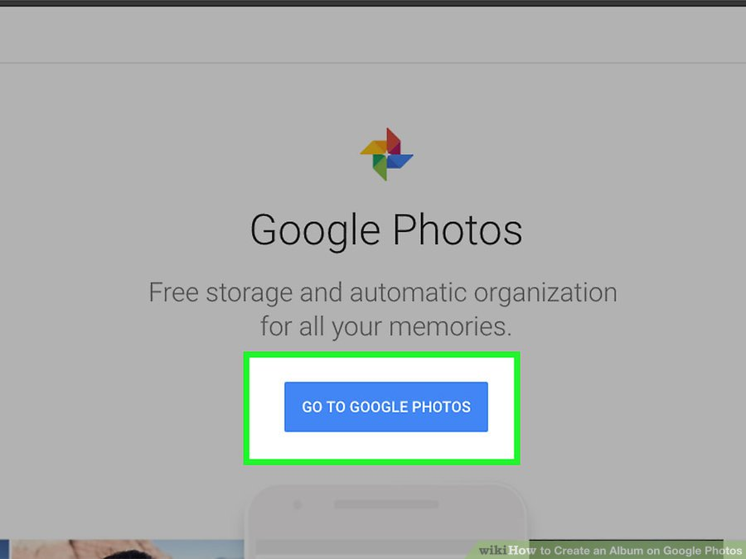
Creating a Private Album on the Web 1 Open http://photos.google.com in a web browser. You can use the Google Photos website to create a new private album for existing photos. When you visit this address, one of two things will happen:If you are not signed in to your Google account, you’ll see the “Google Photos” website, displaying a blue “Go to Google Photos” button. If you are already signed in, you’ll see a list of your photos and/or albums.

Slide 29
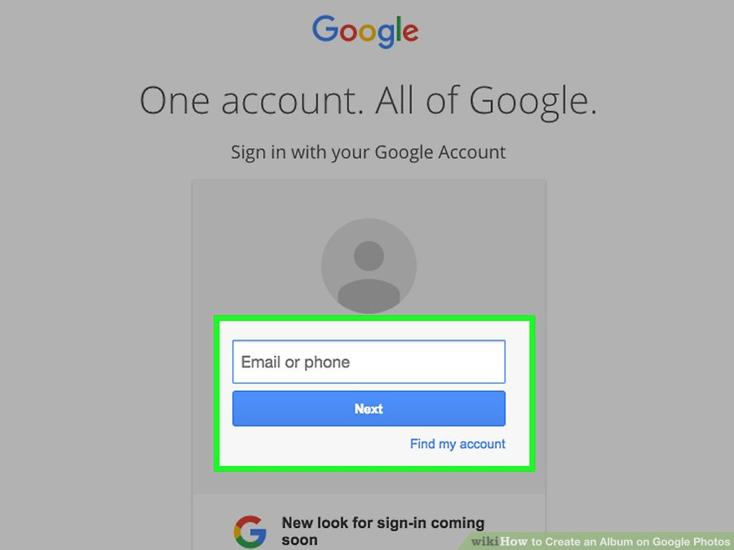
2 Sign in to Google Photos. If you’re not already signed in, click “Go to Google Photos” and then log in with your Google account information. When the password is accepted, you’ll see a list of your photos and/or albums on Google Photos.

Slide 30
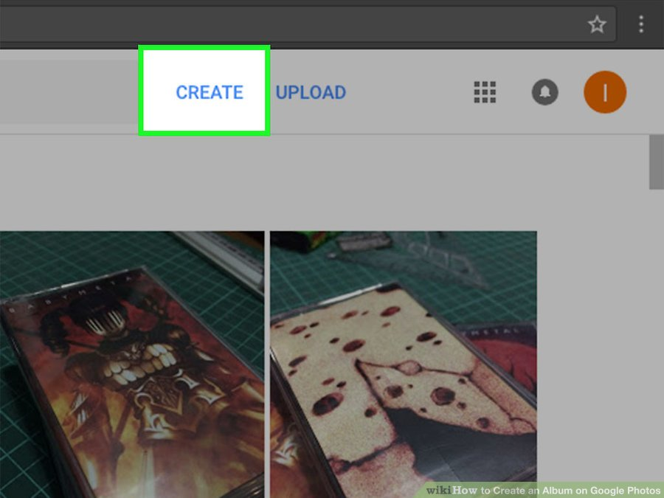
3 Click the plus (+) sign at the top of the page. It’s located to the right of the search field. You’ll see the “Create New” menu appear.

Slide 31
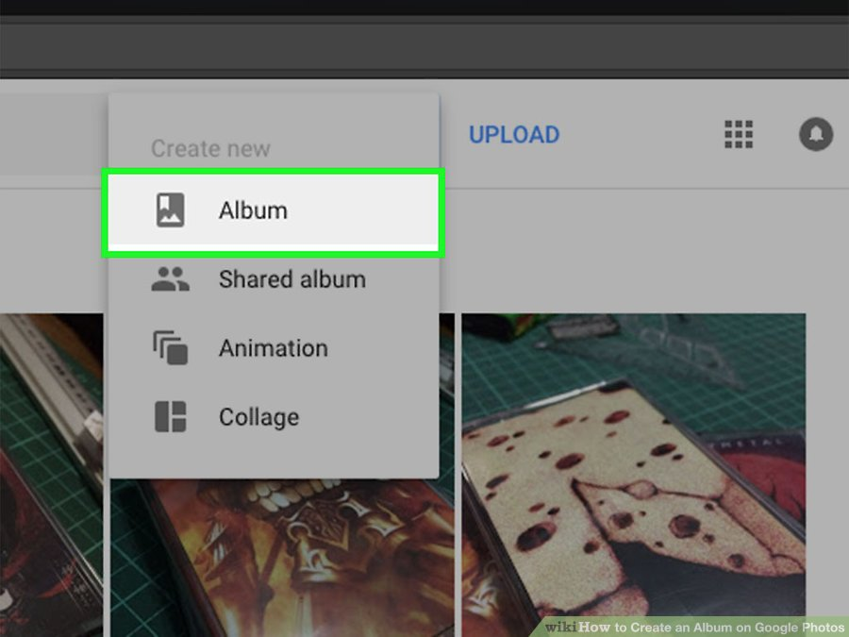
4 Click “Album” in the “Create New” menu. Now you’ll see a list of photos and/or videos already in your Google Photos account. Each photo has a circle at its top left corner.

Slide 32
5 Click each photo you want to add to the album. As you click photos, checkmarks will appear in the circle on each photo. You can click as many photos as you wish.You’ll be able to add new to this album at any time. To remove a photo from the album, click it again to remove the checkmark.

Slide 33
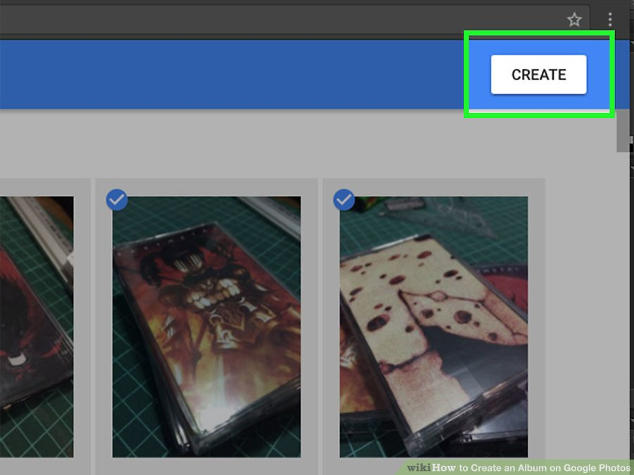
6 Click Create. The button is at the top right corner of the page. Now you’ll see thumbnails of each photos and video you selected. You’ll also see a text area that says “Untitled.”

Slide 34
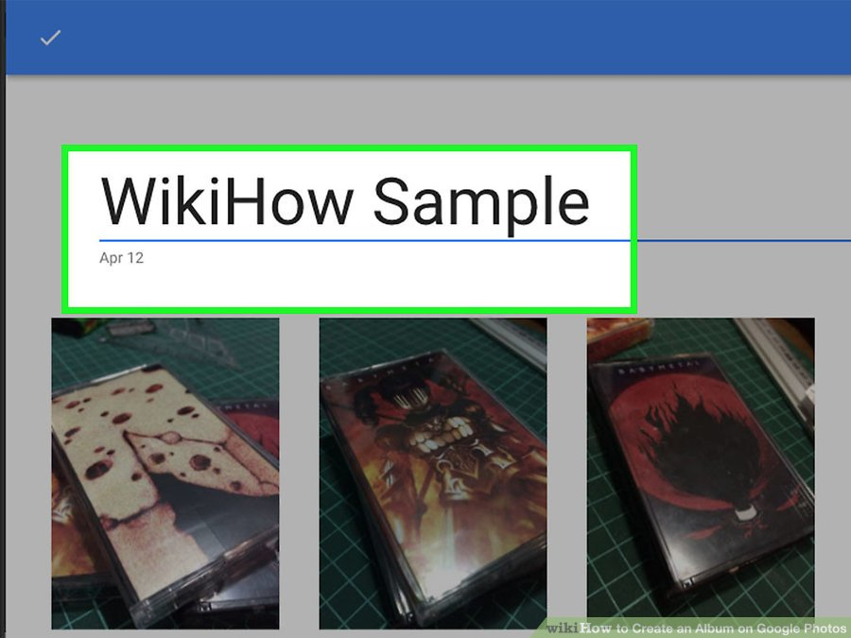
7 Type a name for the album in the text box. When you display a list of your albums in the future, each album will have a name. Give this album a name that describes what the photos have in common.

Slide 35
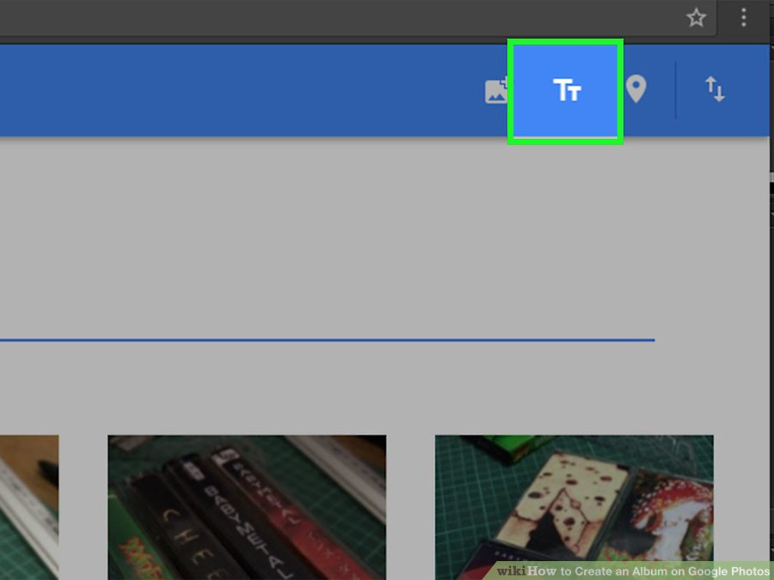
8 Add a description. This is optional, but you can click the Text icon (Tt) in the top right corner to add more text to display under the title. This is useful if you ever share the album with others and want to give some context.

Slide 36
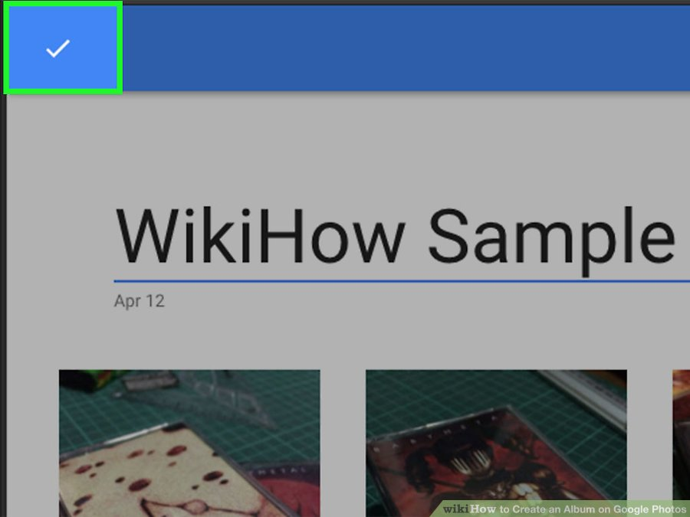
9 Click the checkmark to save the album. This checkmark is at the top left corner of the album. Once the album is saved, you’ll see a list of all of your albums.

Slide 37
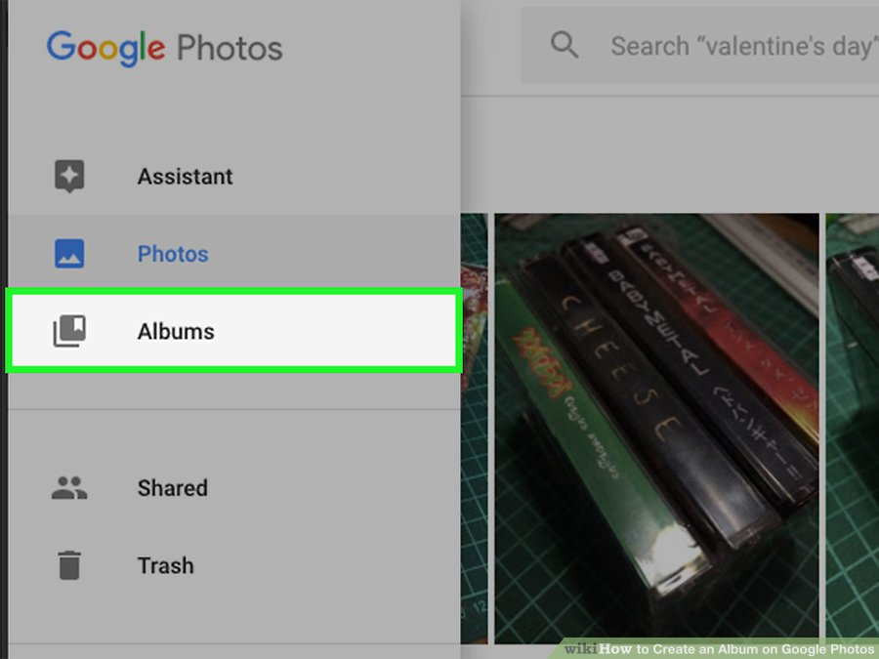
10 View the album in the future. When you sign in to Google Photos, click the ☰ menu at the top left corner of the homepage and select “Albums.” You’ll see a list of all of your albums here—just click an album to view and manage its contents.Add more photos to the album by tapping the Add Photos icon (a square icon of a painting with a + symbol).

Slide 38
Creating a Shared Album on the Web 1 Open http://photos.google.com in a web browser. You can use the Google Photos website to create a photo album to share with others. You’ll be able to control with whom the album is shared, as well as whetherother people can add to or change the album. When you go to this address, one of two things will happen:If you are not signed in to your Google account, you’ll see the “Google Photos” website, displaying a blue “Go to Google Photos” button. If you are already signed in, you’ll see a list of your photos and/or albums.

Slide 39
2 Sign in to Google Photos. If you’re not already signed in, click “Go to Google Photos” and then log in with your Google account name and password. When the password is accepted, you’ll arrive to your list of photos and/or albums on Google Photos.

Slide 40
3 Click the plus (+) sign at the top of the page. It’s located to the right of the search field. The “Create New” menu will appear.

Slide 41
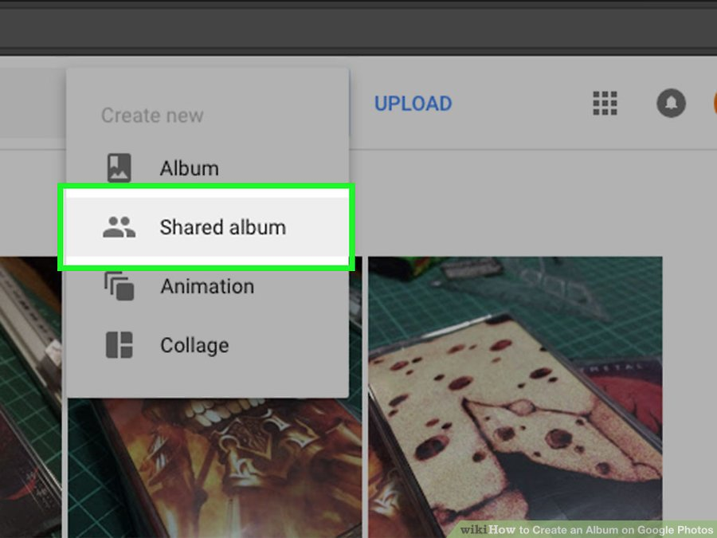
4 Click “Shared Album” in the “Create New” menu. Now you’ll see a list of photos and/or videos already uploaded to your Google Photos account. Each photo has a circle at its top left corner.

Slide 42
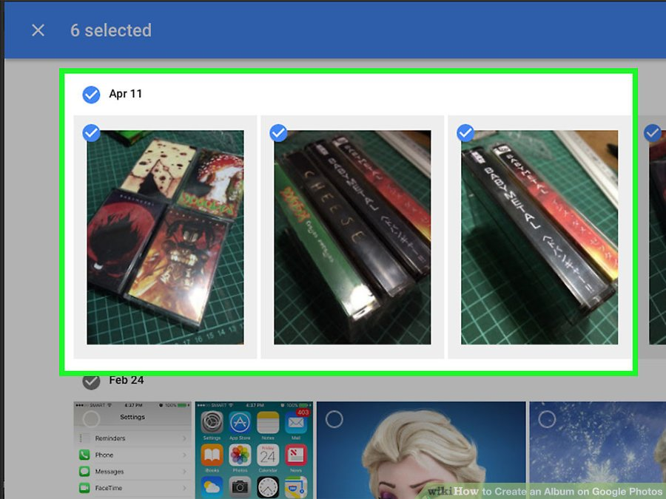
5 Click each photo you want to add to the album. As you click photos, checkmarks will fill the circles on each photo. Click as many photos as you wish.You’ll be able to add new photos to this album in the future. If you change your mind about including a photo, click it once more to remove the check mark.

Slide 43
5 Click each photo you want to add to the album. As you click photos, checkmarks will fill the circles on each photo. Click as many photos as you wish.You’ll be able to add new photos to this album in the future. If you change your mind about including a photo, click it once more to remove the check mark.

Slide 44
6 Click Create. The button is located at the top right corner of Google Photos. Now you’ll see the album page, which displays thumbnails of each photos and video you selected. You’ll also see a text area that says “Untitled.”

Slide 45
7 Type a name for the album in the text box. Give the album a name that applies to its contents. When you share this album with others, this is the name they will see.

Slide 46
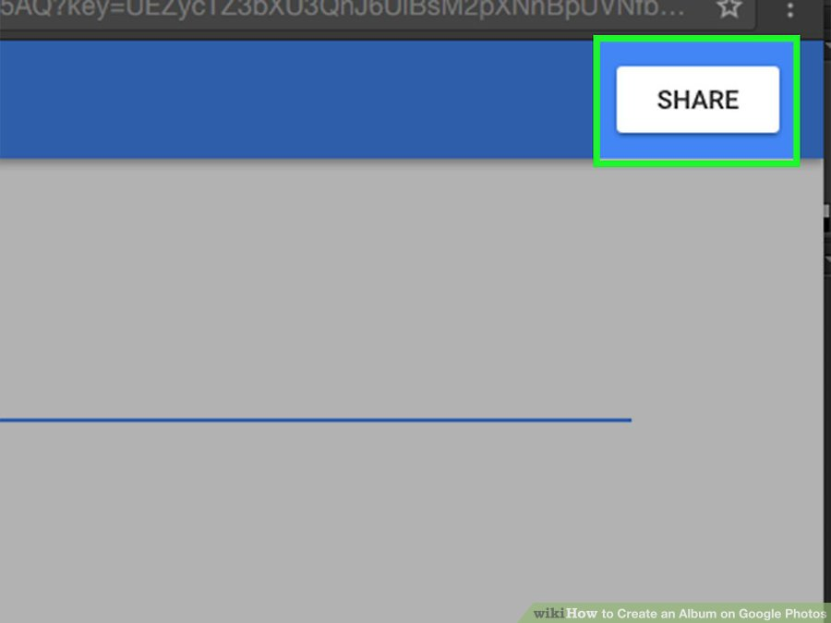
8 Click Share. This button is at the top right corner of the album. Clicking it will save the album and pop up a menu that has several sharing options.

Slide 47
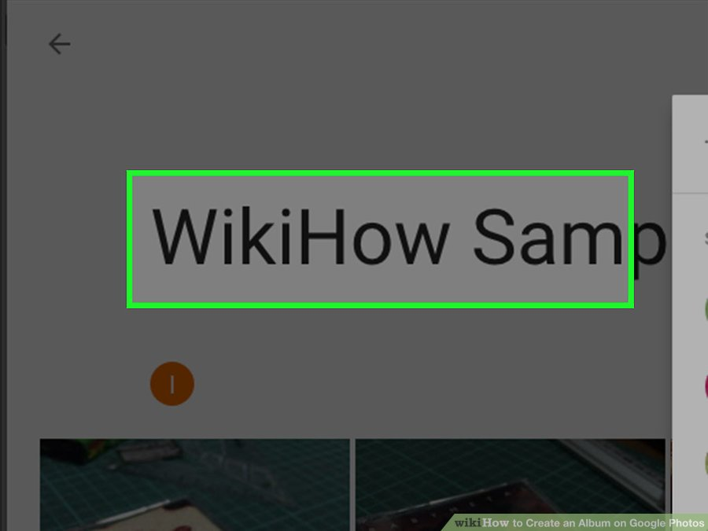
9 Click anywhere in Google Photos except the pop-up menu. This will close the pop-up. You’ll want to do this so you can edit your sharing options before putting your album out into the world.

Slide 48
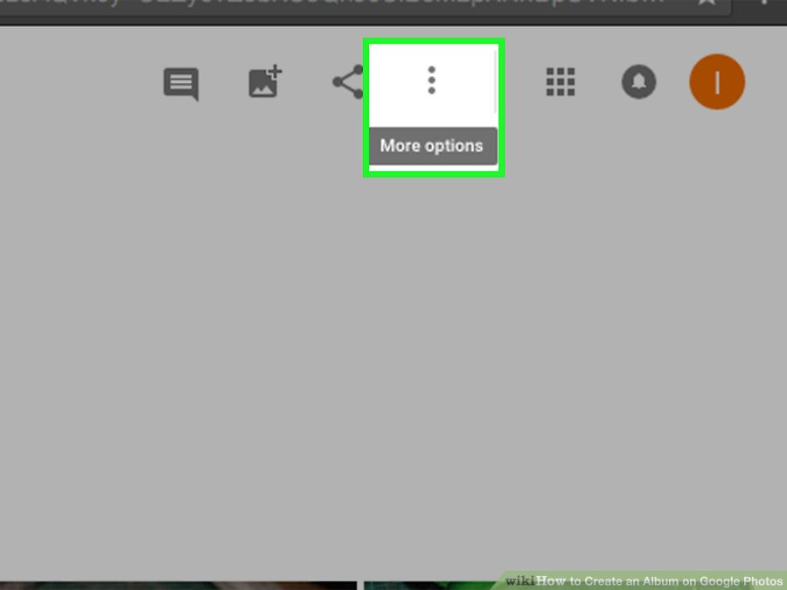
10 Click the ⁝ menu. It’s at the top right corner of the screen. A menu will appear.

Slide 49
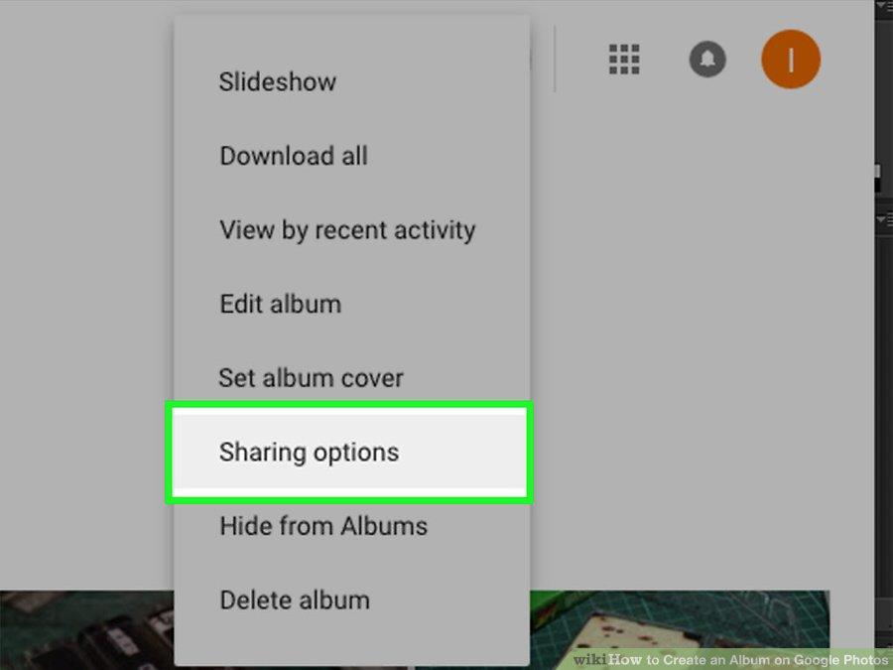
11 Click “Sharing Options.” A new pop-up will appear, containing several options for sharing your album with others.

Slide 50
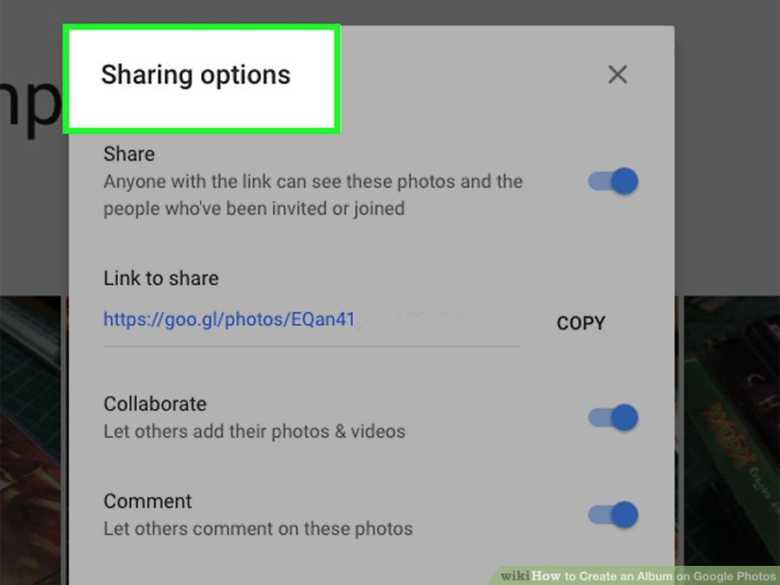
12 Set your sharing options. Adjust these options to suit your needs and then click the X to save your changes.Share: Make sure this switch is in the On position so your desired recipients can view the album. Collaborate: If you want others to add their own photos and videos to the album, enable this option. Comment: Turn on this option to allow people to comment on photos and videos in the album.

Slide 51
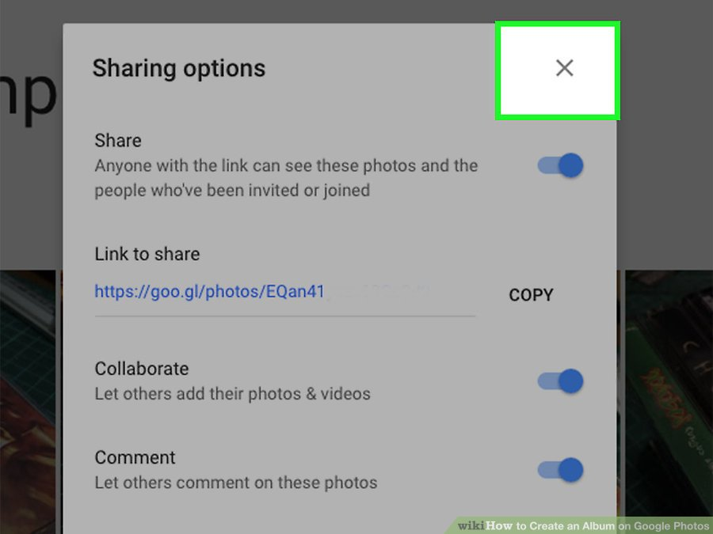
13 Click the X to save your sharing options. Now you’ll return to the album.

Slide 52
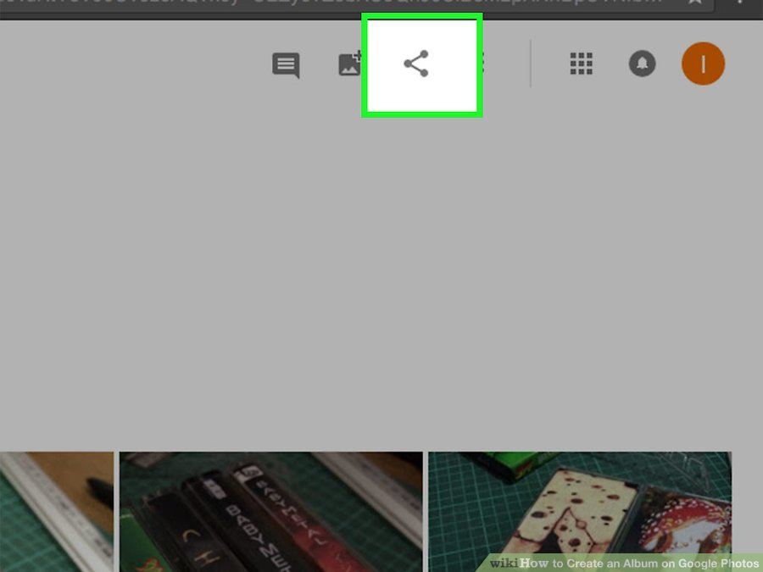
14 Click the Share button. This button is at the top right area of the screen and looks like a less-than symbol (<) with dots at each of its points. When you click it, the Sharing pop-up menu will appear.

Slide 53
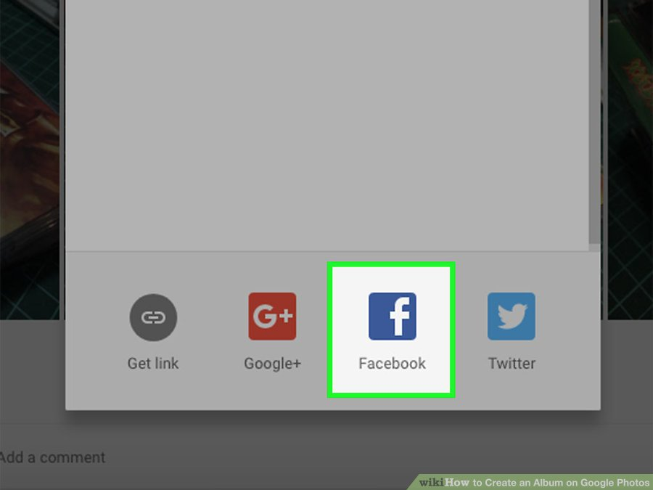
15 Type or click the email address of someone with whom you want to share photos. You can add more than one address to share with multiple people.If you prefer, click “Get Link” to generate a URL to share with others over email or social media. Only those with this link will know that the album exists. You could also click a social media icon, such as Facebook or Twitter, to share the album through that service.

Slide 54
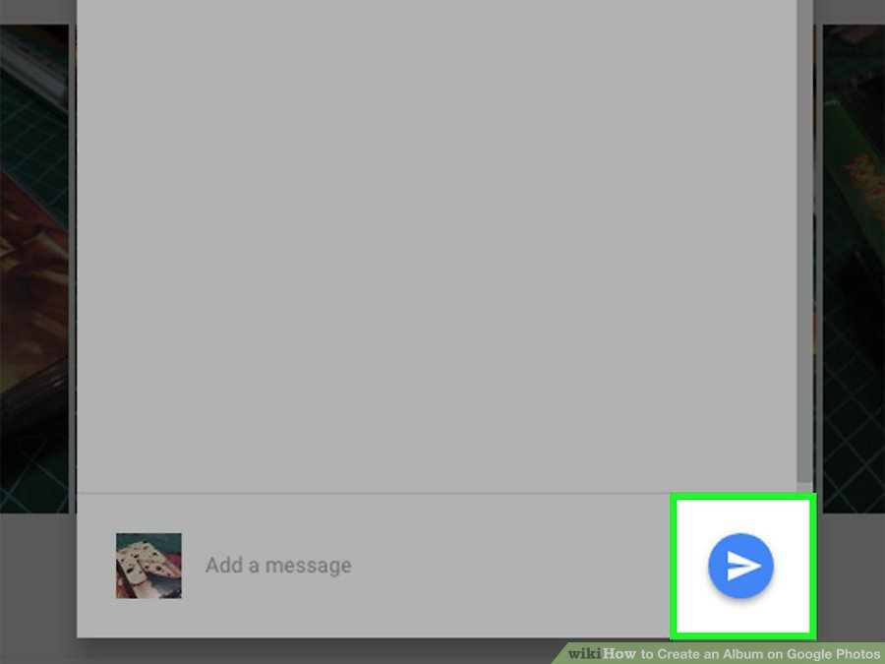
16 Click the Send button. This is the blue paper airplane icon at the bottom right corner of the pop-up. This will send your chosen recipients an email containing a link to the album. When a recipient clicks the link, they’ll see the album in all its glory.

Slide 55
17 View your album in the future. When you sign in to Google Photos, click the ☰ menu at the top left corner of the homepage and select “Albums.” You’ll see a list of all of your albums here—just click an album to view and manage its contents.^{[4]}To change your sharing options, click ⁝ and select “Sharing Options.” To share the album with other people, open the album and click the Share button. Add more photos to the album at any time by tapping the Add Photos icon (a square icon of a painting with a + symbol).

Slide 56
And now open https://photos.google.com The email of our photo album is: open.europe.open.hearts@gmail.com password: erasmus+project

