Slide 1

KA2
Cooperation for Innovation and the Exchange of Good Practices
KA219 - Strategic Partnerships for Schools Only
01.09.2017 - 31.08.2019

Slide 2

Participating organisations
CEIP Reyes Católicos , Melilla – Spania, coordinator
AkdenizIlkokulu, Anamur -Turcia
Radost 20 Kindergarten, Dobrich – Bulgaria
Kohtla-JärveLasteaedTareke, Kohtla-Järve – Estonia
Școala Gimnaziala Nr. 28, Galați – România

Slide 3
"DESIGNING ONLINE CALENDAR”
C4-Short-term joint staff training events
15th to 19th October, 2018

Slide 4

Learning objectives:
Learn what is Google calendar;
Learn about how to create an account;
Understand the Google Calendar interface and layout;
Learn about how to create your Google Calendar Events;

Slide 5
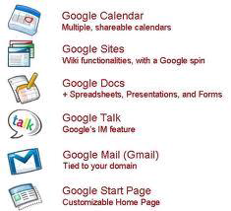
What is Google Calendar ?
Google Calendar is one of the Google Applications available online.

Slide 6
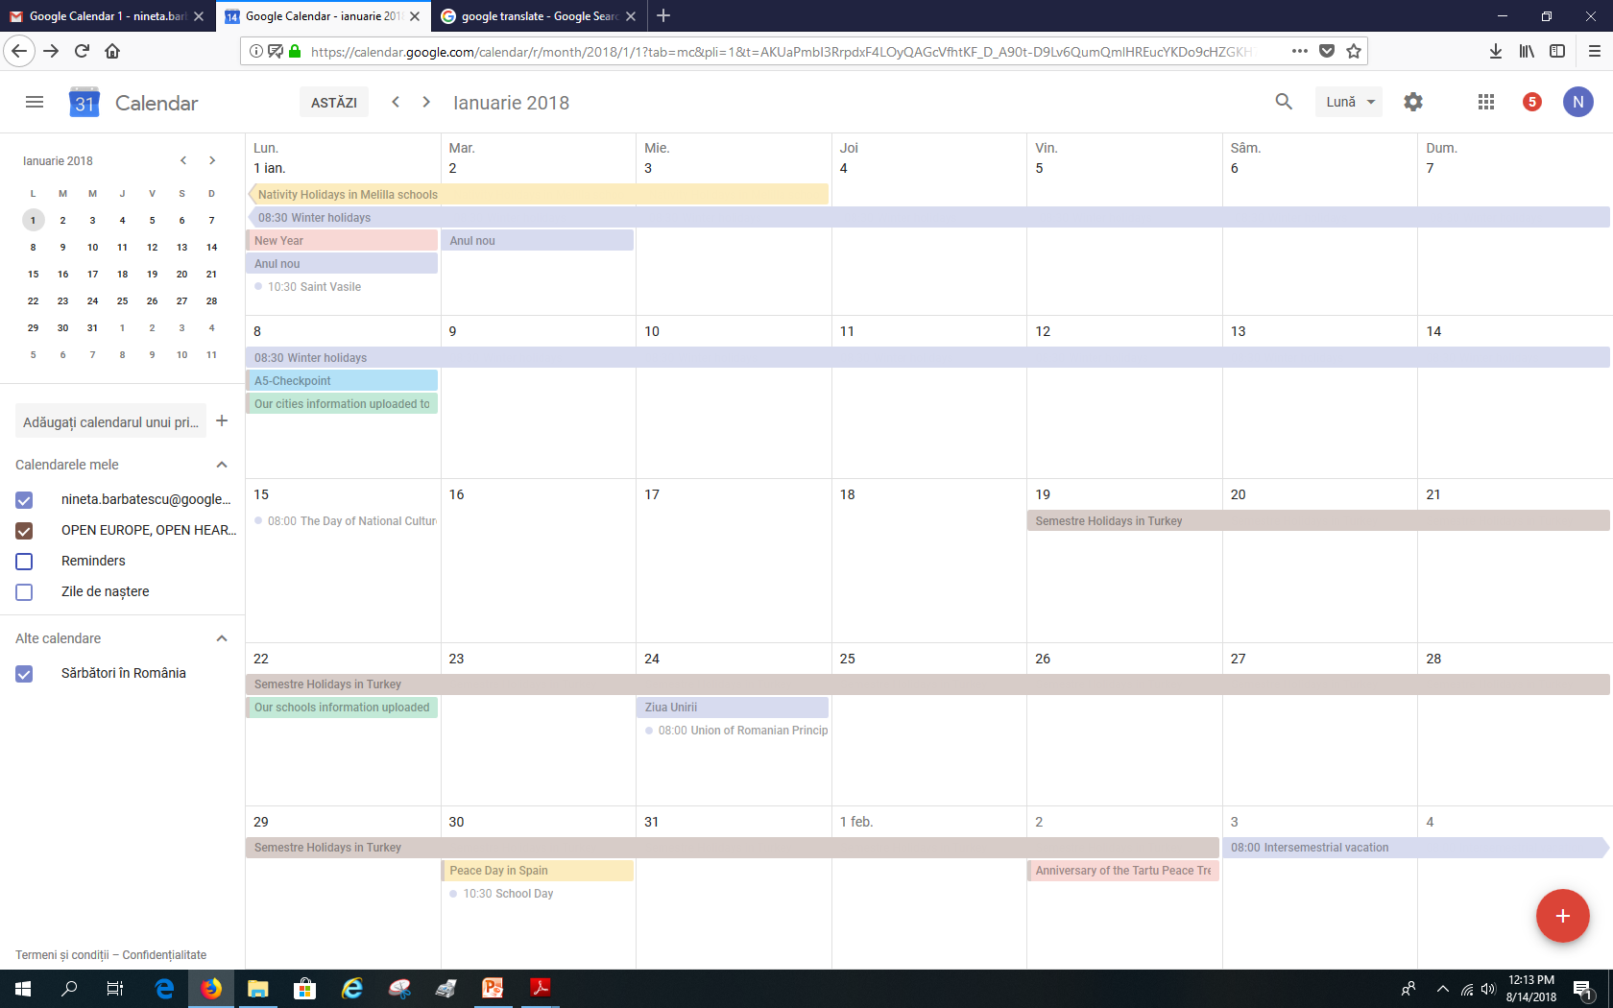
It is a free Internet calendar that lets you keep track of your own events and share your calendars with others

Slide 7

It became available on April 13, 2006, and exited the beta stage in July 2009.

Slide 8
7 reasons to use Google Calendar:
Share your schedule
Get your calendar on the go
Never forget another event again
Send invitations and track RSVPs
Sync with your desktop applications
Work offline
It’s free.

Slide 9
Google “Google Calendar”

Slide 10
Or go to this link…
www.google.com/calendar

Slide 11
Prior creating an event, you are REQUIRED to create an account

Slide 12
There are 2 ways of creating your Google Calendar account.
1.Create it by using your GMAIL account (just 2 easy steps);
2.Create it by using your other EMAIL account .

Slide 13
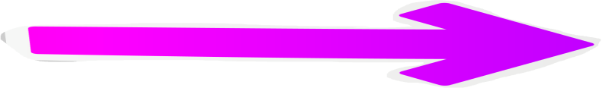
Enter your Gmail account

Slide 14
Enter your Password

Slide 15
Click Sign-in

Slide 17

Click“ ” “icon

Slide 18

Click “Calendar”
Click “Calendar
Click “Calendar

Slide 19
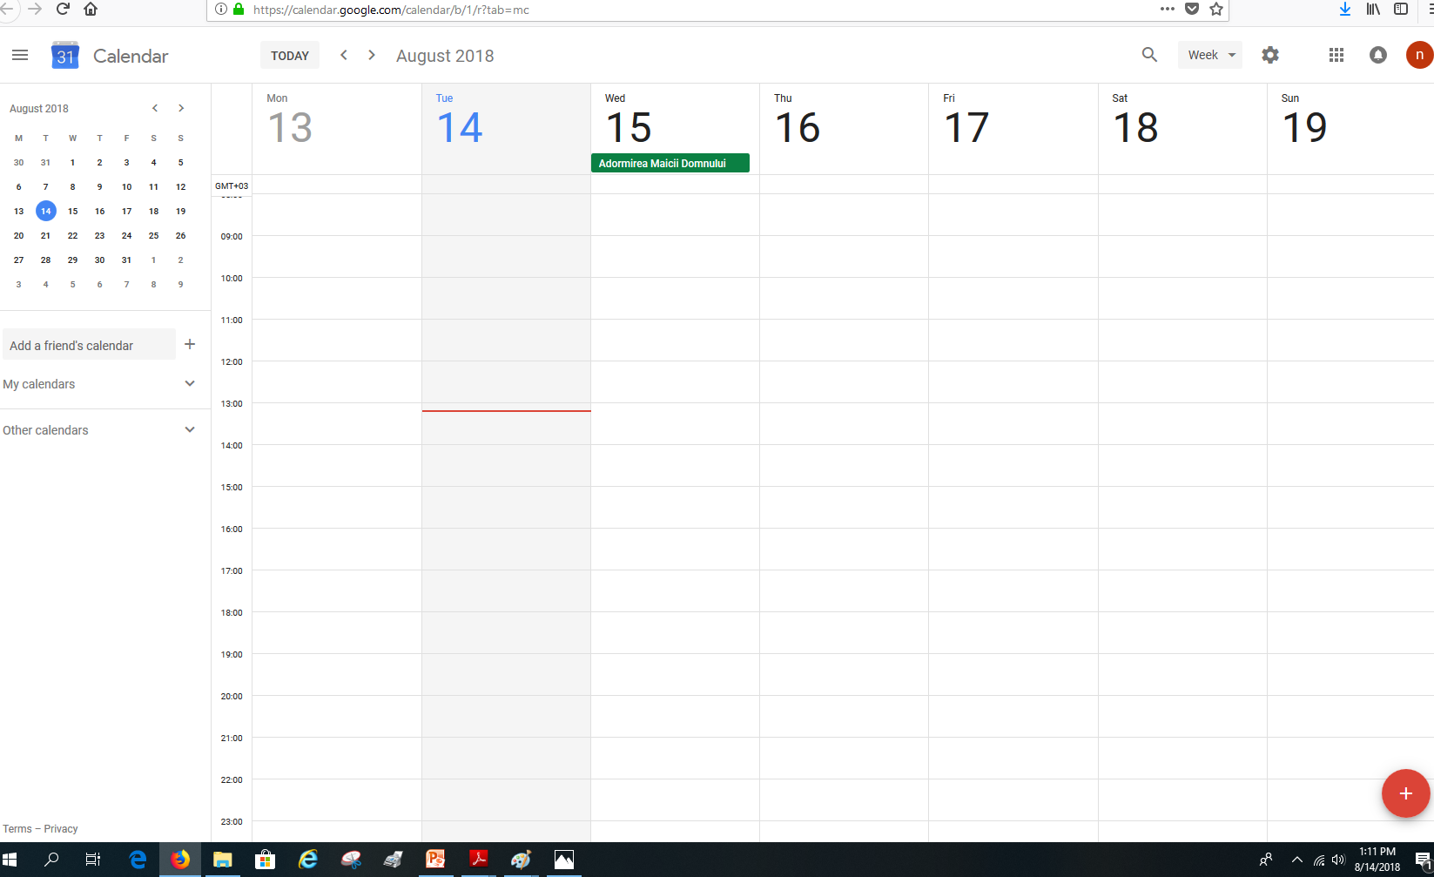
A new page appear and that’s your calendar page
Click “Calendar
Click “Calendar

Slide 20
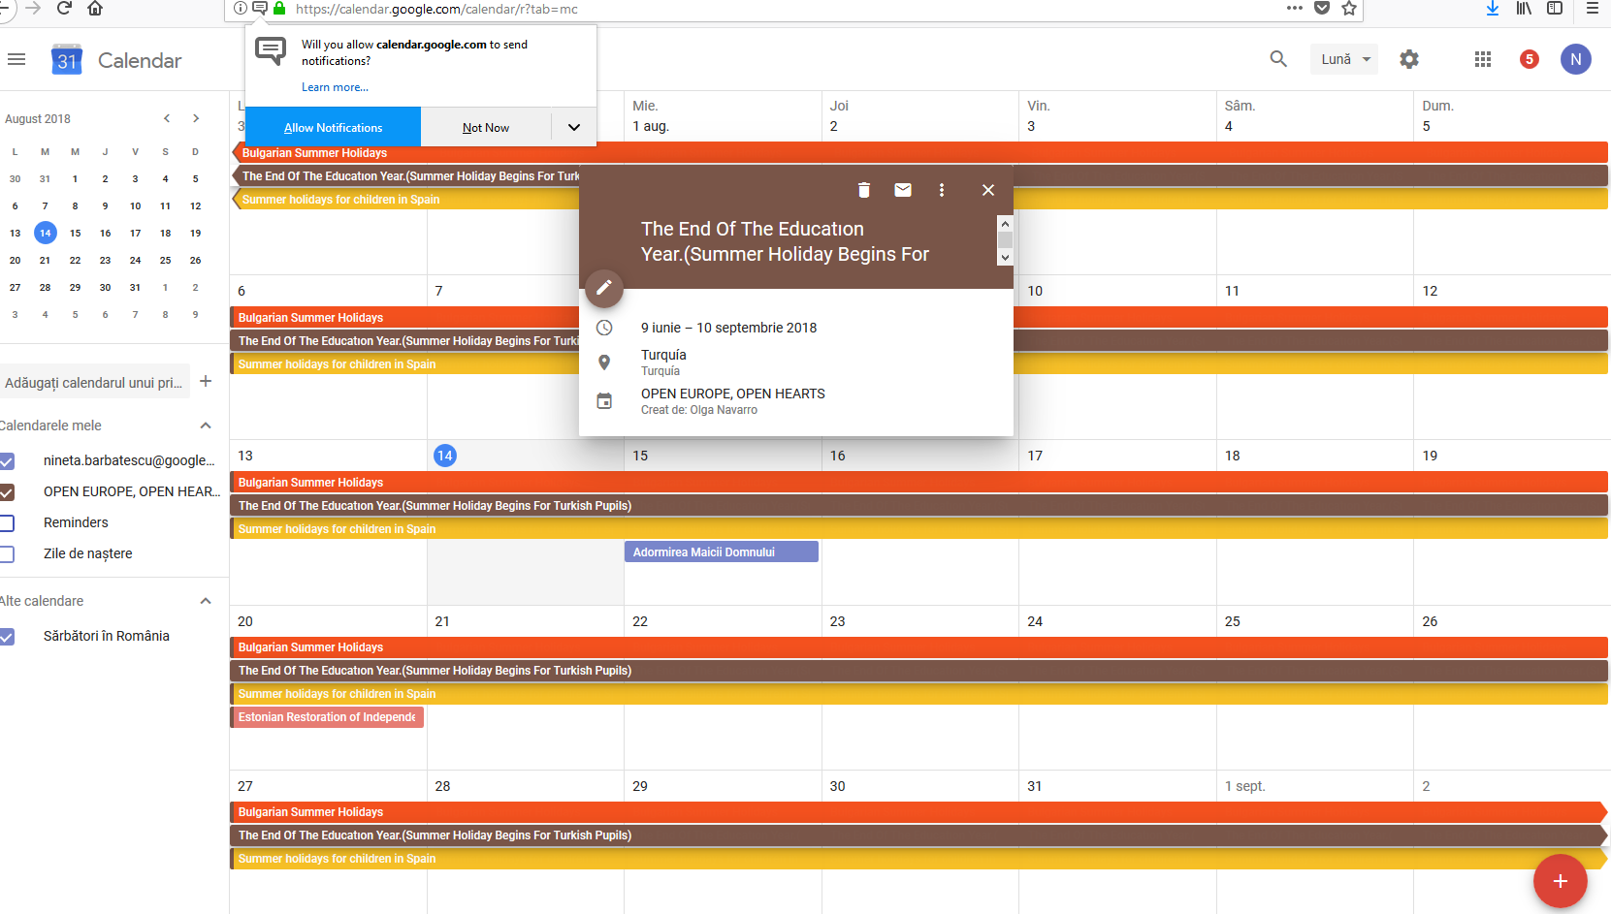
The Calendar Layout
Calendar views
Month preview
Month Preview
Events details
Click “Calendar
Click “Calendar
Notes/ All day events
List of calendar
List of calendar

Slide 21


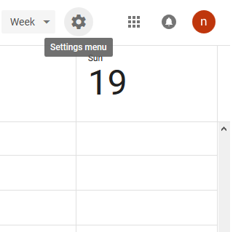
Before you enter your event, you need to select your Country and Time Zone first
Click “Settings” menu
Then, select Settings

Slide 22
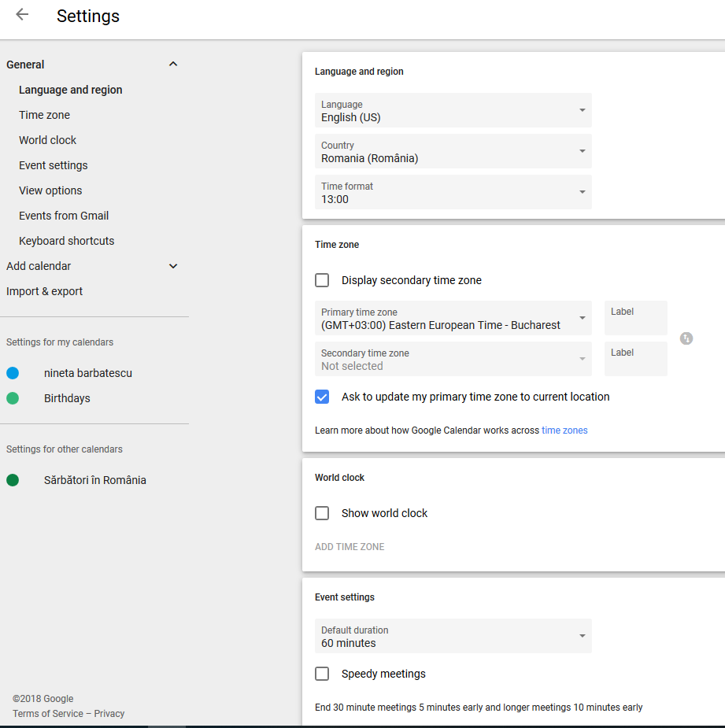
This will appear. Calendar Settings

Slide 23

Select your language

Slide 24

Select your country.
Selecting the country will automatically configure your time zone.

Slide 25
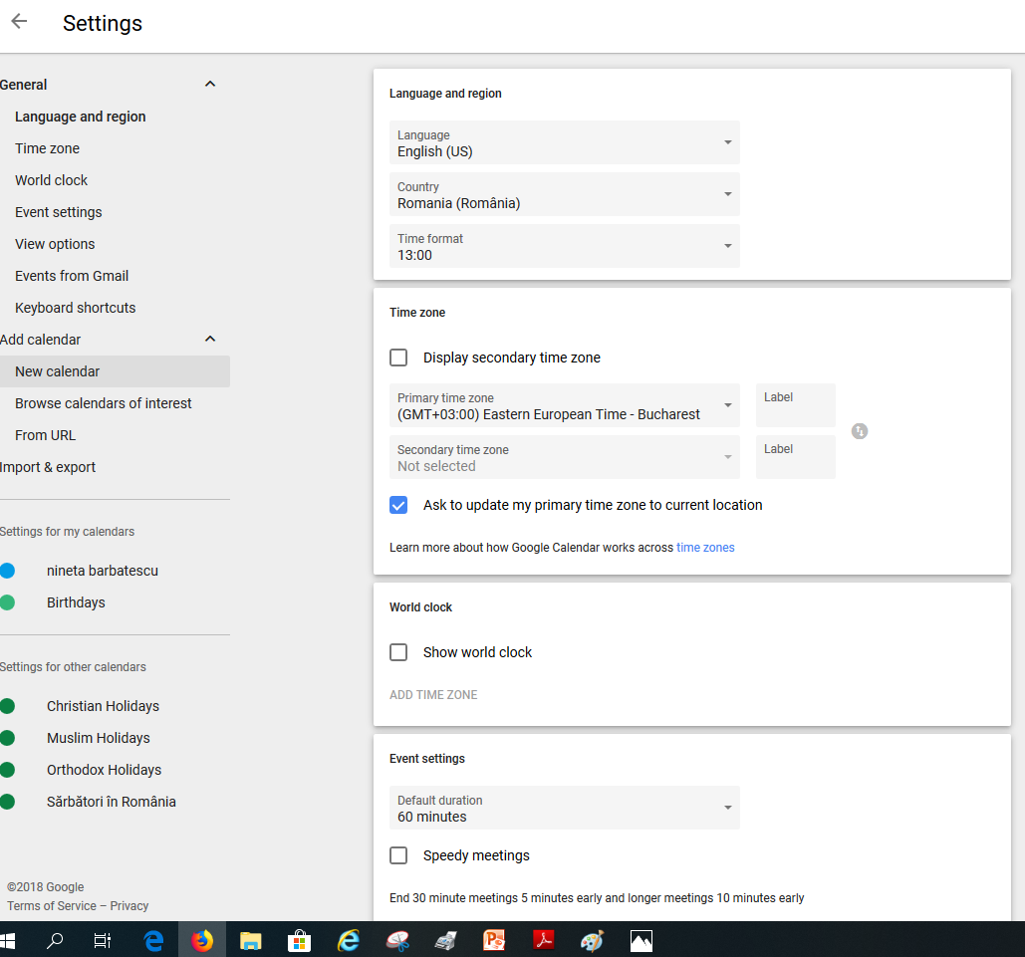

Add calendar
Add calendar →New calendar

Slide 26



Fiil out name, description of the callendar
After, press the button” Create calendar”

Slide 27

Each calendar you create appears under My Calendars list.

Slide 28
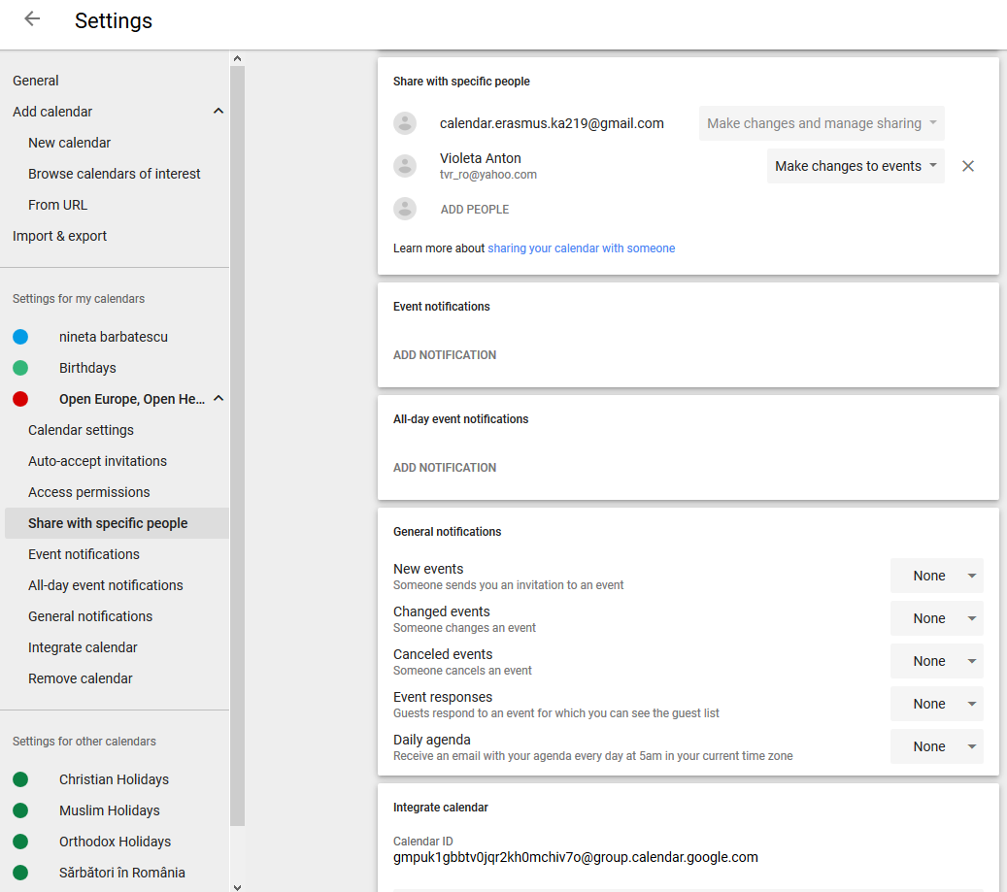
Enter friend’s email if you want to invite

Slide 29
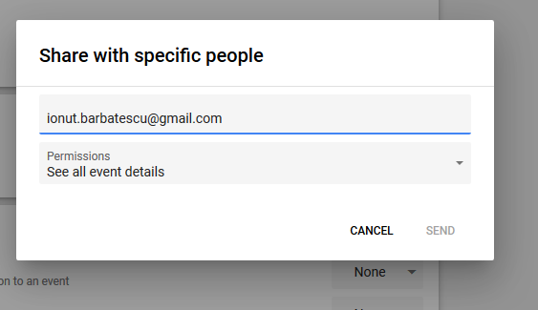


Enter friend’s email if you want to invite, chose the permision you gave and press “Send”

Slide 30
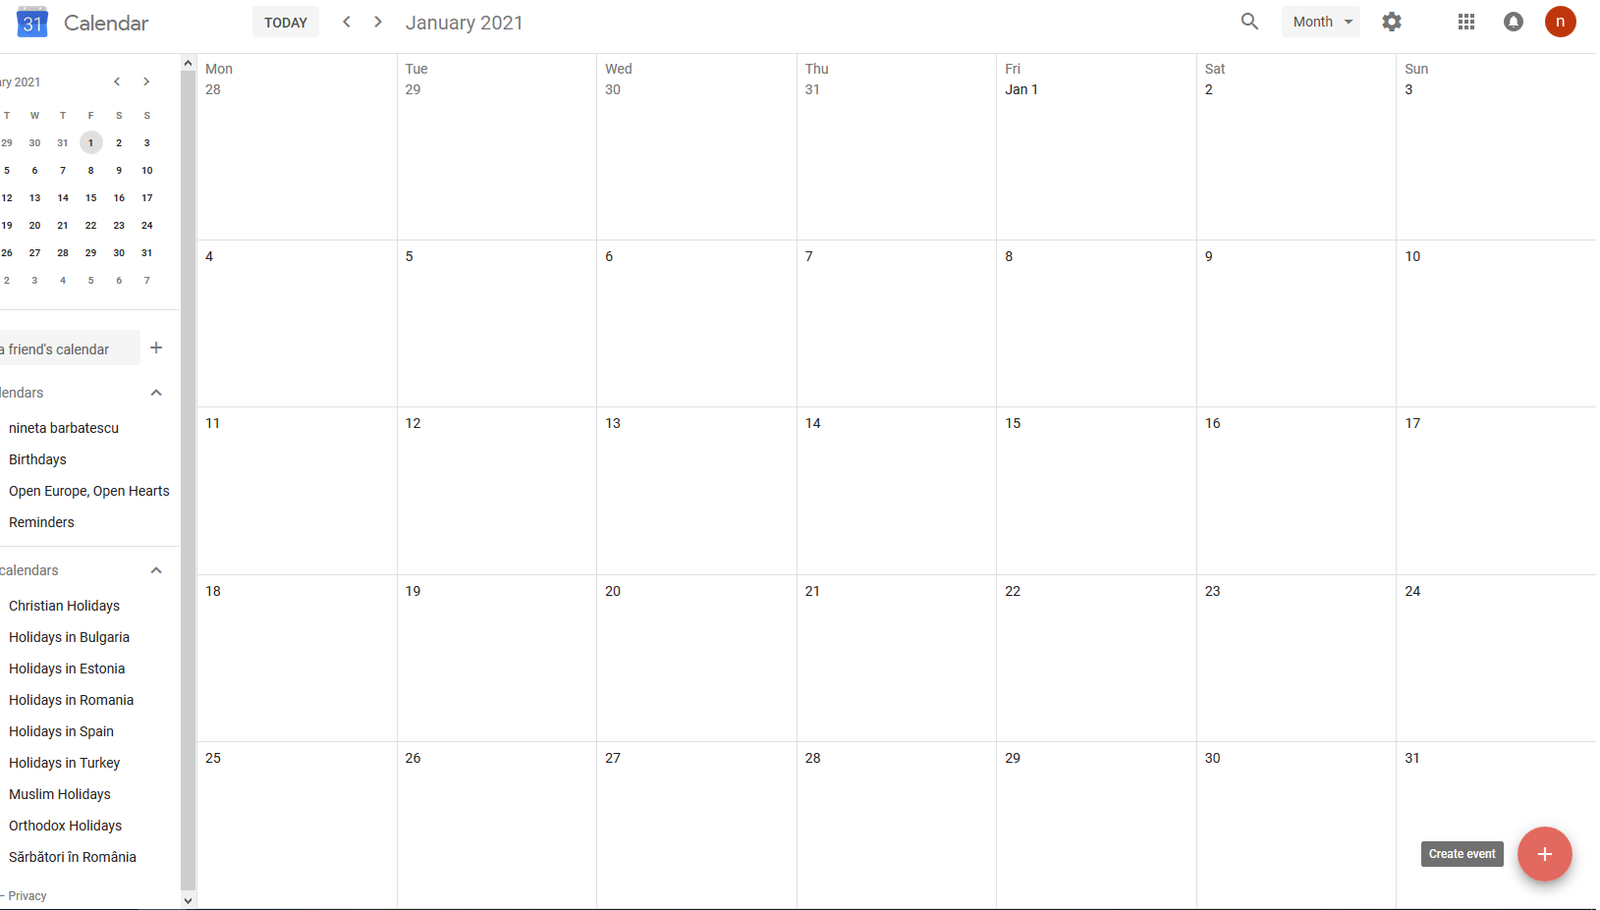
Create “Events”- click “create events”

Slide 31
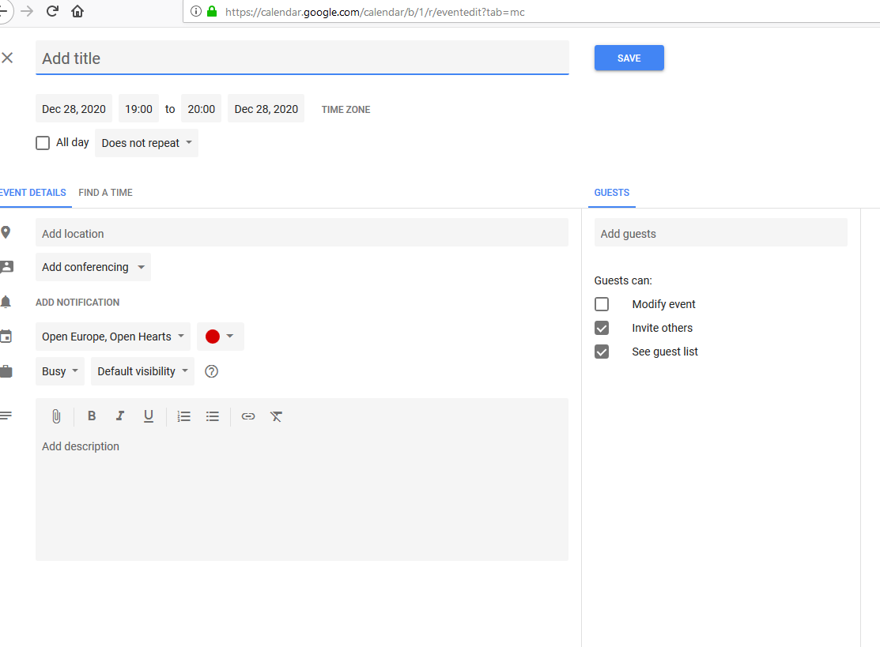
This will appear…

Slide 32
Fill out all the details regarding your event

Slide 33
Once done, click “Save”

Slide 34

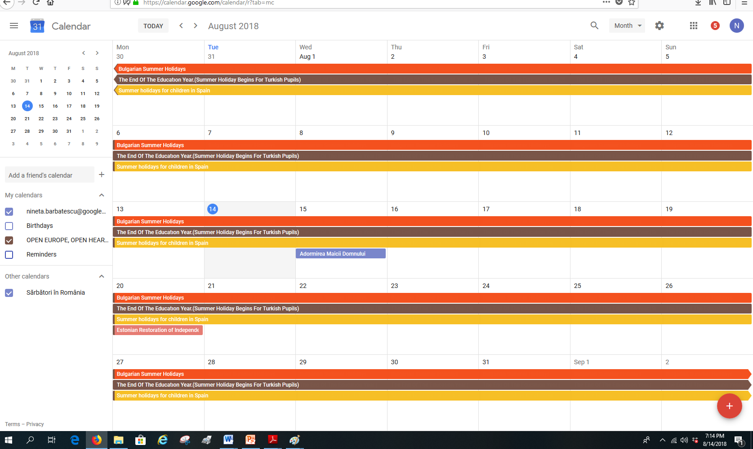
Now, you can see your event

Slide 35

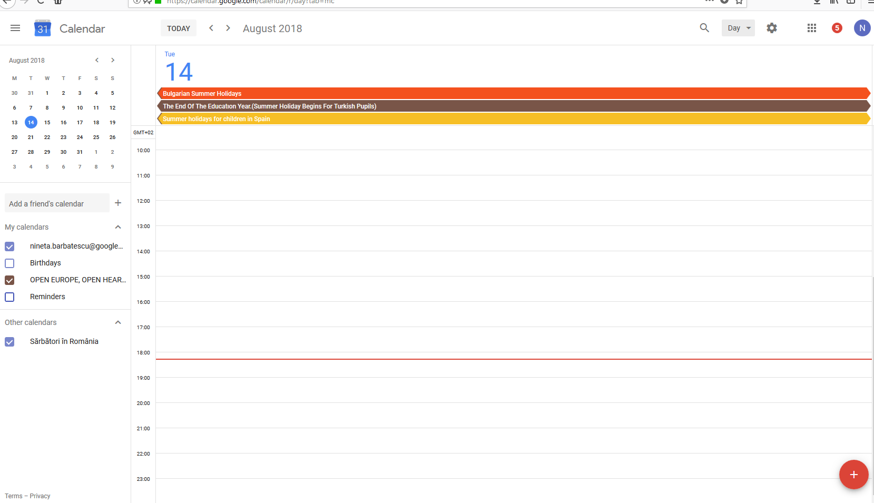
You can view your events in “Day”

Slide 36

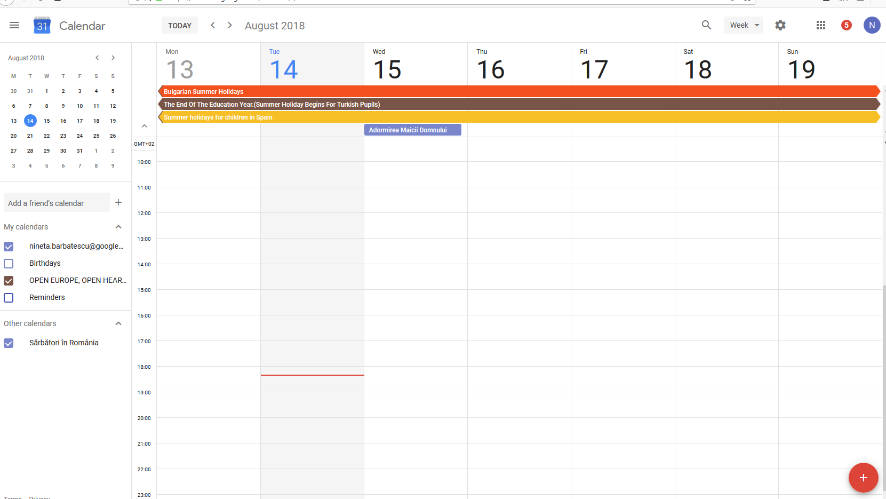

You can have it per “week”

Slide 37
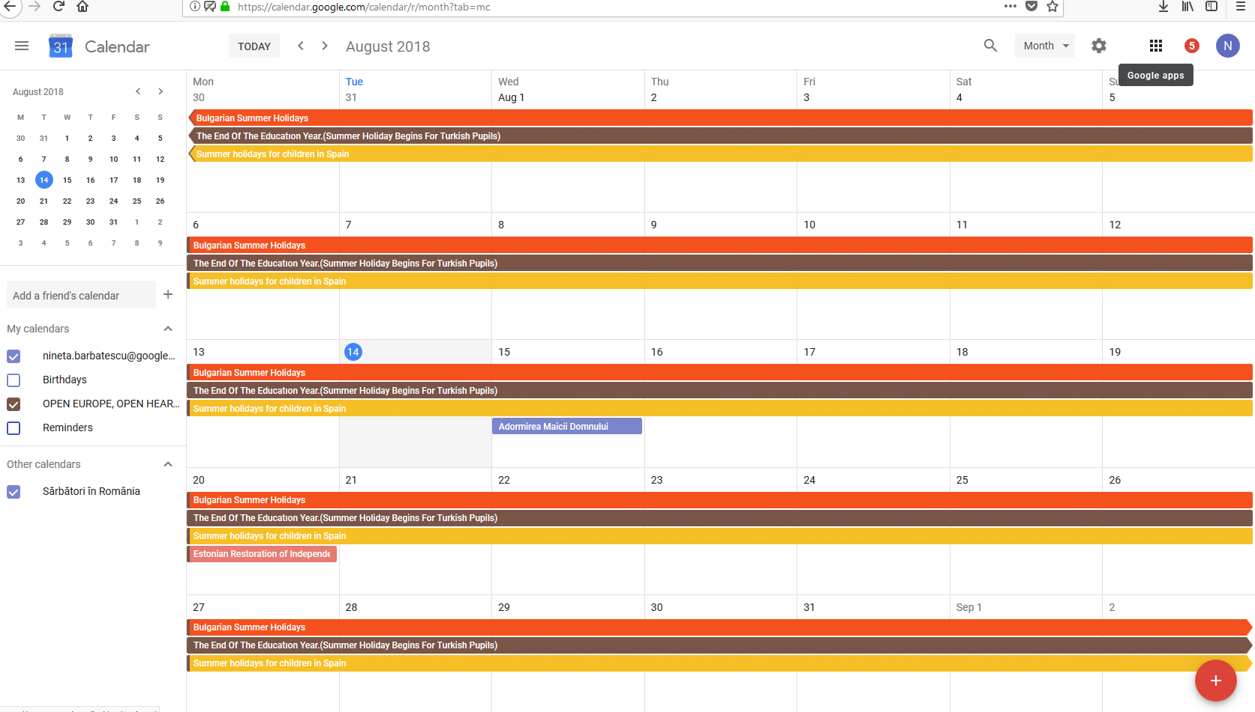
Or “Month”

Slide 38
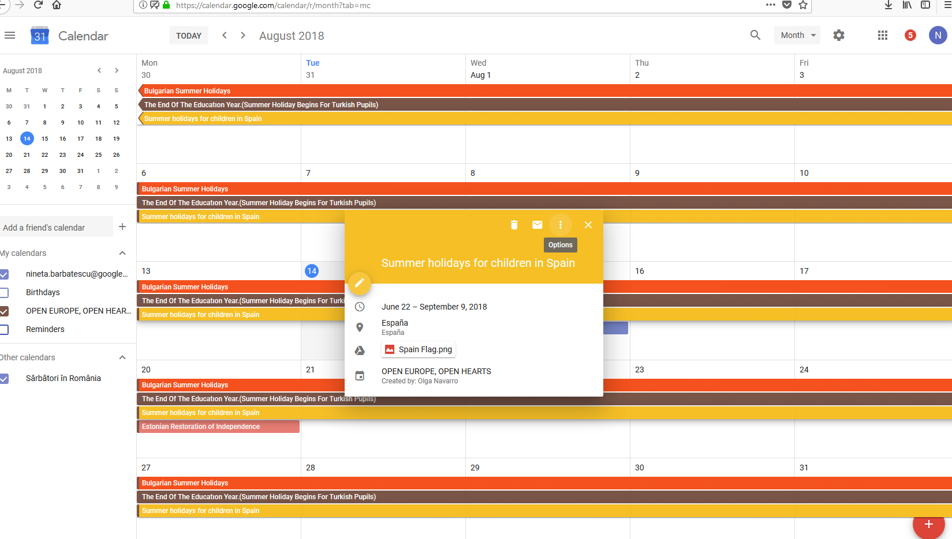

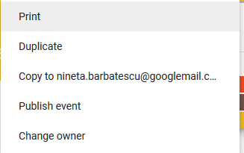
Printing your calendar- a single events

Slide 39
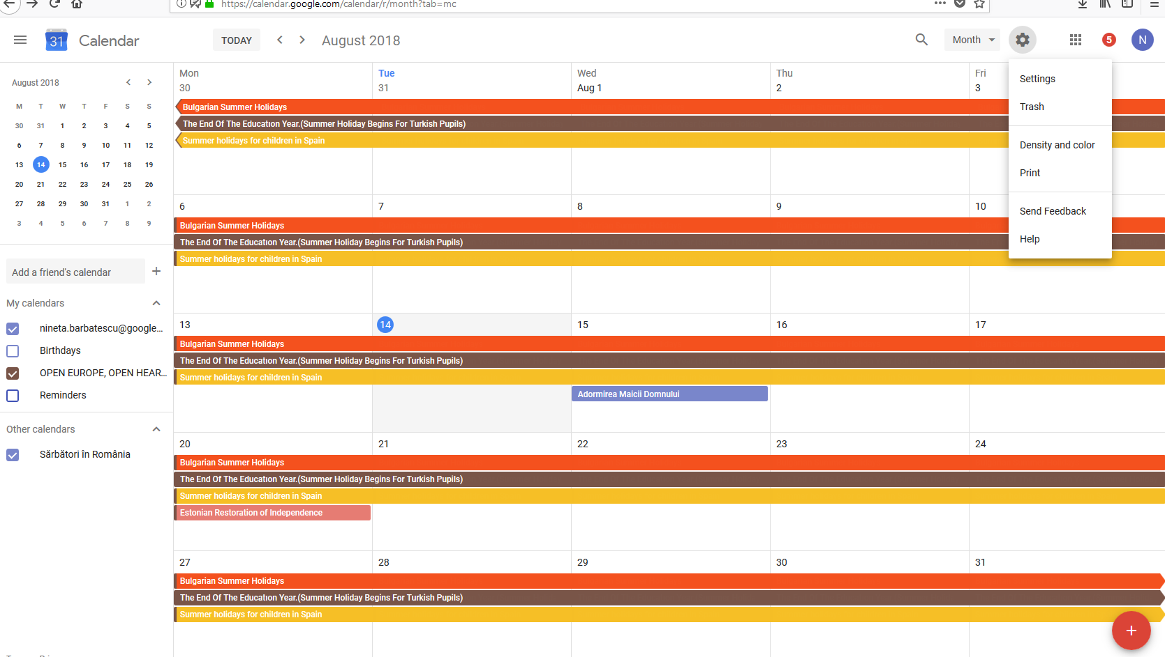
Printing your calendar- in a week, month

Slide 40
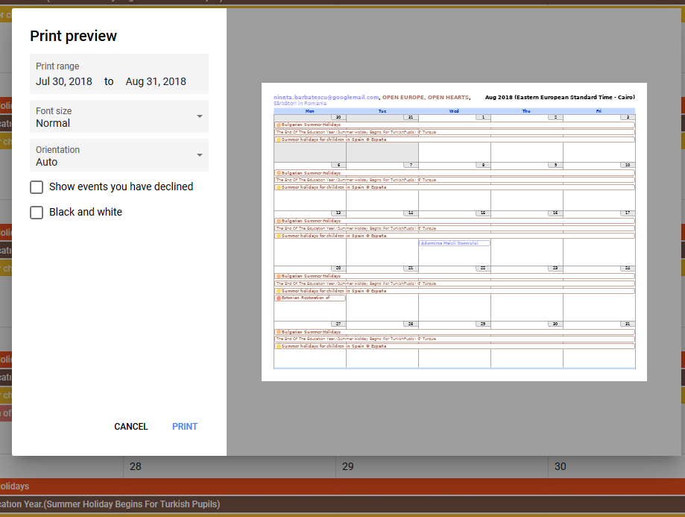
Printing your calendar- in a week, month

