Slide 1
Adults read for kids
Read and share
eTwinning Project
Primary School No 10 Rzeszów, Poland

Slide 2
From January to April 2017 in our class we hosted interesting people from our city, who are passionate about reading books. The invited guests read us fragments from selected books, answered questions about why we should read and they talked about their passions and interests.

Slide 3
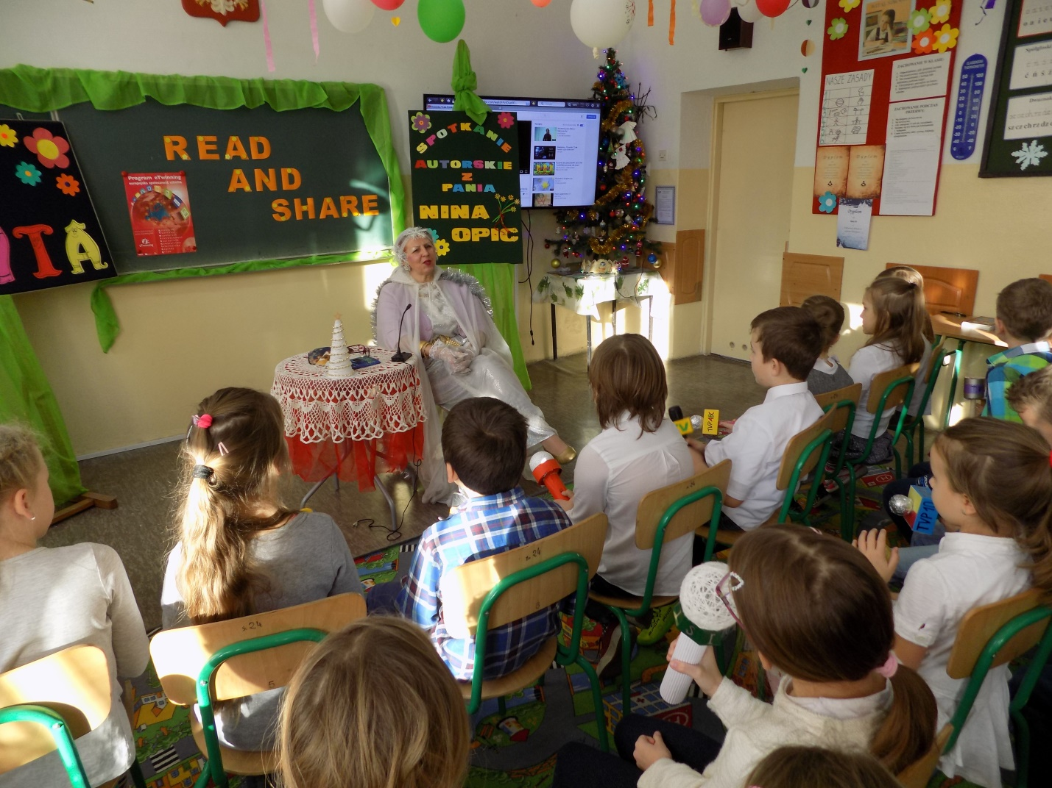
The first was the writer and a poet Nina Opic. The meeting with her was already described in January in our Prezi presentation.

Slide 4
Another guest was prof. dr. hab. Marek Koziorowski - Vice-Rector of the University of Rzeszow. In addition to encouraging us to read, the professor told us many natural curiosities, because researching the animal world is his great passion.

Slide 5
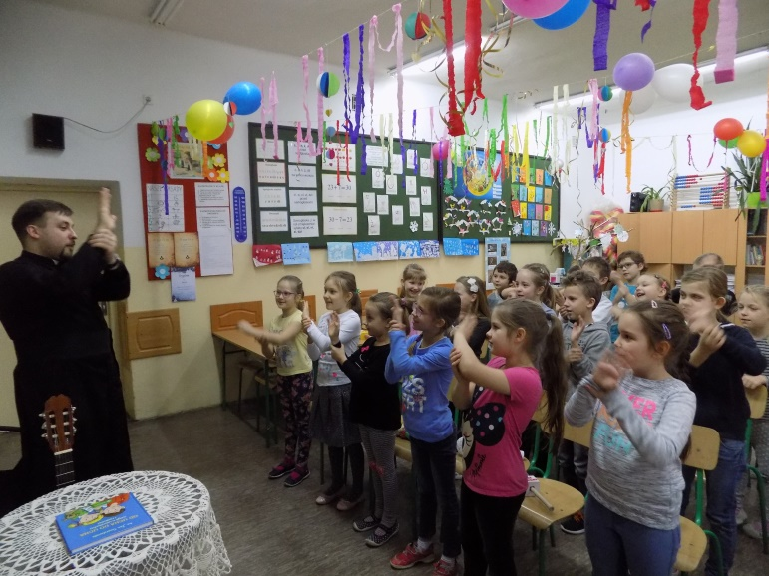
The next person was Father Adam, who introduced us to the books by poet Fr. Jan Twardowski and talked about his own life passion - music. Our guest played the guitar and taught us short songs.

Slide 6
The fourth guest was nurse Mrs. Zofia Bereś. Mrs. Zofia read us a fragment of a book about health and talked about her great passion for travel. She has visited several continents and has been to many countries around the world

Slide 7
The last guest was judge of the District Court in Rzeszow Mr. G. M. who talked about his work and introduced us to books that lawyers have to know.

Slide 8
All the meetings with the invited guests were very interesting and informative. Thank you!

