Slide 1
Japanese Haiku
A beautiful sneeze

Slide 3
What is a Haiku?
A three line poem with no more than 17 syllables.
Expresses a thought, feeling or a mood, using nature.
Traditionally, at least one line must describe or convey a sense of season, or hour (day or night).
Haiku are also accompanied with a picture to help guide the reader.
The layout of a Haiku is 5 syllables, 7 syllables, 5 syllables.
To count syllables break the words into parts when you say it; for example: layout is two syllables lay-out.

Slide 4
Haiku poems…
write about everyday things.
Usually they use simple words and grammar.
Haiku don't rhyme.
A Haiku must "paint" a mental image in the reader's mind.
This is the challenge of Haiku - to put the poem's meaning and imagination in the reader's mind in ONLY 17 syllables over just three (3) lines of poetry
Here are some examples of haiku.

Slide 5
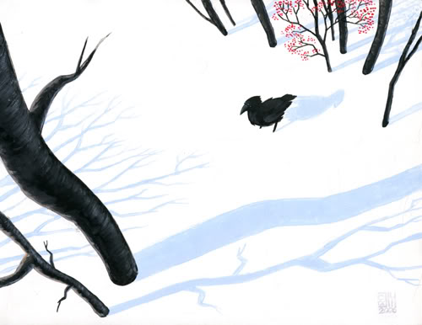
This snowy morning
That Black Crow I hate so much…
But he’s beautiful!
-Basho

Slide 6
No one Travels,
Along this way but I
This autumn evening.
-Basho

Slide 10
Free Write
Over the next few slides you will see some pictures, when I show you each one I want to you take 3mins. And free write, describing the image using 10-15 words. Describe the scene, what emotions it evokes etc. anything that comes to your mind. If the image leads you somewhere else that’s fine.

Slide 16
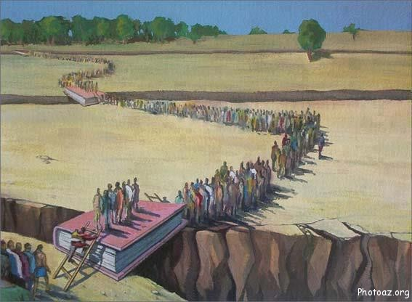

Slide 17
OUTDOOR LIBRARY AT KIMOLOS

Slide 20
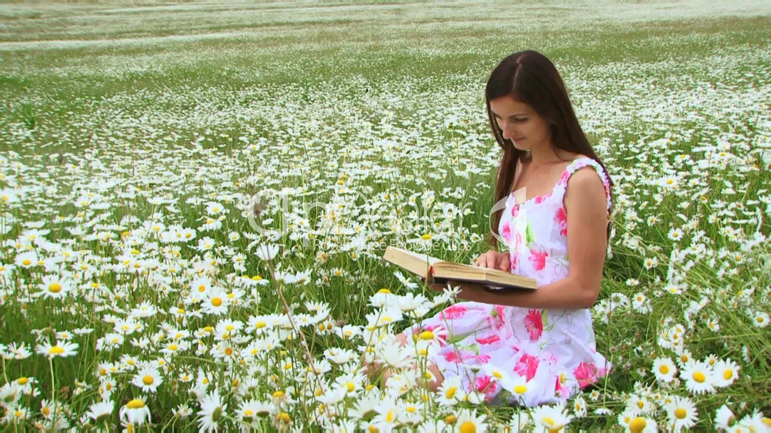

Slide 23
Marilyn Monroe reading at a merry-go-round…

Slide 27
Next Step
Now hopefully you have got your creative gears moving, your next step is to pick one of the descriptions you like the best and transform it into a Haiku. Don’t forget an illustration to help you out.

