Slide 1
Welcome to our library…

Slide 2
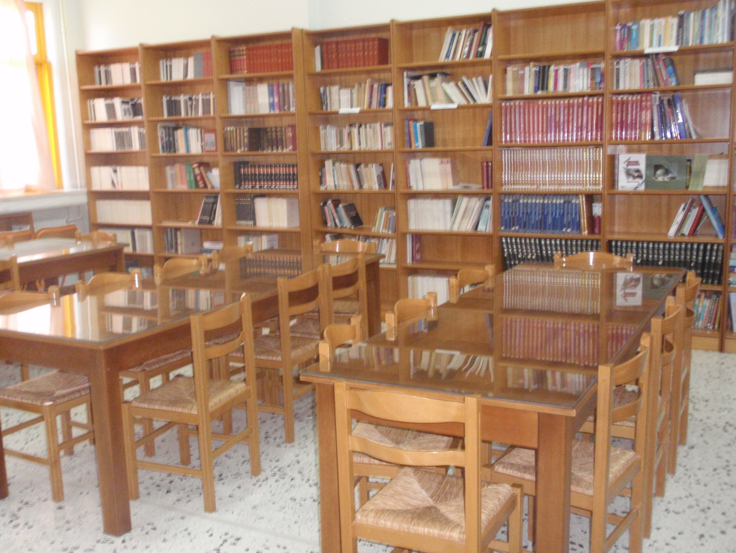
This is our school library. It sits on the ground floor.

Slide 3
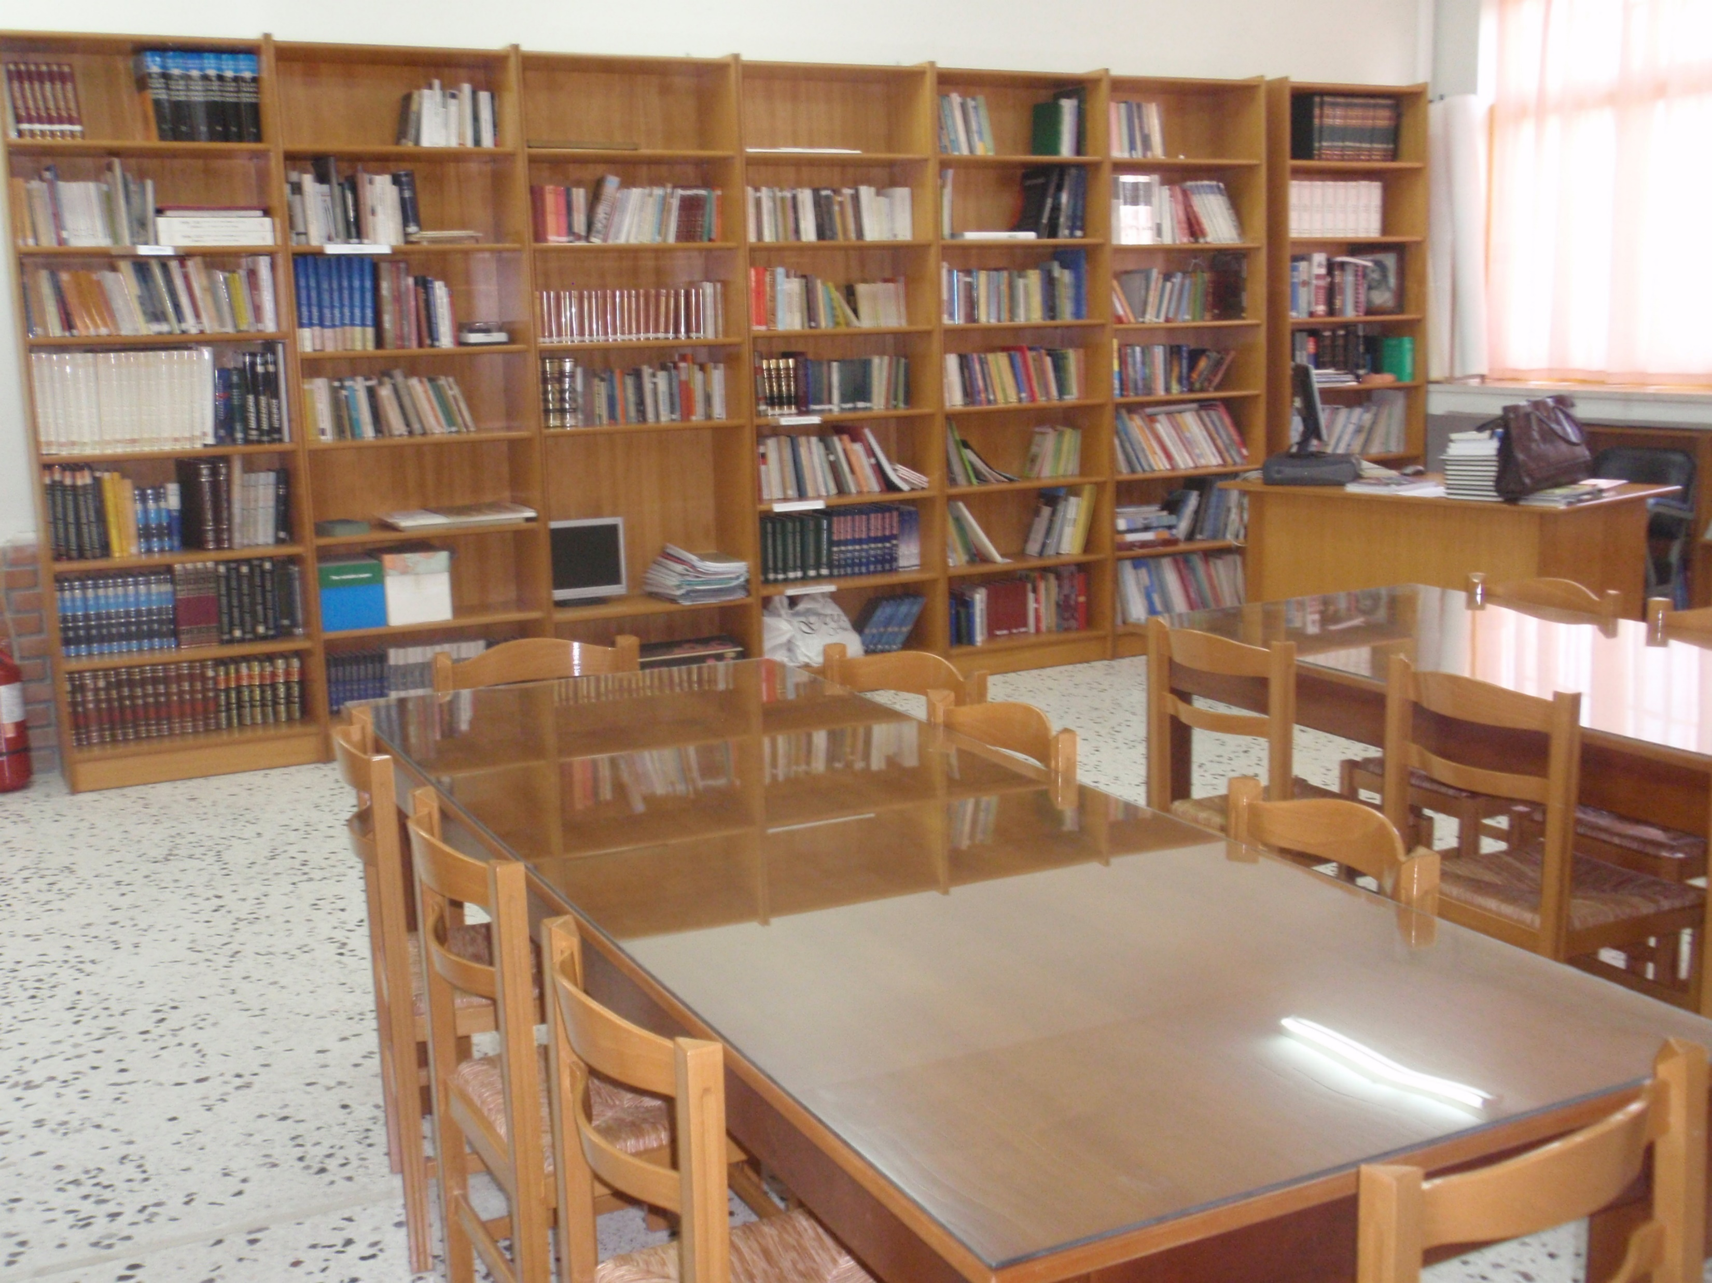
Here we can read and borrow books or do our projects.

Slide 4

It is open every Tuesday from 10 to 12 am. All the students and the teachers are able to borrow books.

Slide 5
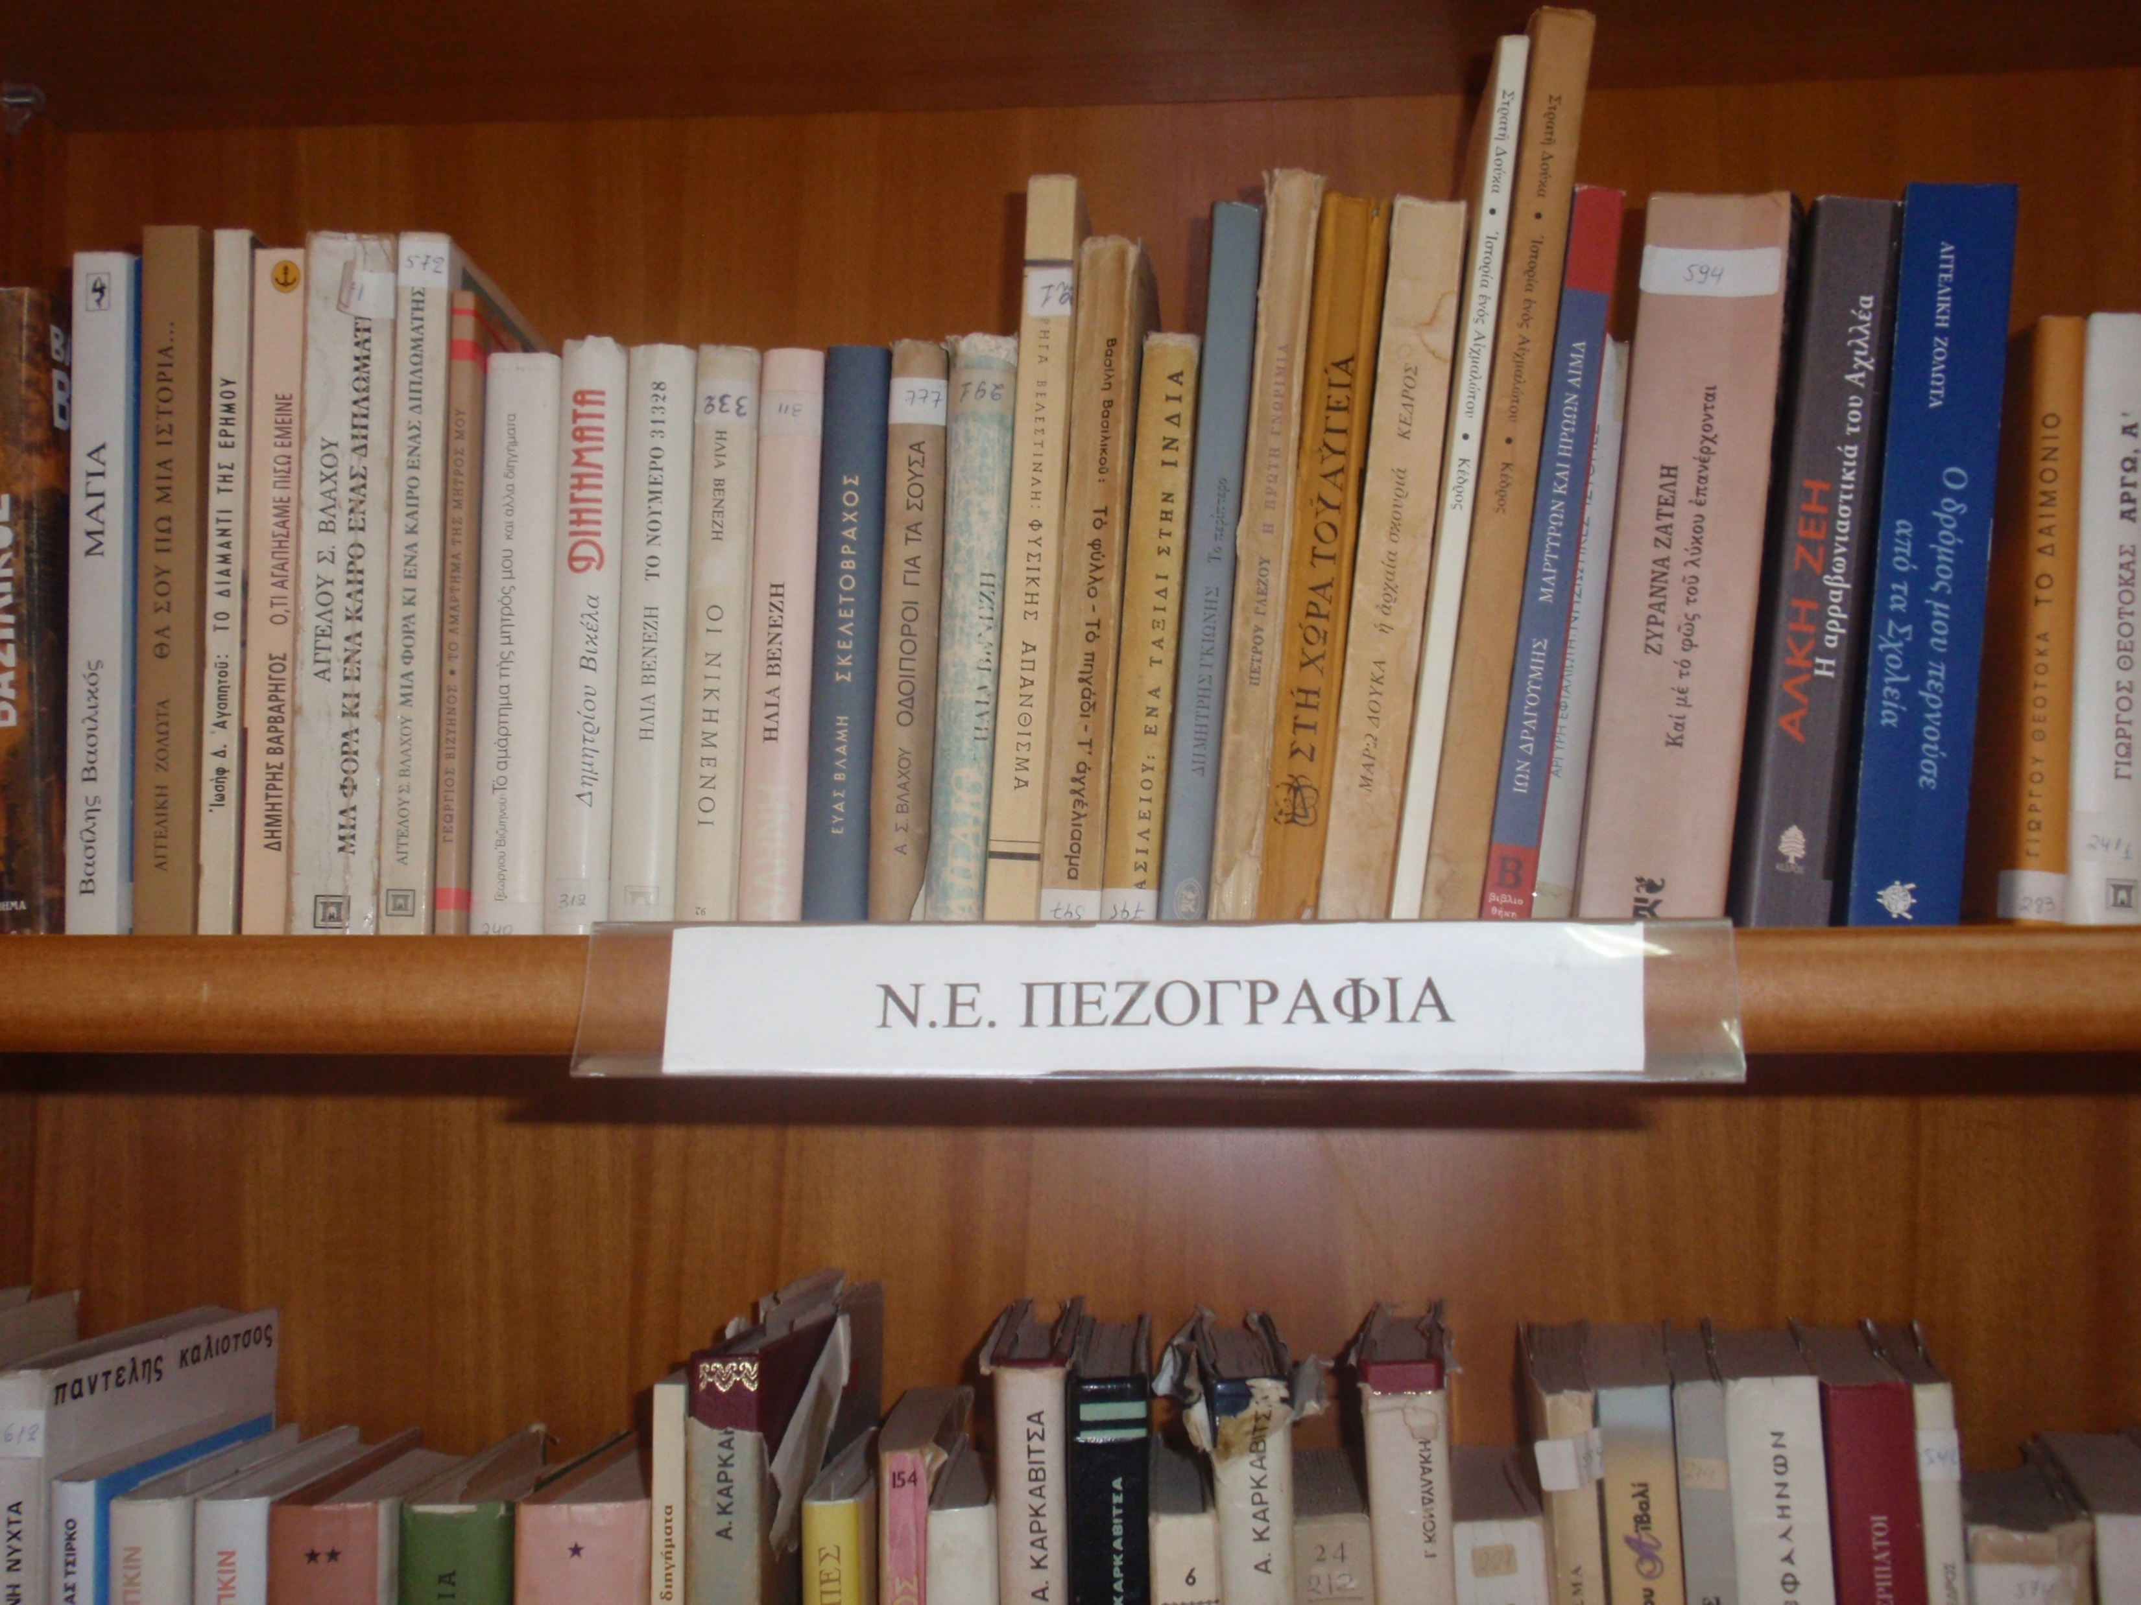
You can find a big variety of books like: Modern Greek prose

Slide 6
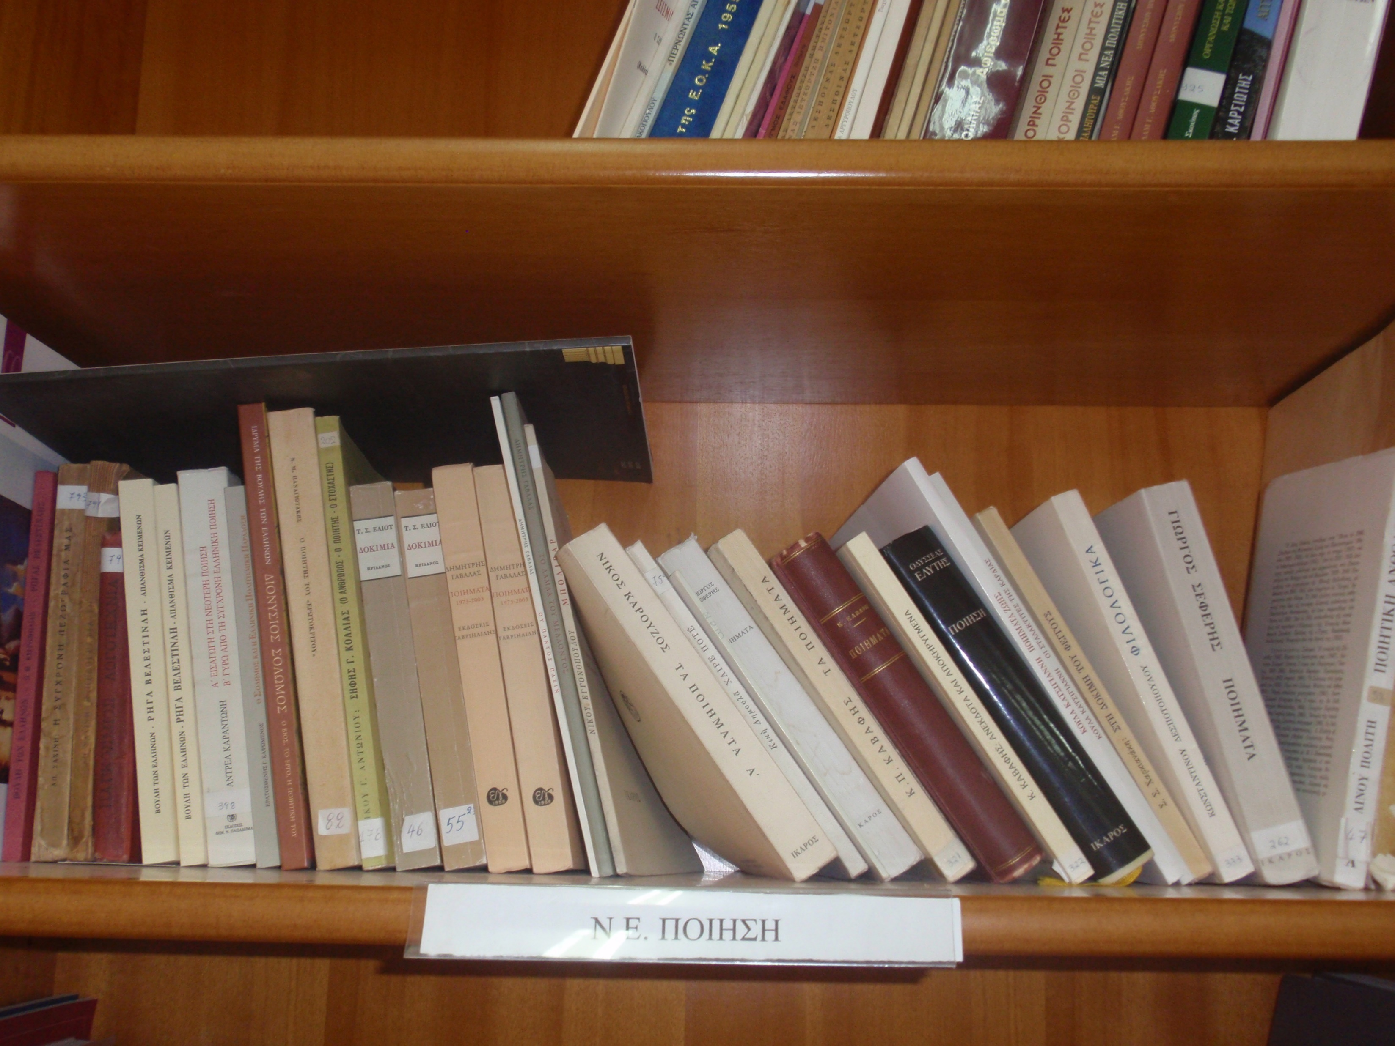
Modern Greek poetry

Slide 7
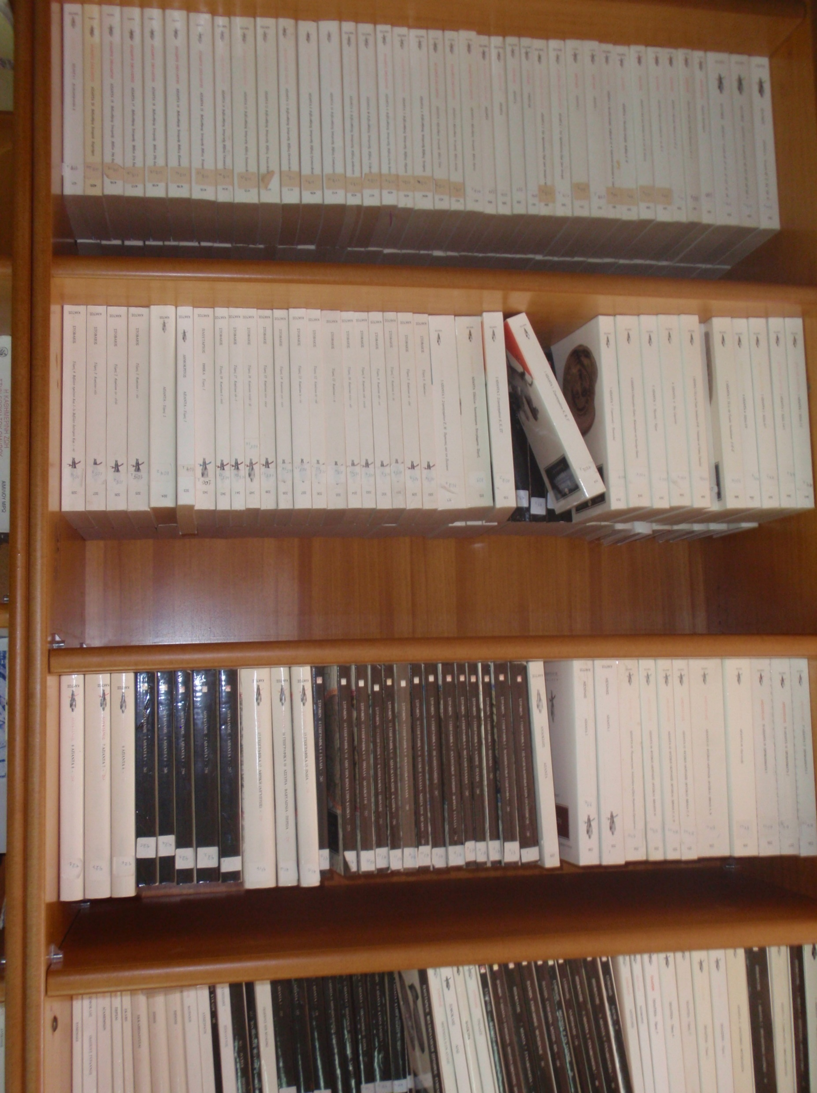
History

Slide 8
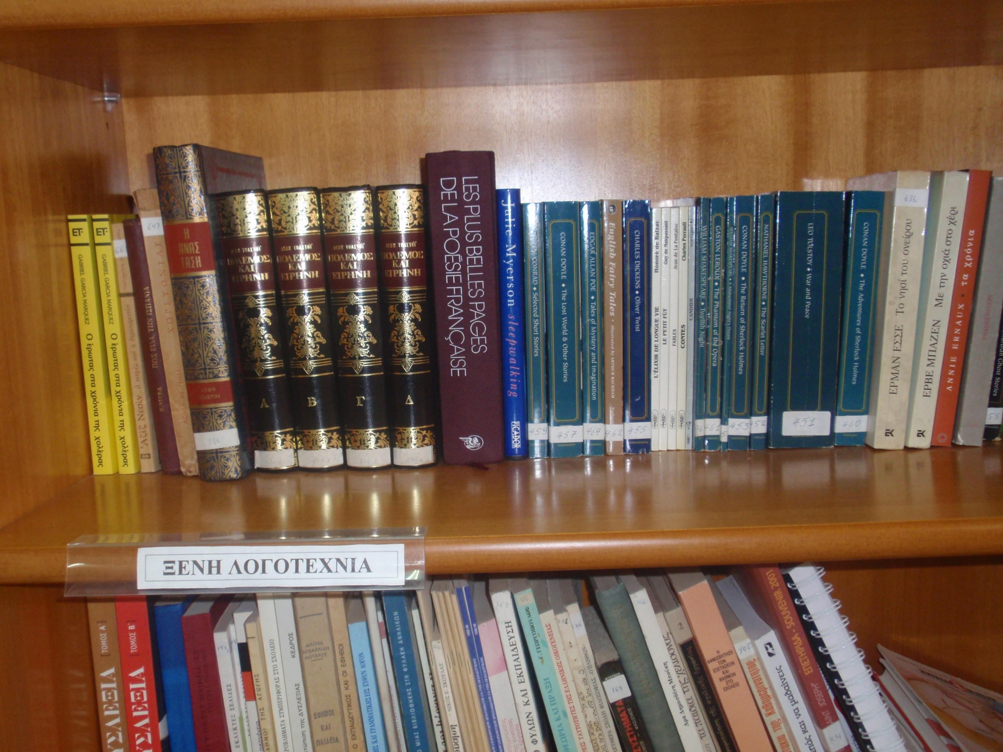
Foreign literature

Slide 9
Thanks for watching!!!

