Slide 1
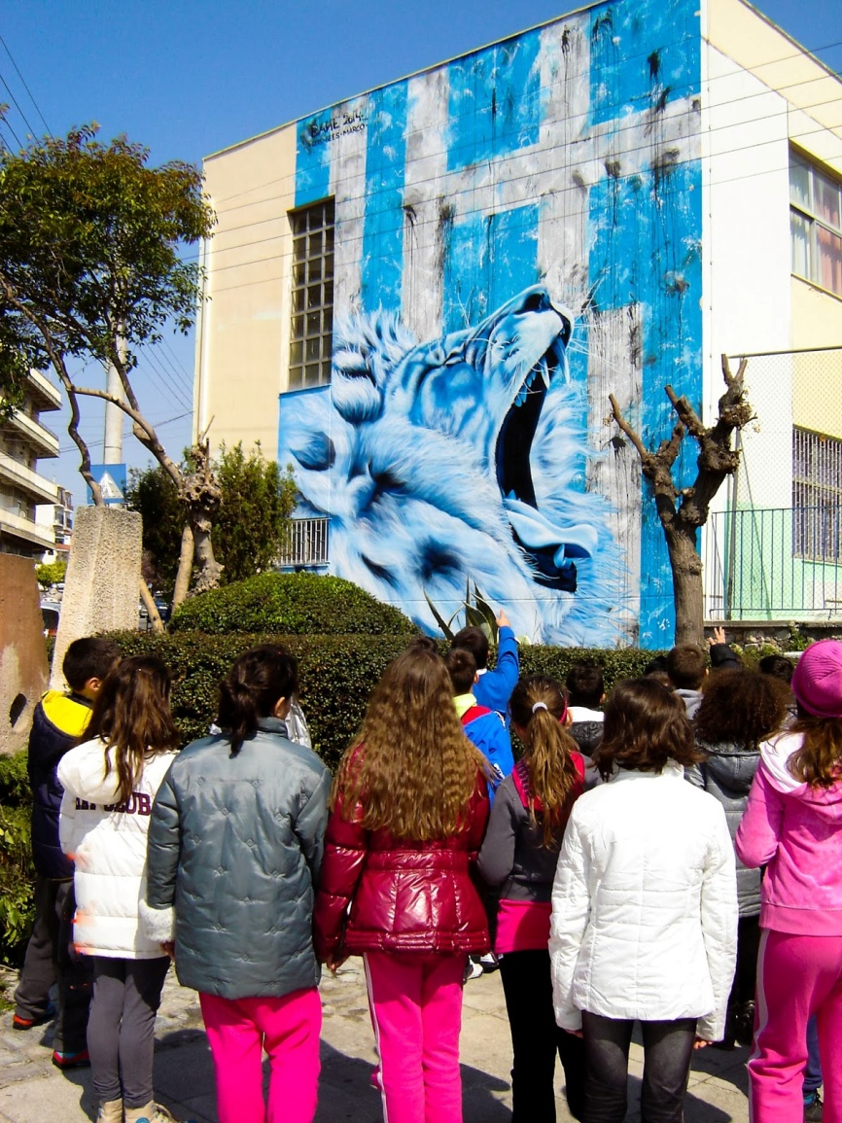
The city and our school

Slide 2
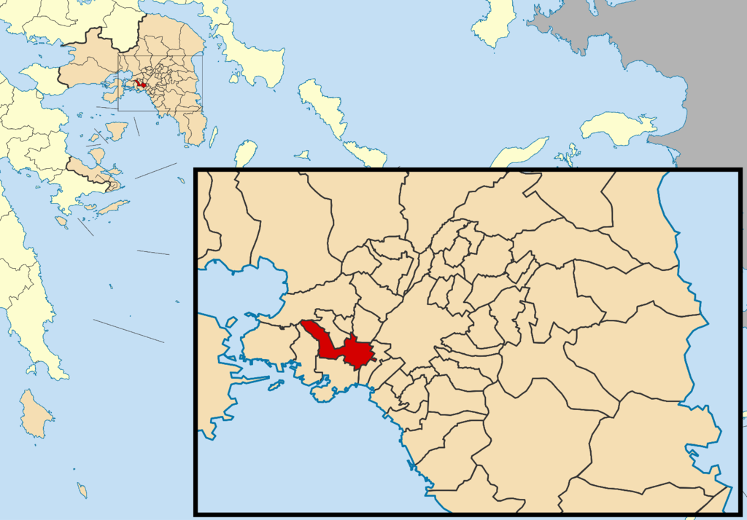
Nikea – Agios Ioannis Rentis is a suburb of Pireas, the largest port in the country.

Slide 3
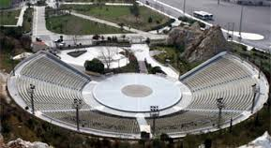
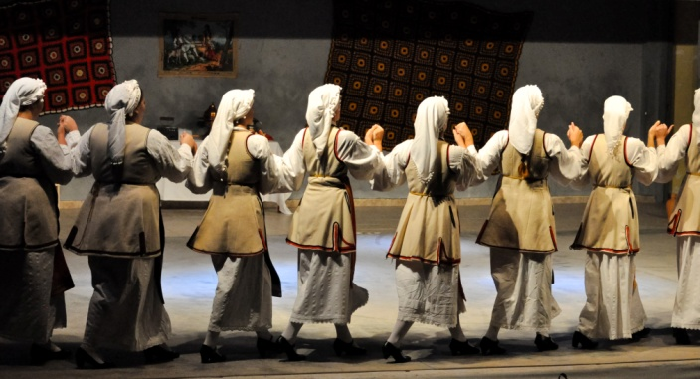
It is a municipality with intense cultural activity.

Slide 4
Monuments and works of art that adorn our region.

Slide 5
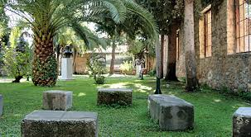

Slide 6
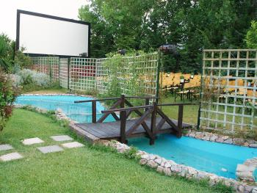
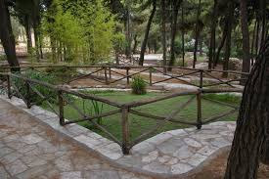
Come to show you where we play and working out.

Slide 8
Our school is one of the oldest in town.
Our yard

Slide 9
Our classes and library

Slide 10
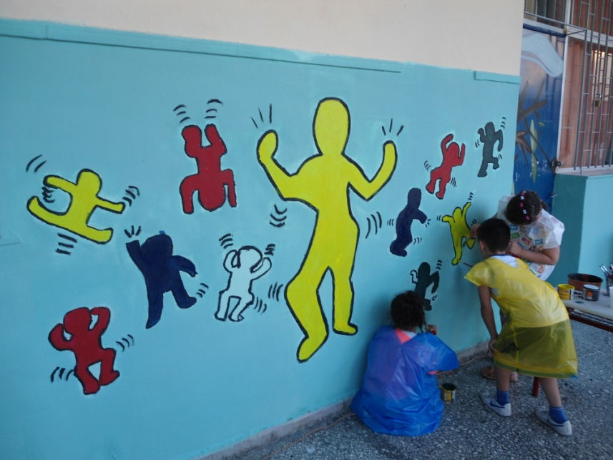
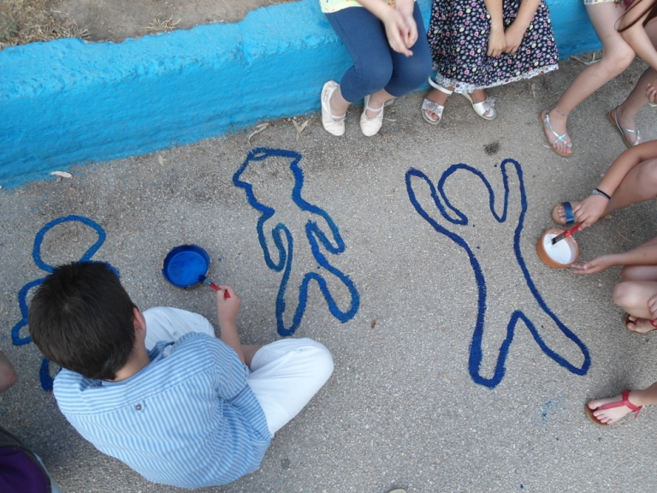
We love it and we try to make it beautiful.

Slide 12
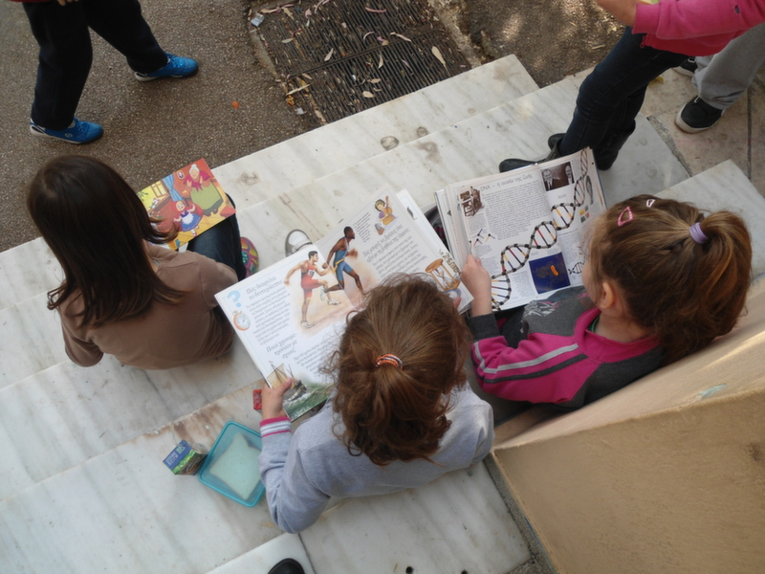
We love reading

Slide 13
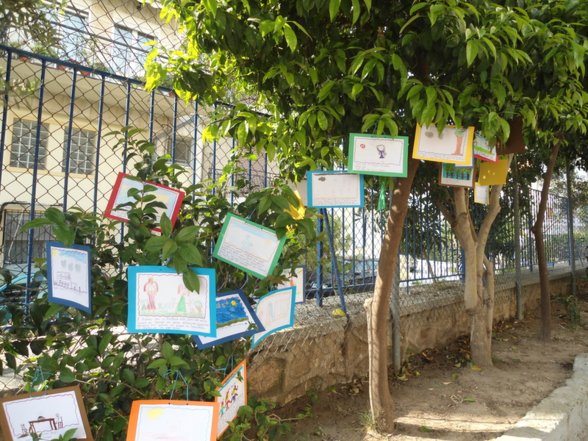

Slide 14
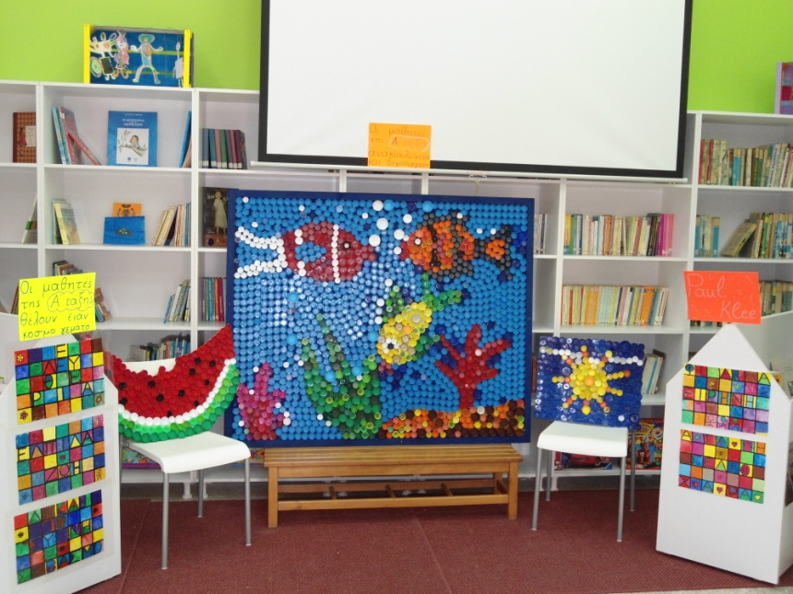
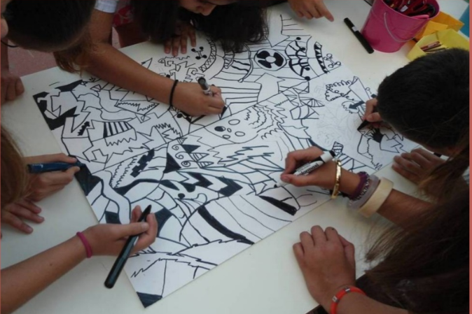
We love painting

Slide 15
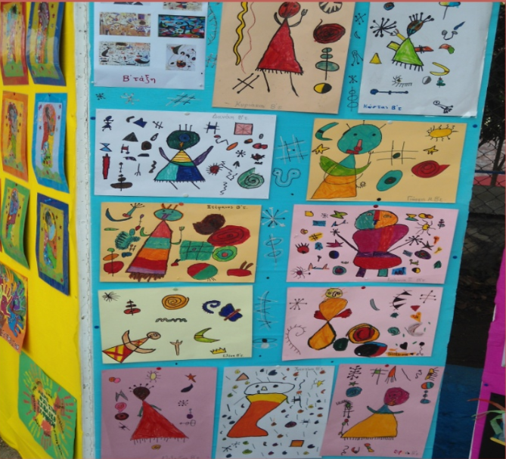

Slide 16
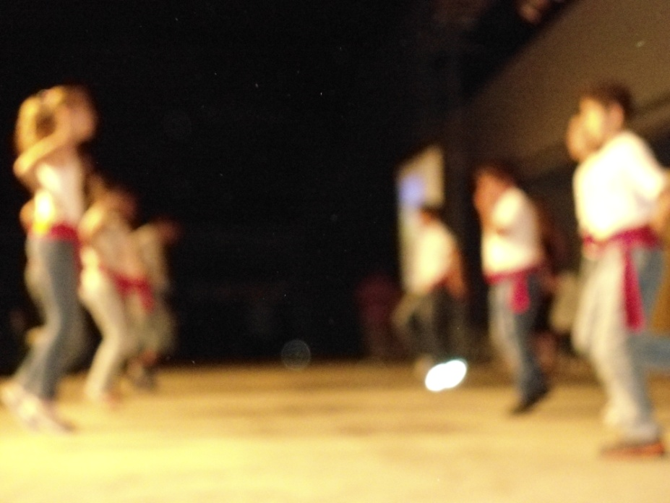
We love traditional dances and carnival disquises

Slide 17
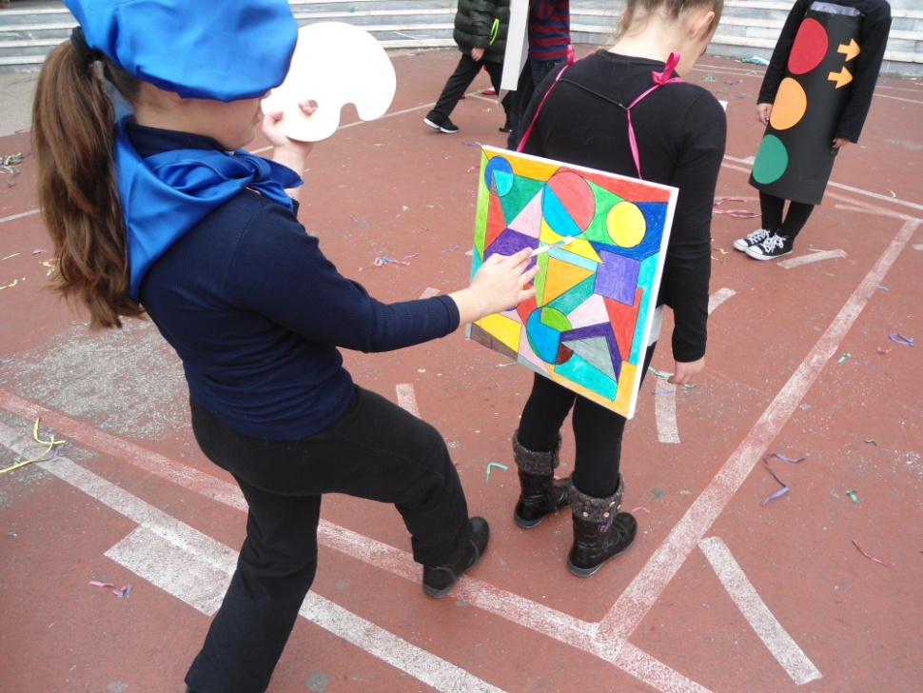

Slide 18
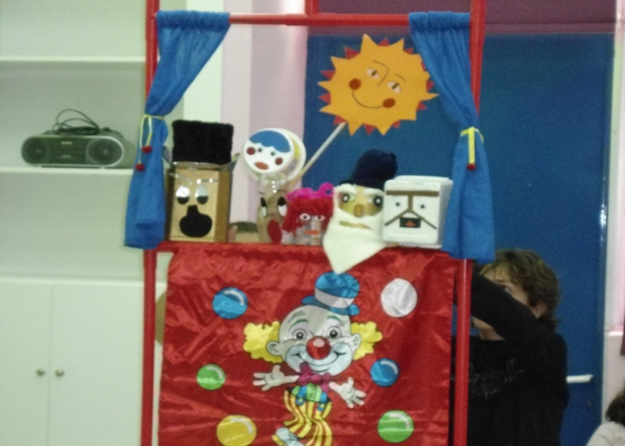
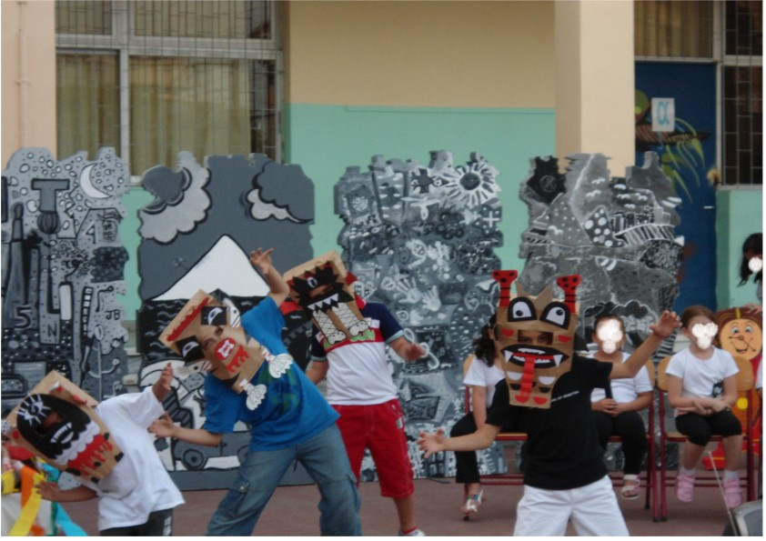
We love theater

Slide 20
We expect you to visit us :
http://7dimotikonikaias.blogspot.gr/
7th Primary school of Nikea
November 2014

