Slide 1
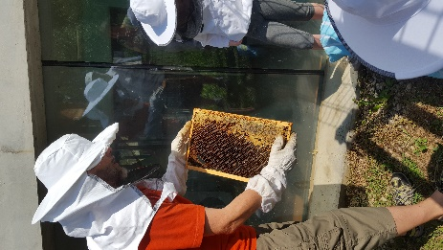
APIARY AND HONEY PROCESSING

Slide 2
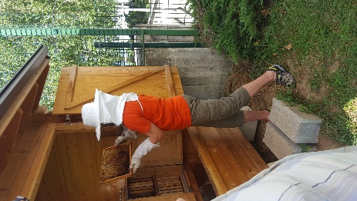
In primary school Medvode we have beekeeping circle,
Where we learn about honey production.

Slide 3
HONEY PRODUCTION PROCESSES
Maturation of honey in the hive
How to take away honeycombs
Transport to the honey dispenser
Opening the honeycomb
Pouring honey (space for dispensing honey)
Sizing
To imitate the process

Slide 4
1.Maturation of honey in the hive
The bees are bringing the nectar into the hive and hand it over to the young bees .Every 5 to 10 seconds, the bees spit out a drop of honey from their honey stomach and dry it for a few seconds at the end of the trunk. They suck the drop again and all the process repeats .This is going on for 20 minutes until honey thickens .It is intresting that bees are turned upside down druing the process. Honey maturates in the hives .

Slide 5
2.How to take away honeycomb
We need following tools:
smoker, wisk broom and scatter .We take the honeycombs out of hives when the weather is nice. We put honeycombs into clean boxes or small containers . We never take the honeycombs that still have bees on.
For smoker it si not allowed to use funds that have strong smell.
To much smoke can leave a smell in the honey.

Slide 6
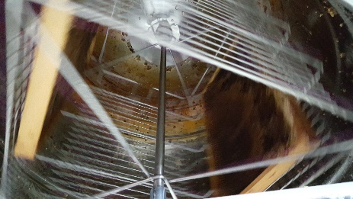
3.Transporting to the honey dispenser
Honey must not be exposed to physical , biological and chemical risks.
How we achieve this:
We do not put honeycombs directly on the floor.
If the transport is longer then needed we have to protect the honeycombs
We have to be carefull with hygien in the car,no polution of honeycombs is allowed

Slide 7
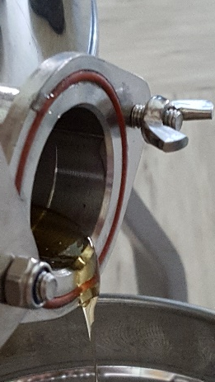
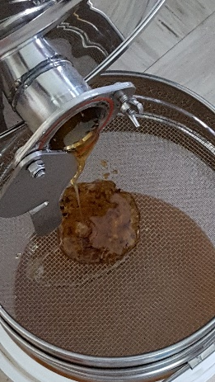
4.Pour honey
Space for dispensing:
The honey dispensing is properly neat and clean space.
The room should be bright with a temperature of 25 to 30 degrees Celsius .

Slide 8
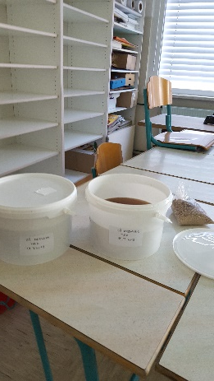
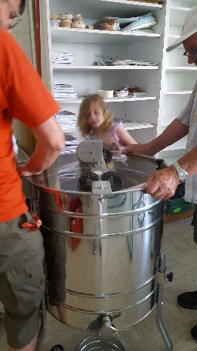
5.Sizing
During pouring honey can happen that parts of wax ,bees and wood get into honey.
Because of that we precede honey throughout catter

Slide 9
6.To imitate the process
After three days in the boxes where honey is stored small wax particles crash on the surface of honey.
If necessary we repeat the process in a few days . This foam should be removed as soon as possible so that aroma of honey is not affected.

