Slide 1
Circular Economy
Reuse
Recover
Recycle

Slide 2
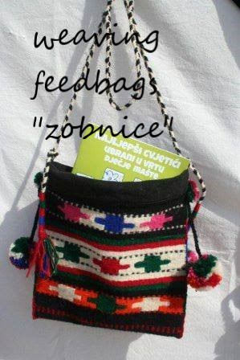
A tradition that goes back to fashion…

Slide 3
Be creative with financial literacy awareness and environmental awareness as well!
Needed:
- wool / old clothes
- the loom
- worthy hands
Even today, girls from Imotski region are looking for a horse feed bag „zobnica“ when they get married. It's a great gift for guests. It used to be the custom of every guest to get a „zobnica“ at a wedding. It takes a few days for the „zobnica“ to be made.

Slide 4
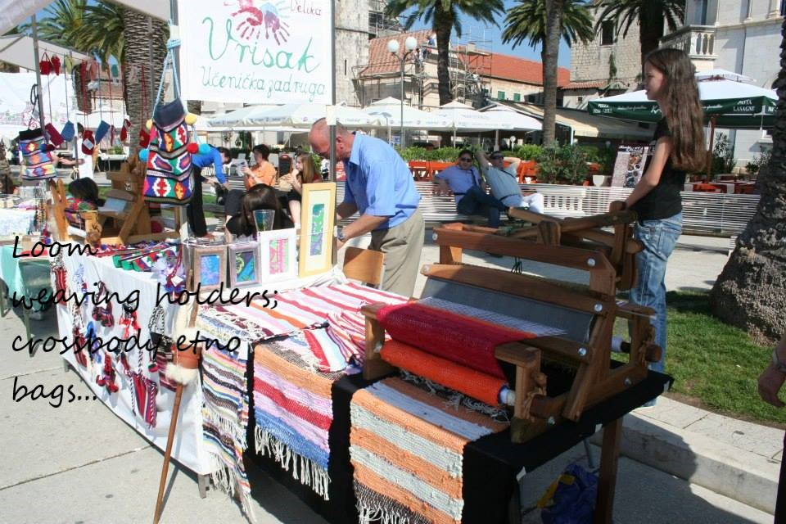
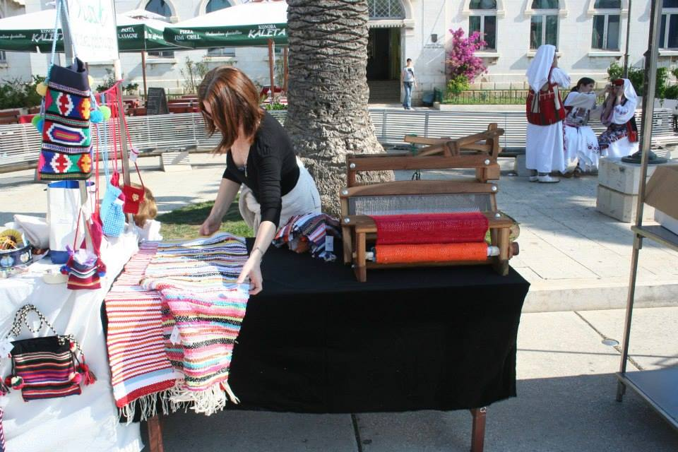
The canvas from the loom can also be used to make blankets, clothes, and floor mats…

Slide 5
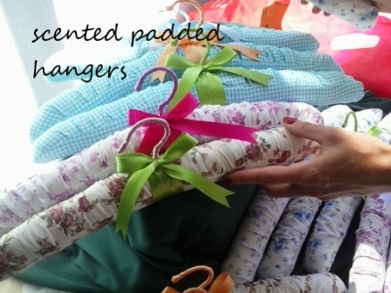
Hangers filled with lavender preserve your beautiful fashion accessories and give off a scent
Materials:
lavender
old clothes
hangers

