Slide 1
WHAT SURROUNDS ME
SOCIAL LIFE
By Elisa, Giorgia, Pamela

Slide 2
Distracted
Informatic evolution
always informed
We are more and more connected, more informed, more excited but existentialy more and more alone
SOCIAL LIFE
Contact who is far away
addiction

Slide 3
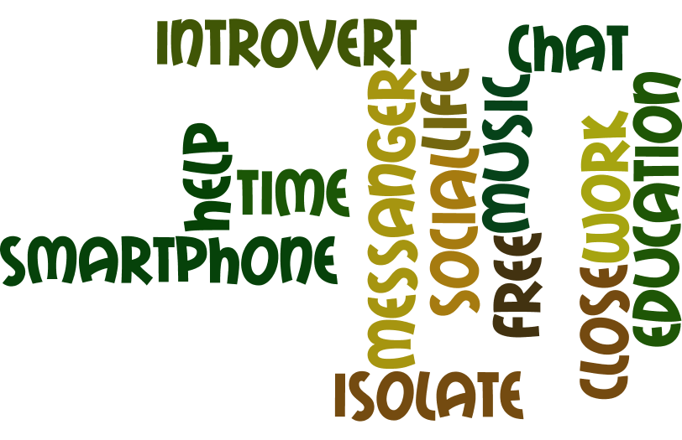

Slide 4
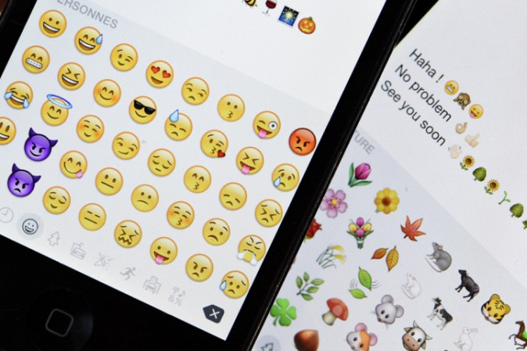
SOCIAL LIFE? Let’s think about it?
How much time do we spend with social networks?
Is it best to write or talk to each other?
Are virtual friends real friends?
Do we talk to the people around us?

Slide 5
If you never talk If you hide like me Escaped the eyes and you stand A locked room and I don't want to eat Squeeze you tight to my pillow Weep don't know How much will loneliness hurt you
Quote by Laura Pausini

Slide 6
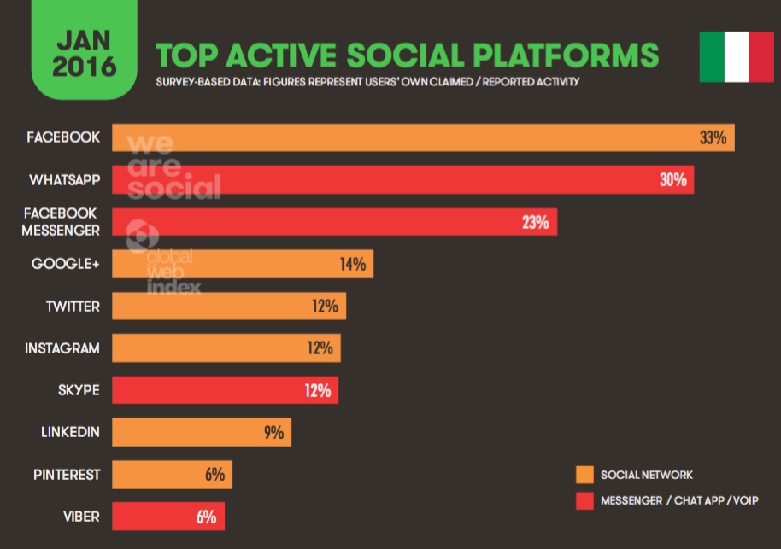
USE OF SOCIAL
Information by Google

Slide 7
Friend
Social
This is the order or order for you is different?
Family
Social
School
This is our order.
As you can family and friends are the most important
Family and Friends

Slide 8
This is our opinion about social networks and life with them
Thanks for watching

