Slide 1
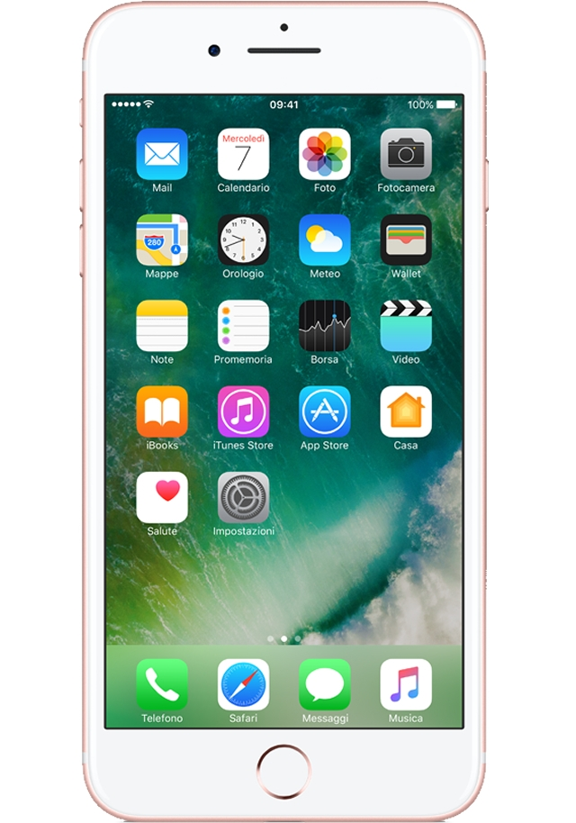
electromagnetic
antisocial
follower
isolation
app
future
create
technology

Slide 2
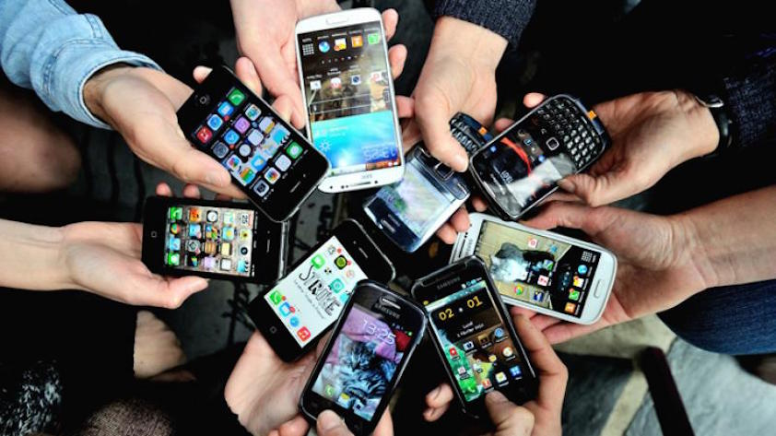
VANTAGE OF PHONES
There are some vantages of mobile phones like:
Use of internet can help you when you need it
You can send messages and call persons
Agenda and alarm clock
from internet you can download music,video,films
Download apps

Slide 3
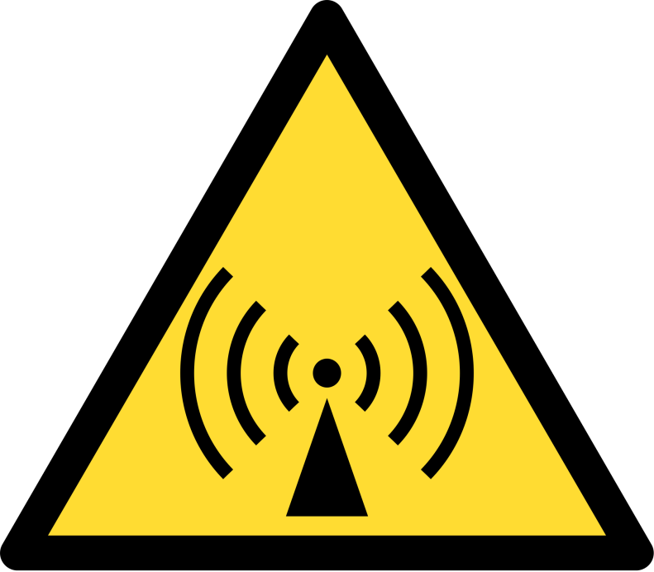
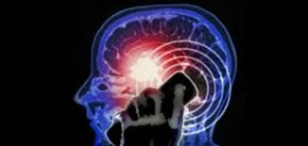
ELECTROMAGNETIC RADIATION AND PHYSICAL PROBLEMS
In physics, electromagnetic radiation (EM radiation or EMR) refers to the waves (or their quanta, photons) of the electromagnetic field, propagating (radiating) through space carrying electromagnetic radiant energy. It includes radio waves, microwaves, infrared, (visible) light, ultraviolet, X-, and gamma radiation.
Electromagnetic pollution are caused by radio-waves, phons, Wi-Fi that create damage to the environment.
Electromagnetic waves generated by cell phons can cause serious diseases like cancer.
The incorrect posture of the head hired to watch the phone can change in the long time the structure of vertebral column.
Inflammation of the thumb tendon.

Slide 4
MOBILE PHONE
Older and technology
Use of phone in class
SOCIAL NETWORK
MUSIC AND VIDEO

Slide 5
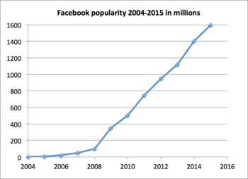
SOCIAL NETWORK
FACEBOOK
This is a graphic that explane how many people use facebook

Slide 6
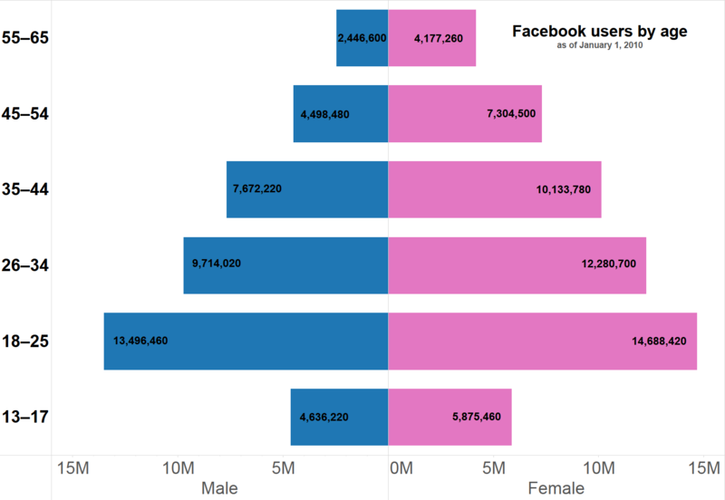
This is a graphic that explane the age of people that use facebook

Slide 7
MUSIC AND VIDEO
There are some music genre like:
Pop music
Rap music
Classic
Reggie
Country
Jazz
Blues

Slide 8
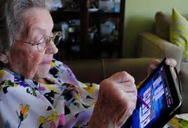
Old and technology
To translate into numbers, Istat notes that today the 25.6% of people between 65 and 74 years old use the Internet, the 12.6% every day. A dizzying growth considering that in 2003 only 4.4% of people in the same age group was familiar with computers and the web. In addition, a trend expected to grow again since, aged between 60 and 64 years, 45.9% of the population regularly uses the Internet.

Slide 9
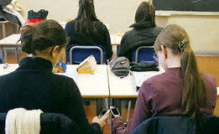
USE OF PHONE IN CLASS
The use of phone in 2001 was not forbidden by any schools in Britain, in 2007 were punctually allowed and now 98% of schools require students to deliver them early in the day and especially before a written classwork or an exam. In Italy according to a survey conducted by Skuola.net in collaboration with Miur and State police on ten thousand boys on 90% of the students have a smartphone to be always active on Facebook, WhatsApp, Twitter and Instagram. Not only. The 60% of those who have a latest-generation mobile uses it to access social networks while the Professor of Latin or mathematics explains the lesson

