Slide 1
Football in Greece
George Santos

Slide 2
Info for football in Greece
There are many sports in Greece, but the most famous of all is football. Football has fans from all corners of Greece. Even though there are many teams, the most popular are Olympiakos and Panathinaikos.

Slide 3
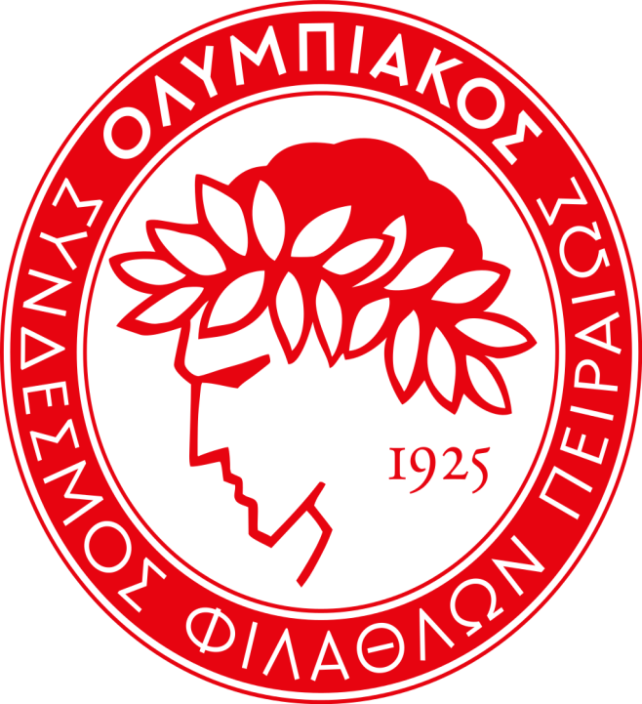
What is Olympiakos
Olympiacos F.C. (Greek: ΠΑΕ Ολυμπιακός Σ.Φ.Π.), also known simply as Olympiakos, Olympiacos Piraeus or with its full name as Olympiacos C.F.P. (Greek: Oλυμπιακός Σύνδεσμος Φιλάθλων Πειραιώς, transliterated "Olympiakós Sýndesmos Filáthlo̱n Peiraió̱s", Olympiacos Club of Fans of Piraeus), is a Greek professional football club, part of the major multi-sport club Olympiacos CFP, based in Piraeus. Their name was inspired from the Ancient Olympic Games and along with the club's emblem, the laurel-crowned adolescent Olympic winner, encompass and symbolize the morality, the honour, the vying, the splendor, the sportsmanship and the fair play value of the Olympic ideal of Ancient Greece.

Slide 4
Records of Olympiakos
Founded on 10 March 1925, Olympiacos is the most successful club in Greek football history, having won 43 Greek League titles, 27 Greek Cups, totaling 17 doubles – and 4 Greek Super Cups, for a total of 74 national titles, all records. Olympiacos' dominating success can be further evidenced by the fact that all the other Greek clubs have won a combined total of 37 League titles.

Slide 5
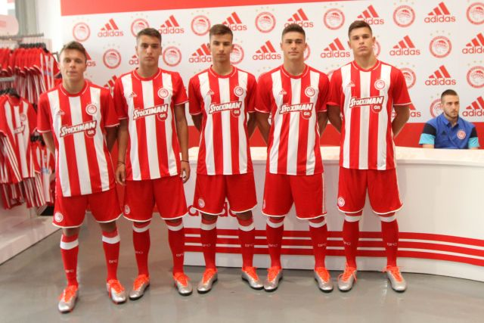
Current kit of Olympiakos

Slide 6
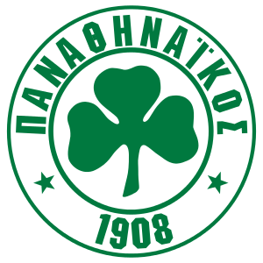
What is Panathinaikos
Panathinaikos F.C. (Greek: ΠΑΕ Παναθηναϊκός Α.Ο.), also known simply as Panathinaikos (Greek pronunciation: [panaˈθinai̯kˈos]), or with its full name Panathinaikos A.O. (Greek: Παναθηναϊκός Αθλητικός Όμιλος, transliterated "Panathinaikos Athlitikos Omilos", Panathenaic Athletic Club) are a Greek professional football club based in the City of Athens. Panathinaikos can literally be translated as "Panathenaic," which means "of all Athens." The name "Panathinaikos" was inspired by the ancient work of Isocrates, Panathenaicus, where the orator praises the Athenians for their democratic education and their military superiority, used for the benefit of all Greeks.

Slide 7
History of Panathinaikos
Today a part of Panathinaikos A.O., they are the oldest active football club in Greece, initially founded only to practice this sport. Created in 1908 as "Podosfairikos Omilos Athinon" (Football Club of Athens) by Georgios Kalafatis, they play in the Super League Greece, being one of the most successful clubs in Greek football and one of three clubs which have never been relegated from the top division. Amongst their major titles are twenty-six Greek Championships, twenty-one Greek Cups, achieving eight times the Double, and five official Greek Super Cups. They are also the only club that won a championship undefeated, going without a loss in a top-flight campaign (1963-64 season), a feat that no other club in Greece has ever been able to achieve.

Slide 8
Records of Panathinaikos
Panathinaikos is also the most successful Greek club in terms of achievements in the European competitions. It is the only Greek team that has reached the European Cup (later changed to UEFA Champions League) final in 1971, and also the semi-finals twice, in 1985 and 1996. It is also the only Greek team that has played for the Intercontinental Cup (1971). Furthermore, they have reached the quarter-finals of the Champions League on another two occasions (in 1992 and 2002), as well as the quarter-finals of the UEFA Cup twice (1988 and 2003). They have also won the Balkans Cup in 1977. Panathinaikos is a member of the European Club Association.

Slide 9
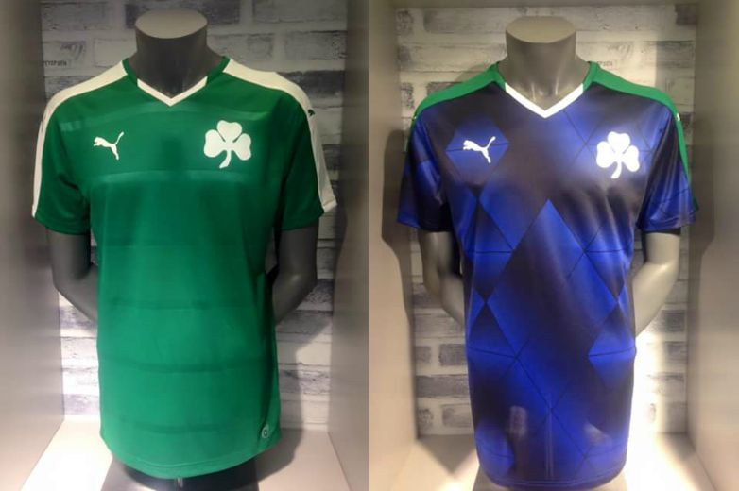
Current kit of Panathinaikos

Slide 10
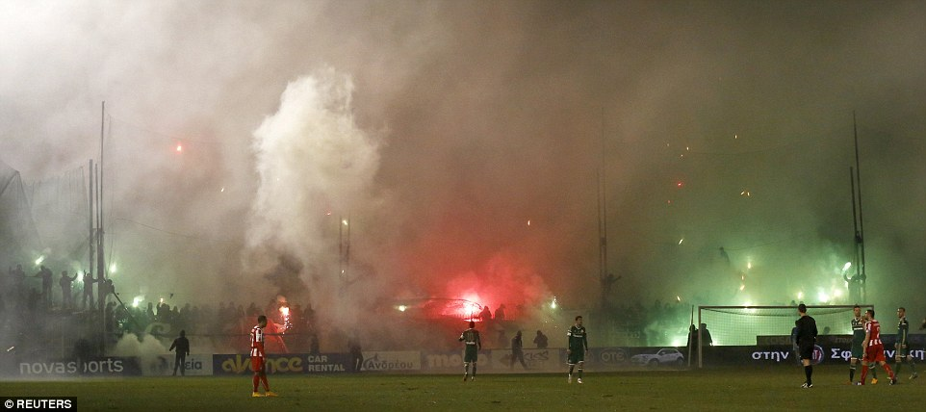
The eternal fight between teams and fans
There have been an eternal fight between the fans of Olympiakos and Panathinaikos. Almost all these conflicts end up in having fans injured or in worst case scenarios dead from the acts of violence.

Slide 11
Thank you for your time
Sources
Olympiakos: Wikipedia
Panathinaikos: Wikipedia
Special thanks from my friend Vasilis Skarlatos who helped me with this assignment.

