Slide 1
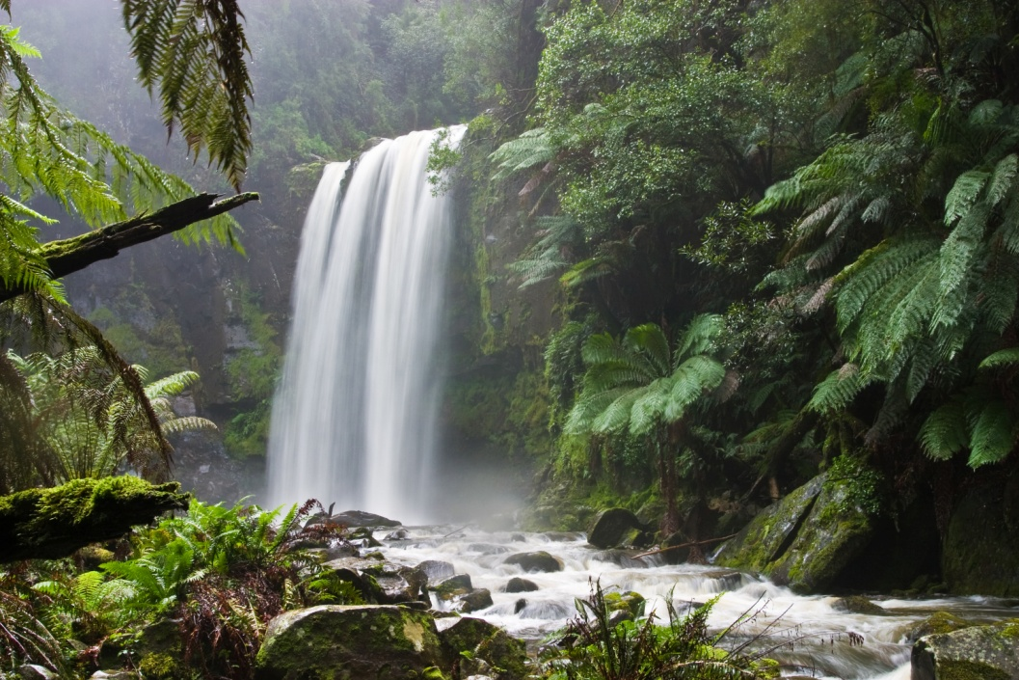
Nature and Environment
By
Alam Rawha
Braila Roman
Selimoski Haris
Nature is everything that was not made by man.

Slide 2
Index
What is Nature?
Mankind Involvment
Overpopulation
Deforestation
What surrounds Us (Venice and its Nature)

Slide 3
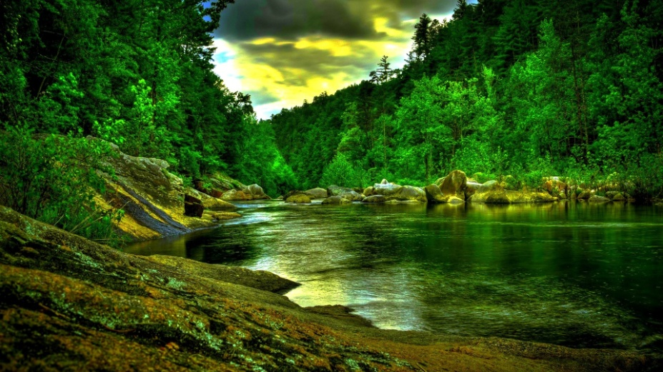
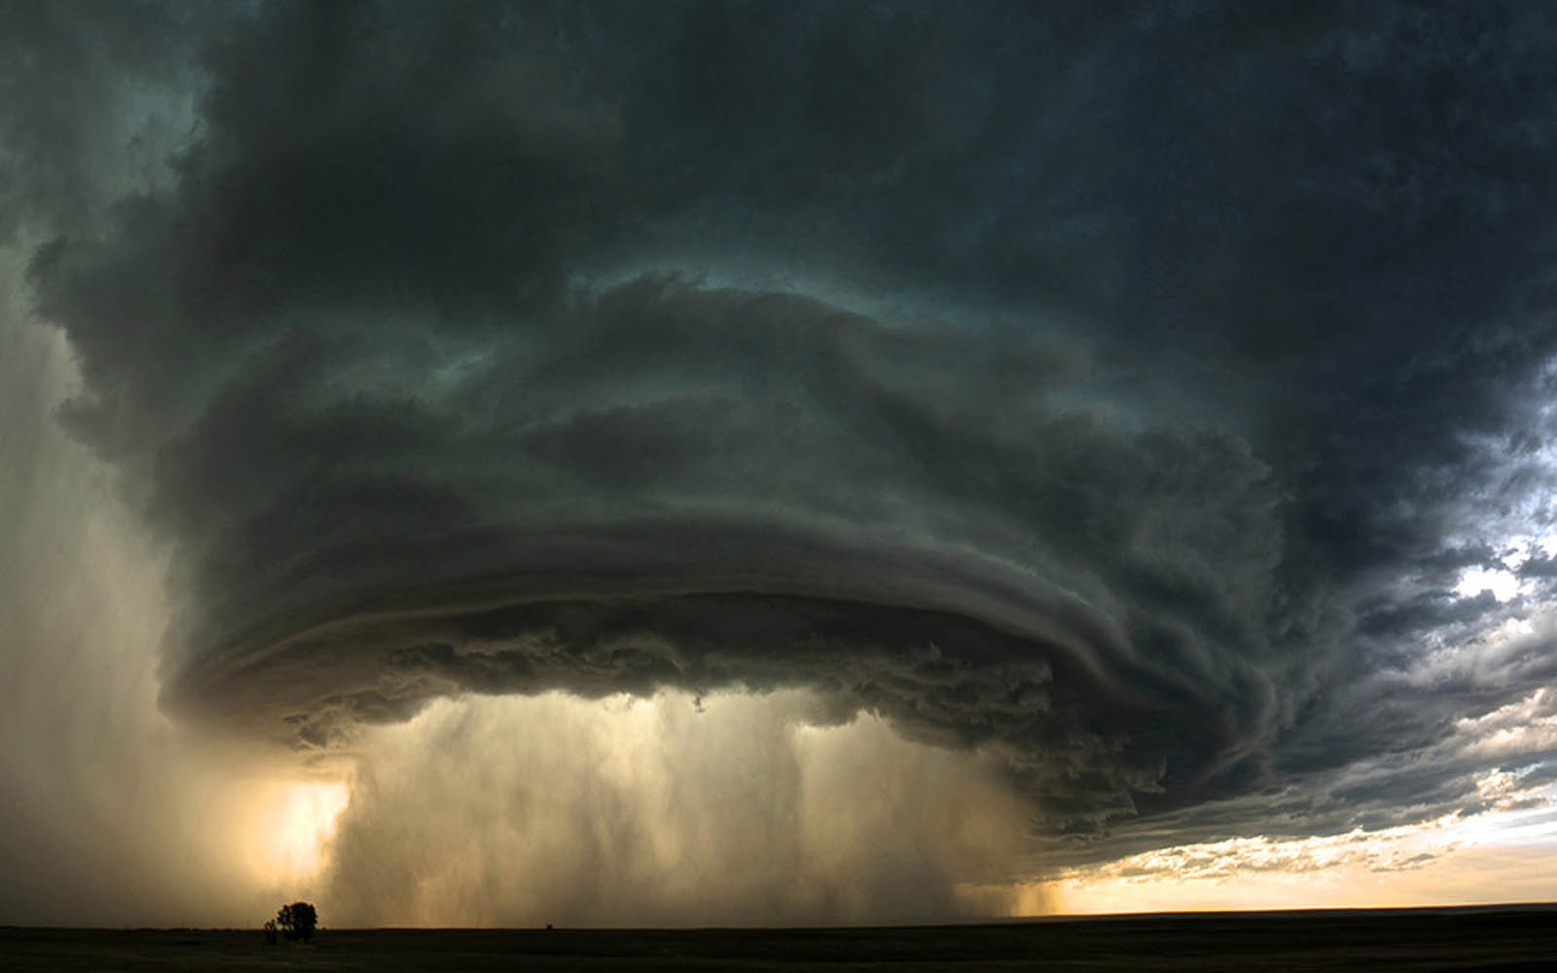
What is nature?
So the definition of nature excludes all things that where introduced by mankind. All those human developments are summarized as culture. The definition of nature summarizes natural objects:
Stones
Animals
Plants.
It also reflects on events in nature like
The wind
The rain
Earthquakes
Food
Index

Slide 4
Mankind Involvement Since the mankind made its first appearance on the Earth, the Nature started to slowly change. But since the Industrial Revolution we started to ruin the Nature heavily.
After
Before
Index

Slide 5
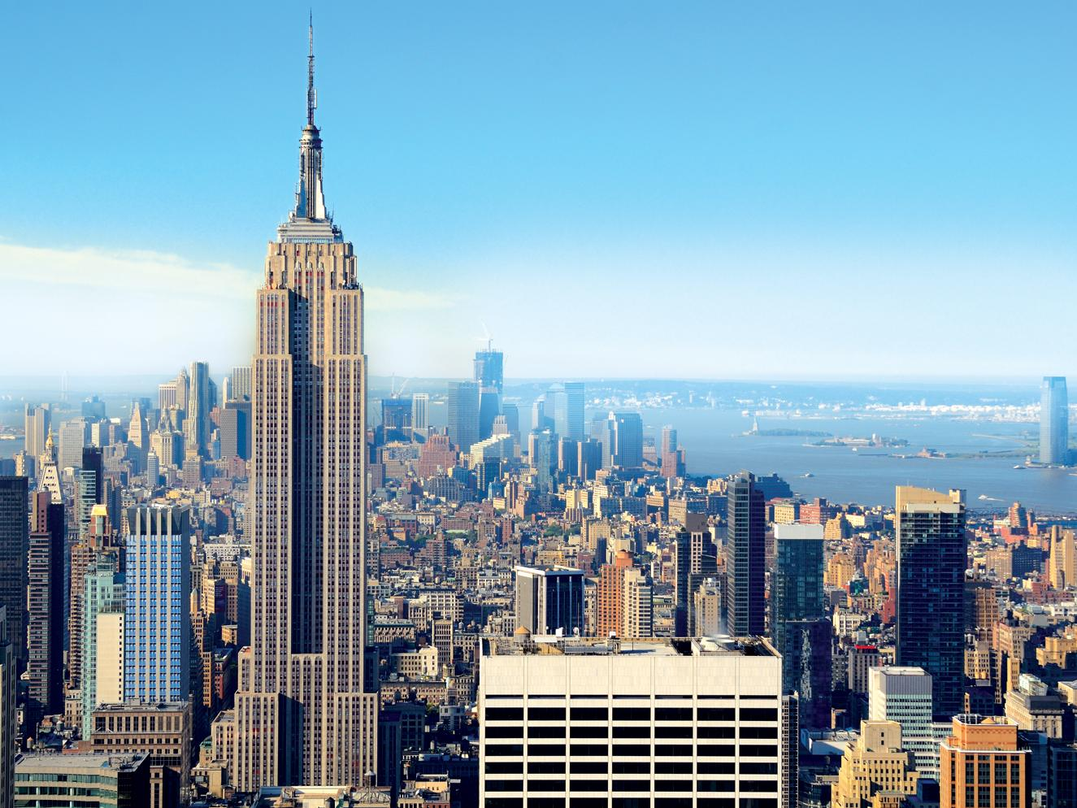
Overpopulation
Another factor that destroys the landscapes of nature is overpopulation.
When the number of human population exceeds, we cut down forests and cause other natural problems to the environment, to build additional urban areas where people can live in. The main consequence of this is that the animals move on to other areas that might not be suitable for their survival or worse, some species can become extinct.
Index

Slide 6
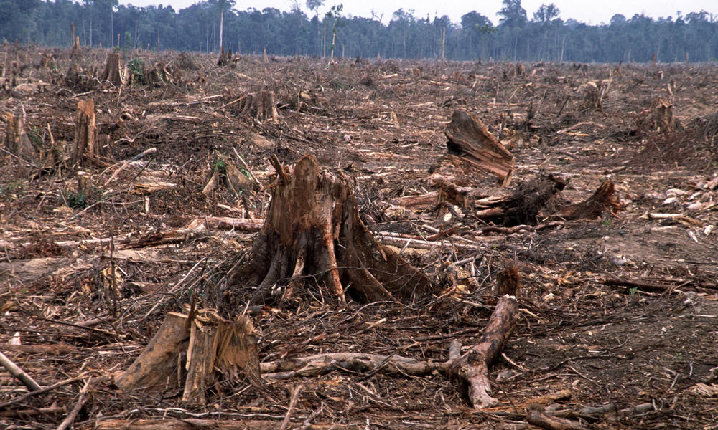
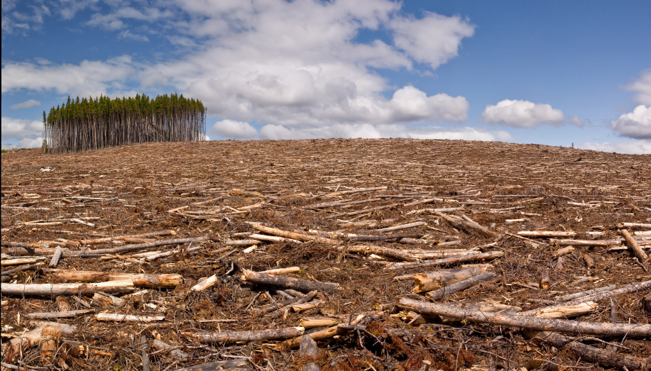
Deforestation
Deforestation occurs for multiple reasons: trees are cut down to be used for building or sold as fuel, while cleared land is used as pasture for livestock and plantation. The removal of trees without sufficient reforestation has resulted in damage to habitat, biodiversity loss and aridity. It has adverse impacts on biosequestration of atmospheric carbon dioxide. Deforestation has also been used in war to deprive the enemy of cover for its forces and also vital resources.
Index

Slide 7
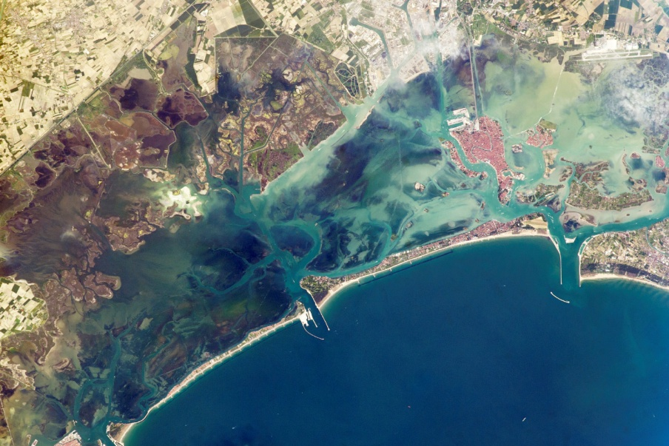
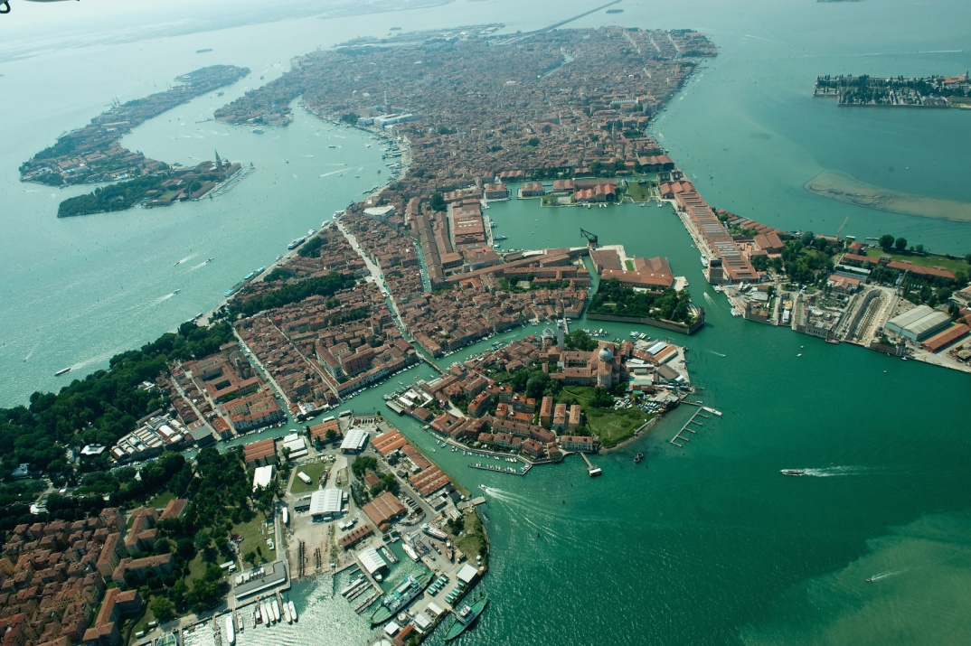
What surrounds Us?
Venice and its Nature
The most notable natural attraction of Venice is its lagoon. The lagoon of Venice, influenced by the tides of the Adriatic Sea, is Italy’s largest lagoon. The most important function of the lagoon is for transportation between the islands, but the other function is also to warm the city. But these advantages also hide a big disantvanage, which is “Venice Flooding”. It’s a phenomenon when the exceptional tide peaks that occur periodically in the Venetian Lagoon, where they cause partial flooding of Venice. Nonetheless Venice remains one of the most beautiful tourist attractions in the world.
Index

Slide 8
Thank you for Watching!

