Slide 1
FRIENDS AND CLASSMATES
A friend is one that knows you as you are,
understands where you have been,
accepts what you have become,
and still,
gently allows you to grow.
William Shakespeare
ALESSIA, ELENA, BENEDETTA

Slide 2
Friends and classmates are very important because we have to share with them good and bad moments and we have to stay with them every day of our life.
“And when I can’t be with you dream me near
keep me in your heart and I’ll appear
all you gotta do is turn around
close your eyes
look inside
I’m right here.”
I’m right here – Miley Cyrus

Slide 3
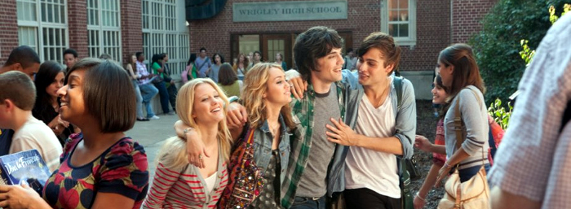
Classmates will be friends also after school is ended. After so much time spent together the friendship remain.

Slide 4
There are two types of friendship: true friends and false friends.
True friends help you in bad moments and they love you like you are. They know the good and the bad part of you and they accept both.
“Count on me through thick and thin
a friendship that will never end
when you are weak, I will be strong
hellping you to carry on.”
Count On Me – Whitney Houston.
True friendship never finish, on the contrary, false friendship sooner or later finish.

Slide 6
False friendships sooner or later finish.
A friendship that can end has never been sincere.
I wonder if a false friend has ever been a real fiend. The falsehood of friends is sharp and hurt like a knife.

Slide 8
But remember true friends are hard to find, even harder to leave and IMPOSSIBLE TO FORGET!!

Slide 9
Now let’s listen to this beautiful song about friendship:
Count on me song by Bruno Mars

