Slide 1
Quiz about Svidník

Slide 2
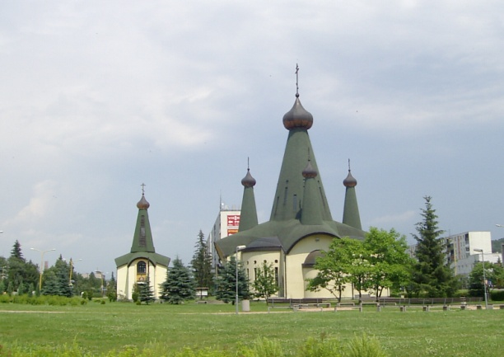
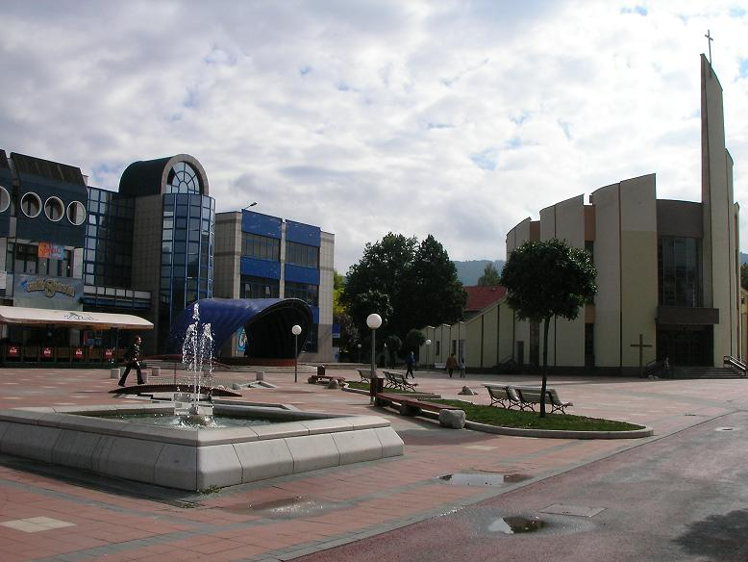
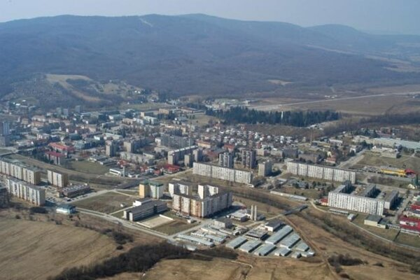
When was Svidník found?
A.)1904
B.) 1944
C.)1864

Slide 3
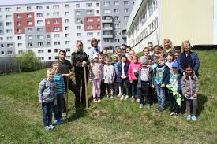
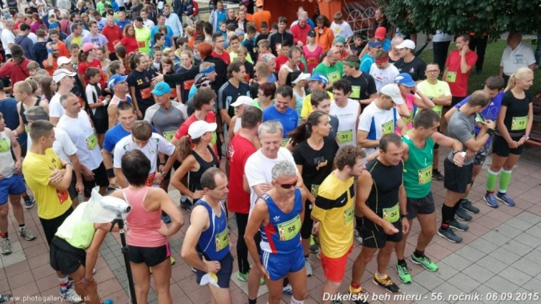
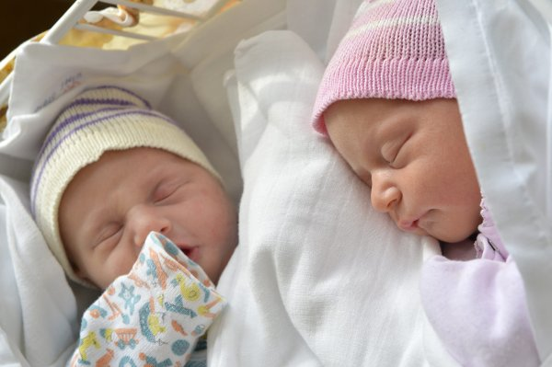
How many people are living there ?
A.) around 11 000
B.) around 14 000
C.) around 9 000
How many people are there living ?
A.) around 11 000
B.) around 14 000
C.)around 9 000

Slide 4
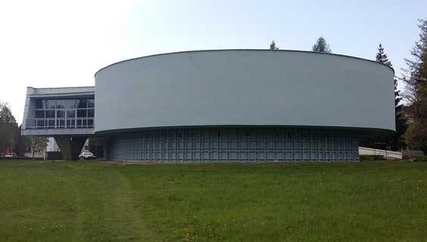
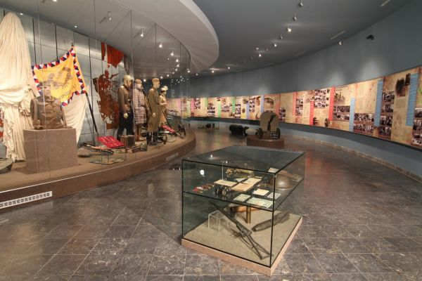
How many museums are there ?
A.)4
B.)2
C.)1

Slide 5
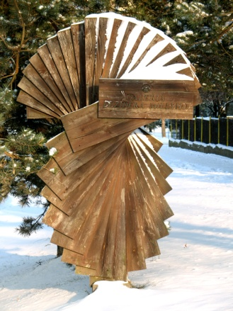
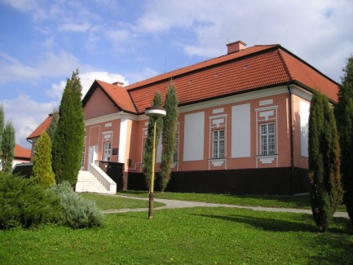
What is the name of the gallery ?
A.) Robert´s gallery
B.) Dezider and Robert´s gallery
C.) Dezider Milly´s gallery

Slide 6
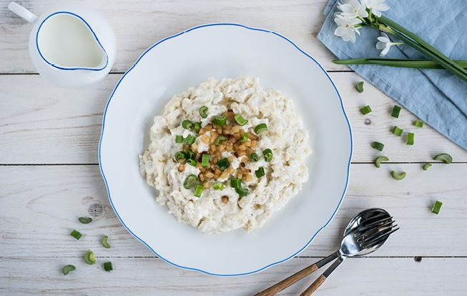
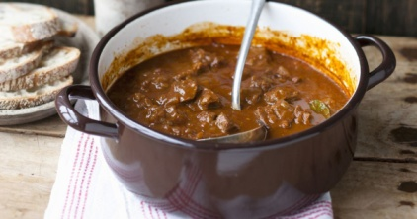
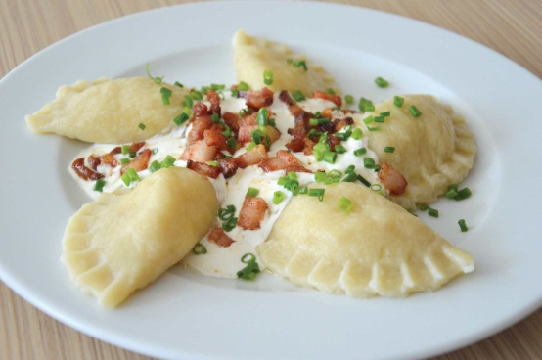
What is our traditional food ?
A.)Guľáš
B.)Bryndzové halušky
C.)Pirohy

Slide 7
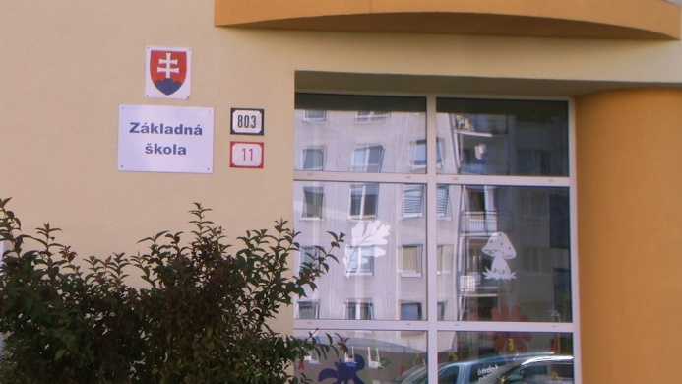
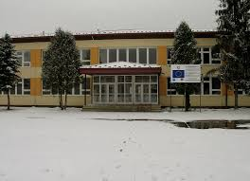
How many primary schools are there ?
A.)5
B.)4
C.)6

