Slide 1
Scratch mechanIcs and how to use them and other borIng stuff

Slide 2
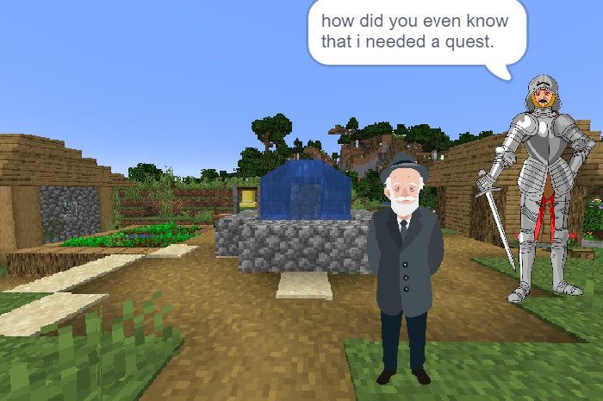
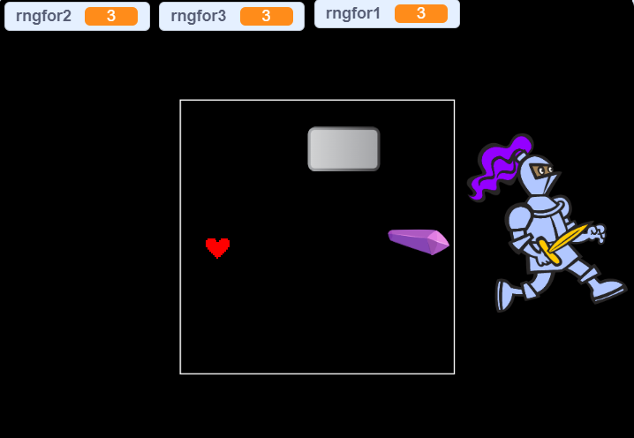
To explaın ıt better we made the presentatıon ın 3 parts: how we made the game and some scratch hıstory and scratch code blocks and how we used ıt

Slide 3
HOW to DIALOUGE
Even though we firstly made it broadcast-based we went with the classic way, we just made it time-based.
It is way too risky to do this way, with one push of a button it can flip the script over.
So we made it that it has broadcast mechanisms every 6 secs or so.

Slide 4
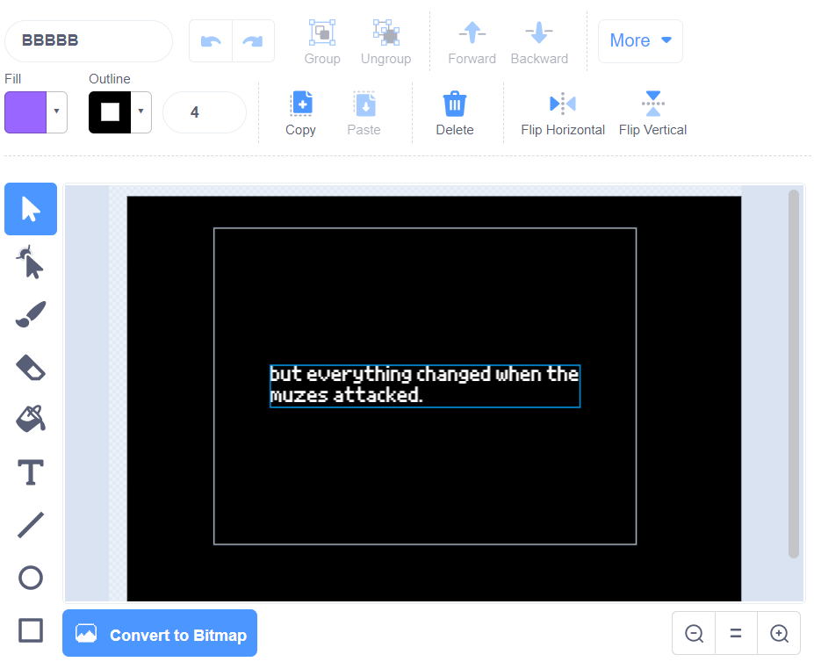
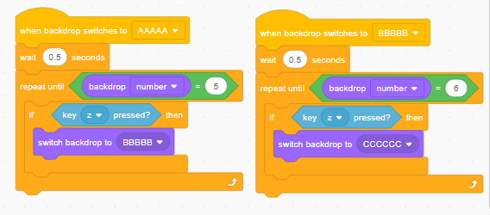
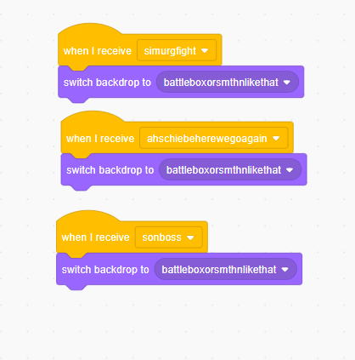
BackgroundS, the showy one
Backgrounds ,especially the battlebox one, are important due to the flow of this game
So we kept it's mechanic simple just we can and the user itself adjust it during the game or in the code itself.
With the ''if'' and the ''''repeat until''+'' pressed'''' we can control the scenes with a push of a button

Slide 5
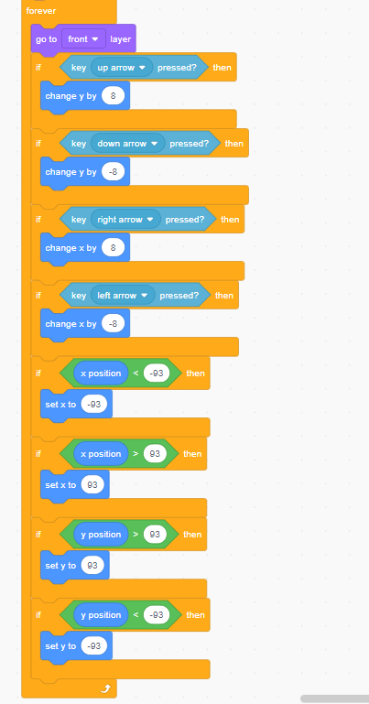
Heart moVE SET
''Heart'' character is our spirit that shows itself only in battles
It is a spirit that can move inside an invisible box, in that box the player needs to dodge all attacks using hearts moves
To make this spirit we made a spirit that will go right when we press right arrow etc. And will stop when it comes to a specific coordinates

Slide 6
Rng attack
The bosses we created uses ''rng''(random number generator) in order to create versatile attacks with changeable damage and velocity
In order to create this rng system we created a rng variable and made the system set it to a random number
And then using this number we made a limit in specific points in this setting-attack-mechanisms so it can create a balanced attack

Slide 7
''balanced attacks''
We had a lot of prototypes before we started on this official project but we just preferred some of them instead of the others
We thought of a type of attack that will just go from the main boss spirit to the heart
To use our different attacks we used rng mechanism

Slide 8
HOW TO ACTUALLY WIN
Instead of making the game turn-based and making it 15 minutes longer, we just made a button that would randomly appear in the battle box that I have mentioned earlier
In order to win the player, or the spirit If you will, needs to go to the button and press a button so it can damage the boss and with enough damage to the boss the player will simply win.

Slide 9
The tape of thıs junk of codes, mıngames, and a story:broadcasts.
While making this game we had only one(most of the time) question in our head how do we kind of make it get on with the other thing we have done?
The answer or the thing we came up with was simple, just broadcast it in order to maintain with the flow of the game and other spirits.
We made it so that everything starts and ends with a broadcast.

Slide 10
Descrıptıon of scratch
Scratch is a free educational block-based visual programming language that was developed by the Lifelong Kindergarten Group at the MIT and website targeted primarily at children 8–16 as an educational tool for programming. Users on the site, called Scratchers, can create projects on the website using a block-like interface. Projects can be exported to HTML, Android apps and EXE files using external tools. The service is developed by the MIT Media Lab, has been translated into 70+ languages, and is used in most parts of the world. Scratch is taught and used in after-school centers, schools, and colleges, as well as other public knowledge institutions. As of December 2021, community statistics on the language's official website show more than 92 million projects shared by over 82 million users, and more than 98 million monthly website visits.

Slide 11
Type of the
Code block
The thing it does when executed
Type of the
Code block
The thing it does when executed

