Slide 1
Greenhouse effect
VII. gimnazija
Zagreb, Croatia

Slide 2
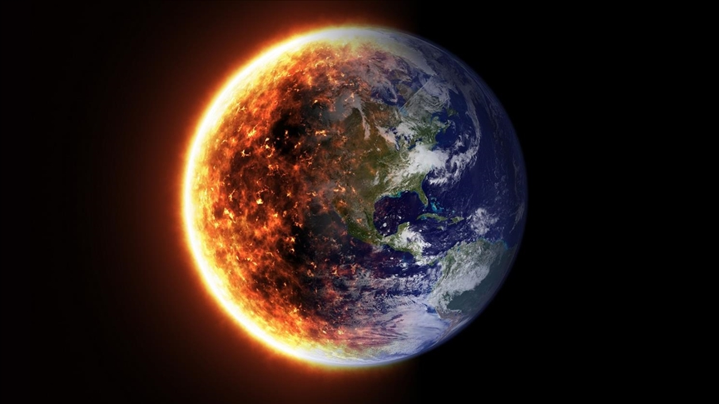
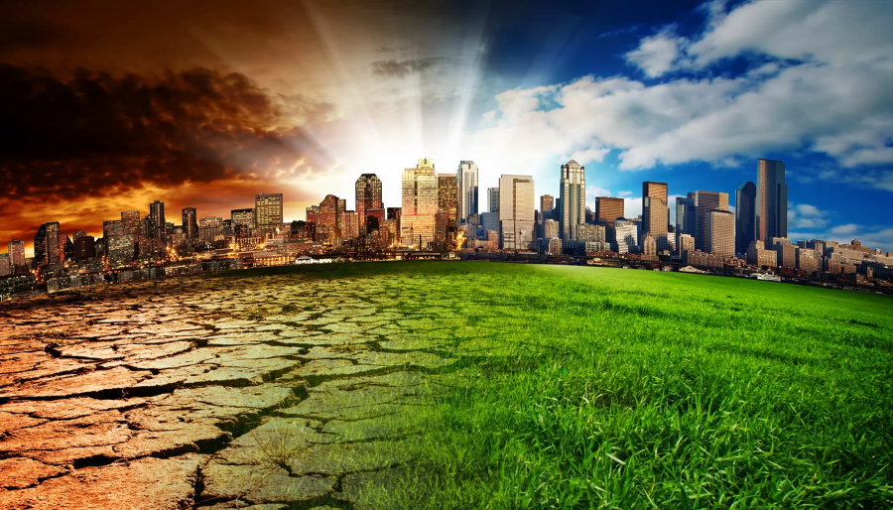
Start of global warmimng
global warming, the phenomenon of increasing average air temperatures near the surface of Earth over the past one to two centuries. Climate scientists have since the mid-20th century gathered detailed observations of various weather phenomena (such as temperatures, precipitation, and storms) and of related influences on climate
any climate scientists agree that significant societal, economic, and ecological damage would result if global average temperatures rose by more than 2 °C in such a short time.
Increasing greenhouse effect is also connescted to ozone holes that which appeared in the 1920s due to excessive freon-12 emissions

Slide 3
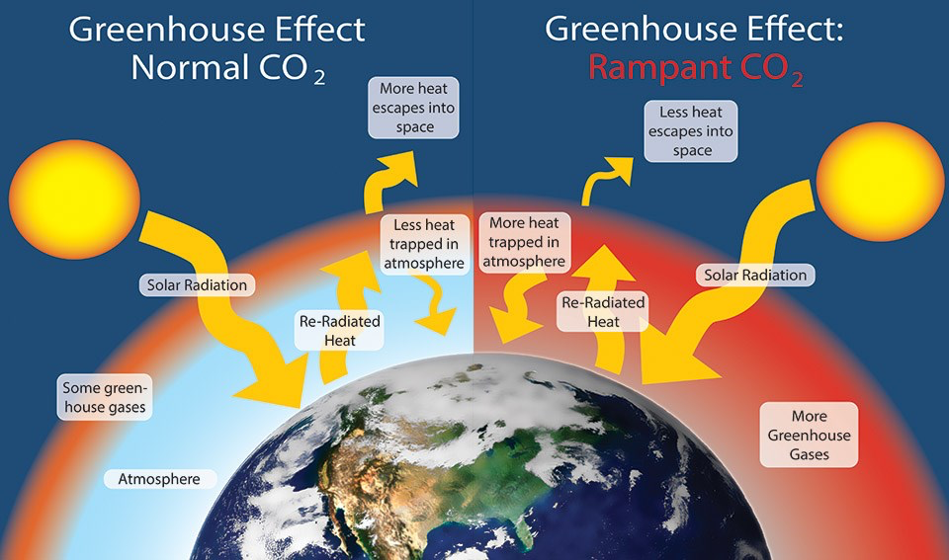
Greenhouse effect
W. Elder, NPS
higher freon content in the atmosphere -> larger ozone holes -> higher UV radiation -> more heat on Earth and more water evaporation -> increasing the greenhouse effect

Slide 4
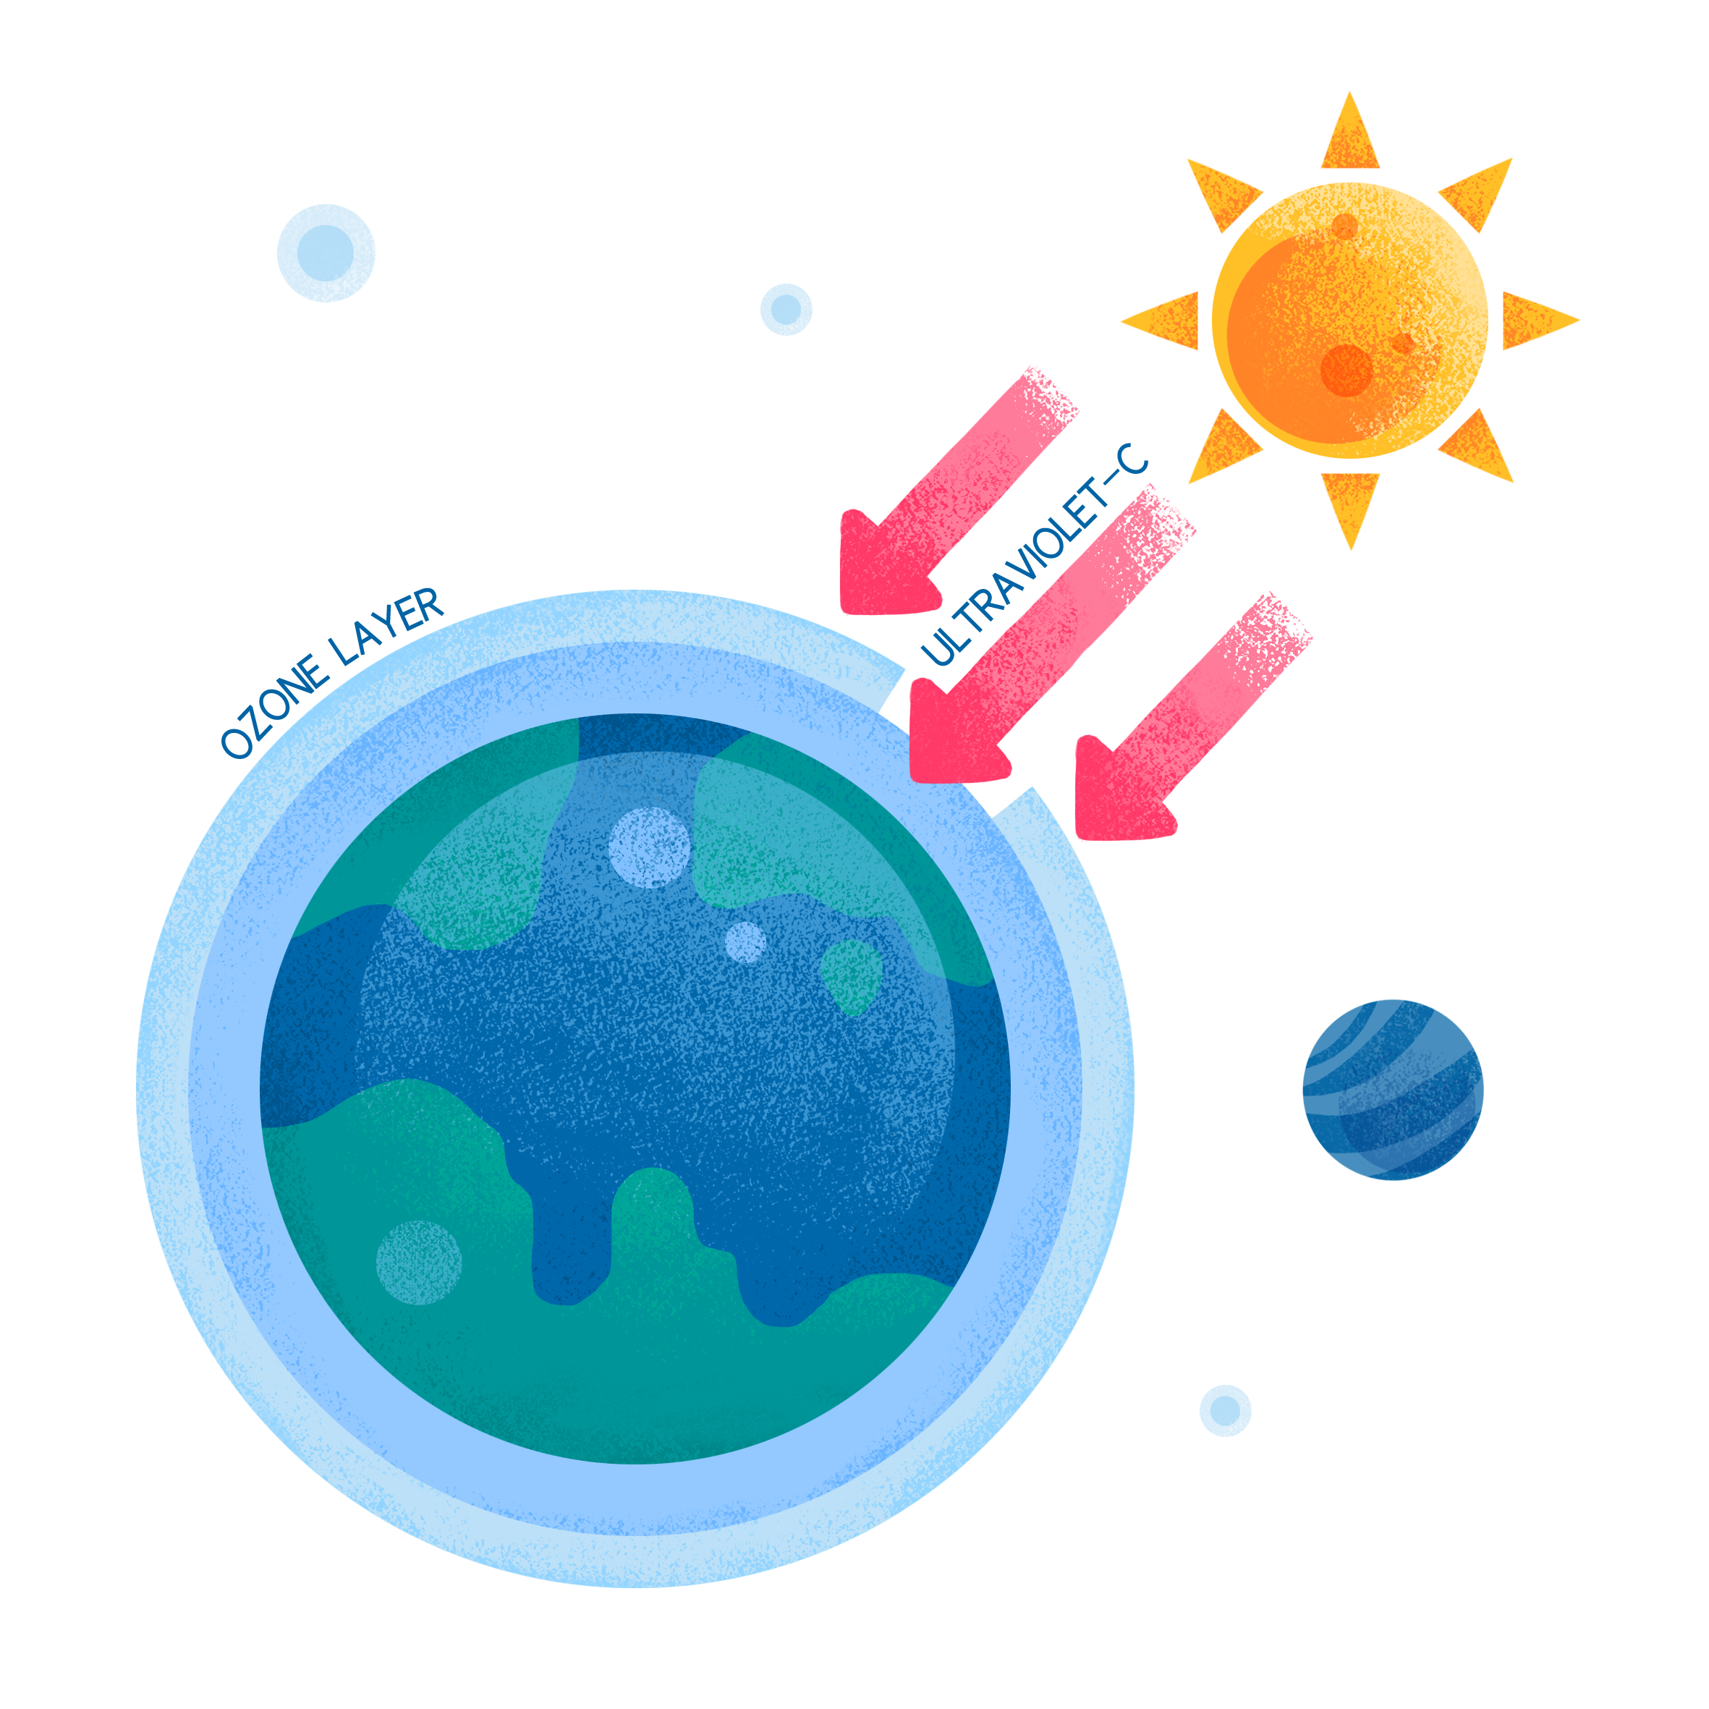
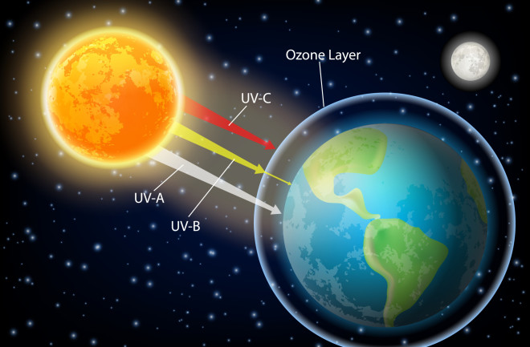
Ozone
Ozone layer - serves as a filter for ultraviolet radiation from the sun
formation of the ozone layer;
O₂ —> 2O
2O + 2O₂ —> 2O₃
an oxygen molecule absorbs UV radiation
and decomposes into two oxygen atoms, which
then react with oxygen molecules to form ozone

Slide 5
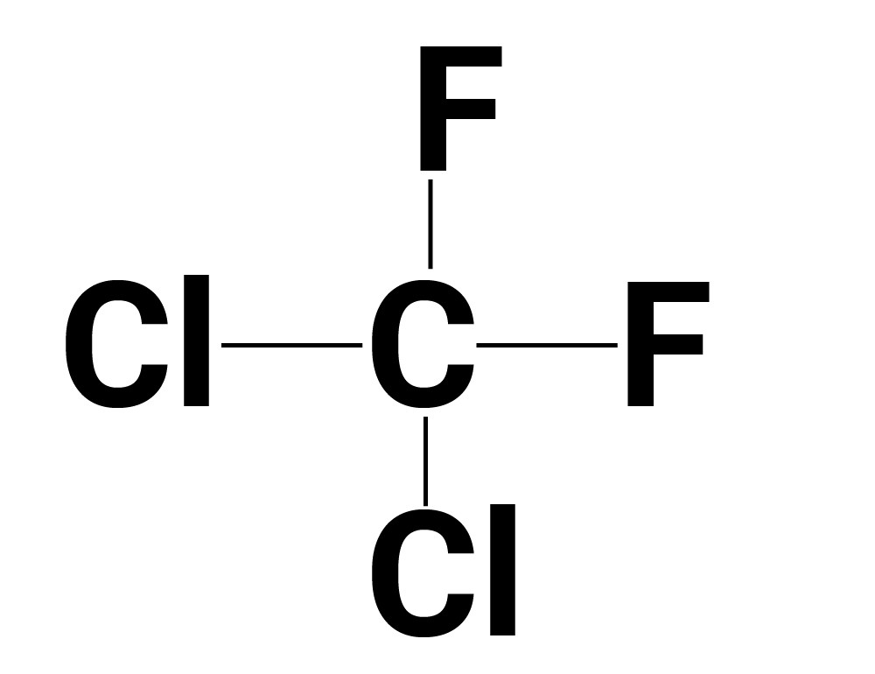
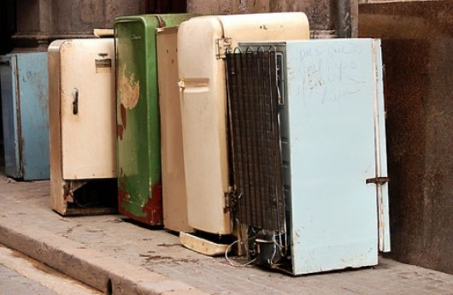
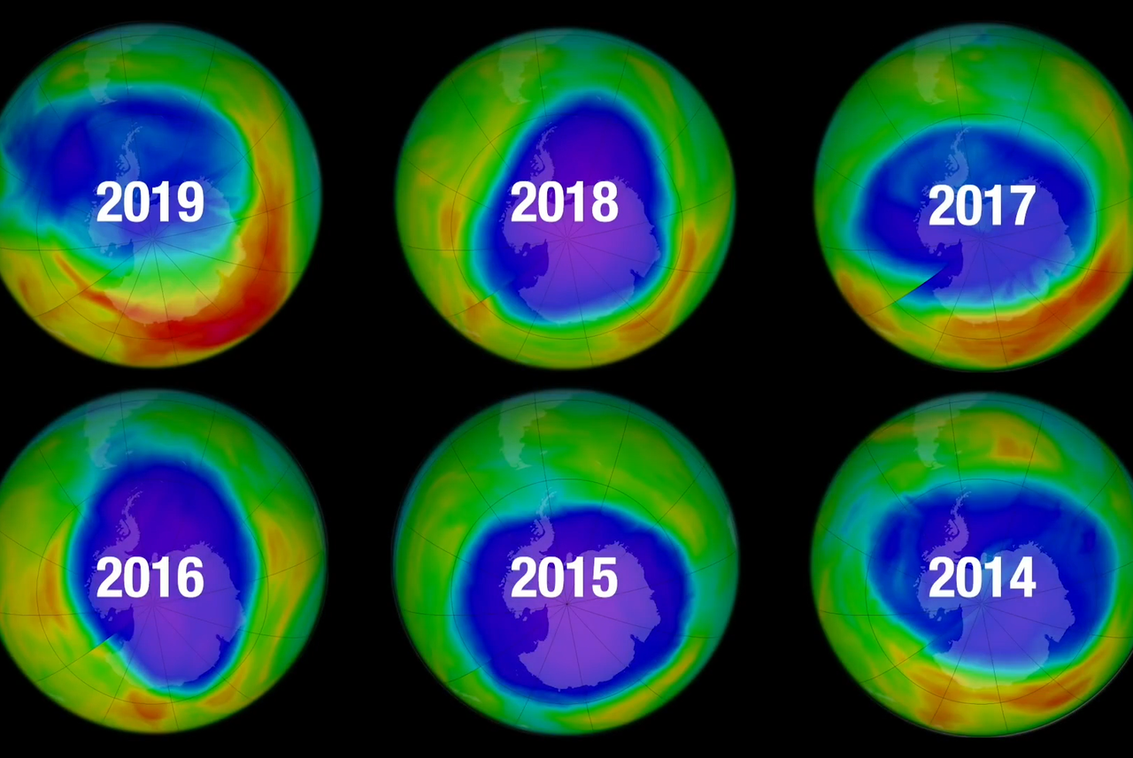
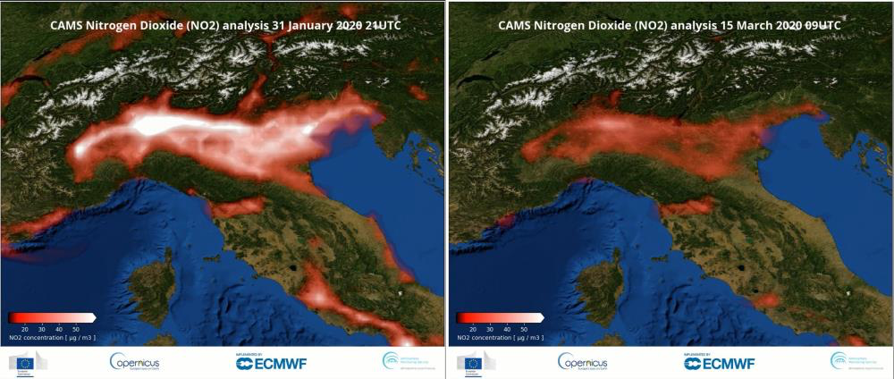
Ozone holes
https://www.toppr.com/ask/content/story/amp/freon-12-68710/
http://www.galaksija.hr/tekst/Koliko_su_opasni_freoni/922
1f1e3ef4a8fb503f363b.png
Copernicus

Slide 6
Ozone holes
the first picture shows freon-12 or CCl2F2
- it is today's biggest cause of ozone holes because its one color atom, when decomposed, destroys 200,000 ozone molecules
-Freons used to be released by air conditioners, refrigerators and perfumes at first people did not know that anything was happening and that there was any negative effect, but when it was found out the freon was thrown out of use

Slide 7
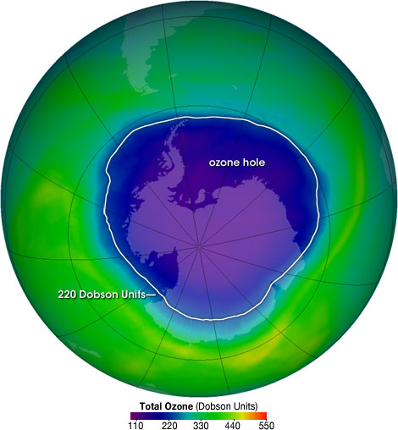
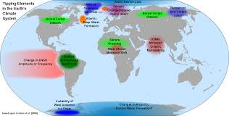
Ozone holes
The ozone hole is not technically a “hole” where no ozone is present, but is actually a region of exceptionally depleted ozone in the stratosphere over the Antarctic that happens at the beginning of Southern Hemisphere spring
Ozone depletion consists of two related events observed since the late 1970s
The main cause of ozone depletion and the ozone hole is manufactured chemicals, manufactured halocarbon refrigerants, solvents, propellants and foam- blowing agents (chlorofluorocarbons (CFCs), HCFCs, halons), referred to as ozone-depleting substances (ODS)
These compounds are transported into the stratosphere by turbulent mixing after being emitted from the surface, mixing much faster than the molecules can settle

