Slide 1
ERASMUS + KA 219
TALES AND STORIES AROUND EUROPE
ITALY 10TH NOVEMBER 2016

Slide 2
TASKS AND ACTIVITIES IN OUR PROJECT

Slide 3
A2 : E-TWINNING
Design an e-twinning project to disseminate
activities, communicate each others, present our stories, celebrate webinars.
.Italy is in charge of it.

Slide 4
A3: OUR LOGO
Every country design a logo in its country and we choose one of them in the first transnational meeting
Some useful tools: Logo creator, logo maker,
photoshop etc
. This logo will appear in our e-twinning space, facebook , blog, Erasmus corners etc
DEADLINE: FIRST MEETING

Slide 5
A4: An information leaflet
Design a leaflet related to our association.
Each country introduces a short piece of information related to its school in a template.
We will use Microsoft Publisher to design it.
This leaflet will be published in our social networks
In our schools we can work this type of text in several subjects: Language, ICT, Arts and Crafts.
Proposal: Secondary students
DEADLINE:

Slide 6
A5: BLOG AND FACEBOOK, WHATS APP GROUP, DROPBOX
1. Association blog: To disseminate our project
Responsible country:
2. Facebook account: To disseminate oour project, to share resources etc
Responsible country:
3. Whats app?
4. Dropbox?

Slide 7
A6: EXTRACURRICULAR ACTIVITIES
In our school we have Romanian pupils. We decided they could be involved in our project.
Once a week, they make a Romanian culture workshop.
They are an useful resource to participate in our activities.
They will act a Romanian story and share with us through E-twinning or another digital tool.

Slide 8
A7: SKYPE AND E-TWINNING MEETINGS
Frequency: Once a month
Aims: Children´s exchange information
Dates:
Topics: Daily routines, hobbies,
School, town, country and celebrations:
Halloween, Christmas( Jan), Carnival(Feb), Easter (March), World Book Day (April)

Slide 9
A8:STORYTRIVIAL
. The idea is to exchange a story between two countries. After working the story pupils from two different countries will ask questions related to this story.
Tools: E-twinning or skype
1.Spain-Italy 2. Greece-Turkey
3. Lithuania-Romania
DEADLINE: JUNE 2018 Level: Number of students:

Slide 10
A9: GYMKHANA
Each country looks for information about a folk tale or legend.
Create a presentation. Tool: Story jumper……
We share our presentation
1.Spain-Greece 2. Turkey-Lithuania
3. Italy-Romania
. We will also create a webquest or questionnaire and send it to our colleague country . If a group complete all the tasks it will get a diploma.
. We publish the final products (e-twinning..)
DEADLINE: JANUARY 2018

Slide 11
A10: Tales and stories in every country (Chained reading)
.We choose a legend or a tale and we divide it into six parts. Every country needs its part.
.We work the text in English .
.We share our presentation on twinspace or padlet to show our works.
.We share our works and a group of pupils (2 in every country) read the story on Skype or e-twinning
. We will read it in this way:
1.Spain 2 Romania 3 Italy 4 Turkey 5 Lithuania and 6 Greece
Decisions: 1. Story. 2.Parts of the story 3. How many stories?
3. Site to read: 4. Site to publish:
6 Dates:

Slide 12
A11:STORIES AND TALES TRAVELLING BOOK
. We start a story using a digital tool or simply we write a word document
. Then we share it with the following country according with our trips.
Spain-Romania-Italy-Turkey-Lithuania-Greece
Idea: The quixote starts the story, then he meets a character in Romania. Next another country…… All the countries will contribute to make an original story
.Finally we can create a presentation, an e-book, as a final product, share via Skype, padlet, twinning etc

Slide 13
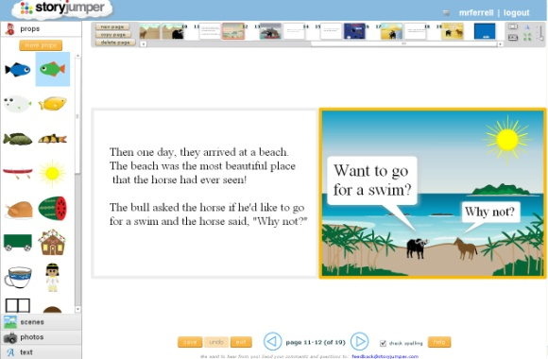
A 12. ON-LINE WRITTEN STORIES
. We write short stories in different classrooms related to our project. Then our pupils, share them with pupils from another countries.
. Tools: Storyjumper, storybird, book creator or even on padlet
. We publish them on different sites.
.Topics: Halloween Christmas, Carnival, World Book Day

Slide 14
A13 Storytelling Lipdub
A video recording every classroom without any pause. We need a videocamera and a musical base.
Pupils are wearing different costumes in relation to different stories in every classroom.
We share our lipdubs on e-twinning
Tools: Viva video, imovie, stayfilm etc

Slide 15
A 14: Reading sponsorship and storytelling among different grades
Pupils aged 10-11 years tell a story to younger pupils.
Then they motivate them to read, talk about their favourite stories etc
How: Skype or we can create a video, share it on e-twinning and watch all of them in our classrooms.
First, pupils can make an oral presentation, then tell the story and finally speak about their favourite stories and recommend a book
Spain-Romania
Italy_Greece
Turkey Romania
DEADLINE: 15TH MAY 2017

Slide 16
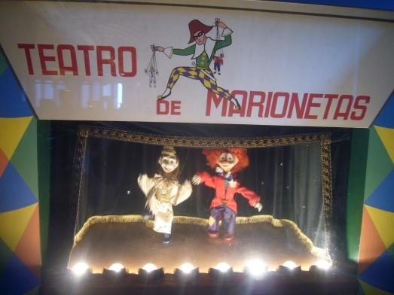
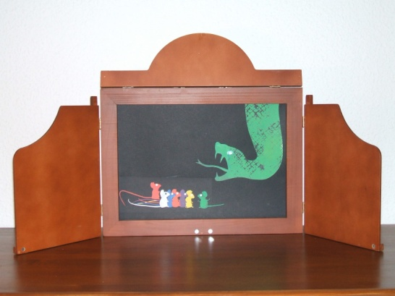
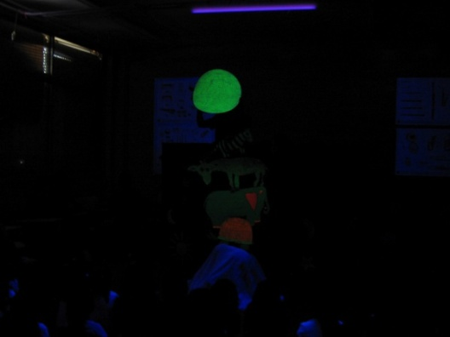
A15: Theatre plays
.We choose a text, rewrite it. Then we adapt it to different ages. We add illustrations in order to make a story.
.Finally we tell it through different techniques:
For example: kamisibai, puppets, singing, black light etc
This activity will be developed in our visits.
.We share them on e-twinning, youtube, facebook, blog etc

Slide 17
A16 SHORT MOVIE :
. Pupils will create a short film in their mobilities using different tools such as vivavideo, stayfilm, imovie etc
. They present this video to different school groups in their countries or even share them with their European colleagues.
DEADLINE: JUNE 2018

Slide 18
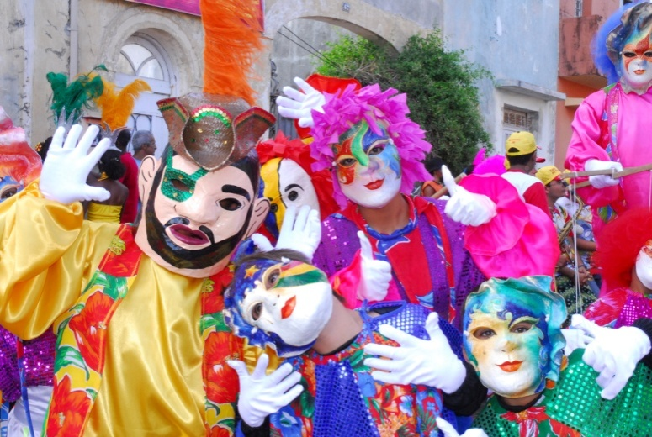
A17: CARNIVAL PARADE
Pupils and teachers will participate in our Carnival parade in February.
We will create a final product related to this
activity to show in our schools. Then, can create different works in relation with this visit or about the Carnival in our countries
DEADLINE TO SHARE AND
PUBLISH OUR WORKS: 15 TH APRIL
ON-LINE: E-TWINNING

