Slide 1
The Birds
«Όρνιθες»

Slide 2
Aristophanes
Aristophanes (c. 446 – c. 386 BC), was a comic playwright of ancient Athens known as the Father of Comedy. Eleven of his forty plays survive virtually complete. One of them is “the Birds”. It was performed in 414 BC at the City Dionysia where it won second prize. The play has many indirect references to Athenian political and social life. It is the longest of Aristophanes' surviving plays and yet it is a fairly conventional example of Old Comedy.

Slide 3
Two Athenian friends, crafty Peistheteros and kind Evelpides, tired with their fellow citizens’ passion for sacrifices, leave their city to find the bird Hoopoe. They want to ask him where they can find a city in which they can leave peacefully and wealthily.

Slide 4
But when they find the Hoopoe called Tireas they are very disappointed, because he doesn’t know any such city. Then, Peistheteros has an idea and persuades Tireas to help them found their dream city up in the sky, between the world of Men and the world of Gods. So, Tireas calls a Birds’ meeting.

Slide 5
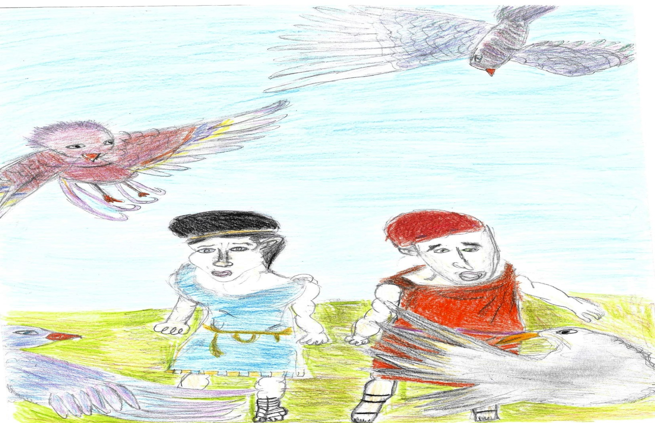
The Birds, angry with the men’s invasion and believing that Tireas is a traitor, are ready to attack Peistheteros and Evelpides.

Slide 6
However, Peistheteros, crafty and clever as he is, talks to the Birds and convinces them to join their plan and build that dream city. In this city, called The Birdcity, the Birds will have the power in between Men and Gods.

Slide 7
The Birds, working in groups, start building a Wall that will prevent the smell of the Men’s sacrifices from reaching the Gods.

Slide 8
But the Gods are furious, because they don’t feel that smell from the animals that Men must sacrifice to honour them. They send Iris as a messenger, but Peistheteros sends her away.

Slide 9
This is where Prometheus appears and gives advice to Peistheteros on how to get the power from Gods.

Slide 10
A three-men committee—Poseidon, Hercules (Iraklis) and Trivallos—comes and together with Peistheteros, Evelpides, Tireas and the Birds they all sit down to eat. Following the rules of Democracy, they decide to Vote and find the best solution.

Slide 11
According to the Vote, the majority wants the marriage of the young Goddess Power with Peistheteros. Everyone starts celebrating for the marriage and the happy ending.

Slide 12
THE END

Slide 13
Travelling Around Tales And Stories

