Slide 1
EGLĖ THE QUEEN OF GRASS SNAKES
LITHUNIA KINDERGARTEN,,EGLUTE‘‘
RITA PUMPUTIENĖ
2017/2018

Slide 2
EGLĖ THE QUEEN OF GRASS SNAKES

Slide 3
EGLĖ THE QUEEN OF GRASS SNAKES

Slide 4
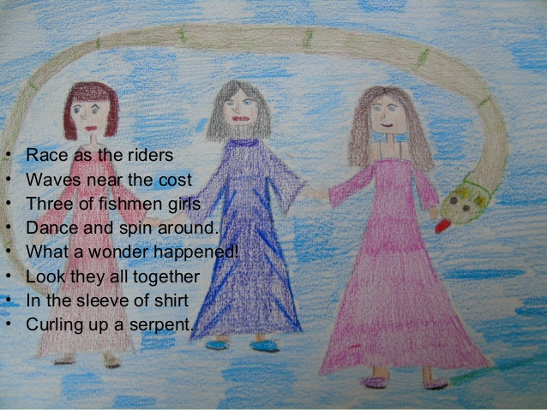
EGLĖ THE QUEEN OF GRASS SNAKES

Slide 5
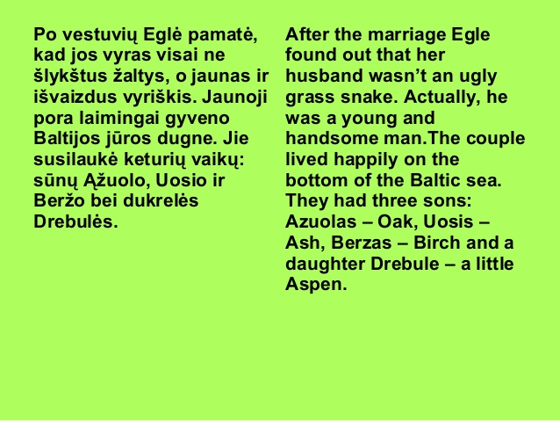
EGLĖ THE QUEEN OF GRASS SNAKES

Slide 6
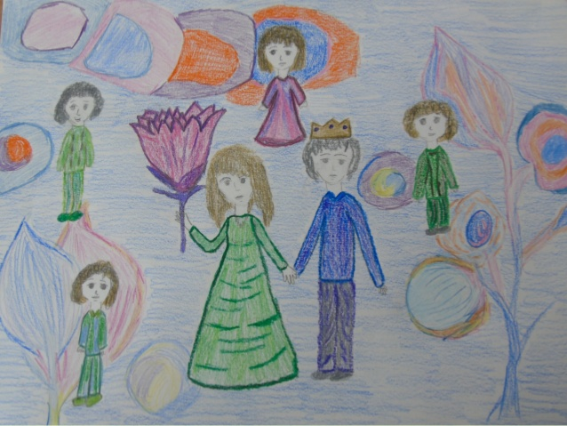
EGLĖ THE QUEEN OF GRASS SNAKES

Slide 7
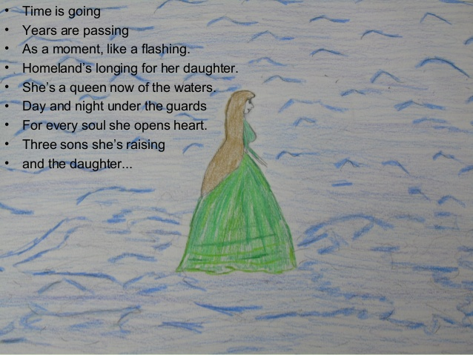
EGLĖ THE QUEEN OF GRASS SNAKES

Slide 8
EGLĖ THE QUEEN OF GRASS SNAKES

Slide 9
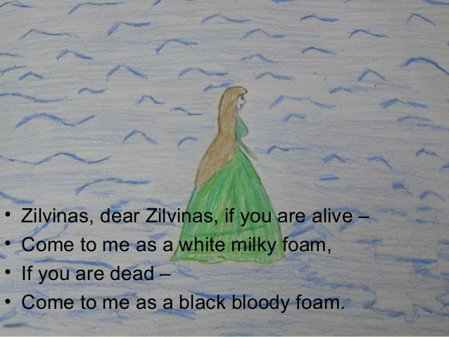
EGLĖ THE QUEEN OF GRASS SNAKES

Slide 10
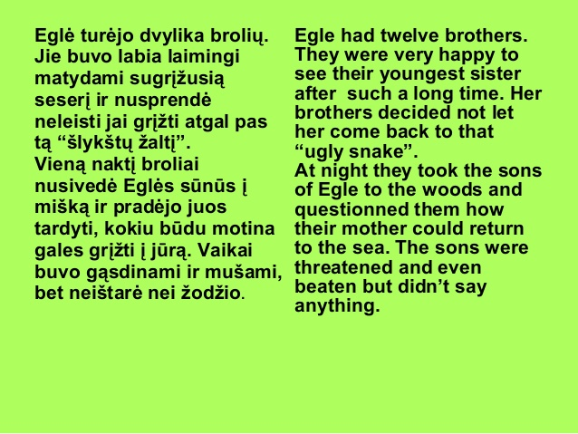
EGLĖ THE QUEEN OF GRASS SNAKES

Slide 11
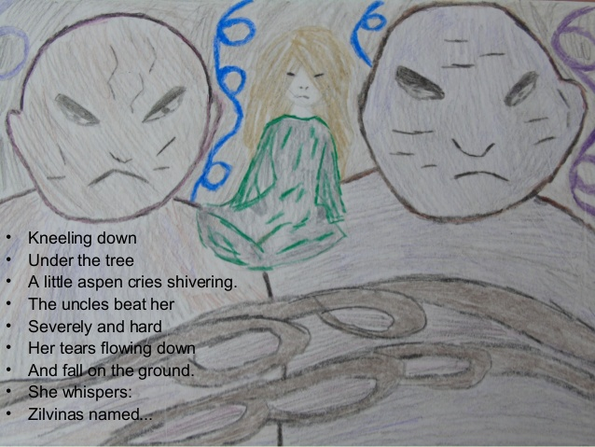
EGLĖ THE QUEEN OF GRASS SNAKES

Slide 12
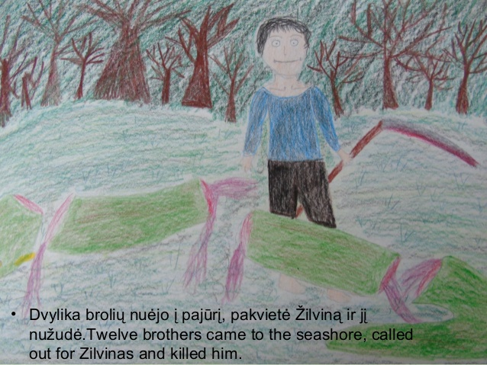
EGLĖ THE QUEEN OF GRASS SNAKES

Slide 13
EGLĖ THE QUEEN OF GRASS SNAKES

Slide 14
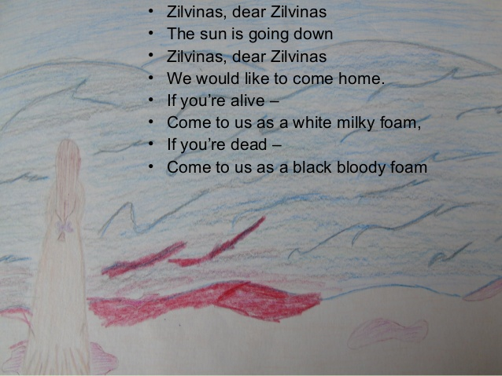
EGLĖ THE QUEEN OF GRASS SNAKES

Slide 15
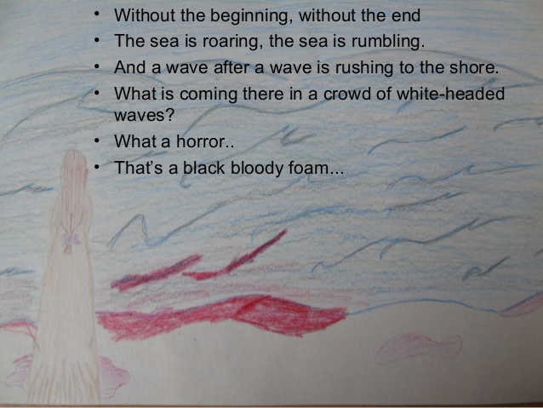
EGLĖ THE QUEEN OF GRASS SNAKES

Slide 16
EGLĖ THE QUEEN OF GRASS SNAKES

Slide 17
EGLĖ THE QUEEN OF GRASS SNAKES

Slide 18
EGLĖ THE QUEEN OF GRASS SNAKES

Slide 19
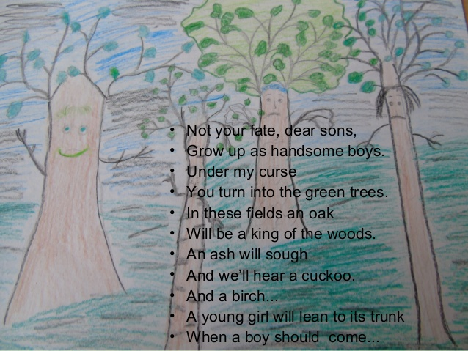
EGLĖ THE QUEEN OF GRASS SNAKES

Slide 20
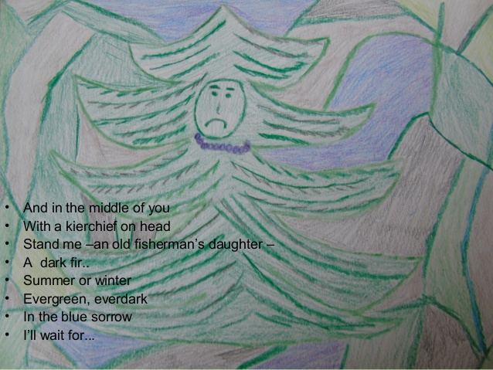
EGLĖ THE QUEEN OF GRASS SNAKES

