Slide 1
Spain
By the Students of the
3rd Primary School of Karpenissi Greece

Slide 2
THE COUNTRY

Slide 3
Spain is located in the North West of Europe. It has a total population of 46,507,760 people.

Slide 4
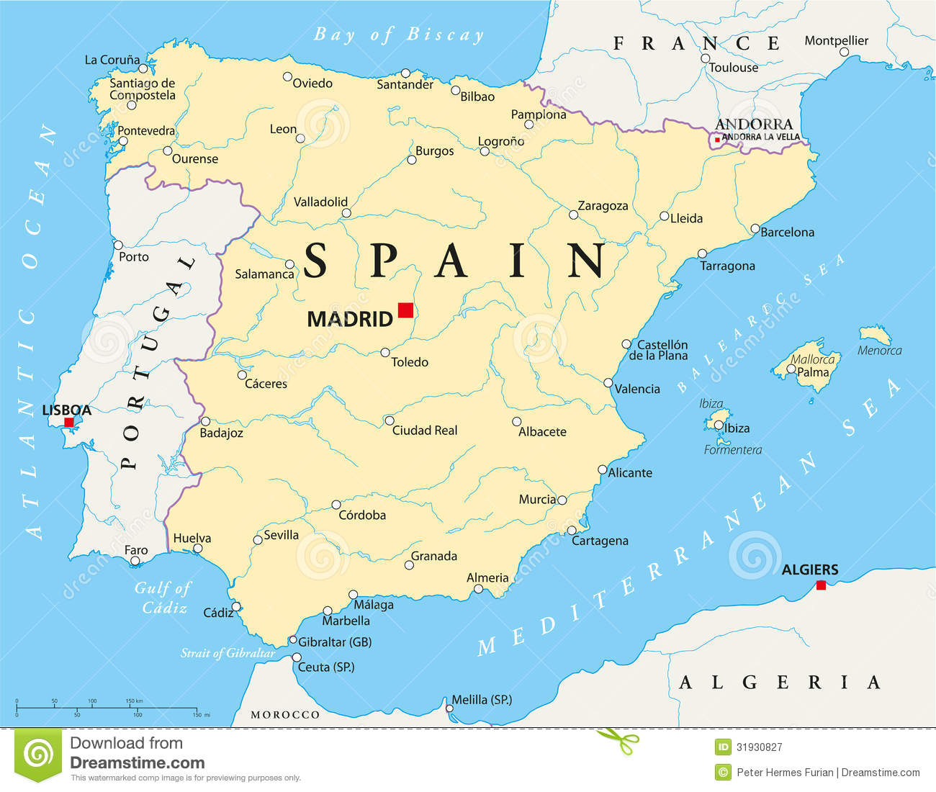
The map of Spain

Slide 5
The Spanish flag

Slide 6
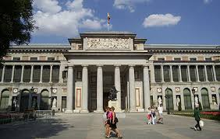
Sights
The Prado Museum, Madrid

Slide 7
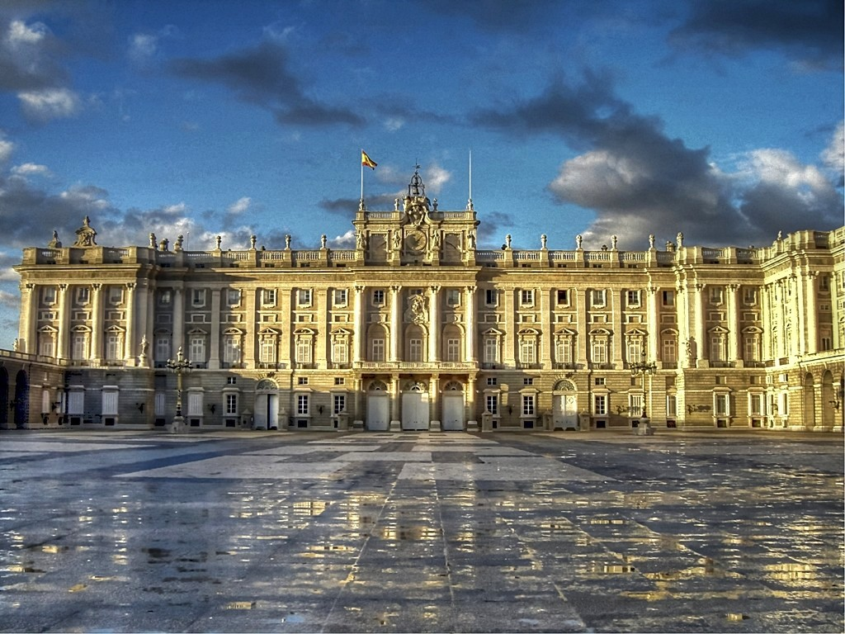
Palacio Real- Madrid

Slide 8
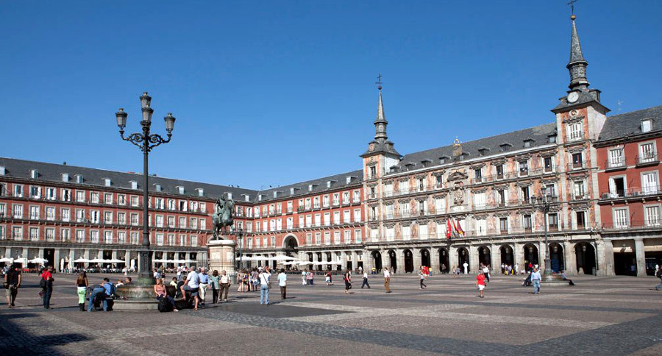
Famous Squares
Plaza Mayor- Madrid

Slide 9
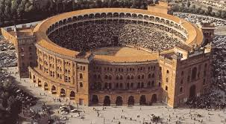
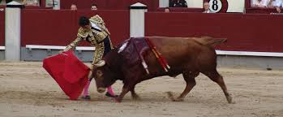
Bull fighting Plaza de toros des las Ventas

Slide 10
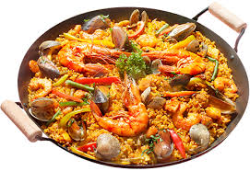
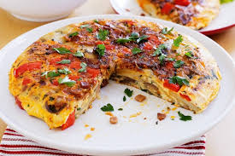
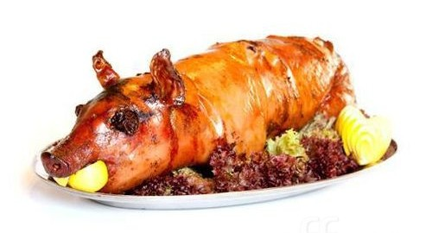
The Spanish Cuisine
Paella
Tortilla
cochinillo asado

Slide 11
Spain has a very successful history in football. Many Spanish teams have won the UEFA Champions League. The most famous are Barcelona, Real Madrid and Atletico Madrid.

Slide 12
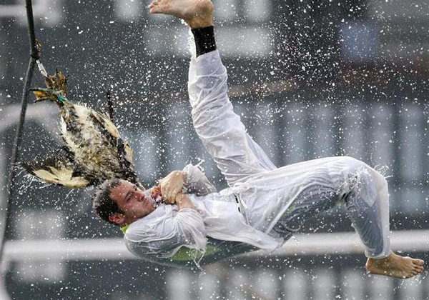
Spanish traditions Antzar Eguna Young men try to catch an oily goose with their hands by jumping from a boat. The winner gets the goose and everyone’s admiration!

Slide 13
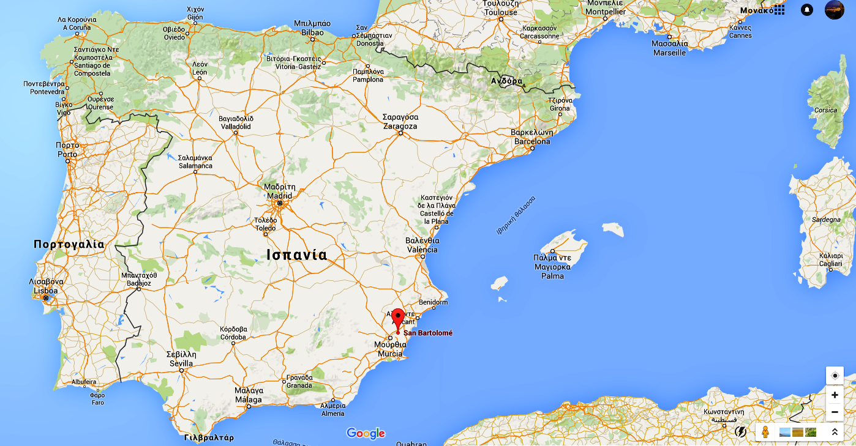
San Bartolomé-Orihuela

Slide 14
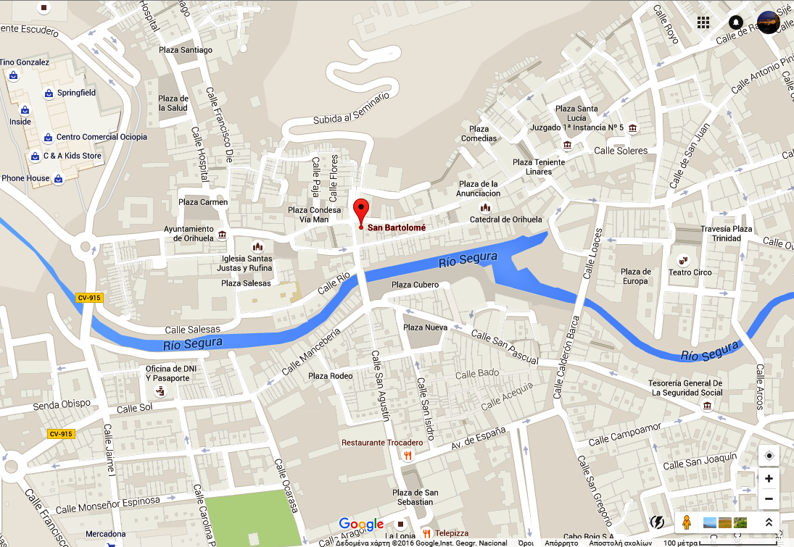
San Bartolomé is located in the south- eastern part of Spain. It is a tourist location near the sea.

Slide 15
This is how our little students from the 1st grade imagined and depicted San Bartolome, using recycled material. Your school is the central building. What do you think???

Slide 16
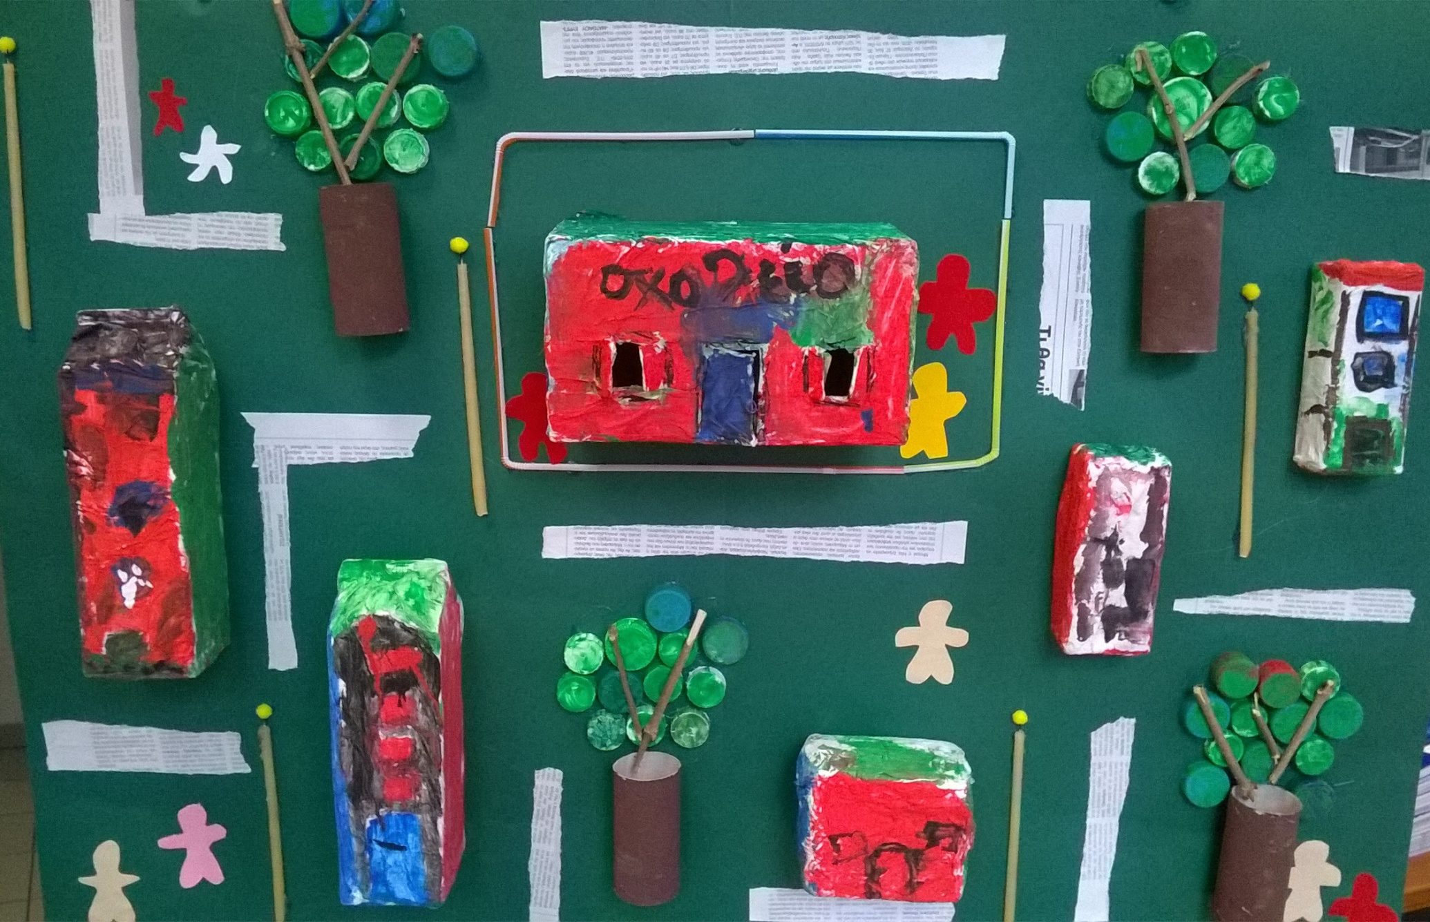

Slide 17
Thanks for watching!!!

